Slide 1

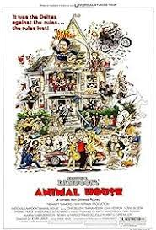


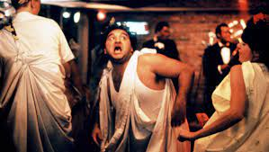

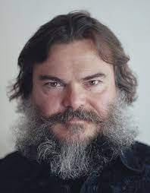
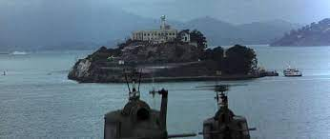

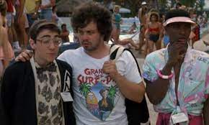

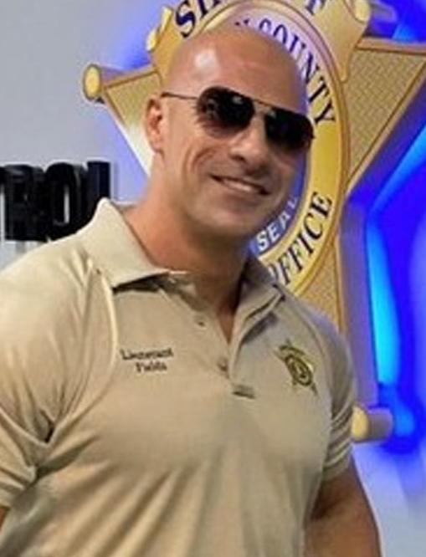

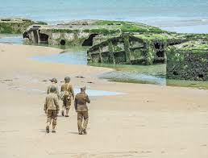
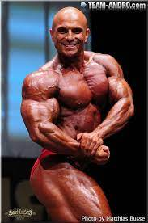

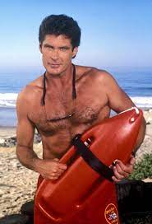
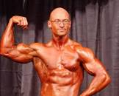
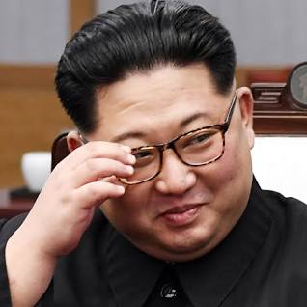

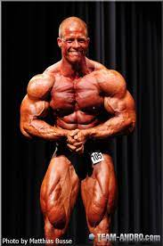
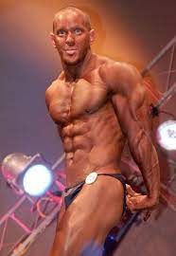


Develoment
MSc.
animal house party studying dorm room
MANISTRET(G.VIRGINA MARY;)
the rock movie 1998 Alcatraz
HOCME:LUXMOVIE:RENTAL:VHS
2015
!G.CPVA gheoh(micheasl)
angelsa(patrics)
HOME:BORIS
The rock
PREA catwalk CHEKCAHALRE
(sales)
HOMEI:NANA elebeth 2 taek hosue under
tathoe
FOSTER ICTY foster make jack,jochebradle 2 tke hous under
normandy omaha beach
WWI.whithous take hosu under jermoe and boyfriend
right said friend
JFK
bald german body builder
Jumanji: The Next Level

Slide 2


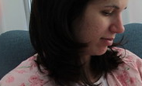
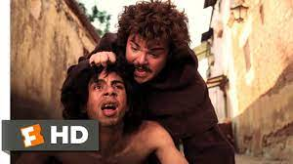
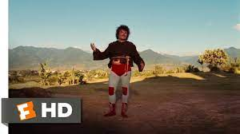
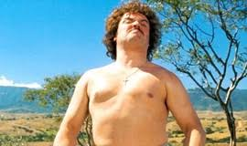
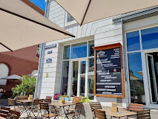








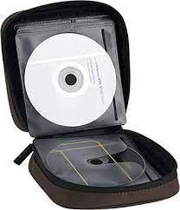
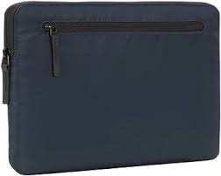
Develoment
Saturday
VIRGINA
MILTIARY
Cherie-Bar
marktluecke karlruhe
Kischheim
LIVE
HEIDELBEG
SQ.Cherrytown
Kevin
Gheoh(SQ)
Heidlberg
HOME:7H:ATOMCLOCI(button)
PENGAOGN.CD
PENGAOGN.CD
PENGAOGN.CD
PENGAOGN.CD
MARY
♥LACE
?HOMCID:JEUSE
Chart
Pentagon Base Paul Reviere
Constitio
Verfassunggeriht Karlrsueh
PENGAOGN.CD
Interupts
In Case

Slide 3




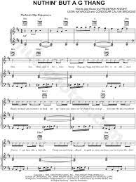


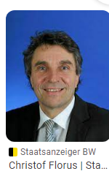
Develoment
HOMICE:IS-a-BELL
HOCME:SUNSTORE(10c)
x/y lake end of lake near sanddrill
Band[crime does not pay]
Chisto pettnics
Auschiwtz
DEA(mdma)
eal
“Pistoff”
Pets’s nik
PREA
“Pistoff Petsnick”
Christof Florus
PREA.§187 pet’s st. nic.st. petersson
HOME:MAYREO(DR PETERSSON SAINKT)

Slide 4

Develoment

