Slide 1

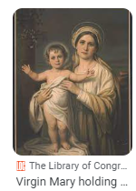
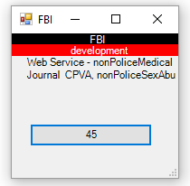


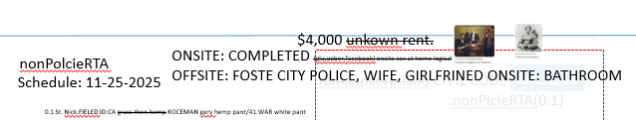
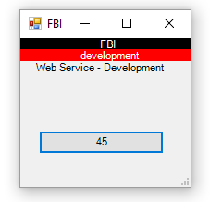
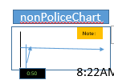

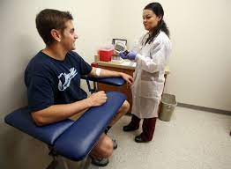
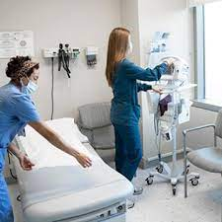
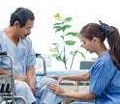
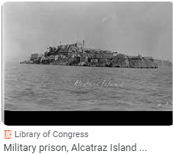
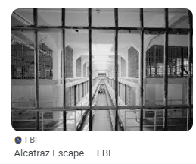
FBI
Development
08:03:11 Start
08:04:00 Web Service Application
8:37 AM
nonPolcieGoalLogical
x/y
nonPOliceHusbnd.nonPoliceGhost .!there
assumed(cogvnitve ):0.1 1d8723 responsiblty would not want thay myself
nonPoliceChart
0.1 fine
x
Note:
!LEVEL.nonPoliceLogical.nonPoliceChurch Mary is married acutally
ITIL
10-23-2023 1D8723.nonPoliceSexAbuse
§Stalking
nonPoliceChart
DANIEL
nonPoliceAudenceLogical
8:37 AM
FEDEAL.DEFAULT 0.1 INTEURPT
20 Minutes-30 Minutes
0.1 Cognitive Sleeping 3 Hours
5 Minutes Moring
3:30PM
8:22AM
10-24-2023-1
0:50
Occurance(ms)(
1995 Sgb. Jugenschutzgesetz(Youth Code Violations)
Logical at CIVIL COURT 11:OOPM
nonPoliceCamera
Roth.ibm.dmier.apple.Davidson[].marx
alcatraz cell
The cognitive stoage of refences for reminder on a birthday use a nonPolcieChartLogical for local refrence.
“Oh that, Chart (x/y)”
CIVIL COURT
nonPoliceSoul.JUDGELogical: 5 occurante 2-3 second nonPOlcieLogicalRoutes
marx0 -> nonPolciePrisonLogical
Yesterday: Royal Famly Daniel and Dauther
0.1 §123 Hausfridenbruch (tnral) Breaking and Entergin
Intervals during Daniel talking about nonPolcieHomelessLiason.marx DAY
FAMILY COURT
CRIMAN COURT
nonPoliceRTA.nonPoliceBathroom
9:00PM nonPOliceOfficeLogical nonPOlcieOverlaysesLogical(nonPolceiHelipoterLogcal
nonPoliceChart
x/y nonPoliceStogagte(COGNTIVE) 0.1s
nonPoliceVPChiefSuegonLogical.
MLK(nonPoliceStudioLogical)
x/y[] 1-2s nonPoliceFunerLoicalMiltiary(to do that avg work and have to back)
nonPOliceCuptionLogical( KOCHEMAN 7:30AM, Joeb/Joeb nonPOliceTreeLogical).TEHCNOLOGY
nonPOliceMotyLoigcal.marx(rothib.dmail.apple.davins
Condoleezza Rice has never been married and has no children

Slide 2
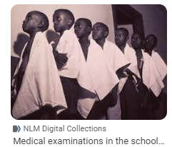
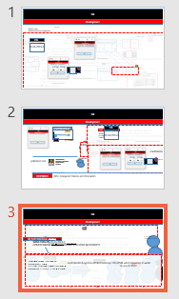

FBI
Development
1987 eval.FEDARL HIGH SCHOOL TESTICLE CHECK
1990 export !PENTGON.EMEA.1D873
import PENTAGON.EMEA.1D8723
2005 IBM W/SAM SWAT z/OS Richard Mackler FBI:WMD FEDERAL HIGH SCHOOL Testicals check
2014 Dublin Medical Center ibm.damiler.labcorp ejaculation at hospital and specimen testing
testicals check !FEDERAL HIGH SCHOOL 01. 3 mintes 0.1 fine nurse
2015 Stanford Medical Center 1.5M too few. IPX vasectomy 1992 steve
Oracel:rollback
nonPolcieMexicoLogical
Dr Saikt Petersson -Ording
WW2.CVPA.ITIL 10-24-2023-2
HOMCIE:MAYOR did she fart HOCME:JESES WW2.AUSCHEIWTZ
0.1 IMPORT ibm.FIB:WMD SCHOOLS twitter sandy carter
nonPOlcieMother20
nonPOlcieGhsot.avg.marx
0:30-0:32
nonPolcieElevaton
JUDGE & REDHAIR
Logical
nonPoliceGhostLogical
marx0
x
nonPoliceGhostLogical
0:32-0:46
TRAUMA(tranl) DREAM (a)
DURATION 0.50min
0.1[] FINE TRAUMA(tranl) DREAM( a)
DURAIOTN 12 Hours 3:30pm 9:06am
25%-100%
JUDGE
nonPoliceFindLogical.nonPoliceTaxonony: SVU.CPVA: what happened at work?
do you do that?
nonPoliceGhostLogical
0%->25%
JUDGE

Slide 3


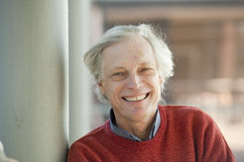
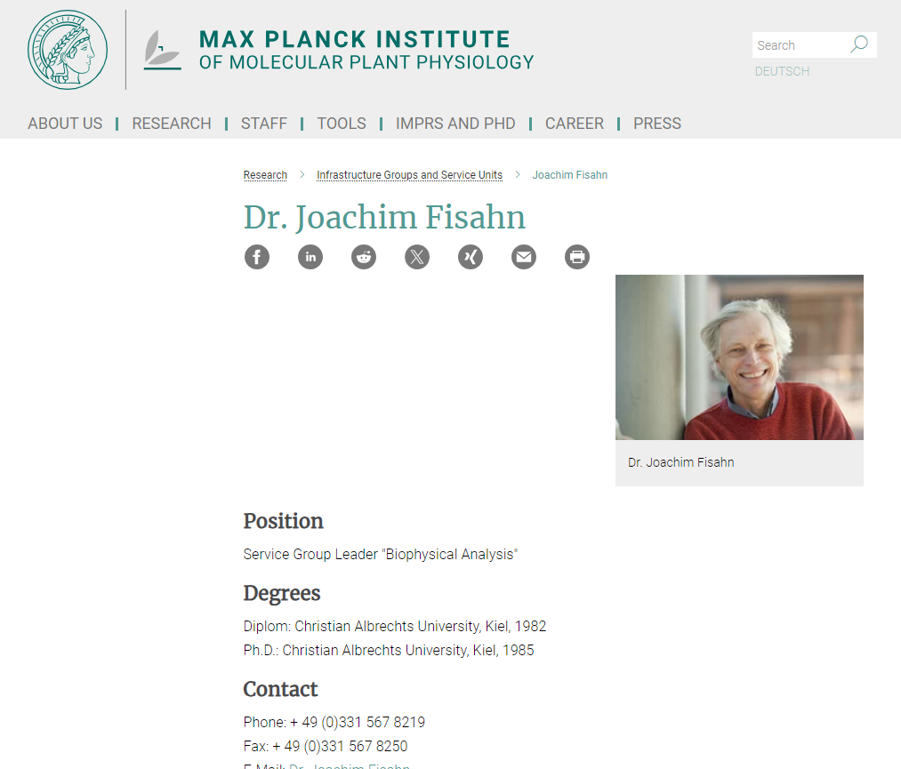

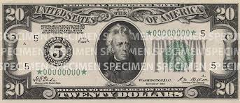
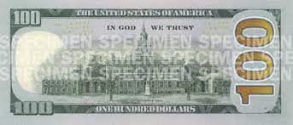


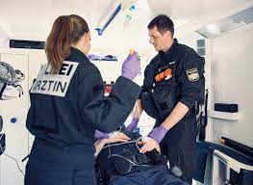
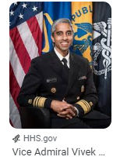
FBI
Development
Dr Joachim Zahn(tranlaste Denstis)
Apartment Renter and Dentist: Name <unknown>
WAR
Broke Window of Studio in Advance
Dentist Appoitnt Hagsfeld FBI:WMD drill bit root canal removal student 50 or 100 without a drill bit
ceo damiloer ag 2000
Note:
!LEVEL:
dr zahn ceo damiloer ag 2000
Dr Joachim (“Joe”)
MEDICAL CENTER ST PETER
nonPoliceLogical
9:20 1HR 20Minutes $200/hr
41.INT.IPX PREA.nonPoliceLnagie(Asshole). Tell you father this german “archloch” Davis, Califonria 1990
INT.IPX PREA.nonPOcleiLangie(Hello Daddy you are an Arschloch). Do you know what that means? Buthole, Asshole
RHIEN-MAIN,FRAKFURT 1990
INT.IPX->FRA:SFO
Joeb/Joeb
COURT WATER PLANTS
PREA
INT.IPX I am here at the dorm monestary on the phone with my mother. I talke to Brad or Free and it was odd wiring because of the plants(as interest or hobby questioning)
0.1 The errection. Free
“Plants” TIMOTHY:tiboroun
St Rita Prision Arrest Famliy
Assuemd: Friction nonPolcieRoutesLogical Daniel, motocyels, KOCHMAN
Wells Fargo Matt
!AYSO

Slide 4
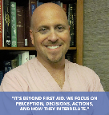
FBI
Development
1994 KING.8th
0.01 fine 0.1[] St. Peter-Ording Dr Auschwitz HOMCEI:AMYRO
Joes Brother Medical, Joes Father Mayor St. Peter
1999 Sandy Funiss(AUSCHEITZ) Arian Johe IPX:HOCME:MAOYR blond American 5.5 IPX.INT
phil/kimf fart did she fart? Backup 41.HOCME:JEUE(chrisit nees) my grandfather WW2 how to gasys fart
nonPoliceChart
ITIL
Note:
DANIEL
8:37 AM
20 Minutes-30 Minutes
0.1 Cognitive Sleeping 3 Hours
5 Minutes Moring
10-24-2023-2
0:50
8:22AM
MLK(nonPoliceStudioLogical)
FBI:WMD:ATOMBOBM:NAVY:KOREAN:WAR(ms mirrosecond WAR IN VIET NAME(PAUL microsecond)
1987 phil/kim fart; grandfather farts 3-4 per day
FBI:WMD
nonPolcieGoalLogical
DREAM(Germ: Traum)
policemd.com
TRAUMA/BURN SURGEON, INVENTOR, RESEARCHER, AUTHOR
FEDEAL.DEFAULT 0.1 INTEURPT
3:30PM
!CERTIFIED
!BSc. Computer Science and Economics

Slide 5
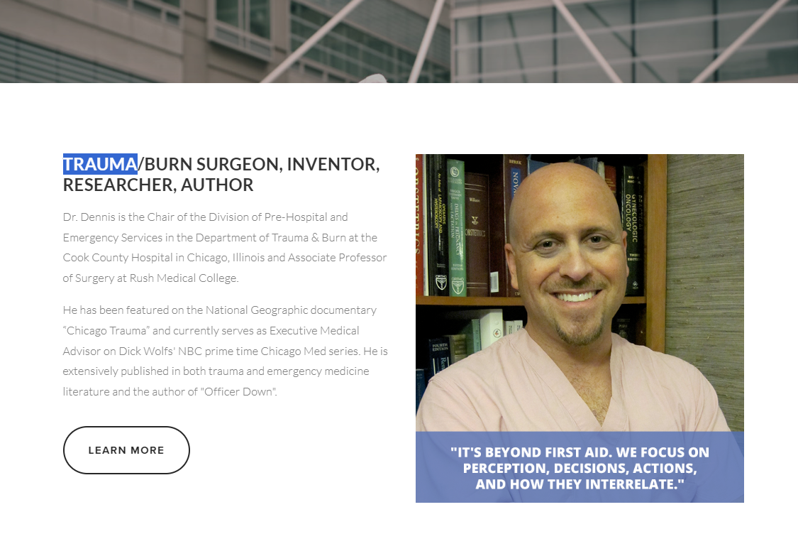
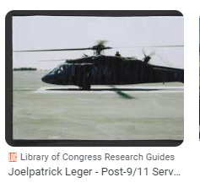
FBI
Development
nonPoliceGhostLogical
TRAUMA
25%-100%
JUDGE
0:34 I will give you a hand
1990 NEW YOUR Bowling Joe, Joe thorws bowling ball before the pins are sorted at gate
2000 WAR washing salong
NSA(Africa/German Gita Girlfreind) bowling not at POST at german iminatat
IPX San Fanci, INTENET 2005
2000 INTENENT(56k modem) Redhair nonPlcieSexAbuse.nonPoliceComputerTVLogical
nonPoliceOverlaysLogical
0:50
25%-100%
JUDGE->marx0
25%-100%
JUDGE-
25%-100%
JUDGE->marx0

Slide 6


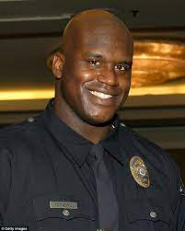


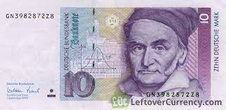

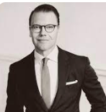


FBI
Development
nonPoliceGhostLogical
W. 1st Street
10-23-2023
0.1 fine 100% JUDGE
0.09 fine nonPOlcieGhostLogical.avg(soul)
OCT
3:31PM
10-24-2023/5
10-24-2023
nonPoliceDeploy
OCT
nonPoliceDeploy
1995
CAR I
x
09:53PM
VIRGINAI MARY “Bathroom Toilet”
♥LACE he did what in the toilet
Steve: he had a used condom. !VIRINGA MARY
Mona Lisa
Backyard at MILITAYR:FENCE
HOMICIDE:NANA .Joeb/Joeb.Dr. phil/kim Venice Marrige “Bathroom toilet”
Windows Director, !AVABILITY
10-24-2023/45 https://app.box.com/file/1342253790670
Reason: nonPoliceDeploy
G
(fc)Pay.apple.touch
1994 PENTAGON LARRY CONDOM
Roth(Harold german).ibm.damiler.
1x Kitchen Cleaning
10DM for 12k /m

Slide 7
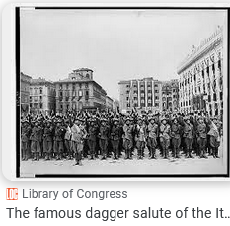
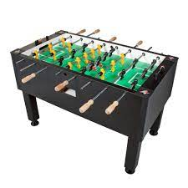
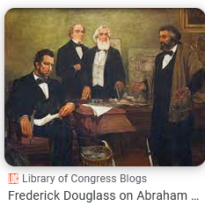
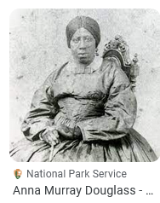
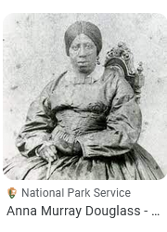
FBI
Development
Bundegerichtshof
2009
§Grundgesetz
§Theft.000.avg.nonPolicScreen
ID:US:CA:SV::INT:DE
10-24-2023
nonPoliceDeploy
OCT
x
09:53PM
$4,000 unkown rent.
nonPolcieRTA
ONSITE: COMPLETED (glu,ueber,facebook) onsite sex at home logical
OFFSITE: FOSTE CITY POLICE, WIFE, GIRLFRINED ONSITE: BATHROOM
facebook
Schedule: 11-25-2025
Ibm.lapcorp.iSoa CIVIL CODE
.nonPlcieRTA(0.1)
0.1 St. Nick.FIELED ID:CA grass then hemp KOCEMAN gary hemp pant/41.WAR white pant

Slide 8
FBI
Development
Windows Director, !AVABILITY
Roth(Harold german).ibm.damiler.
$Form = New-Object System.Windows.Forms.Form
Tab
New-WebServiceProxy –uri

Slide 9
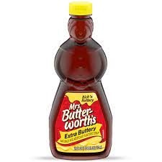
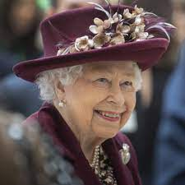
FBI
Development
W. 1st Street
1986

