Slide 1



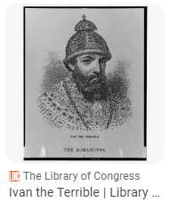
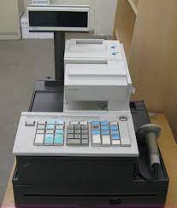
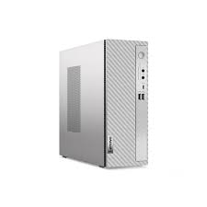
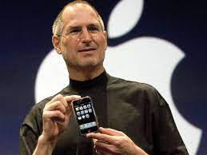

FBI
Partner
Development
ID
St. Dr. Dr. PETERSSON
KING
1883.
Ivan--IV,--Czar of Russia,--1530-1584
JFK(ich)
Alex / ivan ich
1994
Alex(ander) stahl – sex with sister, blacks in social seucity apmetns
Russian sin social scety appemtns alex

Slide 2

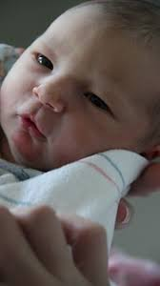
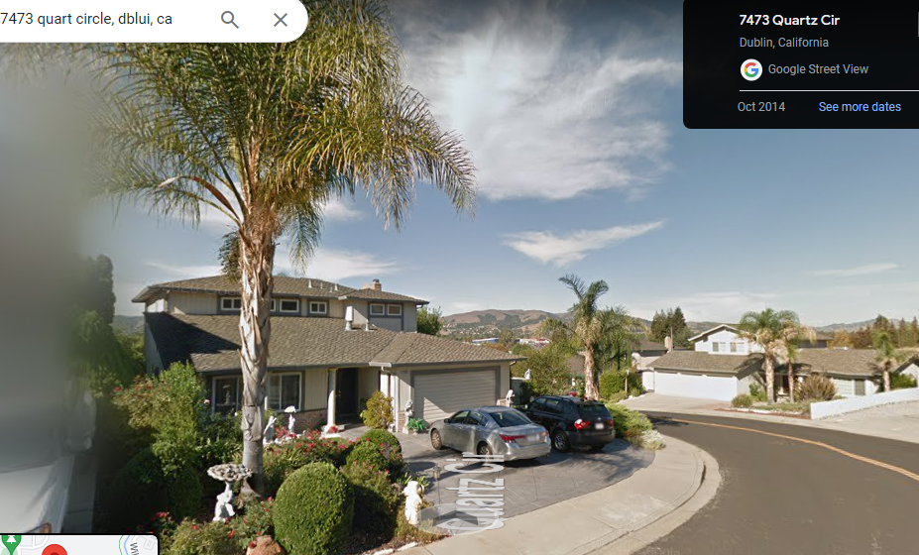
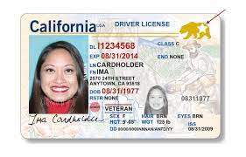
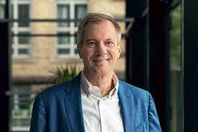
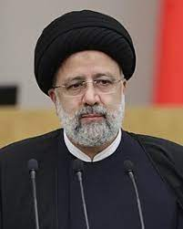
FBI
Partner
Development
V2:FBI:KIDNAPPGIN
FACE
your face
ATOMCLOCK

Slide 3
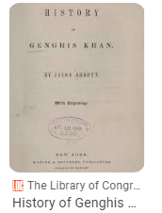

FBI
Partner
Development
2% World Population 23andMe
PETERSSON
ROBERT: chiens never do anything wrong
Al kaida
Gheoh(kito,michela)
POLICE
1.5x FORT WORHT LIBRARY. nonPolciRTA.CPVA.PREA.§187
WAR IN KOREA JFK(phil/kim).v2:FIB:KIDNAPPING 7ft Korean/Alison/intel
FBI:WMD:HOMCE:LUX(olmpics)
VIRIGN MARY
PETERSSON
ATOMPHYICS
1992
HOMCE:LUX:VHS:ID:AUNT

Slide 4


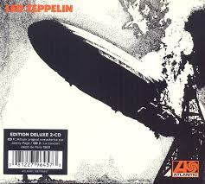
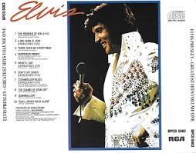


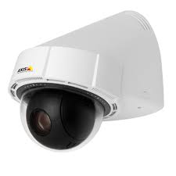
FBI
Partner
Development
W. 1st Street
!In
VIRGINA MARY
FATHER
Gorbachev(micheala)
SQ
Relationship
- Elvis Tom Crus Imataet
- Sex white at work 9 mont bayb caluculator
- Chruchil Tub sinver (FBI:WMD: GREEN)
- Flights SFO FBI:INVESTIGATOIN bin laden
WW2.Elvis
Look down at wife
Whtie husband watching
1:34 PM §Stalking nonPolcieSexAbuse.linst(can I use you bathroom? imitate)

Slide 5
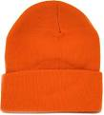
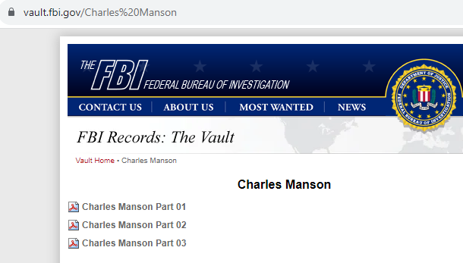
FBI
Partner
Development
§Stalking
1:50PM
0.1
JFK
LIVE
KOMCEHMAN
?HOMCIDE:MATHEW
01 §Stalking HOCME:JOER:KOICHMNE(stev jobs)
POLCIE SOUL
CHART
Angala.§Stalking.gheohmichelaa,stalkings ()
Patica HOMCE:BORIS
Marx0
soul
CPVA.POLICE
(delta)
Intrupts
Joeb/Joeb
Inside/ousidet glu/kyle
LISA

Slide 6
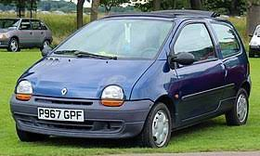
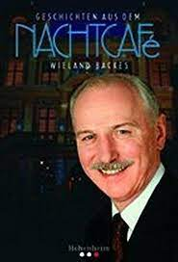
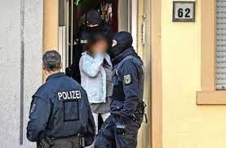

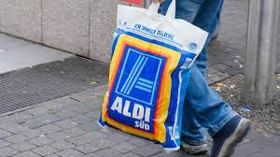

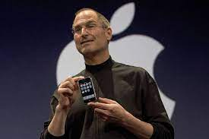
FBI
Partner
Development
2011 New-Born.v2:KIDNAPPG.VIRIGN.MARY
rastatt rotlichtviertel
2011
^{24th}
LISA.”roth”
KING.QUESt.dell(Stefan marx)
DEC
Joeb/Joeb
stalin
marx
Gheoh(micehaala) May go brothel, then may not go to brothel
HOMCE:LUX:INTERN rolanden fixer
HOCNE:LKUX:INTER Stefan: garage Roldan fixer (FKK)
CPVA.PREA.187.ATOMCLOCK(drapes)
LISA.”roth”
HOMCEICI:SUNSTOCK(kodan mother touch red chirm balls)
putin
Joeb/Joeb

Slide 7
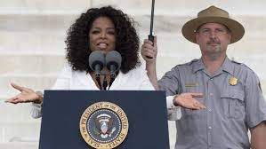
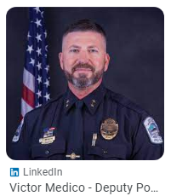


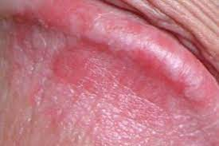
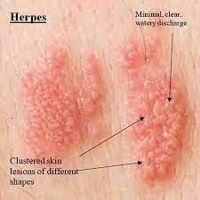

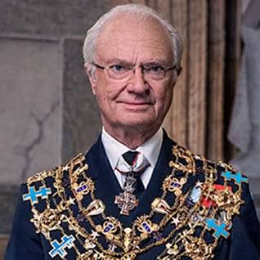
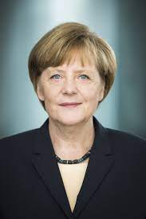
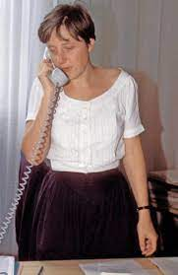
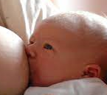
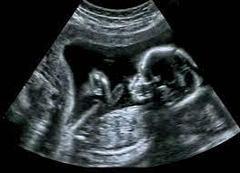

FBI
Partner
Development
11AM
10/28/2023
RTA
nonPoliceRTALgoical.STAFF Phillis or Phillis Jr
Military
1st W. Street
Foster City
MX-US-Medica
KING:FBI:WMD:YELLOW
14:42PM
10/28/2023
RTA-2
!manic.stalin(Mx)
x/y Joeb/Joeb
Penis rash
HOMCE:LUX:SAP
HOCME:LUX:WALDOLF:SAP
“Contry” HOMIC:LUX:COINTONEW
HCOME:LOXU:WALDORF
KING:HCEOMI:LUX:WALDOR;Phcatire:HOCME:[]
Invert MARK KING.* hunting kingmanhunt
RTA-3
§Stalking 3:38 redhat soam bin ladne
3x 2day in a row
Phil/kim.JK.MLK.FBI:WMD:GREEN craiglist VIRIGIA
[x] no
Phil/kim. FBI:WM:YELLOW PENGON EMEA thehun
Penis rash
Judges
2x
[x] no
G.Gedion I
St. Rita.VIRGINA MARY(blond)
RTA-4
MLK(V2:FIB:KIDNAPPING(angleo/a micheala in car VIRIANA MARY age 14 michalbch to gagneau))
x
Penis rash
I drow in a car with angleo and did not kiss him
WAR
FEDEARL DEFUALT invert
LEVEL: ss Seinfeld goheoh stalin marx
RTA-5
41. Ronald Regaon
Penis rash
Vorskin so dry hurts over penis Eichel, cannto shake
VP GERMASN naked englis garden munich, gheoh(kito), PENGON EMA (SQ.OCELMAN IPX ( penton shap appametns; kito,kai)
Penis rash
RTA-6
Penis rash
Redhouse: mother Foscter City ( walk like egpytoin, cindy lauder I know) musi emotions
Cindy Lauper – and Bandgle Wlak like Ecyptoin
RTA-7
14:22PM
10/28/2023
!Docs
G.SQ
Angelo/a 7x
INT
Center of Town.G.VIGINA MARY HOCME:BORIS paticia
SQ.QUEEN hi5/tango
CHECKPO CHAIEL(STORE) HOCMIE:FESENBECK
IPX HCOME:REDHAIR
Roth harild bathoom
PENGON.MUNICH(gheoh(kito appemtns,HW/5gheoh(michaala)
HOCME:LUX:BULLT.JFK.HSOOTER:MUNICH
Avg.Streetcrim ding( father puts penis I nmother during brith) hits head
Al kaida 30 virigins
LARYR
30 gheoh(kito,miceha)
8 gheoh(kito) actual girlfirnds
AVAIABLlY !gheoh(kito,sabry) bald/blad/bald
Mother links sex emtoins
Logical gneated 0.1 “Views” o srendon 0.1 “views”

Slide 8


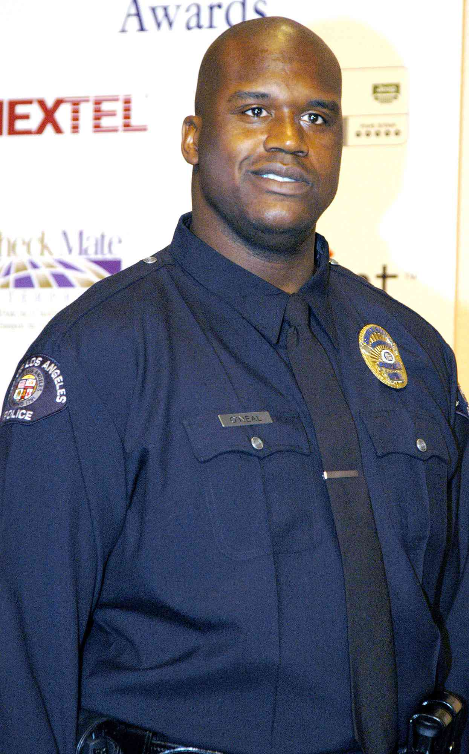
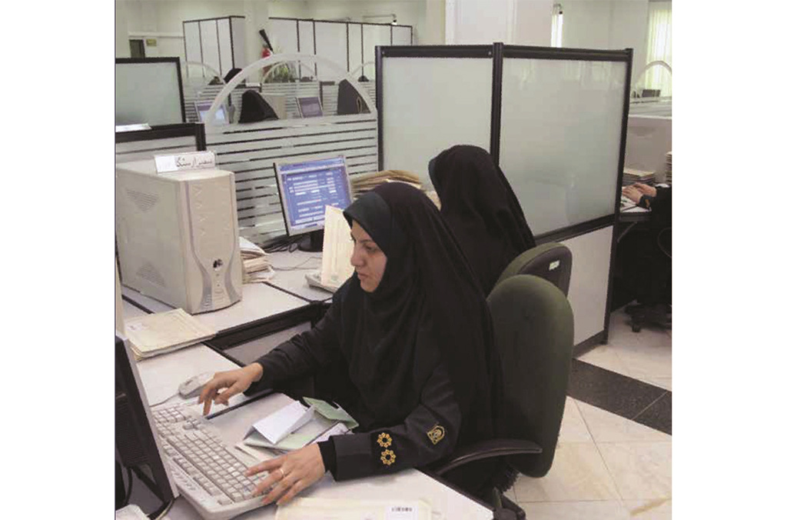
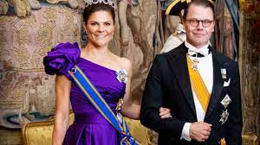
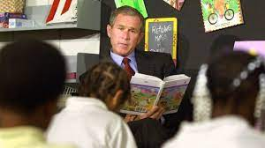
FBI
Partner
Development
Judges
§Stalking 3:38 redhat soam bin ladne
DEFNESE
As Joshe Died
Deere Park, Ave
Fort Knox, Equinox Data center roth.ibm.appe.touch.*
LARRY
TIMONY
JR
Joepshe Sexotn Us Flag Al Kada Osam Bin laden,
V2:FBI:KIDNAPPG joyti/joti

Slide 9
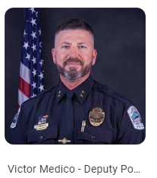
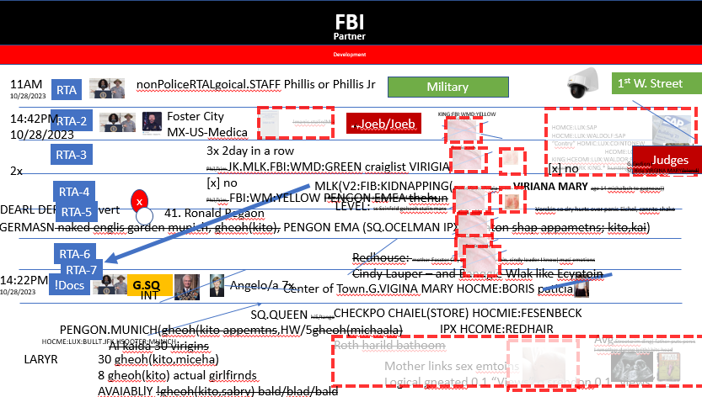
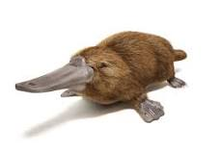
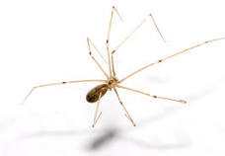
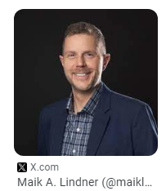
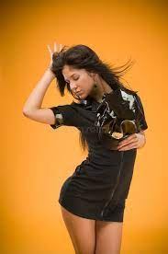
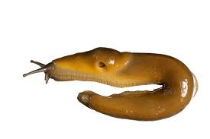
FBI
Partner
Development
CHART
¼.nonPoceSexAbuse
Dr. Dr. Prof.
Waldorf Schools
1983 jenny black man, montessori
2017 moodies
Convited re-Hired as kindergardner;
Closest sex related
“whole room smells like penis”
¼.nonPoceRTALgoical.marx
Waldorf insects are sex abuse refrecnes.

Slide 10


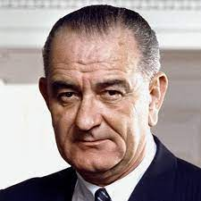


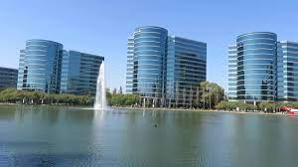
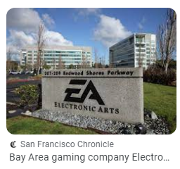
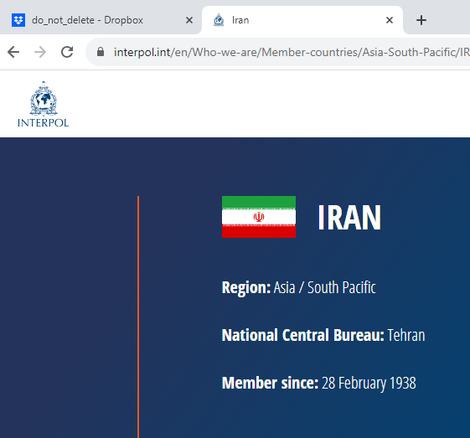
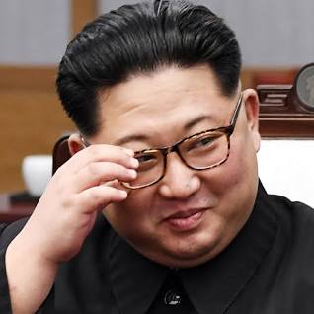


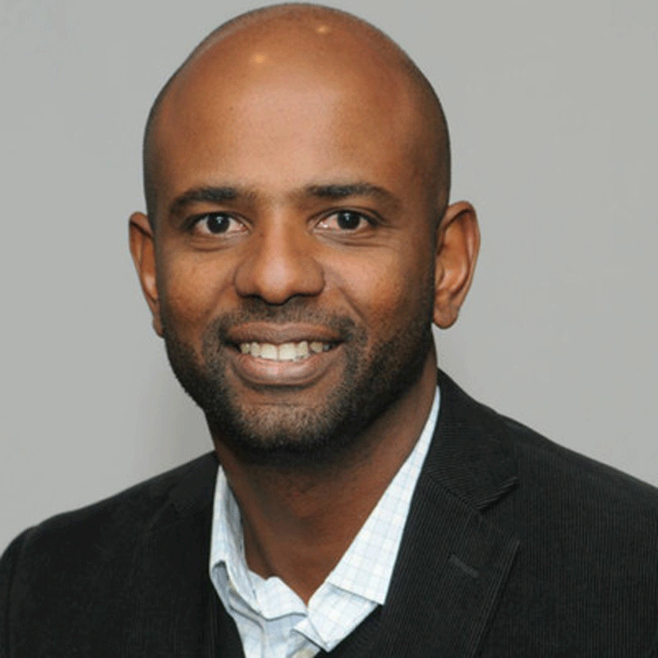

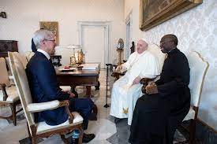
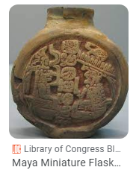
FBI
Partner
Development
BLUE
MAINSTREET(G.MLK(visaroom, womens brest feed, Jason shake room)
I have mtv in my and may date brad(ly) Johnson City Kiffer(tnral) dope
RED
HOMCEI:LUX:belajio
VRIGIN.KOCEMAN.son of eli(elison).favors(Handjob library).911
KOCEMAN
IMPORT HOMCE:MAYOR
41. Questoins
Avg.AVAAIBLITY( I will aso take kim kadiaon and any money)
9/11
x
2008
101 Market 8th Floor 2^{nd(th floor IT}
41.!”Jesus”, Mohammed
The first Maya cities developed around 750 BC, and by 500 BC

Slide 11
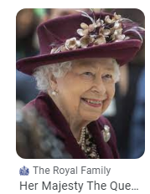
FBI
Partner
Development
I have mtv in my and may date brad(ly) Johnson City Kiffer(tnral) dope
MARLIN
1986
1have mtv in my and may date brad(ly) Johnson City Kiffer(tnral) dope
40Y
JFK(INTENET PAYMENS, fortino
Conffnce room; MTV
St. Gallio confnce room)
Remote contorl(rca)
I have mtv in my and may date brad(ly) Johnson City Kiffer(tnral) dope
x
§Stalking VINGIIA MARY.stanfod tiger woods &
sales
Apple touch tiger woods

Slide 12


FBI
Partner
Development
iWatch.ATOMCLOCK
Onsite: 5ft FBI:WMD:911.0 Children library depment
!white

Slide 13
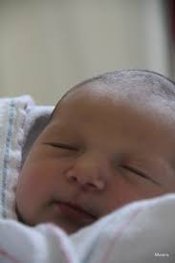



FBI
Partner
Development
G(god).!neil(son)
z/OS INTENT PAMEHT
RETAI PAYMETNS
WAR
soa
FRAUD INTERNET PAYMEETNS
VIRINGA William mckern
VIING MARY Ivy Bar.INTUPET gheoh(anglea),putin ICC-J
CREDIT
§Theft
Whitehouse.marx(take house under)
FBI
W. Middlefield
HOCME:LUX::LV:LAW
bar
Development
Interutps
CAHS REGISTER
VIRING ibm
Bar-1: cash register keyboard
Bar-2 cash rego bkeyboard
Sales
Return
!Sales: do they want a cash resgier
WWI.bar-0
0.1 Evidence
William McKer(WSDL)
Visa Security (kyle)
NCR
Visa
NCR employe gheoh(micheal)
NCR CEO
Visa regail
Visa INTENET
CPVA
000.§Theft(apple pay, steve jobs,gpay LARRY, PRICE)

Slide 14
FBI
Partner
Development
parfume
§Stalking 4:50 white male steecrimfirign
4:58PM
Russin accent:

