Slide 1

FBI

Slide 2


FBI
Daimler AG
ibm
WWI.Son of Joseph
Mona Lisa
Otto-Hahn
Penis and
Scheide
Kirsche(transl.)cherry
Kirsche(transl.)Church
41.Dual meaning
SCH, S-C-H (PRONC.)SS, CEE, HAH

Slide 3

FBI
WWI.Son of Joesph
Mona Lisa
ibm
Wiener, Jeff
Muschiani, Nina
Hermossa
Penis and
Scheide
Church
Creed
.hidden

Slide 4
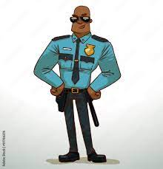

FBI
ibm
Muschiani
Wiener, Jeff
Kirsche S-C-H
LABOR CODE

Slide 5
Joseph's Son ( Francisco, dustin)
Kirsh-i
1st Grade Daughter
1st Grade Sister
1st Grade Half-Brother
1st Grade Kirsch-i, ?
1st Grade Daniel Kirschbaum
Franceso, Daniel and Daniel
Franceo has new friend Jason
kirsch-I since 1st grade
The Pope Francesco is Josphere Son
The Pope Dustin is Joeseph’s Son

Slide 6




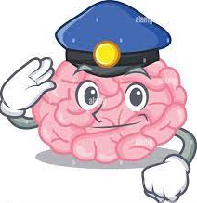
Year 41
1994 Daimler Ag
Layers of §422.6 !Hate Crime
2000 KIT Warstreet
LVA
2013
WWI retirement ATB United States (ROTH)
2016
Kirsch-i
Kirsche(transl.)Church
Kirsche(transl.)Cherry
Kirsch-i(Meaning)
Daniel Kirschbaum,
Fiat, Daimer AG

Slide 7
HELLO this Jeff Winer I am important Meeting Please away

Slide 8
FBI
ibm
Muschiani
Wiener, Jeff
Kirsche S-C-H -I
LABOR CODE AND 24x7
MLK(BLACK ) and Wife Accenture
IN YOUR FACE,
MUSSHCI means Vagaina

Slide 9
HELLO this Jeff Winer I am important Meeting Please away OUT OF MY MEETING

Slide 10
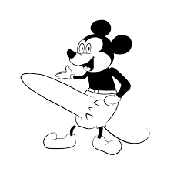

Carl-Benz

Slide 11
FBI

Slide 12
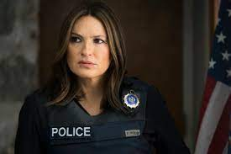
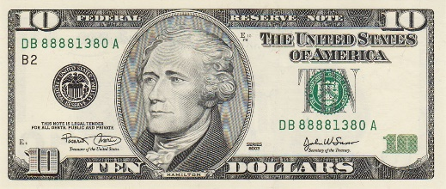
FBI
KRYSTAL
Social Security Administration “Kisch-i” Father
10pm Bar
Pope Paul
Peter
Mary
Joseph
Ron!
1990

Slide 13
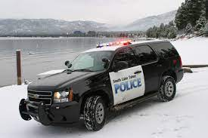
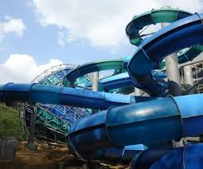

FBI
Polizei Coin Town
LUX
1990 Vice President, Merkel, Vice Vice President Wellereuter
Maria, Son of Joseph
“The Lake”
Denise 11
Coin Town
Lux(ury)
Benjamin Franklin, younger, coin town
Schneller Propeller
(fatster Plan Roter
, faster)
white:medium
41..Aida,API,shipping.nonPolcieRT phil
Sends Cherrytre data fast Bilderberg in Brain

Slide 14
FBI
2004
LUX
Swimming Pool Cabin, KA/BAD-FRA
Gorbachev(Kito,Lips) Chaped
2 Years Younger ( Son of Joseph)
2013 Dr. Rice, Biographie and Lips Chap
1991
Brown

Slide 15
FBI
I am Benjamin
My father is Mr. Lux, from Coin Town

Slide 16
FBI
I am Jesus
My father is God

Slide 17
FBI
I am Goethe
My father is Herr Gott

Slide 18


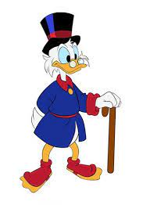
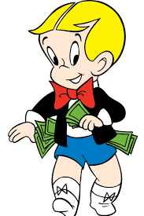

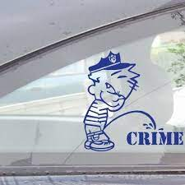
You did not go to coin town, scrooge in Monopoly?
Dr. Dieter Zetsche in the game Monopoly?
Damier AG
Yes
Yes
Vs.
Class-Action TORT

Slide 19
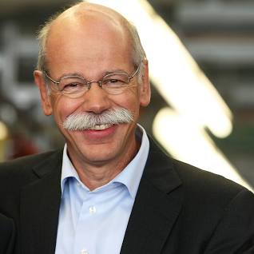

Are you Scrooge in Coin Town
with the Monopoly?
Dr. Dieter Zetchse
Dieter-is-Thomas
Yes
Yes, I killed Wolfgang Lux For the Kaiser Karl Wilhem Emplire And Adophy Hitler Empire, or Nazi Empire I am serial killer

Slide 20
FBI Partner
INTERNATIONAL JUSTICE
Mathew
Scrooge vs. Richie Rich
The Judge found
Scrooge guity of going
To Coin Town from
his monpoloy
Vol. 1, February 17th 2023 for Children
Scrooge vs. Richie Rich
The Judge found
Scrooge guity of going
To Coin Town from
his monpoloy
Scrooge vs. Richie Rich
The Judge found
Scrooge guity of going
To Coin Town from
his monpoloy
Scrooge vs. Richie Rich
The Judge found
Scrooge guity of going
To Coin Town from
his monpoloy
Scrooge vs. Richie Rich
The Judge found
Scrooge guity of going
To Coin Town from
his monpoloy
Scrooge vs. Richie Rich
The Judge found
Scrooge guity of going
To Coin Town from
his monpoloy
Bit.ly/1D8726
Scrooge vs. Richie Rich
Are you Scrooge in Coin Town
with the Monopoly
Scrooge vs. Richie Rich
The Judge found
Scrooge guity of going
To Coin Town from
his monpoloy
Scrooge vs. Richie Rich
The Judge found
Scrooge guity of going
To Coin Town from
his monpoloy
Piliki
Scrooge vs. Richie Rich
The Judge found
Scrooge guity of going
To Coin Town from
his monpoloy
Scrooge vs. Richie Rich
The Judge found
Scrooge guity of going
To Coin Town from
his monpoloy
Scrooge vs. Richie Rich
The Judge found
Scrooge guity of going
To Coin Town from
his monpoloy
Scrooge vs. Richie Rich
The Judge found
Scrooge guity of going
To Coin Town from
his monpoloy
Scrooge vs. Richie Rich
The Judge found
Scrooge guity of going
To Coin Town from
his monpoloy
Scrooge vs. Richie Rich
The Judge found
Scrooge guity of going
To Coin Town from
his monpoloy
Bit.ly/1D8727
Mark
Scrooge vs. Richie Rich
The Judge found
Scrooge guity of going
To Coin Town from
his monpoloy
Scrooge vs. Richie Rich
The Judge found
Scrooge guity of going
To Coin Town from
his monpoloy
Scrooge vs. Richie Rich
The Judge found
Scrooge guity of going
To Coin Town from
his monpoloy
Bit.ly/1D8728

Slide 21
FBI Partner
INTERNATIONAL JUSTICE
Mathew
Scrooge vs. Mr. Rich
The Judge found
Scrooge guity of going
To Coin Town from
his monpoloy
Vol. 1, February 17th 2023
Scrooge vs. Richie Rich
The Judge found
Scrooge guity of going
To Coin Town from
his monpoloy
Scrooge vs. Richie Rich
The Judge found
Scrooge guity of going
To Coin Town from
his monpoloy
Scrooge vs. Mr. Rich
The Judge found
Scrooge guity of going
To Coin Town from
his monpoloy
Scrooge vs. Richie Rich
The Judge found
Scrooge guity of going
To Coin Town from
his monpoloy
Scrooge vs. Richie Rich
The Judge found
Scrooge guity of going
To Coin Town from
his monpoloy
Scrooge vs. Richie Rich
The Judge found
Scrooge guity of going
To Coin Town from
his monpoloy
Scrooge vs. Richie Rich
The Judge found
Scrooge guity of going
To Coin Town from
his monpoloy
Scrooge vs. Richie Rich
The Judge found
Scrooge guity of going
To Coin Town from
his monpoloy
Bit.ly/1D8726
Piliki
Scrooge vs. Richie Rich
The Judge found
Scrooge guity of going
To Coin Town from
his monpoloy
Scrooge vs. Richie Rich
The Judge found
Scrooge guity of going
To Coin Town from
his monpoloy
Scrooge vs. Richie Rich
The Judge found
Scrooge guity of going
To Coin Town from
his monpoloy
Scrooge vs. Richie Rich
The Judge found
Scrooge guity of going
To Coin Town from
his monpoloy
Scrooge vs. Richie Rich
The Judge found
Scrooge guity of going
To Coin Town from
his monpoloy
Scrooge vs. Richie Rich
The Judge found
Scrooge guity of going
To Coin Town from
his monpoloy
Bit.ly/1D8727
Mark
Scrooge vs. Richie Rich
The Judge found
Scrooge guity of going
To Coin Town from
his monpoloy
Scrooge vs. Richie Rich
The Judge found
Scrooge guity of going
To Coin Town from
his monpoloy
Scrooge vs. Richie Rich
The Judge found
Scrooge guity of going
To Coin Town from
his monpoloy
Bit.ly/1D8728

Slide 22
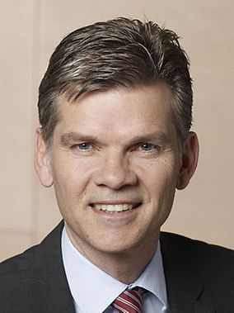







FBI Partner
INTERNATIONALE JUSTIZ
Vol. 1, February 17th 2023
FBI Partner vs. IBM
The Judge found
Scrooge guity of going
To Coin Town from
his monpoloy
FBI Partner vs. Sam Sawres
The Judge found
Scrooge guity of going
To Coin Town from
his monpoloy
FBI Parter vs Joseph Sexton
The Judge found
Scrooge guity of going
To Coin Town from
his monpoloy
FBI Partner vs. Jotyi
The Judge found
Scrooge guity of going
To Coin Town from
his monpoloy
FBI Partner vs. Damiler AG
The Judge found
Scrooge guity of going
To Coin Town from
his monpoloy
FBI Partner vs Visa
The Judge found
Scrooge guity of going
To Coin Town from
his monpoloy
FBI Partner vs. Cisco Montoring
The Judge found
Scrooge guity of going
To Coin Town from
his monpoloy
FBI Partner vs. Dylan ?
The Judge found
Scrooge guity of going
To Coin Town from
his monpoloy
FBI Partner vs. ? Backer
The Judge found
Scrooge guity of going
To Coin Town from
his monpoloy
Vice President
Germany
FBI Partner vs. Yang
The Judge found
Scrooge guity of going
To Coin Town from
his monpoloy
Petersson vs. Yang
The Judge found
Scrooge guity of going
To Coin Town from
his monpoloy
FBI Partner vs. Yahoo!
The Judge found
Scrooge guity of going
To Coin Town from
his monpoloy
Prof. Dr.
Susanne Baer,
LL.M. (Michigan)
FBI Parnter v. Jeff Weiner
The Judge found
Scrooge guity of going
To Coin Town from
his monpoloy
FBI Partner v. LinkedIn
The Judge found
Scrooge guity of going
To Coin Town from
his monpoloy
FBI Parnter v. Nina Mussiani
The Judge found
Scrooge guity of going
To Coin Town from
his monpoloy
FBI Partner
Dr. Dr. Prof. h.c. Jason Petersson
FBIT Partner v. Apple
The Judge found
Scrooge guity of going
To Coin Town from
his monpoloy
FBI Partner v. Tim Cook
The Judge found
Scrooge guity of going
To Coin Town from
his monpoloy
FBI Parnterv. Bertelsmann
The Judge found
Scrooge guity of going
To Coin Town from
his monpoloy

Slide 23
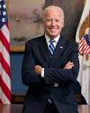
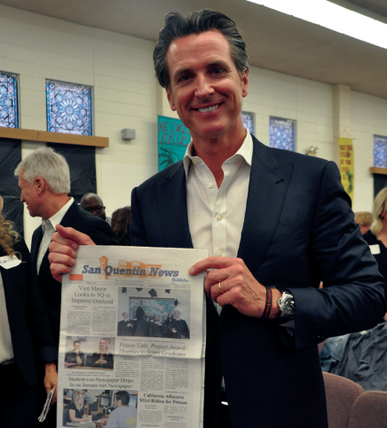


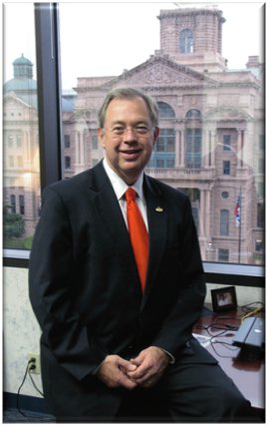
FBI Partner
INTERNATIONAL JUSTICE
2008
Vol. 1, February 17th 2023
Scrooge vs. Mr. Rich
The Judge found
Scrooge guity of going
To Coin Town from
his monpoloy
FBI Partner vs. Sam Sawres
The Judge found
Scrooge guity of going
To Coin Town from
his monpoloy
FBI Parter vs Joseph Sexton
The Judge found
Scrooge guity of going
To Coin Town from
his monpoloy
FBI Partner vs. Jotyi
The Judge found
Scrooge guity of going
To Coin Town from
his monpoloy
Scrooge vs. Richie Rich
The Judge found
Scrooge guity of going
To Coin Town from
his monpoloy
Scrooge vs. Richie Rich
The Judge found
Scrooge guity of going
To Coin Town from
his monpoloy
Governor,
California
FBI Partner vs. Cisco Montoring
The Judge found
Scrooge guity of going
To Coin Town from
his monpoloy
FBI Partner vs. Dylan ?
The Judge found
Scrooge guity of going
To Coin Town from
his monpoloy
FBI Partner vs. ? Backer
The Judge found
Scrooge guity of going
To Coin Town from
his monpoloy
FBI Partner vs. Yang
The Judge found
Scrooge guity of going
To Coin Town from
his monpoloy
Petersson vs. Yang
The Judge found
Scrooge guity of going
To Coin Town from
his monpoloy
FBI Partner vs. Yahoo!
The Judge found
Scrooge guity of going
To Coin Town from
his monpoloy
FBI Parnter v. Jeff Weiner
The Judge found
Scrooge guity of going
To Coin Town from
his monpoloy
FBI Partner v. LinkedIn
The Judge found
Scrooge guity of going
To Coin Town from
his monpoloy
FBI Partner v. LinkedIn
The Judge found
Scrooge guity of going
To Coin Town from
his monpoloy
FBI Partner
Dr. Dr. Prof. h.c. Jason Petersson
FBIT Partner v. Apple
The Judge found
Scrooge guity of going
To Coin Town from
his monpoloy
FBI Partner v. Tim Cook
The Judge found
Scrooge guity of going
To Coin Town from
his monpoloy
FBI Parnterv. Bertelsmann
The Judge found
Scrooge guity of going
To Coin Town from
his monpoloy
Judge
Tarrant County)

Slide 24
FBI
I am Goethe
§vggg
My father is Mr. Gott

Slide 25
FBI
I am Benjamin
I am Harris
I am Wolfgang
I am Özoğuz
My father is Joe
My father is Otto
My father is Olaf
My father is George

Slide 26

FBI
1992
School

Slide 27

1992
School

Slide 28

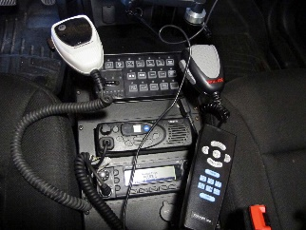
1992
School

Slide 29
1987
Marlin

Slide 30

1984
Red House

Slide 31

1981
Water

