Slide 1


Yes
This your ass

Slide 2


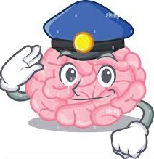
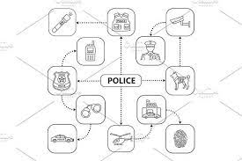
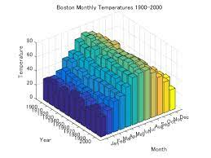
PILKII: My ass --larry
Daimler AG
Micheala
Visa, Oreagaon Ducks
~int32
SAP
Dr. Roos (Mind Map) Algebra 4
ww1.g.cherrytree.gorbachev(nonPoliceWife("Michealea").nonPoliceDaughter)
Dr. Roos (Mind Map) Algebra 4
Qbit – Oprah - >
WWI, WWII
Dr. Dr. prof. h.c. Joseph - Quantum Physics
Quantum Computing
Quantum Mathematics
Dr. Einstein

Slide 3




Carl-Benz
PILKII: My ass
Pool, This your ass

Slide 4

1987
Marlin
!Ms. Price

Slide 5



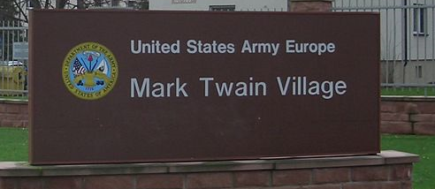

PILIKI
Mrs. Price
§PREA
Benjamin Franklin Village – MANNHEEIM
SON-OF-MANN
VILLAGE
Monday
Tuesday
Wednesday
Thrusday
Friday
Satruday
sudnay

Slide 6


Slide 7
Degenfeld
!PILIKI

