Slide 1
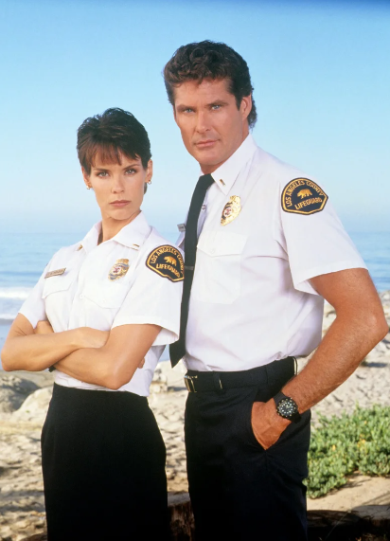
FBI
development

Slide 2

FBI
development

Slide 3
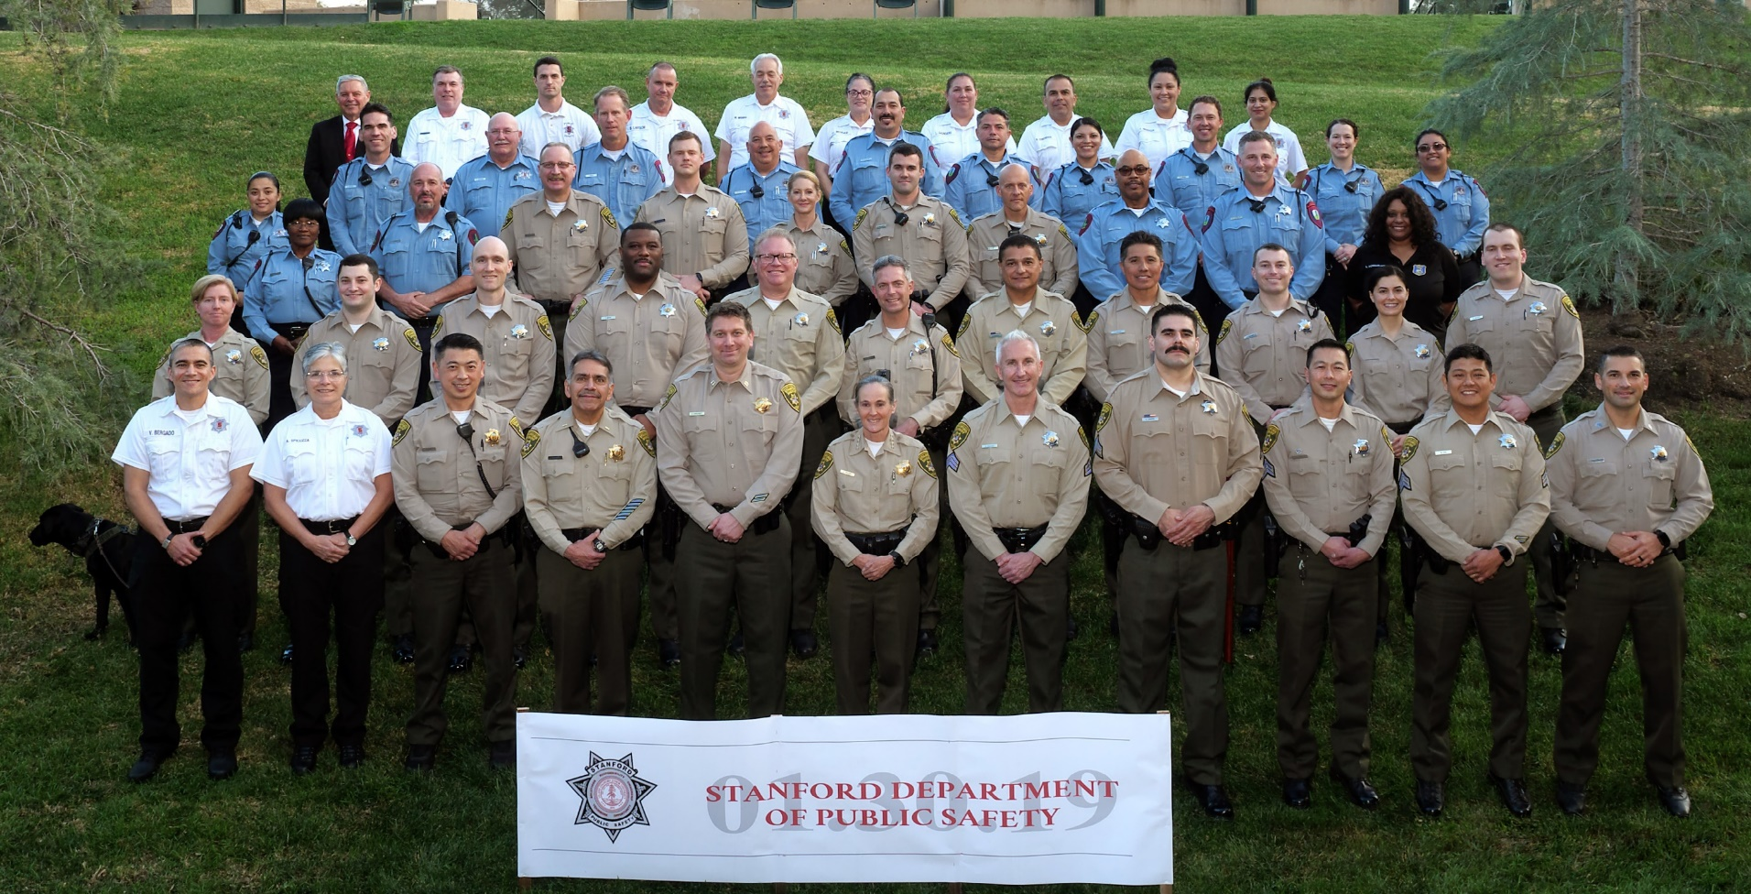
FBI
development

Slide 4
FBI
development
FBI:WMD:GREE
PENGOAN.emea(deere)
nonPolice
raitoan l clear case
GOVERMENT CODE uml(use cases), etc
IMPORT SQ.COLEMAN band ( andre van sctooter)

Slide 5
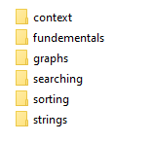
FBI
development
COMPILATION
C++/Java
Mp4 frauenhoffer Instutue,
¼-de.gudid dr mattias frind, joe

Slide 6
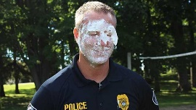
FBI
development
Compilation of animated Gif
C++ Crunching
Bios
Yang.HBR/ MBR
Yang muller

Slide 7
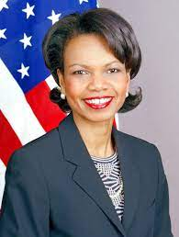


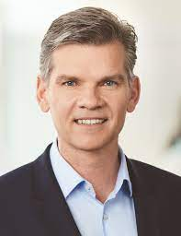

FBI
development
C++ Crunching
Bios
Yang.HBR/ MBR
Yang muller
Yang: my cum
VP GERMA : my cum
Petersson cum
Muller: mein erguss
Angel Mekerl: my petersson cum
2nd 41. Anntonet (at fault
1st 41 Antonet son (at fault)
2011-2023
15Y
15Y
2011-2016-2023

Slide 8
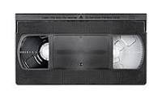
FBI
development
Pentagon Base Paul
Mary
Playboy
1994
7 Dyas at Marrys hosue
Ghcoe(depress) wedding
Micheaigan-Stuttgart
Steve miceha las Christmas
IPX MAINSTREET
al kaid changtal fancec blaketn cum)

Slide 9

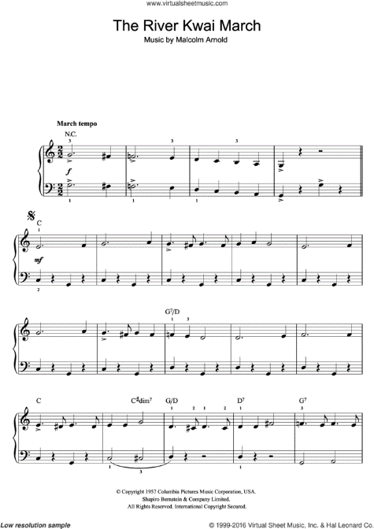
FBI
development

Slide 10
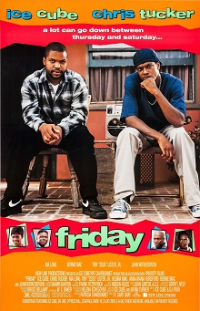
FBI
development
CHART
INTERUPTS
MILITARY ABROAD DATA and PHYSICS
41 eva braun eval, WEEKEND(wochenend,
JFK(ibm visa,breakfast)
LABOR CODE, 41.VACATION. Eva braun
AUSCHEI(ibm damiler; arbiet macht frei)

Slide 11

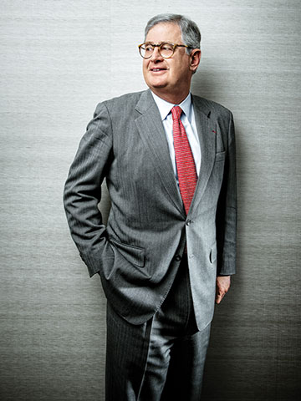
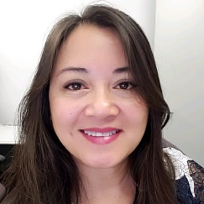
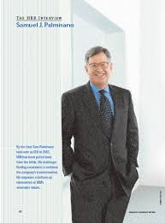

FBI
development
2019 Moodys (mbr) chinse
2015 tango(mbr) chense
MBR – Compilation “kindom cum”
Yang, minlei
HBR/
Do you want
IBM Omegaon XE?
Do you want
ITCAM for Web Transctions?
“Eveyone Sells”

Slide 12



FBI
development
CPVA
(c++)
VIRGINIA.CAR.CIVIL.CODE
PREA
Prison Rape Elimination Act
§187

Slide 13
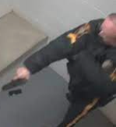
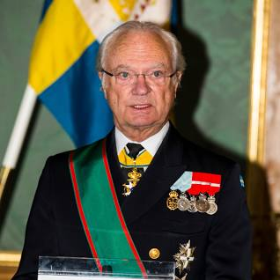
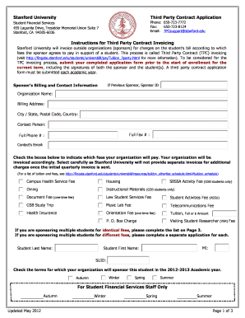
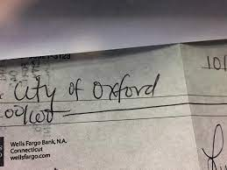
FBI
development
Cumshot, compilation
VP GERMANY : my cum
Petersson cum
Anal facial cumshots
kindomdum
Police Ticket(s)
0.01
§187
Stanford University
Harvard University
Oxford
KIT
CVPA Arrest:HOMICIDE:SUNSTROKE

