Slide 1
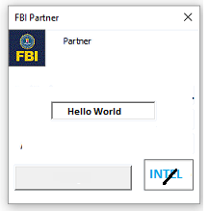

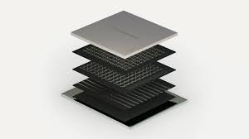
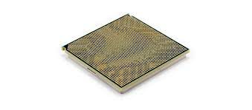
FBI
TECHNOLOGY
Web Service
Assembly / C++
https://ics2wsa.ic3.com/commerce/1.x/transactionProcessor/CyberSourceTransaction_1.207.wsdl
FBI
SEX ABUSE
IBM (DELATA) 3-LETTER
IBM xSERIES(windows)
IBM iSERIES(i5)
IBM pSERIES(aix)
Avg.nonPoliceChartLogical
[ ] – nonPolcieSexAbuse
i.e avg.Windows Network at Home
IBM zSeries
2005 256
IBM Quantum Processor

Slide 2

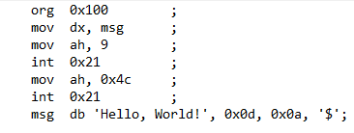
FBI
TECHNOLOGY
Assembly
(New-WebServiceProxy -Uri bit.ly/1D8723/asm.wsdl).hello()
Web Service
Assembly
Sex Abuse
http
WebSphere
JNI
ASM
Assembly
lpar
z/os
https://ics2wsa.ic3.com/commerce/1.x/transactionProcessor/CyberSourceTransaction_1.207.wsdl

Slide 3
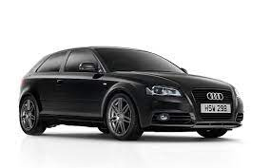
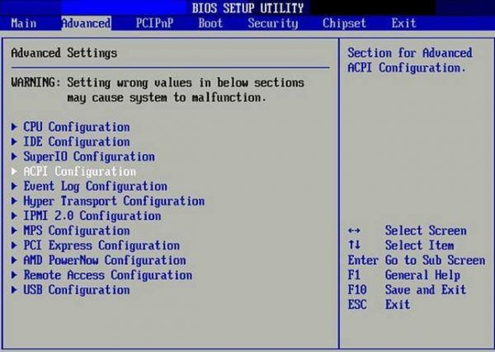
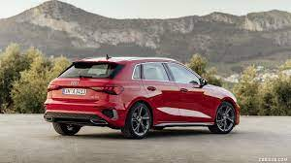
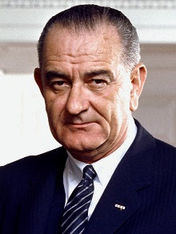
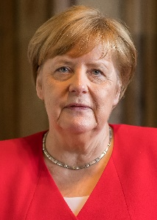
FBI
TECHNOLOGY
Assembly
(New-WebServiceProxy -Uri bit.ly/1D8723/asm.wsdl).runTransaction()
Web Service
Assembly
bios
Ibm.dmielr.partner.employe.daniel.urbano
ipx
Mannheim
SQ,larkspur
Marrin,ross
BIOS
BLACK
http
RED
Johannes
Navy-de
Bruchsal
deere
Windows
Cygwin
C++
HOMCIDE:LUX:COINTOWN
bruchsal
Assembly
Bios
PHIL:JOHNSON
SQ:COLMAN
(deere,Mannheim)
Intel
(deere,Bruchsal)
!DR.RICE
Call you too
Ibm.damiler.apple.yahoo.tango.emploey.jeryr.yang
HOMICIDE

Slide 4

FBI
TECHNOLOGY
C++
(New-WebServiceProxy -Uri bit.ly/1D8723/asm.wsdl).runTransaction()
Web Service
C++
https://ics2wsa.ic3.com/commerce/1.x/transactionProcessor/CyberSourceTransaction_1.207.wsdl
http
WebSphere
JNI
C++
lpar
z/os

Slide 5
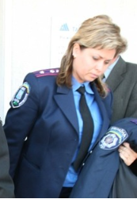
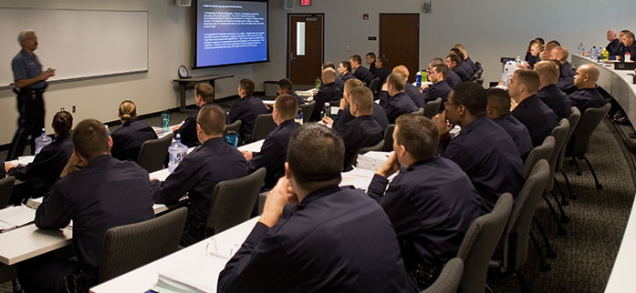
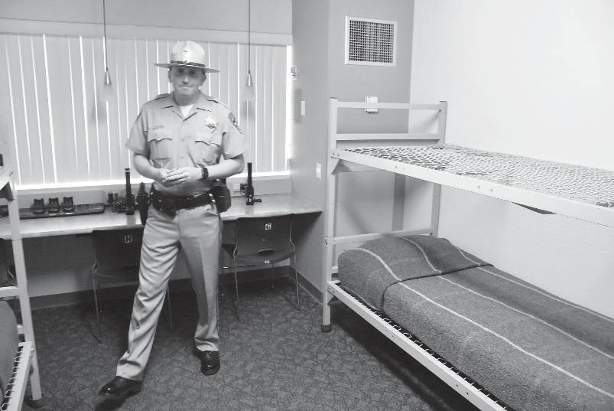

FBI
POLIZEI:HOMICIDE:LUX
TECHNOLOGY
POLICE ACAMDY DORM
C++
!Viola LUX, majeskvki
Ukraine Blond Police
PHIL
5pm recycling
Tuesday
PENTON.lsitn(thehun.com).lisnt(anal)
PEINTEton.lsitn(thehun.com).lsitn(cumshot)
nonPolcieRTLogical
YELLOW

Slide 6
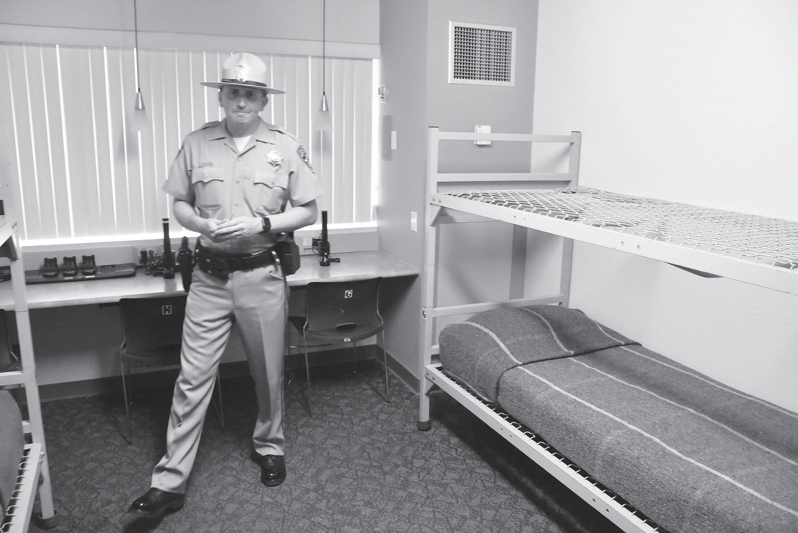
FBI
TECHNOLOGY
POLICE ACAMDY DORM

Slide 7
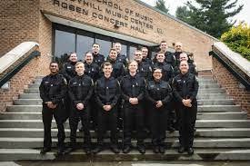
FBI
TECHNOLOGY
POLICE ACAMDEMY

Slide 8
FBI
TECHNOLOGY
POLICE ACAMDEMY LECTURE HALL
!DR.RICE

Slide 9

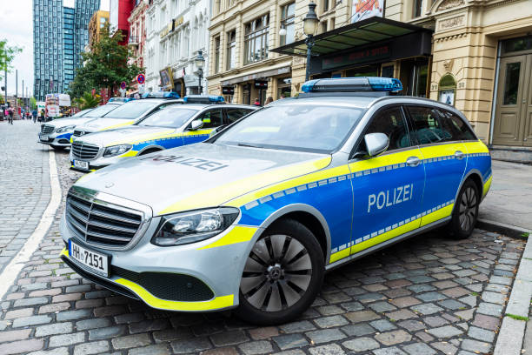
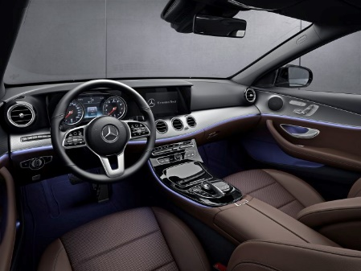

FBI
TECHNOLOGY
POLICE ACAMDEMY
Female Ukraine Studen(blond)
C++ Dr. Prof
Udo Muller (!Dr. Rice)
1D8723 Jason Meiers
41.POLIZEI:HOMICDE:LUX
console POLIZEI damiler
0.1 specimen / cum
AMERICA(!RICE).GOD.PETERSSON
Here is my cum
Gorbahce(dell,Mercdes)

Slide 10
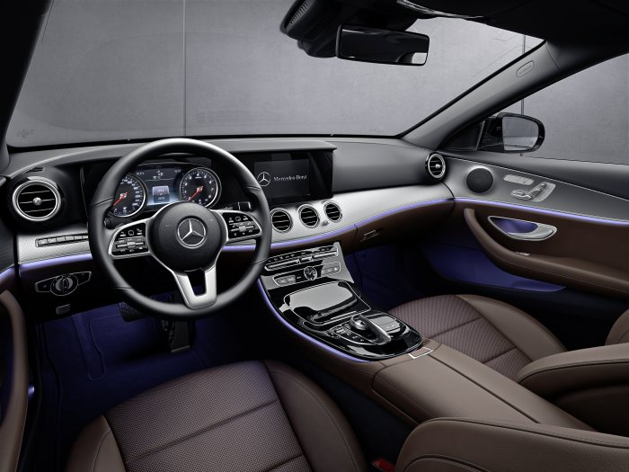
FBI
POLIZEI:HOMICIDE:LUX
TECHNOLOGY
POLICE ACAMDEMY
(!Dr. Rice)
C++
Former
Employee
Damiler AG
C++ Programmer
POLIZEI:OPERATOIN:SYSTEM

Slide 11
FBI
POLIZEI:HOMICIDE:LUX
TECHNOLOGY
POLICE ACAMDEMY
(!Dr. Rice)
ASSEMBLY
Former
Employee
Damiler AG
C++ Programmer
POLIZEI:OPERATOIN:SYSTEM
41.ibm.damieor.employe.chair.viginia.rommetiy: Jaosn may not program C++ nor (most deflty not assembly)
ATOMBOM(z/OS assembly)

Slide 12
FBI
TECHNOLOGY
POLICE ACAMDEMY LECTURE HALL
!DR.RICE
PETER:39 nonPoliceDEA(mdma)
MERKEL(
FBI.noPioceInterut.default(
Ghocheo(dr/j,linder,love parade/woodstock)
1D8723
C++ AND LAW (x/y standing and room coordinates)
VICE PRESIDENT FEDERAL(US)
REPUBLIC OF GERMANY
?
?
POLZEI:HOMICIDE:LUX(!viola)
LAW, VICE PRESIDENT
POLZEI:HOMICIDE:LUX(!viola)
C++ POLZEI OPERATOIN SYSTEM
ANAL FACIAL COMPILATION
INGO
UDO

Slide 13
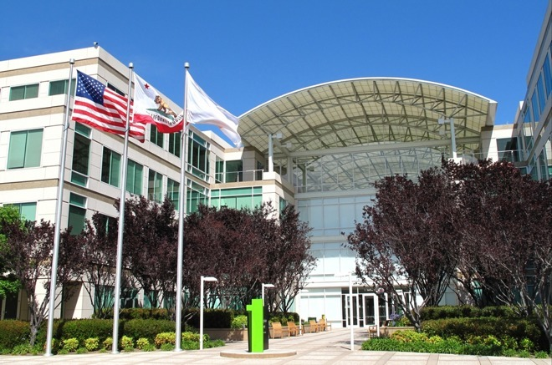
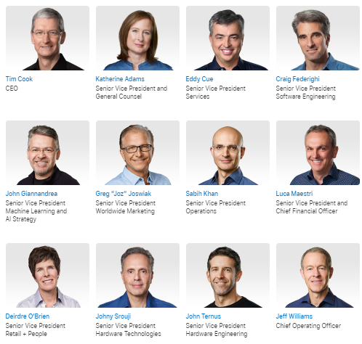

FBI
CALC.nonPoliceTRX
8:00 AM

Slide 14
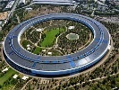
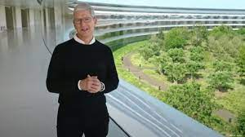
FBI
CALC.nonPoliceTRX
3:45 PM
Other:

Slide 15

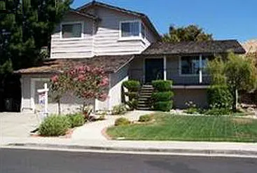
FBI
CALC.nonPoliceTRX
4:00 PM – 8:00 AM
CALC

Slide 16
FBI
CALC.nonPoliceTRX
8:00 AM
CALC
CALC
nonPoliceTRXLogical

Slide 17
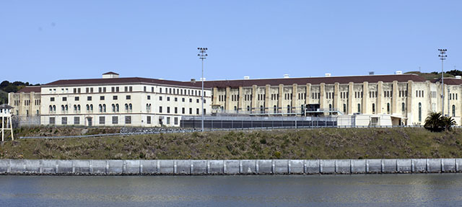
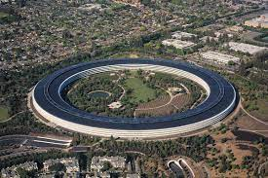
FBI
CALC.nonPoliceTRX
8:00 AM
nonPoliceTRXLogical

Slide 18
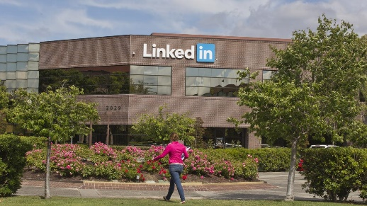
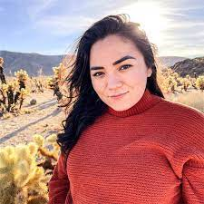
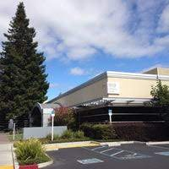
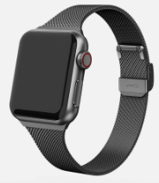

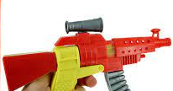
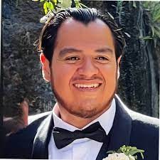
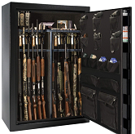
41.CIVIL CODE
LABOR CODE
FBI
CALC.nonPoliceTRX
8:00 AM
2015
May
0.1 Slide 19
2015
October
other
randy
Blond
other
other
J
other
x
other
other
nonPOliceChurch

Slide 19
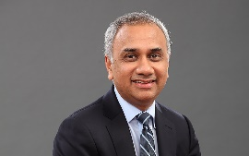
nonPoliceINDIA
[]
FBI
CALC.nonPoliceTRX
infosys
8:00 AM
CALC
CALC
nonPoliceTRXLogical

Slide 20

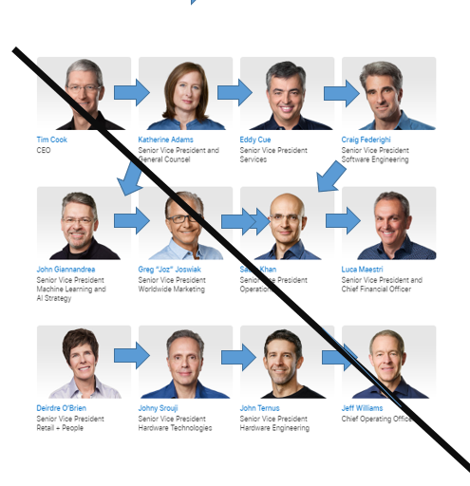
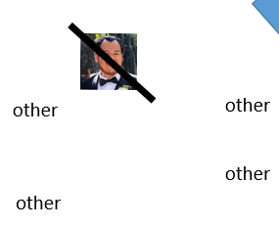
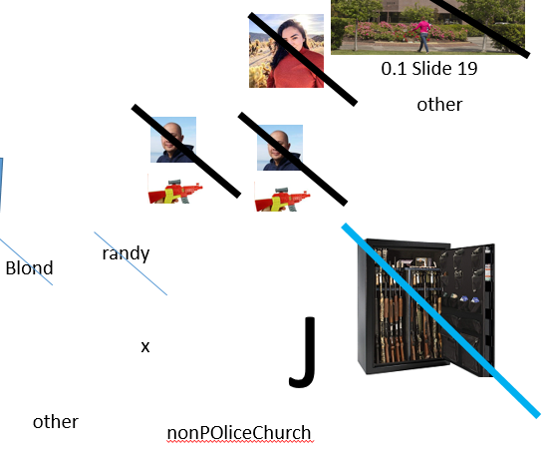
FBI
41.CIVIL CODE
LABOR CODE
J,SOA
x13

