Slide 1
FBI
PENTAGON
FEDERAL REPUBLIC(US) GERMANY
HOMICIDE
IPX PAUL REVERE
MERKEL(ddr)
(GORBACHEV(SOVIET)
PAUL REVERE BARACKS:LOVELACE
PAUL REVERE BARACKS:REYNOLDS
PAUL REVERE BARACKS:PRICE
BILL JR
BILL SR
MRS BILL
1996
1996
GEORGE WASHINTON
MT. VERNON
FREE MASON(G)
HOMICIDE:JESUS
2015
HOMICIDE:PETER
x
LOVELACE
REYNOLDS
ANGELA MERKEL
SUSPECT: ______________
SUSPECT ACCOMPLICE: _____________
MIKAEL GORBACHEV
PRICE
BILL
HOMICIDE:MURDER: ____________
HOMICIDE:ACCOMPLICE: ____________

Slide 2
FBI
HOMICIDE
IPX PAUL REVERE BARACKS
1996 gorbachev(nonPoliceWife(micheala) 14 1D8723 FBI:KIDNAPPING to carry virginity CPVA
CHILD PORNOGARPY VICTUMS ASSTIANCE
[x] no
other: WWI café wien
THE IPX (LINKS) IN BOTH TOWNS WILL INDICATE THE KNOWN PERSONS LINKS
--PAUL REVERE
--PAUL REVERE (ghocheo(michealbach)
--SAINT PATRICK HENRY
IPX PAUL REVERE BARACKS
Other: IPX.ext COINTOWN
IPX SAINT PATRIC HENRY BARACKS
SUSPECT: ______________
SUSPECT ACCOMPLICE: _____________
HOMICIDE:MURDER: ____________
HOMICIDE:ACCOMPLICE: ____________

Slide 3
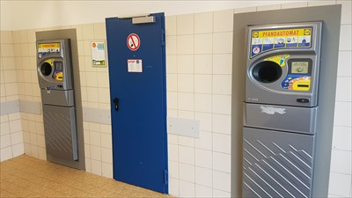
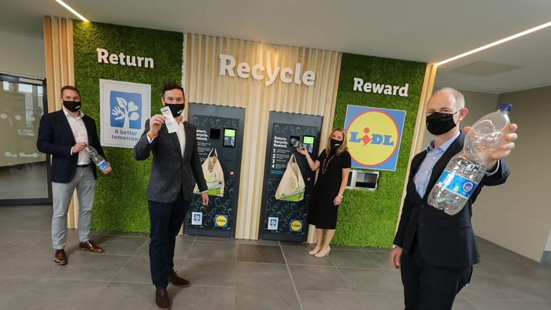
FBI
0.1 IBM REBOOT instead of RECYLING
§187 Viginia Romeeti, IBM Charimen
HOMICIDE
recycling
MOON
GRAVITY
EINSTEIN
SHOOTER
JFK.BULLET.SHOOTER
BULLETWAY
JFK Gynasium Berlin
MATHEW:JFK

Slide 4
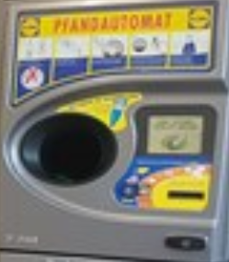

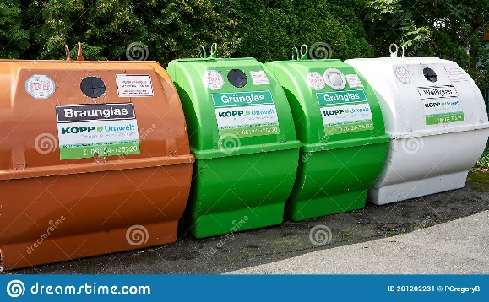
FBI
Tort.kallis: 41AGG MURDER
mother gun asuemd:sexabuse
broken leg
0.1 IBM REBOOT instead of RECYLING
§187 Viginia Romeeti, IBM Charimen
HOMICIDE
Ibm.damiler.pycatrist
recycling
MOON
GRAVITY
EINSTEIN
SHOOTER
JFK.BULLET.SHOOTER
BULLETWAY
MERKEL(PMS)
mother vagaina recycling hole
0.0.1 ibm.dmiler.employ.tim.cook
Ibm.dmielr.emplyoe.denis.fishter
Hitler wife eve bruan
0.1 EDEN ibm.dmiler.employe.viging.rommeti
Ibm.dmiler.employe.verna.broaun
WWI chaped lips
ipx verande/dusitn
kito

