Slide 1
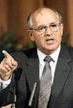


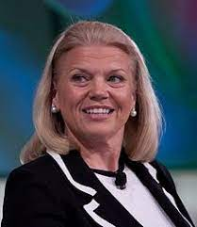
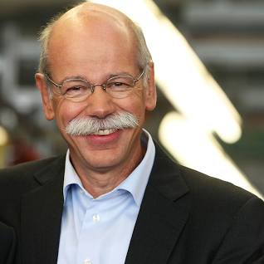
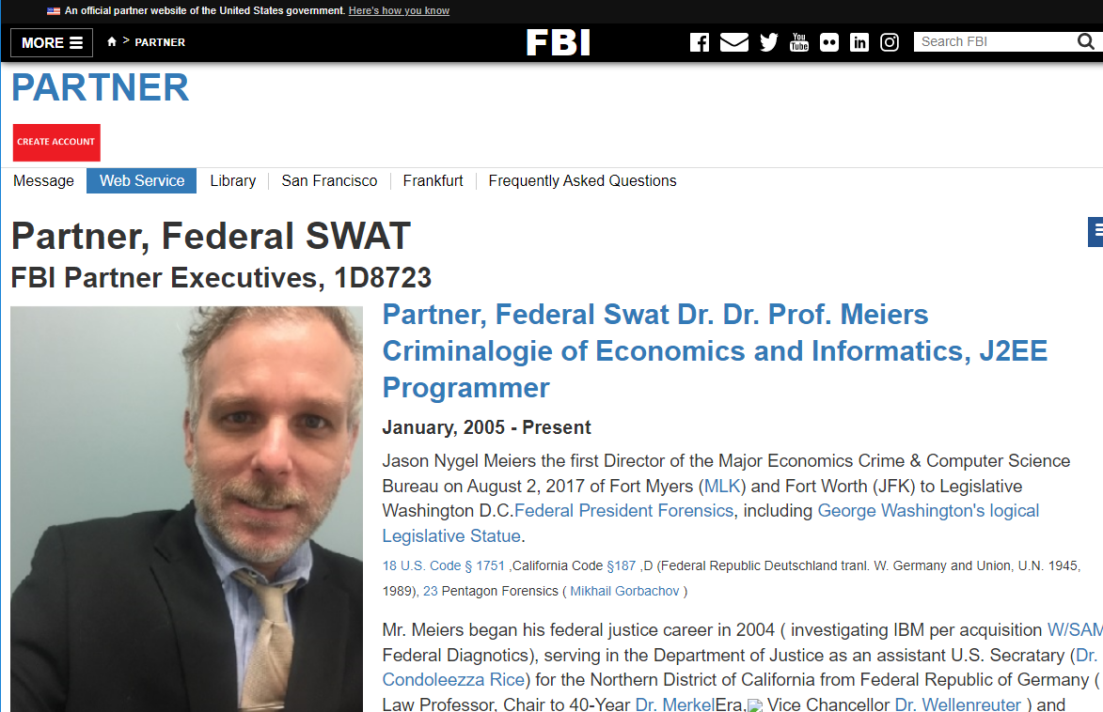
FBI
Add more nonPoliceTRXLogical
HOMICIDE:JFK
PREA
§187
Rich,capilsim
HOMICDE:MLK
1994 HOMICDE:GOD:IS-A-BELL(soviet union)
1994 HOMICDIE:GOD:LUX(ddr)
1991 WWI.HOMICIDE:KYRSTAL
1994 HOMICIDE:SUNSTROKE
2000 HOMICIDE:MAYOR
1982 HOMICDE:FETUS:LUX
2000 HOMCIDE:FETUS:VIRGIN:MARY
1996 HOMCIDE:CHILD(2)
199 HOMCIDE:CHILD(7)
HOMICDE:GOD
1994 HOMCIDE:JESUS
2016 HOMICDE:PETER
2016 HOMICDE:AUSLAEDER :OSAMA

Slide 2
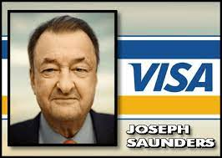
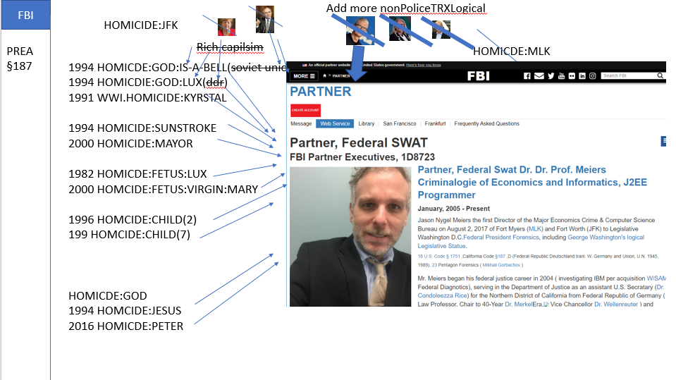
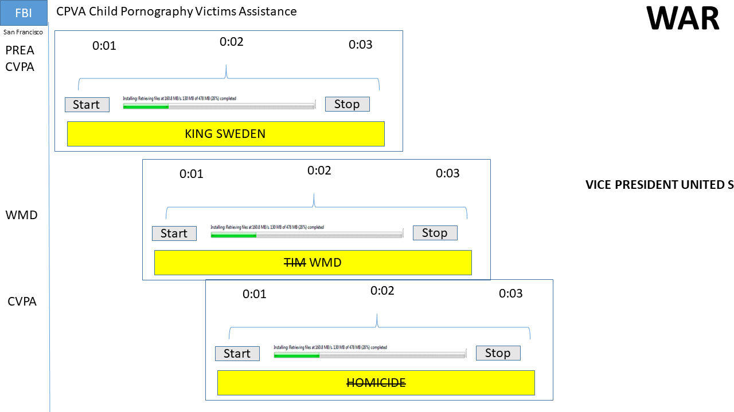
FBI
2016 when ibm.dmiler.apple.accnetoeur.touch.beats we send Jason with codomes
To add more HOMICDE:ur_ur_opi i.e.
PREA
§187
Don’t fort HOMICDE:AUSLAEDER :OSAMA my nonPoliceTRX.nonPiceOverlayswith GOD
PAUL Roth/roth/jobs/jobs/meiers/meiers/meiers/meiers/meiers/
nonPoliceRussiaPresidentLgoical.marx(putin)
PAUL Meiers Sr

Slide 3

FBI
Add more nonPoliceTRXLogical
HOMICIDE:JFK
PREA
§187
Rich,capilsim
HOMICDE:MLK
1994 HOMICDE:GOD:IS-A-BELL(soviet union)
1994 HOMICDIE:GOD:LUX(ddr)
1991 WWI.HOMICIDE:KYRSTAL
1994 HOMICIDE:SUNSTROKE
2000 HOMICIDE:MAYOR
1982 HOMICDE:FETUS:LUX
2000 HOMCIDE:FETUS:VIRGIN:MARY
1996 HOMCIDE:CHILD(2)
199 HOMCIDE:CHILD(7)
HOMICDE:GOD
1994 HOMCIDE:JESUS
2016 HOMICDE:PETER
2016 HOMICDE:AUSLAEDER :OSAMA

Slide 4
FBI
Add more nonPoliceTRXLogical
HOMICIDE:JFK
PREA
§187
Rich,capilsim
HOMICDE:MLK
1994 HOMICDE:GOD:IS-A-BELL(soviet union)
1994 HOMICDIE:GOD:LUX(ddr)
1991 WWI.HOMICIDE:KYRSTAL
1994 HOMICIDE:SUNSTROKE
2000 HOMICIDE:MAYOR
1982 HOMICDE:FETUS:LUX
2000 HOMCIDE:FETUS:VIRGIN:MARY
1996 HOMCIDE:CHILD(2)
199 HOMCIDE:CHILD(7)
HOMICDE:GOD
1994 HOMCIDE:JESUS
2016 HOMICDE:PETER
2016 HOMICDE:AUSLAEDER :OSAMA

