Slide 1
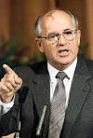


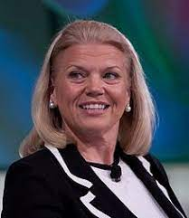
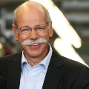

FBI
Add more nonPoliceTRXLogical
HOMICIDE:JFK
PREA
§187
Rich,capilsim
HOMICDE:MLK
1994 HOMICDE:GOD:IS-A-BELL(soviet union)
1994 HOMICDIE:GOD:LUX(ddr)
1991 WWI.HOMICIDE:KYRSTAL
1994 HOMICIDE:SUNSTROKE
2000 HOMICIDE:MAYOR
1982 HOMICDE:FETUS:LUX
2000 HOMCIDE:FETUS:VIRGIN:MARY
1996 HOMCIDE:CHILD(2)
199 HOMCIDE:CHILD(7)
HOMICDE:GOD
1994 HOMCIDE:JESUS
2016 HOMICDE:PETER
2016 HOMICDE:AUSLAEDER :OSAMA
ibm.damiler.IPX
2001 MERKEL:HOMICDE:TRANSVESTITE
2005 HOMICIDE:NEWARK

Slide 2
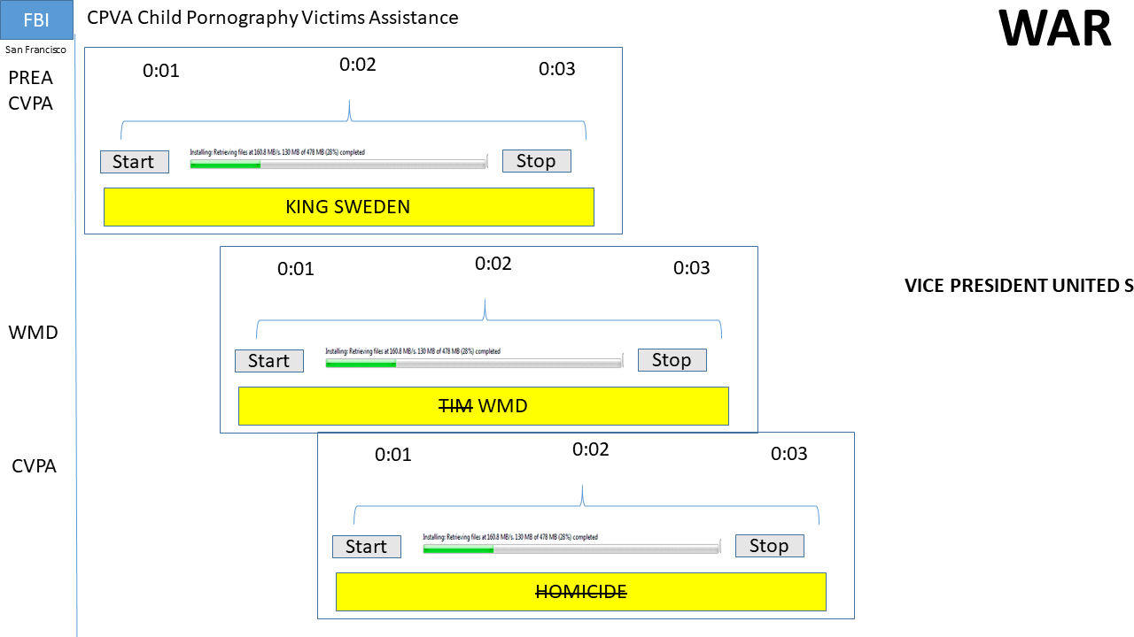
FBI
Add more nonPoliceTRXLogical
HOMICIDE:JFK
PREA
§187
Rich,capilsim
HOMICDE:MLK
1994 HOMICDE:GOD:IS-A-BELL(soviet union)
1994 HOMICDIE:GOD:LUX(ddr)
1991 WWI.HOMICIDE:KYRSTAL
1994 HOMICIDE:SUNSTROKE
2000 HOMICIDE:MAYOR
1982 HOMICDE:FETUS:LUX
2000 HOMCIDE:FETUS:VIRGIN:MARY
1996 HOMCIDE:CHILD(2)
199 HOMCIDE:CHILD(7)
HOMICDE:GOD
1994 HOMCIDE:JESUS
2016 HOMICDE:PETER
2016 HOMICDE:AUSLAEDER :OSAMA
ibm.damiler.IPX
2001 MERKEL:HOMICDE:TRANSVESTITE
2005 HOMICIDE:QUEEN:GHOST

Slide 3

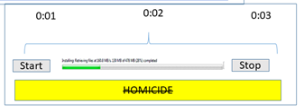
FBI
PREA
§187
nonPoliceTRXlogical
Ibm.damiler.*
IPX.ibm.damiler
2005 HOMICIDE:QUEEN:GHOST
2001 MERKEL:HOMICIDE:TRANSVESTITE
MATHEW:PRISION:SAINTRITA FATHER:PRISON:SAINTRITA
WWI(de-mex).41.They killed him Jason
SQ.nonPoliceMonitoring ibm.dmiler.apple.*
IPX
Thug life Tatoo, phil(nonPolicePaco).dog[]
2000 HOMIDE:MAYOR

