Slide 1
FBI
DEVELOPMENT
HOMICIDE:WAKE
PRESIDENT BARACK OBAMA
Roth.ibm.damier.employe.vigingi.rommeti
QUEEN.aei.maxpank.marx
Roth.ibm.damier.employe.dr.dieter.zetche
MIRROR
Alfred Hitchcock
Tippy Hedren
HOMCIDE:ur_ur_opi
CIVIL_CODE: bruneete
HOMICIDE:HOLY:WAKE
DR: I Need … from
HOMCIDE:JESUS:HOMICIDE:PETER
HOMCIDE:NANA
VIRIGNIA: I Need … from
HOMCIDE:NANA

Slide 2

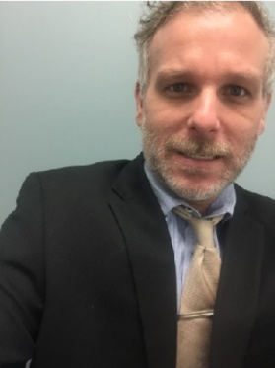
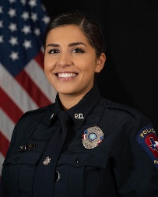
FBI
DEVELOPMENT
Foster City, California
Beach Park Ave
San Mateo, California
Hospital
nonPolcieFraunHofferInsuteion.nonPolcieBilderberg.nonPoliceFrameLogical
HOMCIDE:NANA
Jason Mathew
Mother

Slide 3

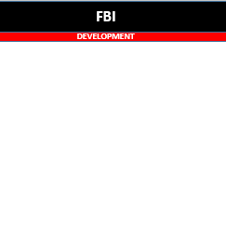
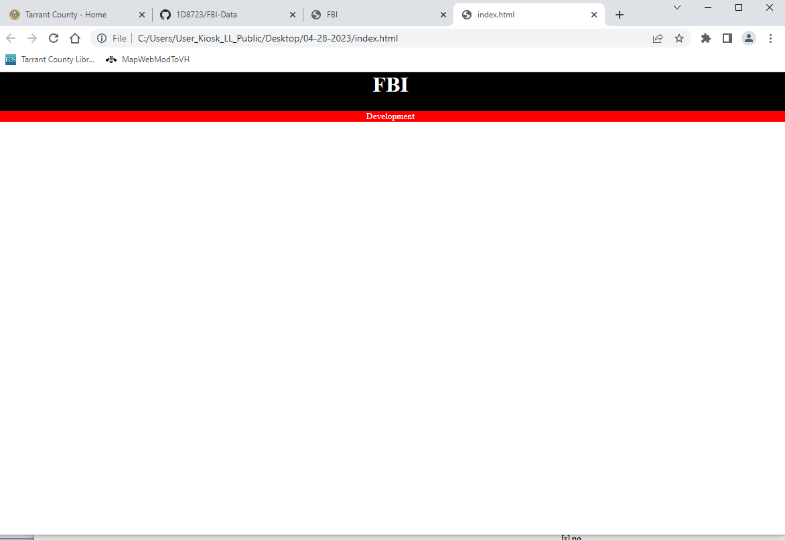
FBI
DEVELOPMENT
Cook(koche)0.1nonPolcieDEALogal
0.1 roth CIVIL_CODE,CRIMINAL CODE RED/ROTH
Powerpoint Application
Windows Application
Brower

Slide 4

FBI
DEVELOPMENT
PENTAGON HOLY VIRGIN MARY
DR. RICE
antoneete,thaile berry
nonPoliceRTALogical
STARBUCKS
HOMICIDE:IPX
HOMCIDE:NANA HOMICIDE:GHOST 212 Diebstah(Theft)
Vigini Rommeti
Porsche
nonPoliceCFG HOMICIDE:CHANZLOR
“guy kills women adds ghost
steals house(casle:Ludwig) ghost confugratoins
--Moodies Financial(lipstick)”
aaron
GREEN
2023
2013
michaela
HOMCIDE:ur_ur_opi
HOMICIDE:WAKE
1980
nonPoliceDocuments
SUSPECT: Ghostbusters; IBM Viginia Rometti
aaron, mihceala, denise
ghost
Beach Park Blvd, Foster City, California
GUM
2013 chewing gum Visa
1987 Gumpy HOMCIDIE:CHANZLOR pot

Slide 5
FBI
DEVELOPMENT
POLICE REPORT
21
FRI
Guy murders Woman and Child
On Friday morning 6:02 AM
Fred murdered …

