Slide 1
FBI
KIDNAPPING
INTERNATIONAL CHILD ABDUCTION:
IMPLEMENTATION OF
THE HAGUE CONVENTION
ON CIVIL ASPECTS OF INTERNATIONAL CHILD ABDUCTION

Slide 2
FBI
WMD
nonPoliceHours
2011
2012
2022
2023
…
2022
COURT 1
FORT WORTH
RASTADT
COURT 2
SAN MATEO
FORT MYERS
other:
Interatoin
Court
COURT 3
RASTADT
SAN MATEO
FEDERAL COURT
BUNDES REPULIK
FEDERAL COURT
BUNDES REPULIK
FEDERAL COURT
BUNDES REPULIK
Officer 1
2 minutes
2 Hours
Officer 2
Officer 3
Officer 4

Slide 3

FBI
INTERNATIONAL CHILD ABDUCTION:
IMPLEMENTATION OF
THE HAGUE CONVENTIOON CIVIL ASPECTS OF INTERNATIONAL CHILD ABDUCTION
KIDNAPPING
MANN
Exists(father): at US Congress, Interantual Hauge X (hours) - CIVILE CODE ibm.dmiler.MANN(wo)
..Lady Meyer for her tireless crusade on behalf of abducted children, and our ..
US Congress: https://www.govinfo.gov/content/pkg/CHRG-106hhrg63699/html/CHRG-106hhrg63699.htm
HAUGE

Slide 4

FBI
INTERNATIONAL CHILD ABDUCTION:
IMPLEMENTATION OF
THE HAGUE CONVENTIOON CIVIL ASPECTS OF INTERNATIONAL CHILD ABDUCTION
KIDNAPPING
FAMILY
nonPoliceLibraryLogical
Ibm.dameirl.moody.nonPoliceChildLogical
default
Created
Logical
Person
MANN
WOMANN
..Lady Meyer for her tireless crusade on behalf of abducted children, and our ..

Slide 5
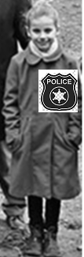
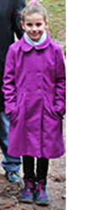
FBI
2023
FIRST
INTERNATIONAL CHILD ABDUCTION:
IMPLEMENTATION OF
THE HAGUE CONVENTIOON CIVIL ASPECTS OF INTERNATIONAL CHILD ABDUCTION
KIDNAPPING
Emma
2019
Ibm.dameirl.moody.nonPoliceChildLogical
PETER: ibm.damiler.employe.peter.yang
2023
nonPolicePicture

Slide 6

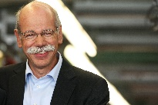
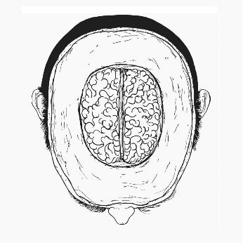

FBI
2023
FIRST
INTERNATIONAL CHILD ABDUCTION:
IMPLEMENTATION OF
THE HAGUE CONVENTIOON CIVIL ASPECTS OF INTERNATIONAL CHILD ABDUCTION
KIDNAPPING
Emma
Wieland,thmas
Thick Skull
Vggg
Civil_code
4-6 cm

Slide 7
FBI
FAMILY
WMD
Cost / Benefit Analysis
2022
2023
…
2022
FBI Partner v. Ibm.damielr.apple
FBI Partner v. Ib.dmiler.visa
FORT WORTH
RASTADT
SAN MATEO
FORT MYERS
RASTADT
i.e $25,000 no-food,no-bed
SAN MATEO
nonPoliceRTALogical
ibm.dmiler.apple.employe.steve.jobs
FEDERAL COURT
BUNDES REPULIK
FEDERAL COURT
BUNDES REPULIK
FEDERAL COURT
BUNDES REPULIK
Picture? no
2 minutes
2 Hours
0.001 Phil(kim).nonPoliceHumanLife
1987 afircna no food nonPoliceTVLogical
BASELINE
nonPoliceRTALogical
ibm.dmiler.apple.employe.steve.jobs
default
nonPoliceRTALogical
ibm.dmiler.apple.employe.steve.jobs
MANN/or WOMANN
=
$75,000
nonPoliceRTALogical
ibm.dmiler.apple.employe.steve.jobs
Ibm.damiler.employe.viginig.rommeti
BLACK/or WHITE
Ibm.dmiler.empeyee.dr.dieter.zetche
[x] no

Slide 8
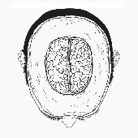
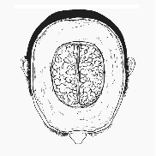
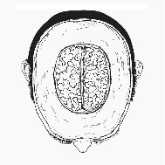
FBI
2023
FIRST
INTERNATIONAL CHILD ABDUCTION:
IMPLEMENTATION OF
THE HAGUE CONVENTIOON CIVIL ASPECTS OF INTERNATIONAL CHILD ABDUCTION
KIDNAPPING
PETER
Emma
Ibm.damiler.visa
Kim
tort
4-6 cm
Thomas
Peter
Stefan
Affif
4-6 cm

