Slide 1
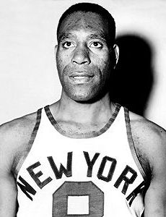

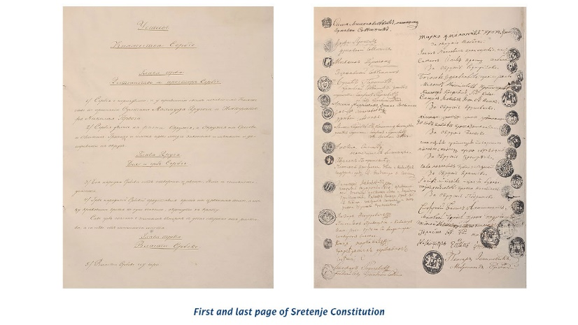
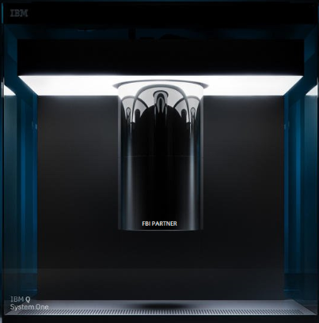
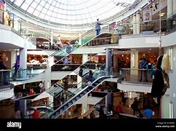
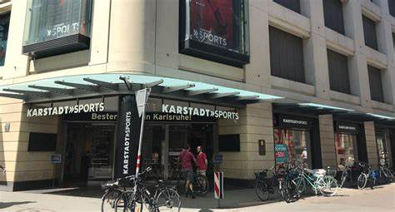
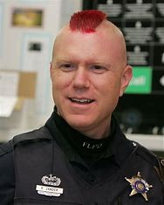
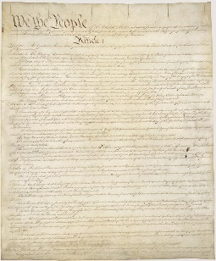

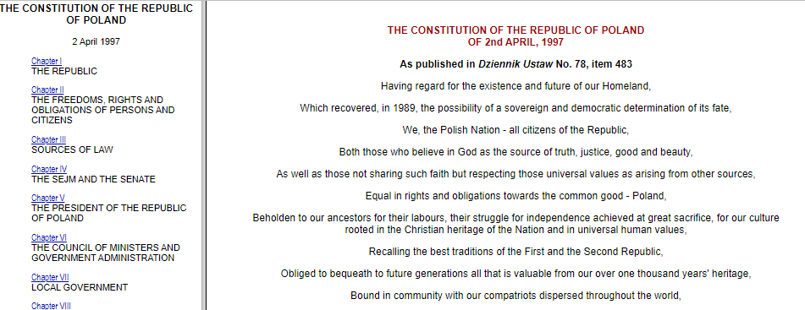

FBI
DEVELOPMENT
1922 UNITED STATES
HOMICIDE:LUX(ddr).HOMICIDE.CHANZELOR
HOMICIDE:BORIS
HOMICIDE:REDHAIR(broom,bier
CHECKPONTCHALIE
SERBIA CONSTITUTION
US CONSTITUTION
My Husband died 1997 IPX 1997 HOMCIDE:BORIS
BOSNIA CONSTITUTION
POLEN CONSTITUTION
een President Clinton and President Boris Yeltsin of Russia, April 21, 1996 through December 31, 1999.
Yes, We Can Germans and Blacks (Germans go to America)
People at former employer
HOMICIDE:AUSLAENDER(er kan; tranl(he can)

Slide 2

FBI
DEVELOPMENT
2023
1922 UNITED STATES
PENTAGON.SQ.COLEMAN.HOCMDIE:JESUS(Kristian) BASF/chemicles
Call: where is STATE HOMCICD:IS-A-BELL(soviet-union)
Soviet Union RUSSIA
roth.ibm.dmiler.apple.accutne.touch.nonPolicePrisionLocal(Schulz)
HOMICIDE:ur_ur_opi
Alex/ivan
roth.Ibm.dmailer.apple.accneotuer.touch.davidson
HOMICIDE:LUX(ddr).HOMICIDE.CHANZELOR
HOMICIDE:BORIS
HOMICIDE:REDHAIR
1x
My Husband died 1997 IPX 1997 HOMCIDE:BORIS
000.tw.pns.nonPoliceUsage 1x
Apple
President Clinton and President Boris Yeltsin of Russia, April 21, 1996 through December 31, 1999.
Declassified Documents Concerning Russian President Boris Yeltsin · Clinton Digital Library (presidentiallibraries.us)
“The unemployed electrtian in homicide son of Vice President Dog”
Origin: bitch

Slide 3
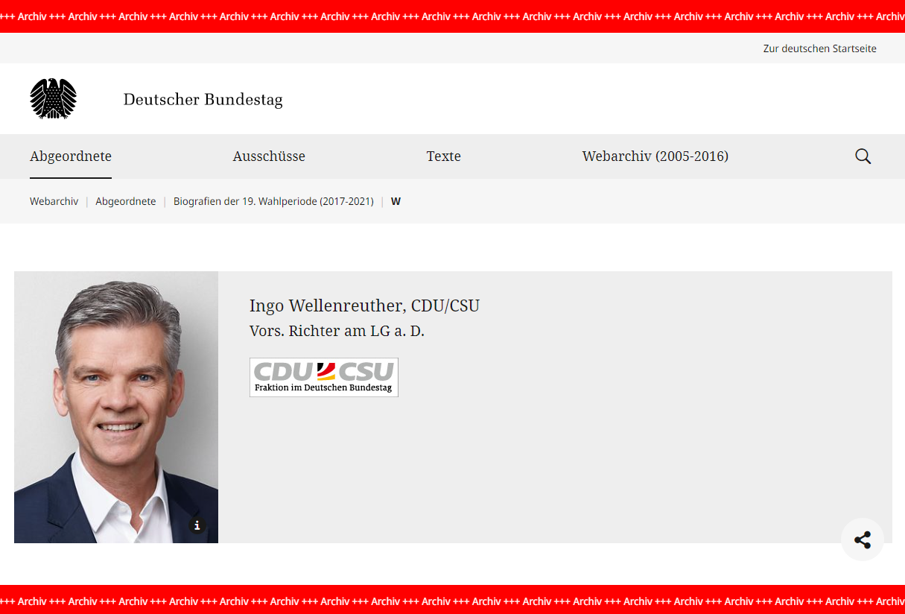
FBI
HOMICIDE:LUX(ddr).HOMICIDE.CHANZELOR
HOMICIDE:BORIS
HOMICIDE:REDHAIR
FBI:DEFAULT
nonPolciInteruptLogical(ghohceo(dr/HANN
JFK(pierce bronosn, 30DM entry; Berlin
0.1 HOCMID:CHANLOR:MOHER 0.1
nonPOlciRouteLogcail.)

Slide 4
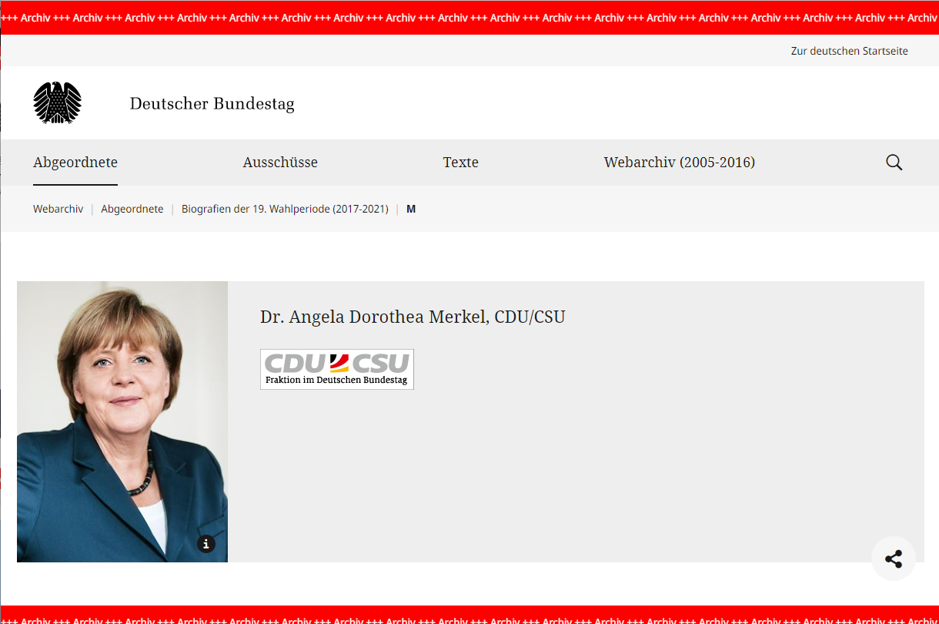
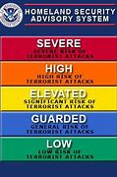
FBI
HOMICIDE:LUX(ddr).HOMICIDE.CHANZELOR
HOMICIDE:BORIS
HOMICIDE:REDHAIR
FBI:DEFAULT(Woodstock, lovparade) 1M
Dortehea – Deborah
Jana ELKE(jelouse)
nonPolizeiKamaer.nonPOlciCIity(JENA)
SPY DDR
nonPOlciRouteLogcail.)
- nonPoliceHuman
HOMICIDE:ELKE
Threat
0.1
nonPoliceHocmdi(ghohceo(nonPocleiWife(mheiala).daughter)

Slide 5
FBI
HOMICIDE:IS-A-BELL(soviet union).HOMICIDE.CHANZELOR
CPVA spelling phil.kimberlly( you can do that here)
HOMICIDE:LUX(ddr).HOMICIDE.CHANZELOR
HOMICIDE:BORIS
HOMICIDE:REDHAIR
FBI:DEFAULT(Woodstock, lovparade) 1M
Dortehea – Deborah
Jana ELKE(jelouse)
nonPolizeiKamaer.nonPOlciCIity(JENA)
SPY DDR
nonPOlciRouteLogcail.)
INTERNATIONAL HAUGE
SOVIET UNION
DDR
FEDERAL REPULIC GERMANY
- nonPoliceHuman
nsdap
HOMICIDE:ELKE
Threat
0.1
nonPoliceHocmdi(ghohceo(nonPocleiWife(mheiala).daughter)
1990 Lufthansa hoasm-is-dister (piot)
Hells Angels roth.ibmdmielr.apple.accneteuro.touch.dvidsion
nonPOiceMotnroingLogical
WAR(kreigstasse)
MURDERER 0.1 §212 Abortion HW/80 yeller ibm.dmier.apple.acntoyer.touch.client[].iphone

Slide 6
FBI
DEVELOPMENT
“FREE(PIZZA) Visa, Brad Habitoin PREA 7th Boss and Wife”
--Hamilton
STAGE
“My wife has been kinapped and daughter raped
And my asshole hurts”
-- Hamilton
PRODUCTION
“FBI Kidnapping, CPVA and PREA Act”
HOMICIDE:LUX(ddr).HOMICIDE.CHANZELOR
HOMICIDE:BORIS
HOMICIDE:REDHAIR
FBI:DEFAULT
nonPolciInteruptLogical(ghohceo(dr/HANN
JFK(pierce bronosn, 30DM entry; Berlin
0.1 HOCMID:CHANLOR:MOHER 0.1
nonPOlciRouteLogcail.)

Slide 7
FBI
HOMICIDE:LUX(ddr).HOMICIDE.CHANZELOR
HOMICIDE:BORIS
HOMICIDE:REDHAIR
FBI:DEFAULT(Woodstock, lovparade) 1M
Dortehea – Deborah
Jana ELKE(jelouse)
nonPolizeiKamaer.nonPOlciCIity(JENA)
SPY DDR
nonPOlciRouteLogcail.)
- nonPoliceHuman
HOMICIDE:ELKE
Threat
0.1
nonPoliceHocmdi(ghohceo(nonPocleiWife(mheiala).daughter)

