Slide 1
Low Level Networking
FBI

Slide 2
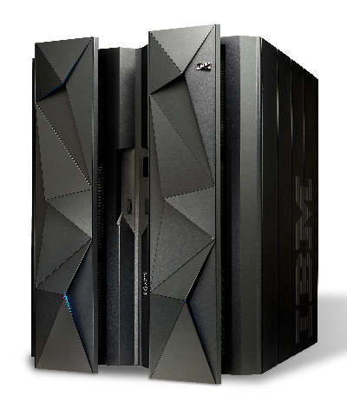

ASM
FBI
Assembly

Slide 3
JNI
FBI
C++

Slide 4
Low Level Networking
FBI

