Slide 1
FBI
Development
nonPoliceBlueprint

Slide 2
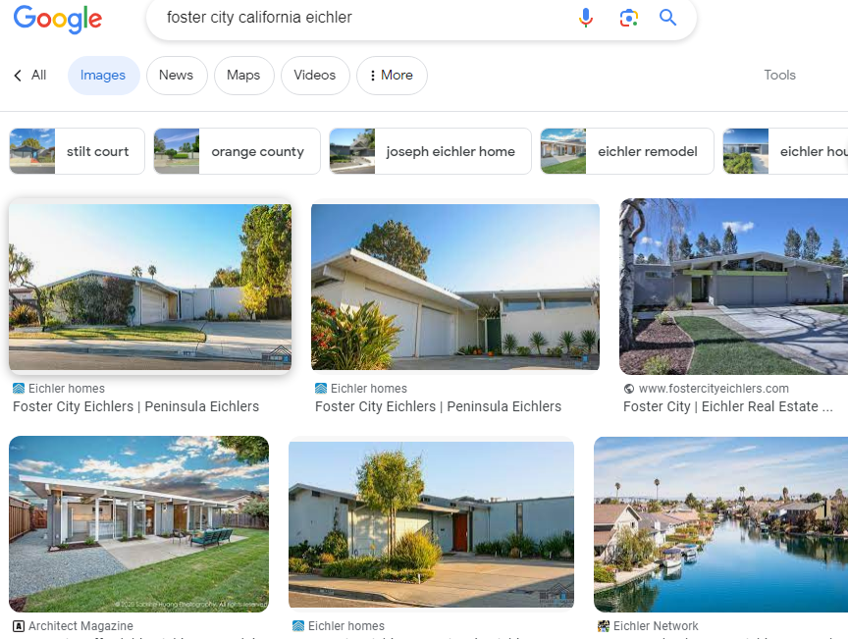
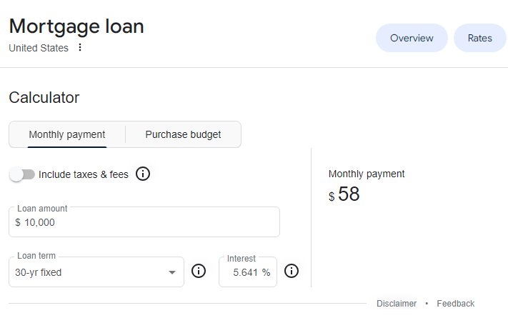
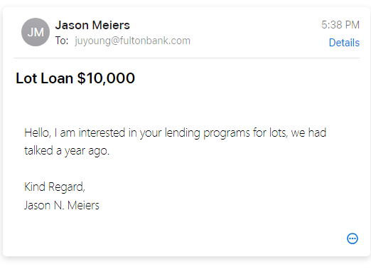

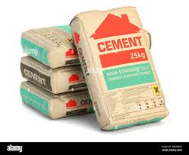
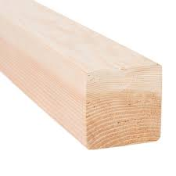
FBI
Development
<td width=100px style=bgcolor:black>
 | <b>$50/month</b><br>
 | Lot loan: Fulton Bank ( judy fulton (juyoung@fultonbank.com) 1-800-385-8664
 | Carpert order <a href=homedepot.com>carpet</a>
 | Brick, cement order <a href=homedepot.com>bricks</a>
 | </td>
 | <td width=100px>
 | nonPolieBank of nonPoliceAmerica: <b>1700/month</b> 500k<br>
 | </td>
 | <td>
 | nonPoliceBank of nonPolciAmerica: <b>3600/month</b> 1M</b>
 | </td>
 | </tr>
 | </table>
Eichler
https://www.fultonbank.com/
https://www.fultonbank.com/
mortgage calculator
Polilce Sircne: 5:39PM

Slide 3
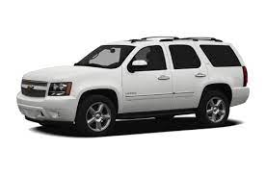
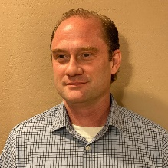

FBI
Development
Mountain View,
California
ATOMCLOCK
Castro Blvd
nonPoliceSummer
nonPoliceWinter
2015 apple.Atari.tango
white chevy tahoe 2011
Avg.David vs. Goliath
St.
PETERSSON

Slide 4





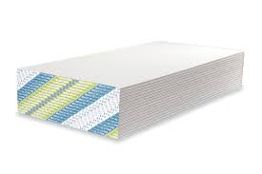
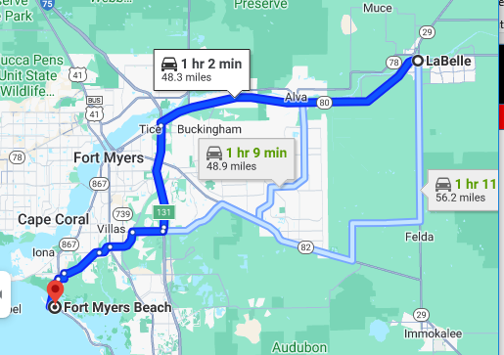
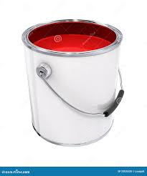

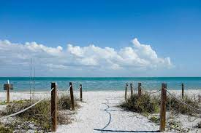

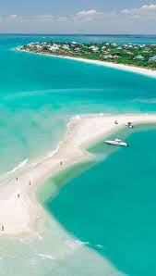
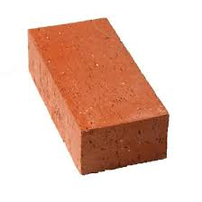
FBI
Development
VIRGINA.anglea.JACK.soa
FBI.marx
4x
nonPoliceWinter
money pit builder
nonPoliceSummer
MAINSTREET
Eichler
Granite Consturction
Police Sirnes: 5:39PM
Iwatch.ATOMLCOCK(MLK(HOMCIDE:JESUS(metz,v2:FBI:KIDNAPPING))

Slide 5
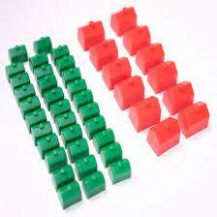
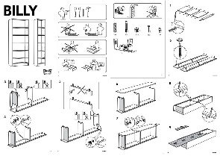
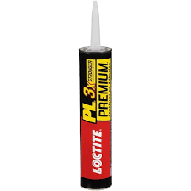

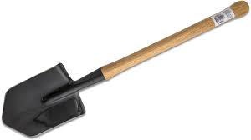
FBI
Development
nonPoliceWinter
nonPoliceSummer
Pump
Plexiglas Window
Bodega Bay
Alfred HitchCock Tippi Hedren
TIMOTHY

Slide 6
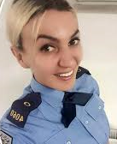
FBI
Development
Materials & Land
$50/month
Eichler
nonPolicePartnerBank
Fulton bank
Judy Young
juyoung@fultonbank.com
1-800-385-8664
Police Sirens: 5:39PM
fultonbank.com

Slide 7
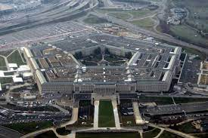
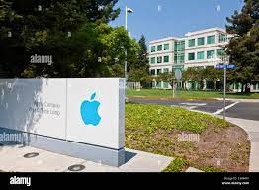

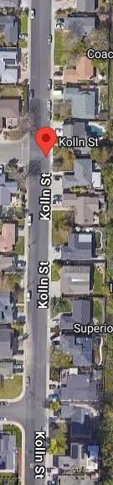
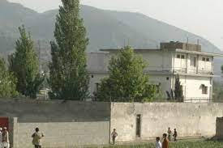


FBI
Development
KING.QUEST Pleason, Ca Kollen Stret
Dom Cogln
ATOMCLOCK
MLK(Matthias, Center of power, zentrum dermacht)
Zillow overflights
nonPoliceAdd
FBI:WMD:TERRORSM.instis(al kaida, cisoc monriong )
Interpol Afgaign
MLK.CPVA.1987.PREA
10:50000
appple headquarters one loop tree
0.1 HOMCIDE:IS-ABELL
nonPolieBank of nonPoliceAmerica: <b>1700/month</b> 500k<br>
</td>
<td>
nonPoliceBank of nonPolciAmerica: <b>3600/month</b> 1M</b>
</td>
2010 0.1 INTETN PAYMENS.MLK( Ubaid, joyti/joti)
1Acre(!SF)
x
1Acre(SF)
!Police Sirens: 5:39PM

Slide 8
FBI
Development
1Acre
x
CHART
MLK
Dream
Completed
(delta)
&nonPoliceQOS.eval
!Police Sirens: 5:39PM

