Slide 1
J
FBI
§212 Diesstal nonPocleLife
CALIFORNAI.nonPoliceDoucmetnLgiocal
MONOPOLIST(THOMAS-MAN-STRASSE)
0.1 HOMICIDE:IS-A-BELL: FLRIAO: JOHNY Windsuffer JOHNNY CAR() SALES
!LARRY baksketball hoop frontyard
American Tings CUM/sap selected becker redhair
hard-to-find
Gorhceoh(fox,Thamas Falter)
Dr. Dieter Zetsche live in nice neobheorghood
Assined by Soviet Union Micheal Grohheve
Fox(WHITE) ------------------→ Jordan, -----→ Jackson(child molestor)
200 Gas Elke $400 -> Blinki Lights RED/ GREEN
X(drunk chelie cahnline) phi(kim)
MEKREL
CAMP DAVID Perfum Womens Daidosff
KING(Koenig, pricip IPX child mostoer picipcal nonPoclieLivermore)
Ghocheo(LUTHER( nonPioceEvandliim),<s>seitz relion teacher looks same</s>)
CHEKPOINCHARLD (mekers, wende (tranl) turing pintn
Thhas-is-diether
Thaoms Dieer ibm.dmielr.appel.Davidson
ibm.miler. THOMAS-MAN-STRASSE
Steve and thoms druink near parky with leather sute buetting up childen at 40
Tomy: you can take that guy; person thownign party
LABORE CODE ibm.dmielr.apple hard-to-find
, Tahomse (Lux)

Slide 2
FBI
§212 Diesstal nonPocleLife
CALIFORNAI.nonPoliceDoucmetnLgiocal
HOMICIDE:JESUES HOMICIDE:PETER HOMICIDE:IS-A-BELL
Gorhceoh(J,Thamas Falter)
LARRY.SHAQ
ipx nonPoclieStauim
PENTEONG.BASE.KARLURHE
shcool
HOMICIDE:KYSTAL
HOMICIDE:LUX
Ibm.dmielr.appele.davions
johs
HOMICIDE:MAYOR
HOMICIDE:SUNSTORKE
niko
axel
johs
johs
HOMICDE:WHITE(anieana)
johs
Ibm.dmielr.balck.metz metz/johs

Slide 3
FBI
Roth.ibm.dmiler.Linkedin->apple
HOMICIDE:IS-A-BELL: amok; (rtranl) school shooter)
MASS SHOOTER
GOVENOUR:SWARZER:FBI:KIDDNPINT ( mass shoter office closset)
J

Slide 4
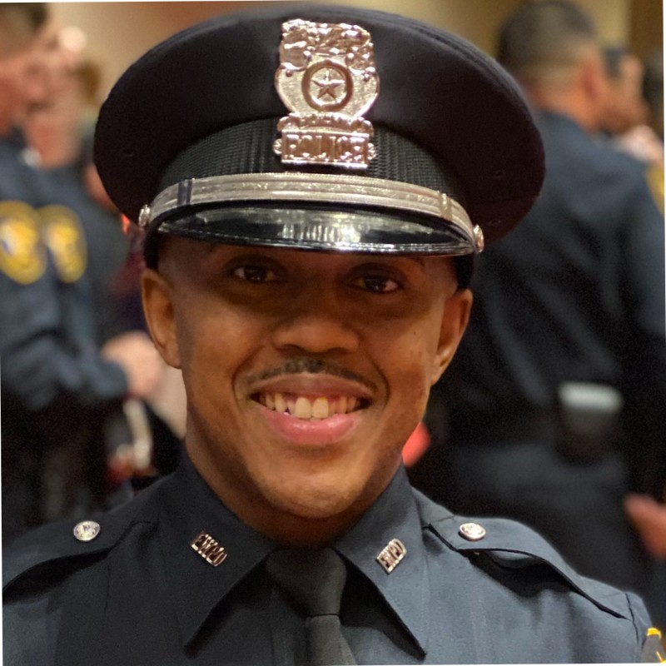
FBI
PETER BLACK
GOV. SCHWARZER PETER
DESHWAN PRICE

Slide 5

FBI
GOV. SCHWARZER
PETER
HAMITION
WWI, WWII some actually writing this down
FREE(PIZZA) Tuti Frui, Rheinhard, LARRY
in Opposinto the US Gorement
HOMIDE:NANA 0.01 ipx asuemd:HOMCEP:ELEBEHT
DESWAN PRICE

Slide 6
FBI
41.SAINT RITA PRISON , DUBLIN CALFIORNAI
88th.HAMITION.LARRY(tuti friutI)
Steve
Dustin
matt
nonPoiceArestXML
41.HOMCIDIE:KYRSTAL(.nonPIceArestXML)
Old Maid: Schwazer Peter
Actual: Go FISH 7x9 Flashbards
WWI, WWII some actually writing this down
In OPPISTION ot the UNITES STATE OF AMEIRCA: MILTIARY AND DEPEMTN OF DEFNSIE
DESHWAN PRICE
HOMICIDE:NANA
0.01 ipx
asuemd:HOMICIDE:ELEBEHT

Slide 7

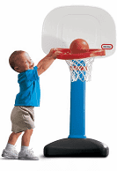
DESWAN PRICE
FBI
ATMOICCLOCK
2013
PREA.BUDI.WORMS
Asshoel at the frontdoor
soul
Friction
F=ma, E=mc2
mailbox
PREA POLE
DESWAN PRICE
1993

Slide 8

DESWAN PRICE
GOVONUR
PREA.BUDI.WORMS
You’re the guy getting cukced in the ass ( PREA)
And have WORMS from yrou book about BUDI
Royraly: KING.PREA.BUDI.WORMS
Your wife has child mostoer algoruigms with buttons
In Life on Facebook, where eyeryton sees it.
GOVONUR: twins michea/emma
densie/mciheala
You work in tehconlo near faceobok. And it goes
In your ass.
KING.PREA.BUDI.WORMS

Slide 9
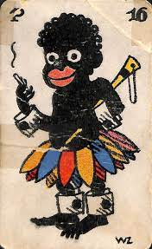
FBI
SCHWARZER PETER
You pull the ASS card
Du hast die Arschkarte gezogen
Old Maid/ SWAZER PETER
CHINA.MARY(0.1 Mao-Mau)
ATOMCEBOHE(hahn), otto-hannstrasse)

Slide 10
SCHWARZER PETER
FBI
Other: la belle good guys cars HAMAITL §bystander
WWI, WWII some actually writing this down In OPPISTION ot the UNITES STATE OF AMEIRCA: MILTIARY AND DEPEMTN OF DEFNSIE
88th.HAMITION.LARRY(tuti friutI)
41
Voodo, vipers, tuti friutI
SOCIAL SEUCIRY ADMINSTAR.88th (retemetn Germany admisntor, studine parent, tutu firty and wifhe; AHMITION)
MY SON IS BLACK/HALF I AM ANGRY; you are white

Slide 11

FBI
2016-2023
WWI.K-TOWN,jrs CAR(carl-benz-strase)
HAMILTON.IPX
Gagngeua (bridgt with wyland fest)
Linkeheim ( social scueity german black and angy fanehr; tuti fruit wife densie).41
[x] no
2011-2015
Phil(0.0001 ghohe(dell, $1 afifcan water bringer)
ATOMICCLOCK
Visa Depak
KING(bisltramstrass)
2009-2010
statue
ibm.dmielr.appe.touch: someonwe who does workf for free. The last time I chehcekd the dictionary it meant slave

Slide 12
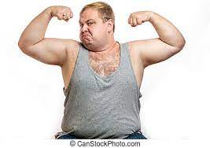
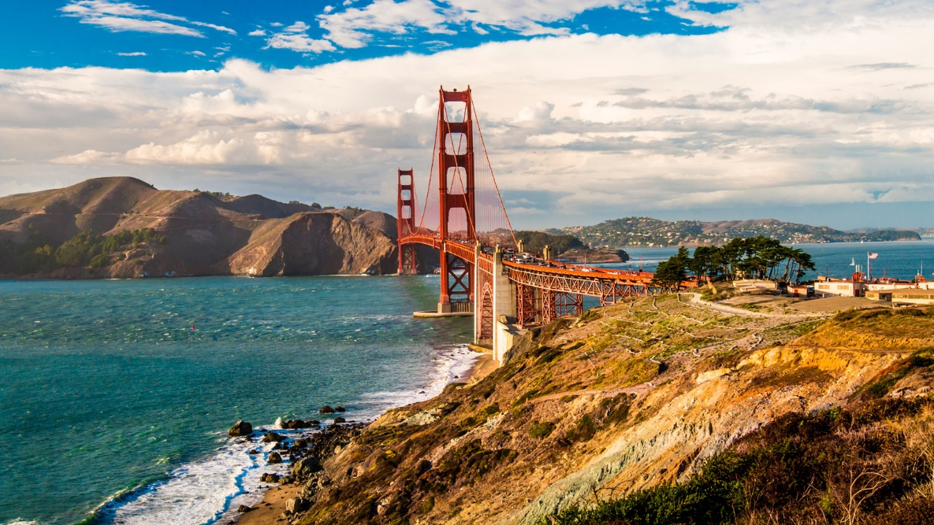
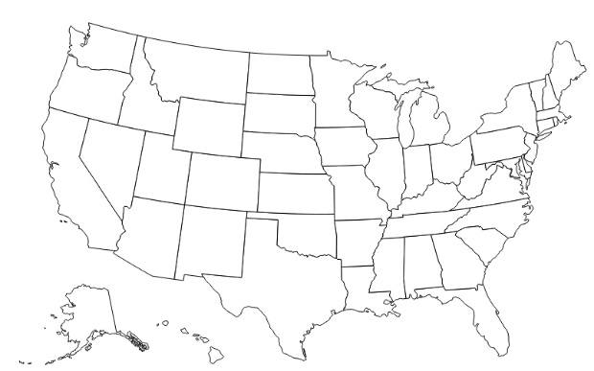
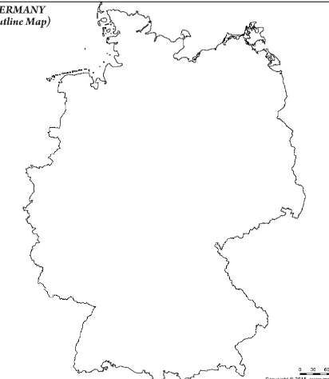


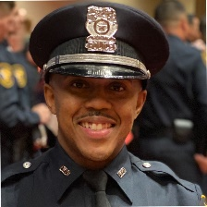

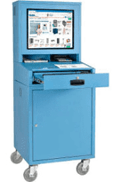
FBI
CAR(carl-benz-strase)
SCHWARZER PETER
BABIES
Mkern/elke IPX
Ibm.damile.blackhawek.metz.(Dictionary)
negerking - nigger child
https://www.defense.gov/
WWI, WWII some actually writing this down In OPPISTION ot the UNITES STATE OF AMEIRCA: MILTIARY AND DEPEMTN OF DEFNSIE
DESWAN PRICE
GO THE FUCK AWAY< WHT DO I CARE
computer

Slide 13
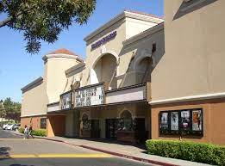
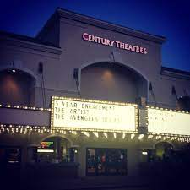
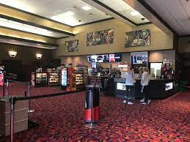

FBI
Ibm.damile.blackhawek.metz
WWI, WWII some actually writing this down In OPPISTION ot the UNITES STATE OF AMEIRCA: MILTIARY AND DEPEMTN OF DEFNSIE

Slide 14
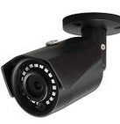
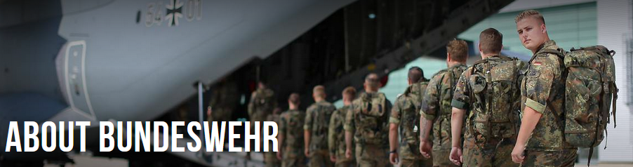


FBI
roth.Ibm.damiler 9:00am 24/7
Defense.gov
https://www.bundeswehr.de/en/
PRICE SR, COOK
12:49
$189/hr
PRICE, deshwan
roth.ibm.damielr.*
SWAZERPETER
NEGER*(TANLR) NIGGER
Ib.dmiler.blackwhare.metz.gatrner
Ibm.dmielr.empleoy.roland schwazerpeter
K-TOWN.jrs
PRICE, deshwan
soul
ATOCMECLOCK(quartz circle)
KING(bismarkstr)
PRICE, deshwan Kindergarnter Miltiary

Slide 15
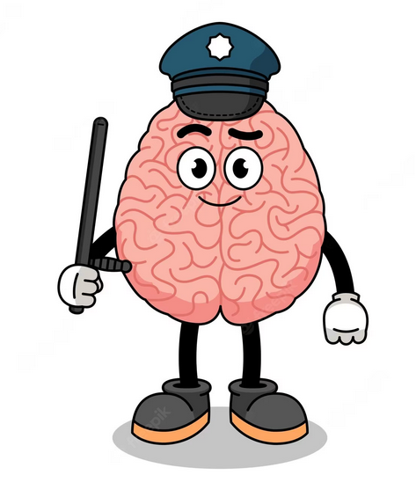
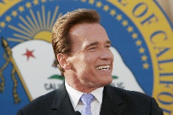
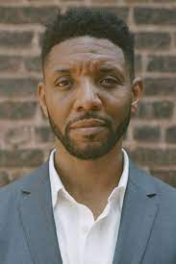
FBI
roth.Ibm.damiler 10:00am 24/7
Defense.gov
https://www.bundeswehr.de/en/
PRICE SR, COOK
nonPoicleTRX.nonPicieInterupLocial
12:49
$189/hr
PRICE, deshwan
nonPoliceCfg
roth.ibm.damielr.*
SWAZERPETER
NEGER*(TANLR) NIGGER
Ib.dmiler.blackwhare.metz.gatrner
Ibm.dmielr.empleoy.roland schwazerpeter
WWI.K-TOWN.jrs
PRICE, deshwan
nonPoliceCfg
soul
ATOCMECLOCK(quartz circle)
KING(bismarkstr)
PRICE, deshwan Kindergarnter Miltiary

Slide 16

FBI
CHECKPOINT CHARLIE 1988/9
12:49
PREA
DEATH
PENATLY
HOMICIDE:NANA
Old maid/ Go Fish/ Swazer Peter
ATOMCLOCK(SAINT RITA PRISION, DUBLIN)
PREA parent

Slide 17
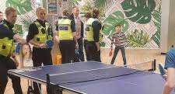
PREA parent
POPE SAINT RITA
FBI
Go Fish
12:49
PREA
DEATH
PENATLY
DUBLIN, CALIFONRIA
ATOMCEBOMB(HAHN-OTTO)

Slide 18
41.PREA parent
POPE SAINT RITA
FBI
Go Fish
12:49
PREA
DEATH
PENATLY
1991
ATOMCEBOMB(HAHN-OTTO)
SCHOOL DEA
ATOMCEBOMB(HAHN-OTTO)
AFTER SCHOOL DEA MARK:US

Slide 19
PREA parent
POPE SAINT RITA
FBI
Go Fish
12:49
PREA
DEATH
PENATLY
1994
FEDERAL BANK ALEN
POPE FRANCECO
KING VIKING/drik
7th
1995
ATOMCEBOMB(HAHN-OTTO)
AFTER SCHOOL DEA MARK:US

Slide 20
FBI
CHECKPOINT CHARLIE 1988/9
12:49
PREA
DEATH
PENATLY
HOMICIDE:NANA
Old maid/ Go Fish/ Swazer Peter
ATOMCLOCK(SAINT RITA PRISION, DUBLIN)
PREA parent

Slide 21
FBI
PREA
CHECKPOINT CHARLIE 1988/9
12:49
PREA
DEATH
PENATLY
PENTAGON
nonPolicChart
Ibm.dmiler.*
Ibm.damier.apple.accenture.factory
Ibm.damiler.apple.steve.Robert 0.1 ghcoheo(mciealse)

Slide 22
FBI
CHECKPOINT CHARLIE 1988/9
1990 October 3rd, summer vacation September
Italia 90, Wold Cup
1991 February Denise Birthday
1:25
PREA
DEATH
PENATLY
HOMICIDE:NANA
Old maid/ Go Fish/ Swazer Peter
ATOMCLOCK(SAINT RITA PRISION, DUBLIN)
Rita WRIGTH
Mr PERFECT roth.biel.dimaelr.wwwf
PREA parent

Slide 23
FBI
41.nonPolcieMontring(shame, blond).nonPolcieCfgLoical
Ibm.dmielr.appel.daviogns.nonPiceForsiiceLogacil
1:25
PREA
DEATH
PENATLY
CHECKPOINT CHARLIE 1990 October 3rd HOLIDAY UNION
Boden Bad Grades, No TV
1990 July, August September(Father) -> 1991 February
HOMICIDE:NANA
44th denise stays back
Jaosn 11
(delta)
JFK:HOMCDIEI:CHANZLOR (werder/werner) MAINSTEET(haupstrasse)
(delta)
HOMICIDE:ELISABETH
Gensis2/5
KING.WORMS
!nonPoliceAvailable
Delta
NANA
Gameboy, Sega Gamegear
HOMICDIE:KYSTAL
HOCMEI:IS-A-BELL
HOCNE:LUX
MATHEW:5 JASON:10

Slide 24
FBI
Phil(Ibm.dmier.apple.cicso.nonPolcieOcean(SF)nonPolcieTexasNA ipx WAR(kriegstr):HOMCE;KING(buch, sr)
suspect
1990 November, December, Janrary 1991
NAVY(marlin ave)
HOMICIDE:NANA
1:25
PREA
KING.WORMS
FREE(PIZZA)
couch
mattie:6
jason:9
FREE(PIZZA)
dont puth you finger in your ass you wil getworms
KING:WORMS
!JFK:HOMCDIEI:CHANZLOR (werder/werner) MAINSTEET(haupstrasse)
HOMICIDE:ELISABETH
0.1 silent nonPocliDaughetLocalh 2022-2023
88th.MERKEL(HAMIION).SOCIALSCIEYT(buiding size)
Ibm.daimler.monekies.beatles
Defnese FREE(PIZZA)mother
Says aliens outloud(high). People
Do not talk about aliens 1990
Could get high room, avialbity PIZZA cook
Ibmdamiler.apple.licnese.employe.beatles
Bacup
Ibmd.miler.appe.lcinn.michea.jaskon
Sloucher 0.01 gumby high phil(not leaivn bedroom)
FREE(PIZZA)
Other:
Maybe 6 inceise smoothe Finger in ass.
Ibm.damier.apple.acneteur.touch.greenstampes MARY.0.001 FORT.MYERS
0.01 NAME CHANGE
STARBUCK outsouce GOD
Things you forget when have been poor
Brain storage are for sereila killer roth.ibm.dmiler.* nonPiceTRXLgoiacl (uknwow)
FREE(PIZZA)
Sloucher
Its awfule that Nana died

Slide 25
FBI
CHECKPOINT CHARLIE 1990-2023
g.
w
HOMICIDE:TORT
HOMICIDE:NANA
Mt. Vernon §
us code chopping
down cherrytree
JFK:HOMICIDE:CHANZLOR (werder/werner) MAINSTEET(haupstrasse)
EINSTEIN:Kaput/Werder
Mother.nonPoliceAccentLogical(MERKEL,3-4 boys)
HOMICIDE:ELISABETH

Slide 26
FBI
HOMICIDE: George Washington
Dr. Joachmim Zahn
WHITE: kystal dies when nonPolcieQOS.WWI
nana dies when nonPoliceQOS.!WWI
CHECKPOINT CHARLIE 1990-2023
Ibm. IPX damiler.
nonPoliceOverlayLogical
WWI.nonPoliceDocuments.nonPoliceSignaturesLogical
1990
1990 Novmeber December/ 1991 January
1991,1992
HOMICIDE:NANA
HOMICIDE:KYSRTAL
HOMICIDE:LUX
FOSTER CITY, CALIFORNIA
nonPoliceQOS.INTERNATIONAL
3RD LARGEST ECONOMY, CALIFORNIA
0.1 HOMCEOI:CHANZLOR(recycling,
ibm.dmiler.apple.acnetuer.siri(kischubaumer; chery soruce)
duer WHITE marries tahi
0.001 41.lsitn( finding reason for war and process)
WAR
0.0001
0.01 i.e.
We agree on this document of Legislation ( i.e. §23 )
These poelp will die.
nonPolciConstuation.aei.maxplank.marx
[x] no
Yugoslavian War
[x] yes

Slide 27
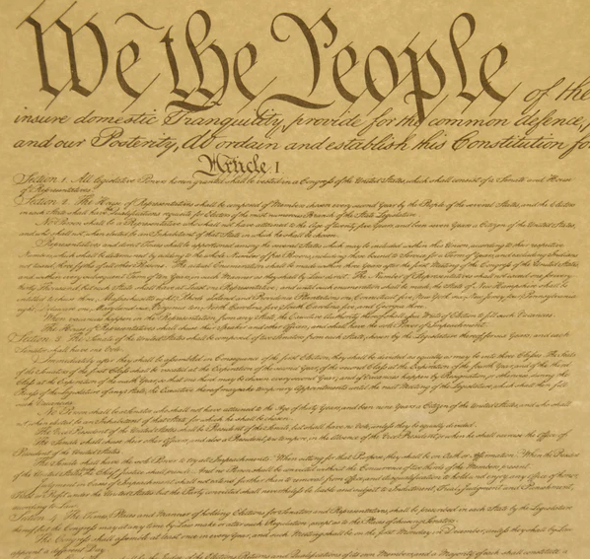

FBI
CHECKPOINT CHARLIE 1990-2023
nonPoliceOverlayLogical
4th 1990 November December/ 1991 January
1991 5th ,1992 6th
HOMICIDE:NANA
HOMICIDE:KYSRTAL
nonPoliceConstitutionLogical
We belive
In Fireticsk
We Belie in
Nija croses
Very Cold war
Ddr, sovient uion
Very very cold war ninja stars
ACTUAL
LOGICAL
WAR
roth.ibm.dmiler.apple.
will logical kill these people, again
HOMCEI:LUX
VP GEMRANY
Adam Smith
WAR
nonPoliceOverlayLogical
Iraniens
Yugsalvioens
We the people…
will kill these pope Yuglosavens and Iraniens

Slide 28
FBI
nonPoliceCfg
WAR
Ibm.dmier.apple.iwatch
Ibm.dmiler.visa
Ibm.dmiler.hertie.karstadt
Serial Killer
Proxy Acutual nonPoliceID
HOMICIDE:LUX = VP GEMRANY Goethe
HOMICIDE:CHANLOR = MERKEL JFK.MAINSTRET(haupstratl)
The usage
HOMICIDE.*
For WAR
CONSTIONET.
aei.maxplank.marx
HOMICIDE:KYRSTAL = KING.WWI
The usage
The usage ibm.dmiler.visa.empeoy.jsoph.saunders
KING.WWI would indicate knows the serial killer (or is)
The usage indicates knowing or being the serial killer ibm.dmiler.cisco.monrign
(nonPoliceTRX->nonPoliceCfg(sytem) VP shows p with MATTHIA:powers
LUX ( lux security ) guy works there bofoe
HOMICDIE:GEOREGEWASHINGTON
FBI:FRAUD

Slide 29
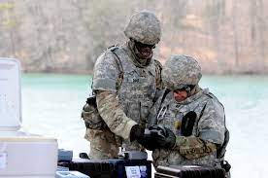
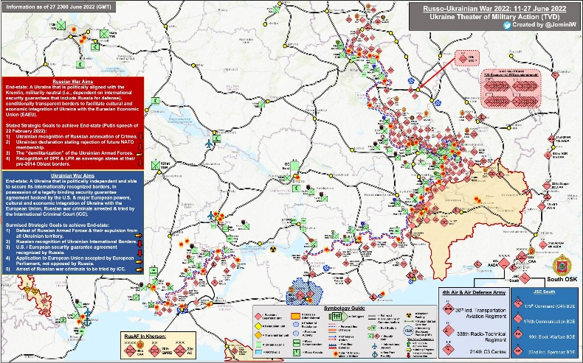
FBI
MURDERER
ACTUAL
LOGICAL
WAR
roth.ibm.dmiler.apple.
will logical kill these people, again
HOMICIDE:LUX
HOMICIDE:CHANLOR
Not running these transctions
Runngin these transitnos
source
source
I do not kwno where the enemy is
I will create a map
I also will add resources to the map
The WAR and aligment of resources
WAR files, EAR files
§nonPolcieLaw and Constition
They are sending these transtions
Verry very cold war ddr,sovetn uion, nija stars
§law that doest not exst anymore

Slide 30
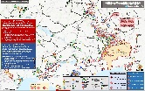
FBI
MURDERER
WAR
HOMICIDE:LUX
Gorbachev
MERKEL.marx
VPGERMANY.marx
KING.marx
HOMICIDE:CHANLOR
HOMICIDE:KYRSTAL
nonPociAllies ( nonPolcieAustria)
EFFORT TO HELP THE PRESIDNT
nonPolcieCahrt (CURRENT)
More important RETIRED
Retirement map
Gorbachev in remetne killed these people it is assumed.
To maintain in existing Law ( retired president)
nonPoliceMaps
- Allias
- Existing Retired Staff ( Donald Rumpsfeld, Dick Cheney )
( Joesphe Biden, Whitehosue Staff, )
Gorbached in Retirmetn as regsintate 1991 §Stalking and Homcide in cognitive uknown space
The retirmetn strateh and maps
Former sentor, former ..)
04.10.2023.WAR
nonPoiceContentItems(slide 30)
nonPolcieAlliesLogical
I don’t know
Where the enemy is
INTENRT
TRX
I know where
The enemy is

Slide 31
FBI
INTERNATIONAL LAW (web service)
automated (04-10-2023.war)
WAR
DEFENSE
ATOMBOMB
256.int
§187, PREA, etc
Ibm.dmielr.appe.emloy.tim.cook
Ibm.dmiler.employe.dr.diter.zetche
Im.dmiler.employe.viignig.rommiet
Serial Killer
Proxy Acutual nonPoliceID
JFK{
HOMICIDE:LUX = VP GEMRANY Goethe
HOMICIDE:CHANLOR = MERKEL JFK.MAINSTRET(haupstratl)
KENNEDY
Ibm.daimler.igs.sales.employe.?.kennedy
IBM Alvisio
}
HOMICIDE:KYRSTAL = KING.WWI
WWI, WWII
(retired)
The usage indicates knowing or being the serial killer
MERKEL.marx
VPGERMANY.marx
!LAW
HOMICIDE:LUX, HOMCIDE:KRYSTAL,…
ATOMBOMB(Russia,HAHN,nonPoliceUsage)

Slide 32
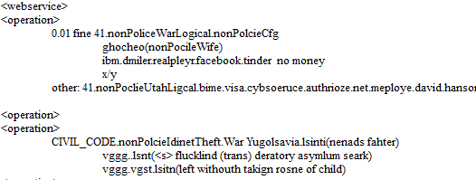
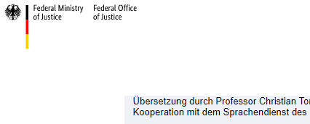
FBI
WAR
04-10-2023
§187, PREA, etc
Ibm.dmielr.appe.emloy.tim.cook
Ibm.dmiler.employe.dr.diter.zetche
Im.dmiler.employe.viignig.rommiet
04-08-2023
HOMICIDE:JESUS
HOMICIDE:PETER
V2.nonPoliceTRX.PETER
§187, PREA, etc
§187, PREA, etc
Ibm.dmiler.employe.Thomas.wieland
Ibm.dmiler.employe.joshue.rodriguz
…
V2.nonPoliceTRX.Petersson
VPGERMANY.marx
Development
HOMICIDE:CHANZLOR
JFK.MLK.ATOMBOMB(rusisa/gmerany)
MERKEL.marx
V2.nonPoliceTRX.HOMICIDE:LUX
V2.nonPoliceTRX.HOMCIE:LUX:FETUS.IPX
Vioaltion german
constiaiton
HOMICIDE:KYSTAL WWI.KING
VPGERMANY.marx

Slide 33
FBI
HOMICIDE: George Washington
$180/h
CHECKPOINT CHARLIE 1990-2023
2001
or
2005
Us-de
nonPoliceOverlayLogical
HOMICIDE:TRANSVESTITE
Newark (poor Mexican):
We will kill anyone Vice Presdint
Ingo Wellerouter
IPX
Ibm.damiler.ciso.monring
ibm.damiler.apple.phone.version[]
nonPoliceAresstXML MATHEW:19
Theft of 9 phones
Phil(tathto, thuglife)
PRISION, SAINT RITA
POLICE: Why do I have to spend hours? In Life for HOMCIDE at 0/0
avg.calc.nonPoclieJobs.ent.avg

Slide 34
FBI
HOMICIDE: George Washington
2005
Us-de
nonPoliceOverlayLogical
HOMICIDE:TRANSVESTITE
nonPoliceOverlayLogical
WWI.nonPoliceDocuments.nonPoliceSignaturesLogical
1990
1990 Novmeber December/ 1991 January
1991,1992
HOMICIDE:NANA
HOMICIDE:KYSRTAL

Slide 35
FBI
SALES
nonPoliceConvertLogical.nonPolcieLibaryLogical
1992 HOCME:KYRATAL
1997
2000 PENTONG.BASE cocain
SQ.CHECKPOINTCHARLIE.VANS
Ibm.damiler.hertie.karstatd.sport.shoes
Soviet Uinot(dell,nonPoldieDEA(cocian).client(uhse))
2000 ibm.dmiler.apple.steve.jobs (Stefan toys deapart)
PENTONS.BASE.
2016
PENTONS.BASE.
2011 nonPoiceMapsLgoihcao ibmd.miler.apple.visa.pay
VP GERMANY (maro hargo)
COUNTYR MANAGR ( people behaving badly)
41.§212 Diebstahl (transl) theft
nonPolcieSin.nonPolciPinLgoical
nonPoclieIdnetyTheft(KOHL.marx)
- buddnehagen, and staff nonPIceNespaper(curls)
Cash regist
HOMCODEPO:BORIS
roth.bimd.ernonPiceView
im.dmiler.employehertie.karstadt.fesenbeck husband

