Slide 1
FBI
Ibm.damiler.pope.university.Stanford.kit.polytechnic
8th Floor
1st Floor

Slide 2
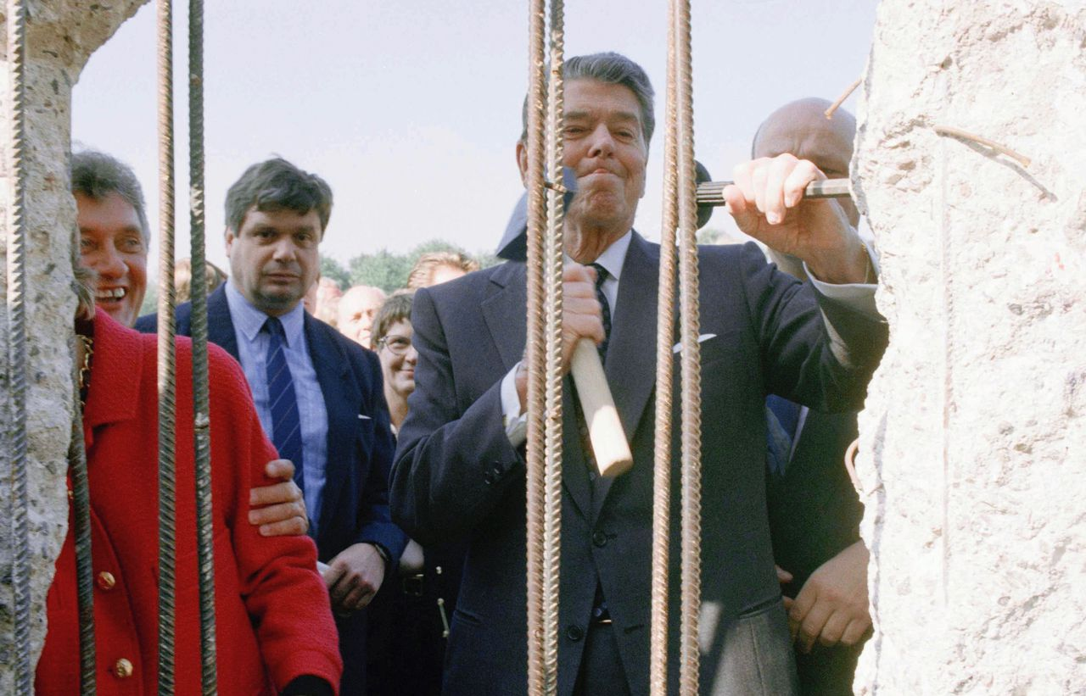
FBI
Ibm.damiler.pope.university.Stanford.kit.polytechnic
These Angela Merkel Apartments
In violation of
§187, §31

Slide 3
FBI
Ibm.damiler.pope.university.Stanford.kit.polytechnic
GAS(Rudolf-diesl-strasse)
SQ.COLEMAN
HOMICODE:CHILD(2Y)
WINDOW
HOMOIDE:TENNIS
8th Floor
8th Floor
8th Floor
8th Floor
8th Floor
8th Floor
8th Floor
8th Floor
8th Floor
JFK(roth.redhouse.redhair, BROTHER)
CPVA: ASSHOLE IPX.marx
41.ATB.eval.nonPoliceTRX
POPE

Slide 4
FBI
Ibm.damiler.pope.university.Stanford.kit.polytechnic
GAS(Rudolf-diesl-strasse)
SQ.COLEMAN
HOMICODE:CHILD(2Y)
WINDOW
Ghorhoce Jackon hodlin baby out woinding
8th Floor
8th Floor
8th Floor
WWI.41.KING.<s>marx</s>: Hello Are you there?
WWI.41.VICE PRESING GERMANY: how much?
WWI.41.KING: you don’t have to pay for me</s>

Slide 5
FBI
GAS(Rudolf-diesl-strasse)
8th Floor
8th Floor
MERKEL(Visual basic)
§212 Diebstahl
Ddr.ciggeretes
5th Floor
Phil(kissin sister spy
IPX 4th floor )
G.PREA
IPX G.ibm.dmiler.paernter.prolifics.tamgroup.employe.Daniel.urbano(cherrytree)

Slide 6
FBI
GAS(Rudolf-diesl-strasse)
8th Floor
8th Floor
MARY §212 Diebstahl
§212 Diebstahl
4th Floor
G.PREA
Zuckerberg books
nonPoliceMonitoring

Slide 7
FBI
GAS(Rudolf-diesl-strasse)
8th Floor
8th Floor
G.PREA.TORT.MERKEL(PARKER)
pms:recyling
4th Floor
Ipx FBI:FRAUD:FEDELAL BANK(johnathn)
ATOMBOBM(Ghohceo(HAHN))
- johnathan bird PHYSIC(HAHN)
- jonathanhn BROTHER.marx GAS(ruodl-diesl-strase)
41.FBI:FRAUD( goldman sachs)
phil(ATOMFACTORYY.philpsburg).(HOMICE:JEUSES (kiristina).nonPoilceTV(mona))
pms:recyling

Slide 8
FBI
GAS(Rudolf-diesl-strasse)
8th Floor
8th Floor
G.PREA.TORT.MERKEL(PARKER)
pms:recyling
8th Floor
Ipx FBI:FRAUD:FEDELAL BANK(johnathn)
ATOMBOBM(Ghohceo(HAHN))
- johnathan bird PHYSIC(HAHN)
- jonathanhn BROTHER.marx GAS(ruodl-diesl-strase)
41.FBI:FRAUD( goldman sachs)
phil(ATOMFACTORYY.philpsburg).(HOMICE:JEUSES (kiristina).nonPoilceTV(mona))
pms:recyling

Slide 9
FBI
GAS(Rudolf-diesl-strasse)
8th Floor
1st Floor
POLICE MITCHEL

Slide 10
FBI
These Harold Roth and Angela Merkel
Apparmnets SFO-FRA kempinkski,dropin,wildbore
Walmart,werkauf
Roth/Jobs/jobs/meiers/meiers/meiers/meiers
HOMICDE:ur_ur_opi
In violation of
§187, §31

Slide 11
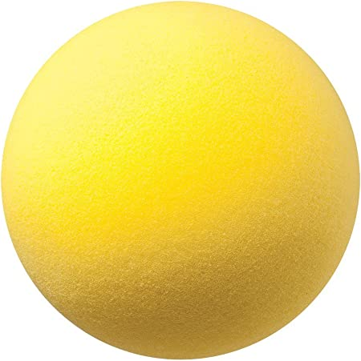
FBI
GAS(Rudolf-diesl-strasse)
8th Floor
Kicking soft silent ball against
Graage doors ( odl from ddr)
IPX
School: guido, other guy
POLICE MITCHEL
IPX

Slide 12
FBI
These Harold Roth and Angela Merkel
Apparmnets SFO-FRA kempinkski,dropin,wildbore
Walmart,werkauf
Roth/Jobs/jobs/meiers/meiers/meiers/meiers
HOMICDE:ur_ur_opi
In violation of
§187, §31

Slide 13
FBI
GAS(Rudolf-diesl-strasse)
JFK(Zellendorf)
JFK.MOON(Pankau)
8th Floor
41.ibm.dmiler.apple.acctuer.toruch
G.nonPoliceTelevions
DESERT STORM
7th Floor
ERIC LUDWID
JOSHOSN SEXTON
TIM COOK
TORHC THES PEOPLE WITH
YOUR WHITE COAT PEOPLE
OUTSIDE, HERE IN TEXAS
. USE THE PICTFORK WITH WIHTE COAT OVER YOUR HEAD. THE
WHIE ONE.

Slide 14

FBI
§187, §31 Kondompflicht
41 years later guy
Is still criminal. Helmun is in
Priion (captilst) VP (killer) and
The crimain(merila ) are outside?

Slide 15
FBI
There was one jogger gernated 0.125 local 9-11 towners
Today. Ther about about 4-5 per week. Nutcases.
TORHC THES PEOPLE WITH
YOUR WHITE COAT PEOPLE
OUTSIDE, HERE IN TEXAS
. USE THE PICTFORK WITH WIHTE COAT OVER YOUR HEAD. THE
WHIE ONE.
[x] no
§187, §31 Kondompflicht
WE HAVE YOUR DOCUMENT
With BLUE SLIDES (eric,joshp,tim)
We belive…. Buring crosses (in buring corssss)
at your house and nreibhor house
although, we will used these blue
high risies of capisblm
GTFA.

Slide 16
FBI
Ibm.damiler.pope.university.Stanford.kit.polytechnic
8th Floor
1st Floor

