Slide 1
FBI
FBI:WHITE COLOAR: FRAUD; HOMICIDE
nonPoliceDocumentsLogical
nonPoliceBPM(roth.ibmd.miler.apple.accnetyer.touch)
2007
FBI:WMD
FEDERAL COURT GERMANY CONSTITIONAL COURT
DR. PROF
2023
FINANANCIAL FRAUD ACT
nonPoliceCountry(Luxemburg; HOMIDE:LUX)

Slide 2
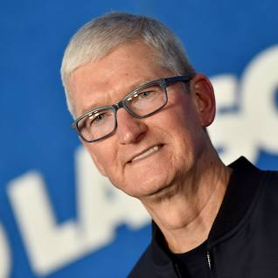
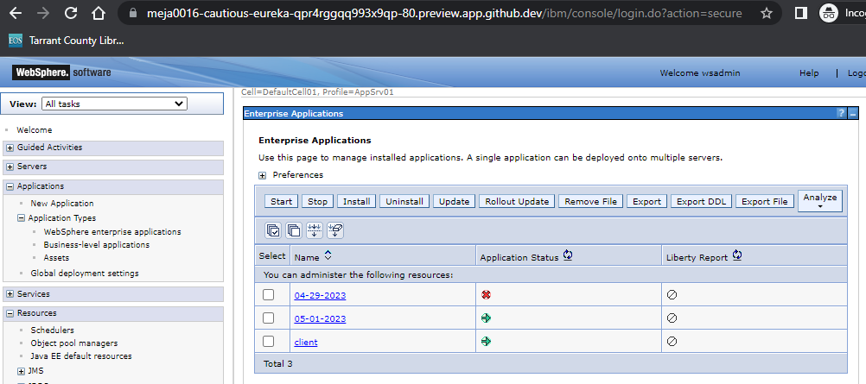
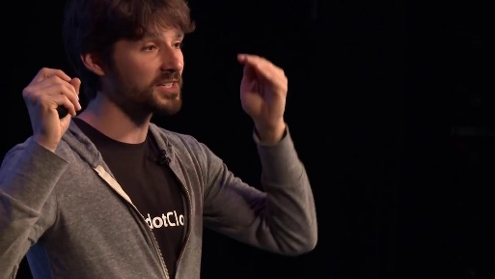
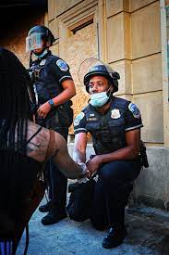
41
FBI
Bash the women
With you fist in her face
Ghrocheo(Visa nonPocleiCouryt(“France”)
White-colar
Sex Abuse
41.DOMESTIC VIOLAANCE roth/roth/jobs/jobs/meiers/meiers/meier/msier/meiers
I am leavvving w/o car/ --Carlos.
[x] no
Do it dirty
docker exec -ti www_websphere_1 /bin/bash
[x] no
SQ:HOMICDIE:SUNSTOKE
[x] no
<head> giving head
[x] no
SQ. (interrupt 2007 tivoli/hperic) Javier salter; Intuep ASSSHOLE anal sex
[x] no

Slide 3
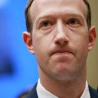
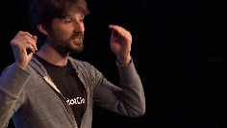
SQ.COLEMNA.aei.maxplank.marx
FBI
nonPolcieChartLgoical
SQ:HOMICDIE:SUNSTOKE
[x] no
FREE(PIZZA)
Craigslist
Find a job
2023
<head>
/bin/bash
docker
[x] no
CIVIL_CODE/LABOR_CODE: CERTIFICATE:WEBSPHERE:
VICEP PRESINE (Schultz;nonPolciePrionCfgLogial)
[x] no

Slide 4
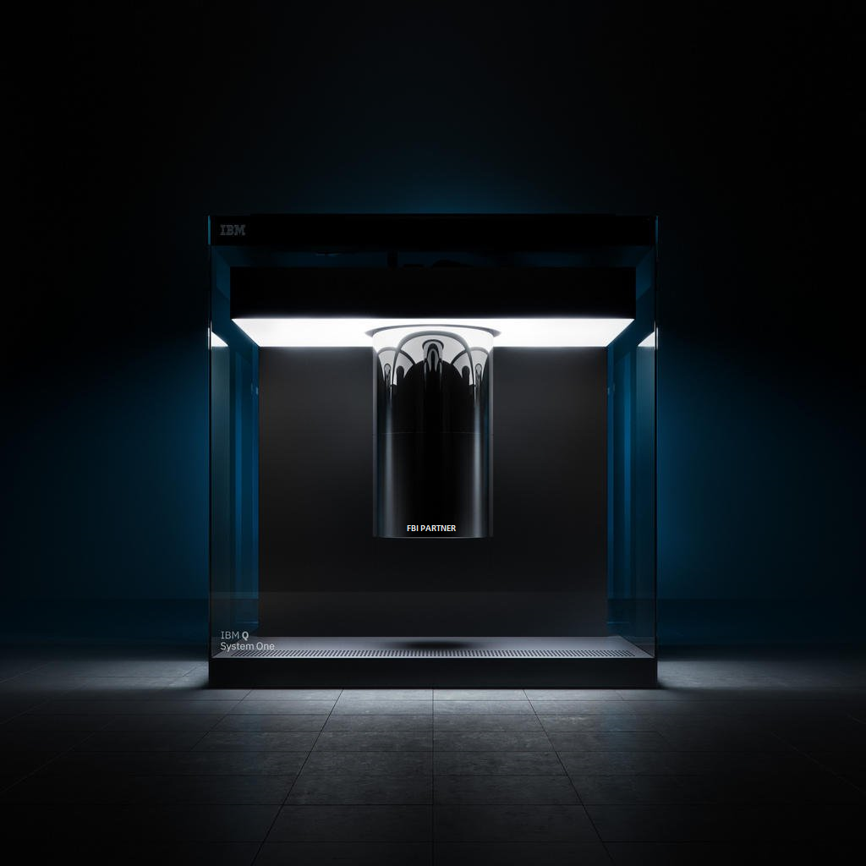
FBI

Slide 5
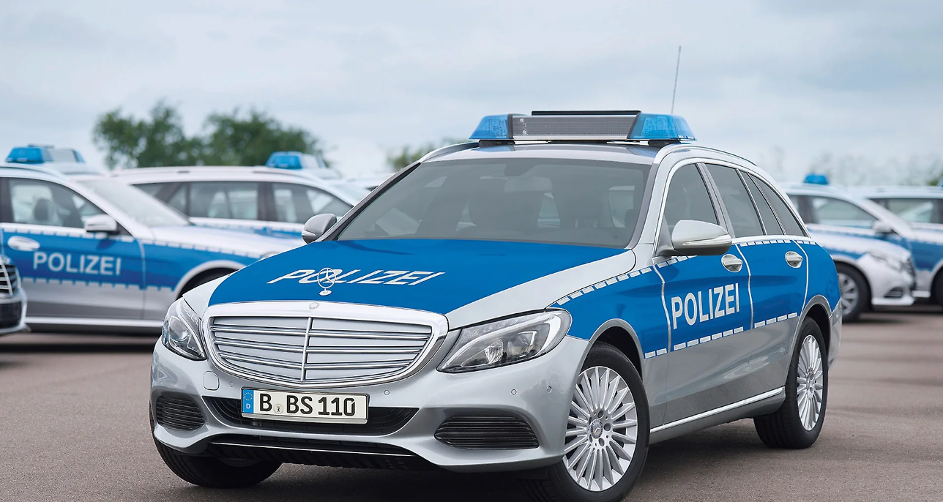
FBI

Slide 6
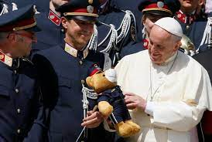
FBI

Slide 7
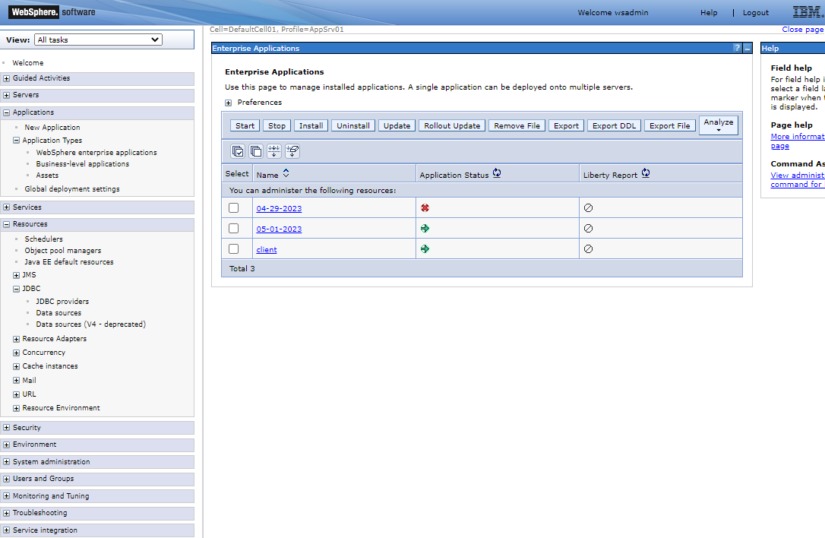
FBI
VICE PRESIDGN GERMANY(41.schulz,ingo(
Sex with Micheall, laura(offsite/onsite:coscto) kelsy
KING(wanderlust,litte miss sunshine, camper bank swidhs)
[x] no
LEE, FORTIN, DALLAS ghcohe(nonPolcieWife())
HW5/A5 cheating; 2010 picked up with roses $2000 flight last minute

Slide 8
FBI

Slide 9
FBI

Slide 10
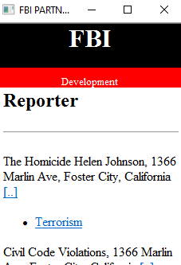
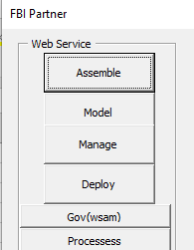
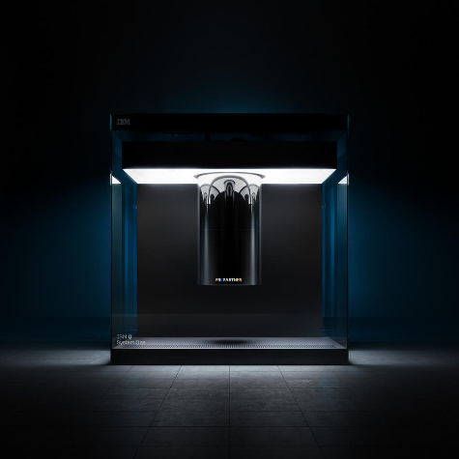

FBI

