Slide 1
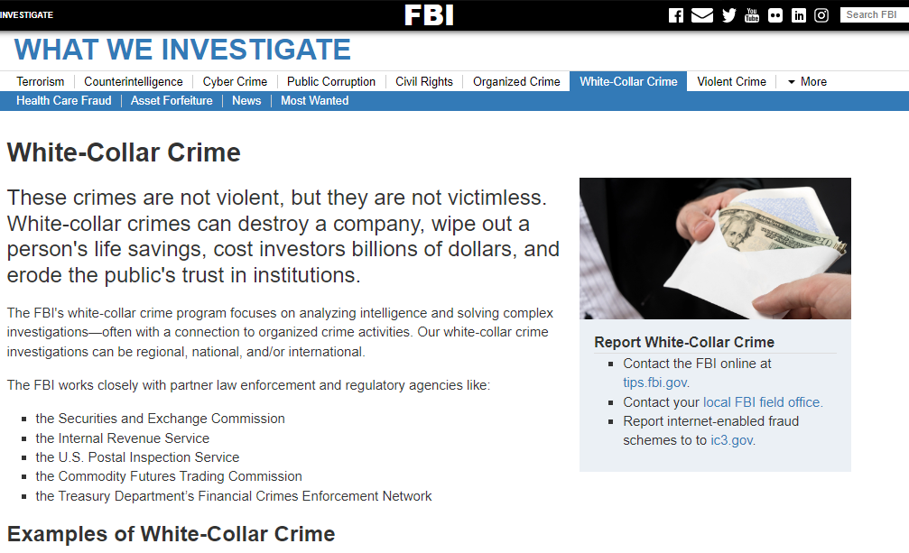

SELECT * FROM nonPoliceAccouting, nonPoliceHomicide where
nonPoliceAccouting.HOMICIDE = nonPoliceHomicide.HOMICIand nonPoliceAccouting.HOMICIDE=LUX

Slide 2
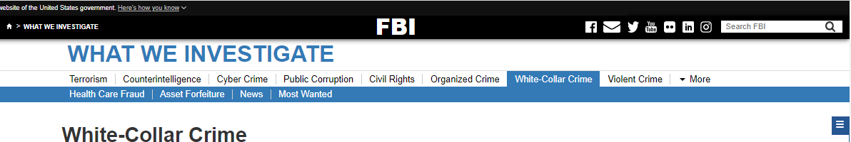
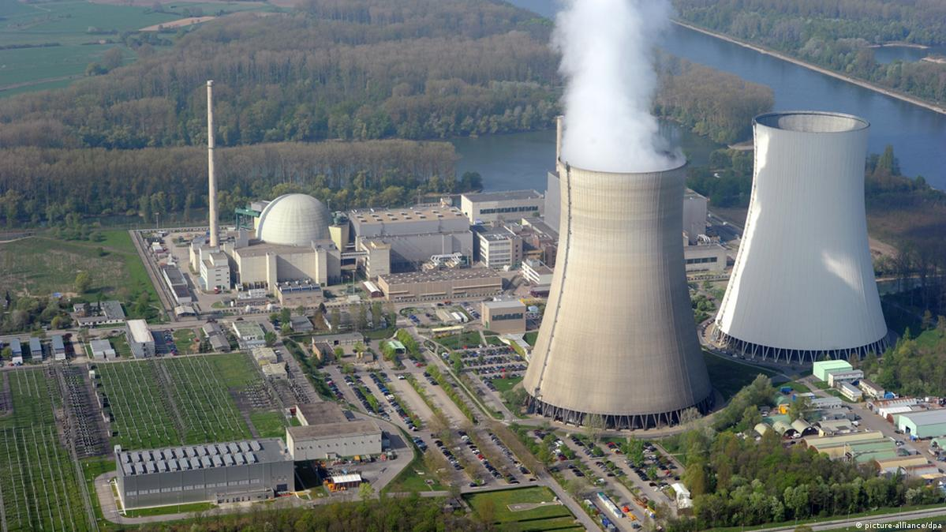
PHILIPSBURG MAINSTREE(VIEW)
1997 BEJAMIN FRANLIN,THANKSVIGING
PHINSGTUNIR
E=MC2
NAVY Philip Johson, Foster City
Angel Mekel Legilsatoin, NATO
CLOCK
nonPolicRTALogical
CLOCK
GOVMENT MANGMENT
E-=MC2 w/o mathematics
PostDoctor, Dr Disteration
GOVMENT MANGMENT

