Slide 1
FBI
§187
§187 ibm.damiler.pwc MAINSTREET(425 Market, Floor 11, San Francisco)
gorbachev(23 2pac (micheal or angy black,2pac)
1D8723 D Deutschland
Distinguished
Menace to Socity 5.0L Ford
5.0 Deutsch
5.0 History
5.0 Ford
D/5.0 School

Slide 2
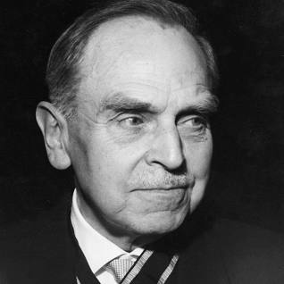

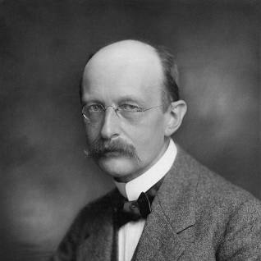
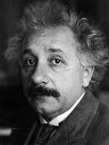
FBI
§187
11
ghoeh.(dr/j).ATOMCEBOMB)HAHN) gas stastino 11(elf)

Slide 3
FBI
§187
10
ghoeh.(dr/j).ATOMCEBOMB)HAHN) gas stastino 11(elf)

Slide 4
FBI
§187
9
ghoeh.(dr/j).ATOMCEBOMB)HAHN) gas stastino 11(elf)

Slide 5
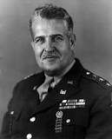
FBI
§187
Angelican Chruch
8
WWI
WWI,WWII
ghoeh.(dr/j).ATOMCEBOMB)HAHN) gas stastino 11(elf)
Lieutenant General Leslie Groves

Slide 6
FBI
Lieutenant General Leslie Groves
WMD
ENGLAND ROYAL CONSITUTION 1215
1727
7

Slide 7
FBI
Lieutenant General Leslie Groves
WMD
ENGLAND ROYAL CONSITUTION 1215
ROYAL CONSITUTION 1215
nonPoliceChartLogical
WWI,WWII
King.ibm.dmiler
WWI
WWI,WWII
Ibm.damiler.apple.yahoo
Gorbachev(nonPolcieWife.daughter.phil.marx)
[x] no
Ibm.dailmyer.glu.employe.eric.lugwig
King.ibm.dmiler.* starucsk haddops king2kp.org

Slide 8
FBI
§187
Angelican Chruch
7
WWI
WWI,WWII
ghoeh.(dr/j).ATOMCEBOMB)HAHN) gas stastino 11(elf)
Lieutenant General Leslie Groves

Slide 9
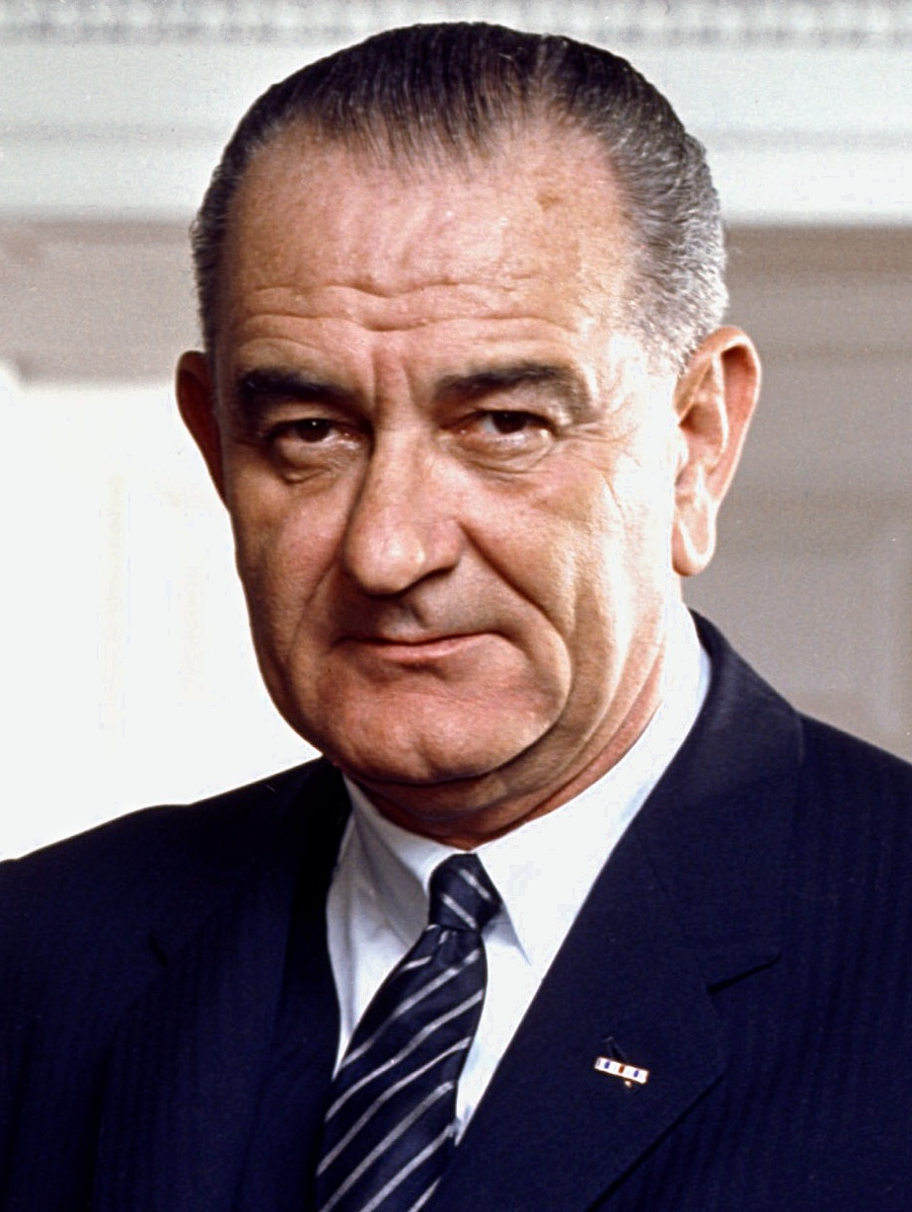
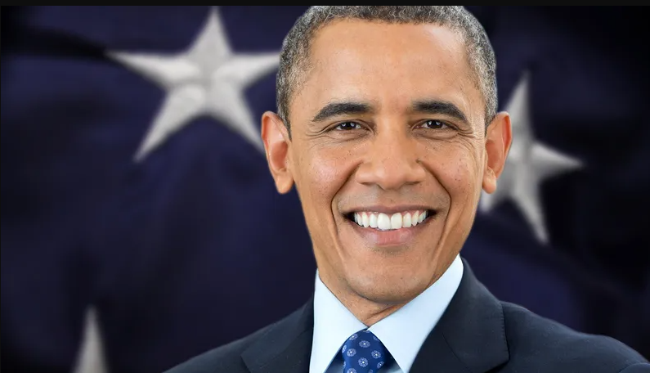
FBI
Lieutenant General Leslie Groves
§187
JOHNSON
6
ghoeh.(dr/j).ATOMCEBOMB)HAHN) gas stastino 11(elf)
Lieutenant General Leslie Groves

Slide 10
FBI
Lieutenant General Leslie Groves
§187
JOHNSON
5
?kaite/outside/tv
Son? german
Lieutenant General Leslie Groves

Slide 11
FBI
Lieutenant General Leslie Groves
§187
4

Slide 12
FBI
§187
Lieutenant General Leslie Groves
Nevada Test Site
3

Slide 13
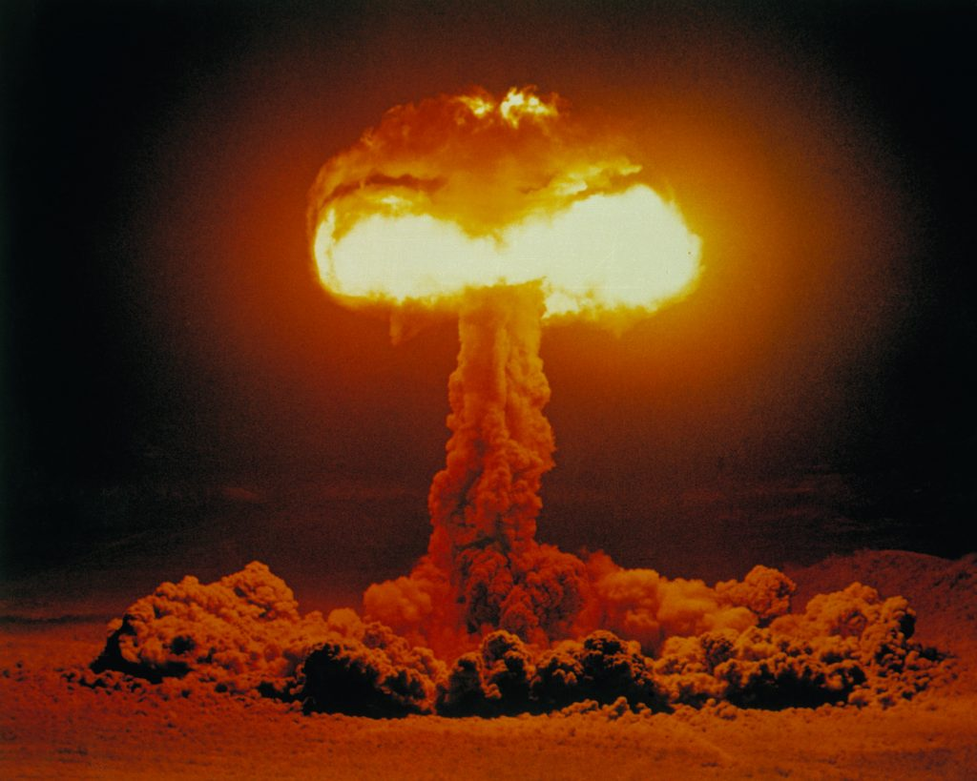
FBI
§187
Lieutenant General Leslie Groves
Nevada Test Site
Computer Screen
PAUL REVERE VILLAGE
POST EXCHANGE
COMPACT DISK (CD)
2
ibm.dmilaer.apple.beats.dabomb
AFTER MATH
Ibm.dns: season.com CHISTEM WINDTER niko winter
ibm.dns: dropapple.com
ibm.dmier.apple
ibm.dmiery.apple.yahoo

Slide 14
FBI
§187
Lieutenant General Leslie Groves
Nevada Test Site
Computer Screen
1

