Slide 1
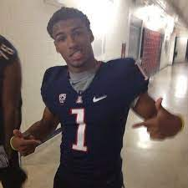
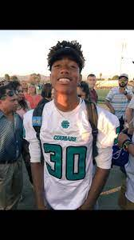
FBI
WMD
Ibm.damielr.apple.tim.cook.riot (1%)
RECYLING pms nonPOclieContenttem(bottlethwoer)
Ibm.dmiler.cisco.motnriong(1%)
Theft 1million
Mayor
bmx
x
1
30
LEE, KING ipx bruce ACHSO
bmx
2004
x
2007.avg
LEE, KING.MATHEW
2017
Bmx Ibm.dmier.glu.employe.Oscar.hernadez

