Slide 1
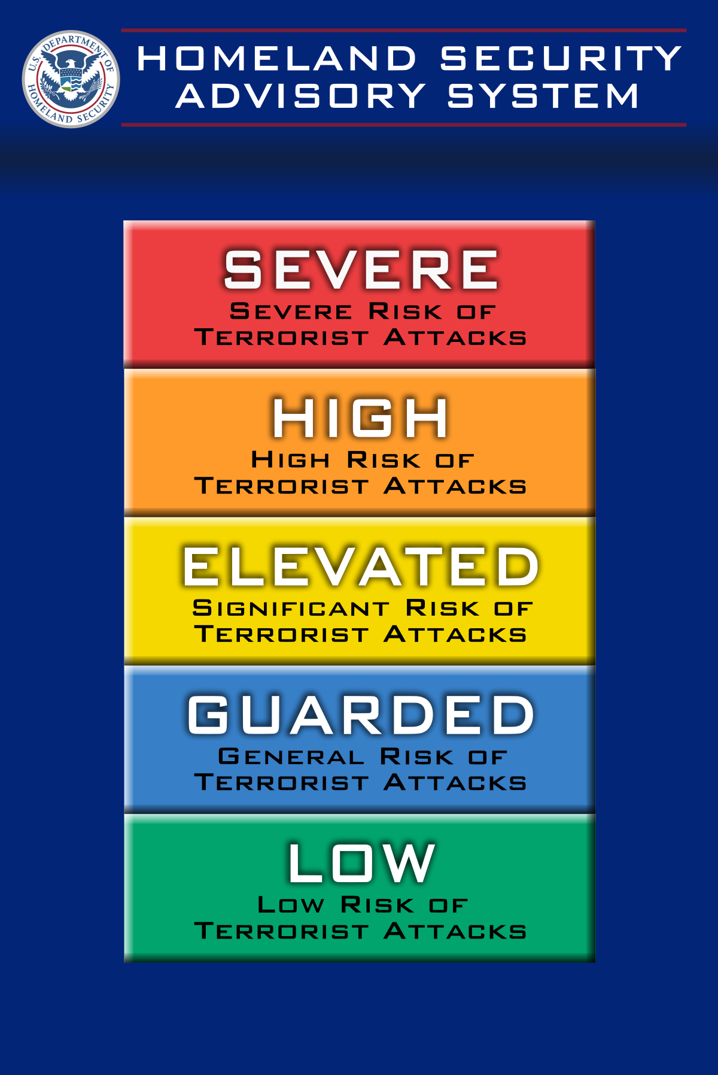
FBI
2023
WMD
Forth Worth
Gorbachev
(Ibm.daimler.visa.employe.micheal.dryer)
2013, 2014, 2015,2016
Ibm.damiler.apple
Gorbachev
(Ibm.daimler.visa.employe.micheal.droz)
Ibm.daimler.visa.employe.mark.travis

Slide 2
FBI
WMD

