Slide 1
FBI:WMD
SQ. AVAILBLITY
CUM ON BABIES FACES
FRE(PIZZA)
DISLANE.employe
CHRIST VENTURE SABRYTOZN
CUM ON BABIES FACES;
SABRI CUMS ON BABIES FACES

Slide 2
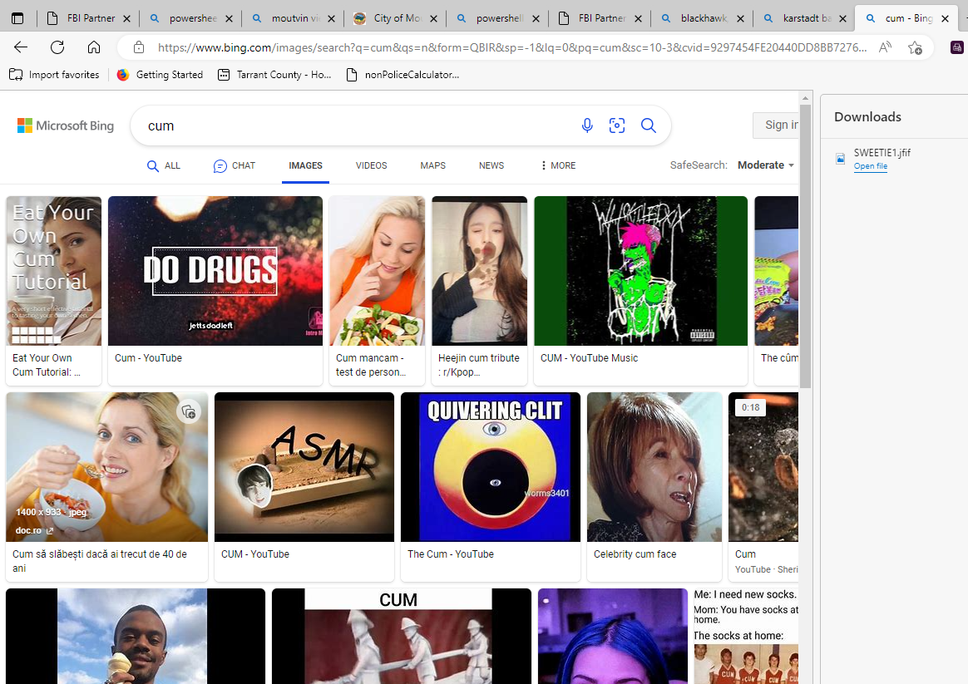
FBI:WMD
KINGDOM CUM

Slide 3


Roth.ibm.dmiler.blackwhar
SQ. AVAILBLITY
FBI:WMD
www.sweetieface.com
SQ. AVAILBLITY
CUM ON BABIES FACES
FRE(PIZZA)
DISLANE.employe
CHRIST VENTURE SABRYTOZN
CUM ON BABIES FACES;
SABRI CUMS ON BABIES FACES

Slide 4

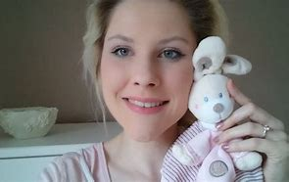
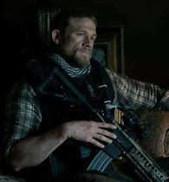
FBI:WMD
NAME CHANGE: JACK
41.MARK:lelis
Guywaint at schelter
For guy with ./ibm start
[x] no
0.1 jacks teller()tranl)plate full of cum

Slide 5
SQ. AVAILBLITY
FBI:WMD
WE KLLED A KID
K,O,R.N
BLACK HAWK – METZ
Roth.ibd.miler.apple.acneoetue.touch
And a guy with
./ibm start
./ibm weservices

Slide 6
Roth.ibm.dmiler.blackwhar
SQ. AVAILBLITY
FBI:WMD
www.sweetieface.com
SQ. AVAILBLITY
CUM ON BABIES FACES
FRE(PIZZA)
DISLANE.employe
CHRIST VENTURE SABRYTOZN
CUM ON BABIES FACES;
SABRI CUMS ON BABIES FACES

Slide 7
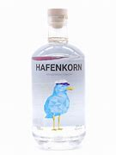
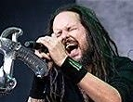


HOMCDIP:CHNLOR:MEREL
SQ. AVAILBLITY
OLIVIA
FBI:CPVA
FBI:WMD
WE KLLED A KID
K,O,R.N
BLACK HAWK – METZ
Roth.ibd.miler.apple.acneoetue.touch
And a guy with
./ibm start
./ibm weservices
PILLS
Cut off head Eva borw ; PILS nonPOecDEA(mdma)
HOMCPD:MAYOR.INT.IPX
x
IPX
sex and city naked guy show beach
Mohter: noNPoceHamburg.alkadia)
ELKE

Slide 8
FBI:WMD
4pm WHITE TRASH
Dev-eng-avg
[x] no

Slide 9
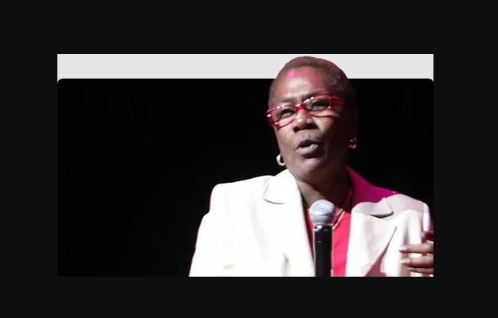
4pm WHITE TRASH
Dev-eng-avg
[x] no
4:19
FBI:WMD

Slide 10
FBI:WMD
SON
SSON-OF-PETER
HOMCIDE:JESUSE
HOMCPE:PETER

