Slide 1
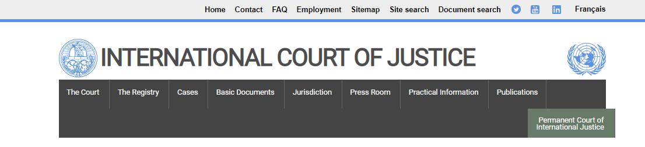
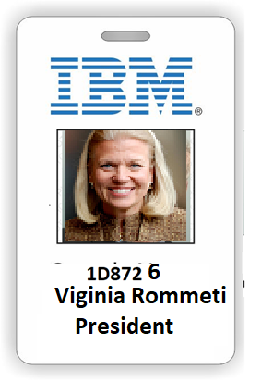
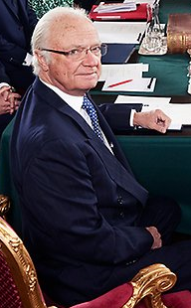

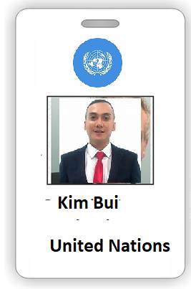
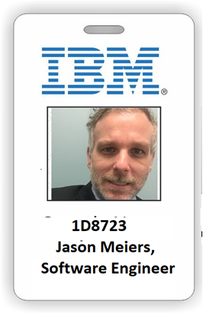
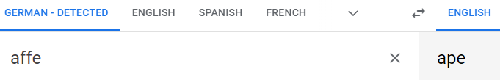
nonPoliceWife
Larry,densie
Pope.mona.lisa
Phil Family Room
[x]no
UN San Francisco
2005 Affif nonPoclieHmellessLiason
2010 Affif CLOCK
Fbi.white-color: FRAUD
Crazy horse/Crazy Talk
Fbi.white-color: FRAUD
UN San Francisco
2005 Gavin Newsom, Mayor San Francsio
Fbi.white-color: FRAUD
IBM
IBM Partner
GMAC Financiang
2014 Internview (blond ibm sf court) my vagain here water
Kim Gerlace
Kim Kolla
Affe (trals) monkey

Slide 2

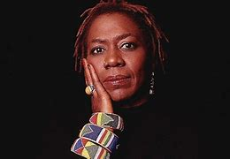
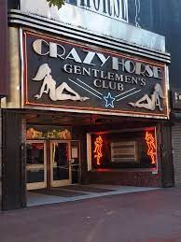
SAN FRANCISCO
WWI.KING
IPX
(41)
CIVIL CODE: Former United Nations Employee and IBM Chair
PHIL(KIM), JFK.BULLET(ATOM BOMB)(joe moon einstien)
41
LAMB OF GOD
distance
Dan (Craigslist), Berkley Hottub, Emveryvill
Ford (gay) 2 sitting 1am, Berkely
Concert Tickest Mazda Fater(Steve) Sait Jose
Warfield / Crazy hourse
Are you at the
Crazyhourse? On
your way to the UN?
I am dancing her poor.
And later I will be
On CLOCK street.
?
Yes, outside
with donnovan
On my wa to INTERNET(webster)
from 425 MARKET IBM
nonPoliceEvidence nonPoliceAtomicInvestigation (JFK Maxplank Albert Einstein, Gravitation Waves Moon)

Slide 3
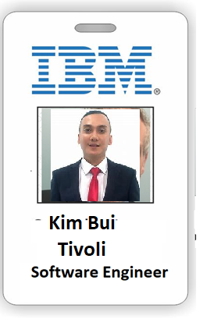
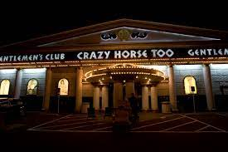
LAS VEGAS
WWI.KING
IPX
(41)
CIVIL CODE: Former United Nations Employee and IBM Chair
PHIL(KIM), JFK.BULLET(ATOM BOMB)(joe moon einstien)
LAMB OF GOD
Dan (Craigslist), Berkley Hottub, Emveryvill
Ford (gay) 2 sitting 1am, Berkely
Concert Tickest Mazda Fater(Steve) Sait Jose
Warfield / Crazy hourse
Are you at the
Crazyhourse?
Yes, outside
with donnovan

