Slide 1


UN
FBI

Slide 2
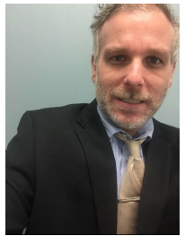
UN
FBI

Slide 3
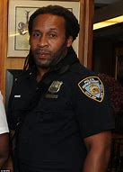




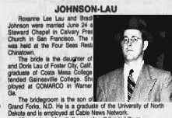

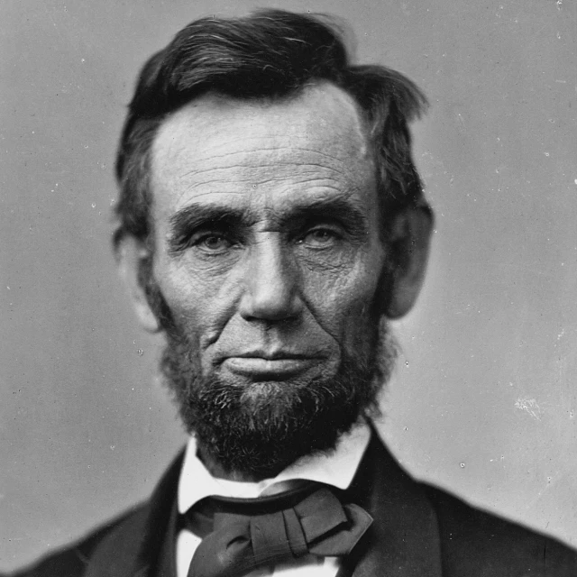
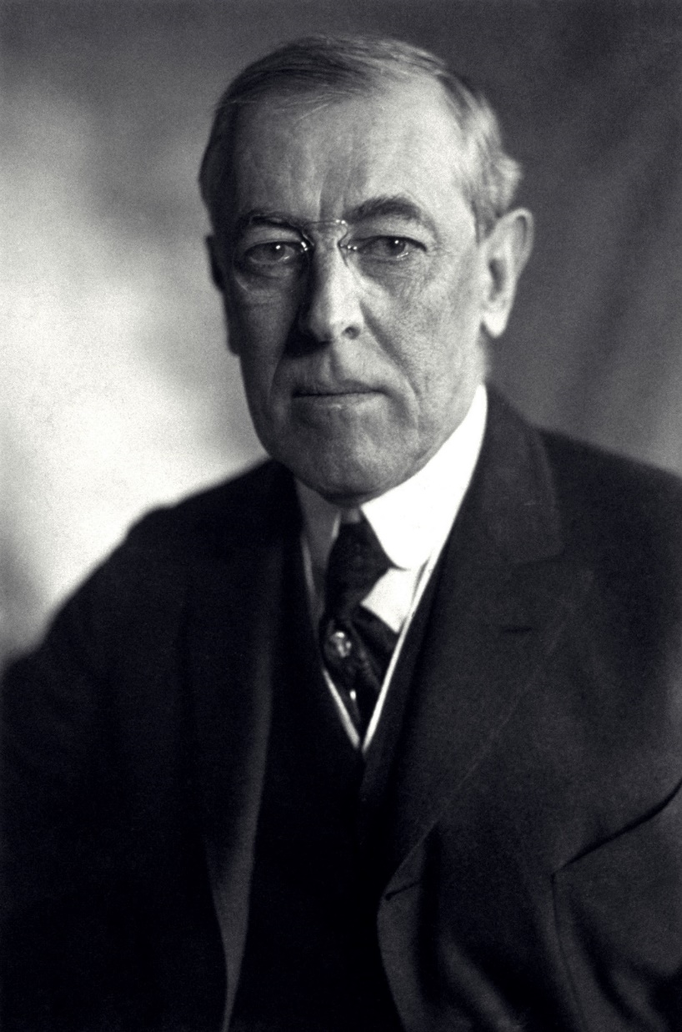
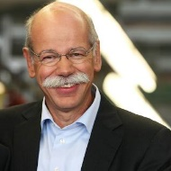

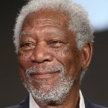
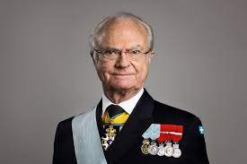
Uncle Sam
Bradly Johson Still reads all the books in Foster City at
The public Library
Pham, wwI
Water
Mr. Johnson a IBM
and Daimler AG Free
1D8723
1955 Damiler Ag
10980 Daimler AG
1986 Damiler Ag Mr. Free
nonPoliceTRX.nonPoliceDEA

Slide 4
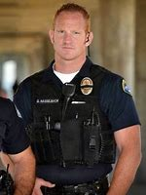
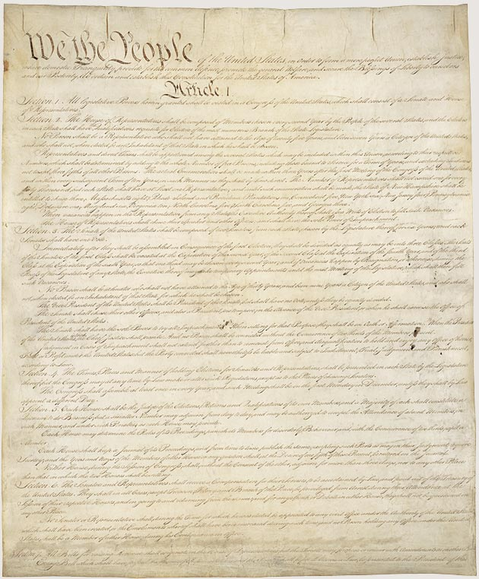
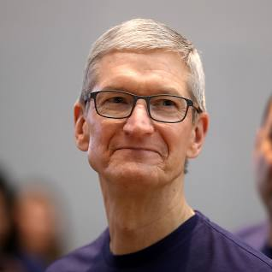
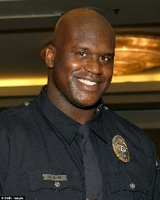
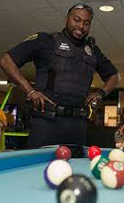
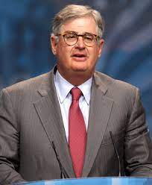
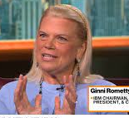
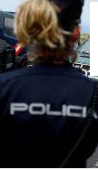
nonPoliceCalifornaiNA(apple,Atari)
I will puth garbae in your can
Water
UN
FBI
2000
2000 C Plus/Plus
2016
uncle
Brian/Esways Father
G.marx(Chertytree)
Ibm.dmielr.apple.yahoo
gary
PHIL
(assumed:kim hash,MR. FREE )
gary
stephanie

Slide 5
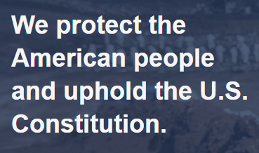


UN
FBI
Water
JFK.BULLET.MERKEL(mr.free)
ibm.daimler
ibm.daimler
Other:realplayer.facebook
attari.apple

Slide 6



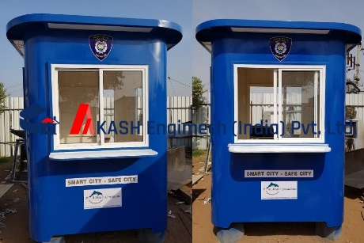


Ibm.daimler.nonPoliceDEA(high)
UN
FBI
WATER
Phil(Int.ipx)
Pizza Password
Uncle
FEAR THE TREE, PILKI
[x] no

Slide 7
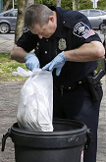
UN
FBI
ibm.daimler.nonPoliceDEA(high)
Water
nonPoliceCalifornaiNA(apple,Atari)
I will puth garbae in your can
ipx
nonPolizeiDeutshcNA
I want ot the garbabe in your can
Daimler ag
Phil(King.Worms ; magets)
Garabhce cans Kim Katy

Slide 8
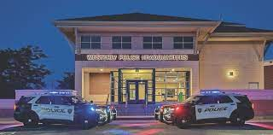

ibm.daimler.nonPoliceDEA(high)
UN
FBI
Water
2016
1965
2000
Foster City Library
Here a paint of cabin
CLOCK(quartz)
2000
Santa Cruz, Library
I can build a cabin, I have book
Where do I live?
Homelees Liason,
Where will he go?
nonPoliceCaliforniaNA(apple,Atari)
I will puth garbae in your can (tim)
Ciscomontoring appdyancmie( tshirt)
Gary

Slide 9
UN
FBI
Mathais:34, I tried Phil many tims with Atomboms and Kim Jun Un
As well as gave many drugs to your family.
I kill many poeople
Wolfgang von Geoteh Lux
1987
And gave children drugs, killed Kryal Fisher
for WWI german empire
in 2013
I sold IBM
a used car.
and was fired
as IBM

Slide 10
UN
FBI
I look like you
Father in law
Thoams Wiland
With my mustah
Form WWI and WWII
While still threaing
To kill your or rest of your
family
Tim cook did not make
homeless

Slide 11
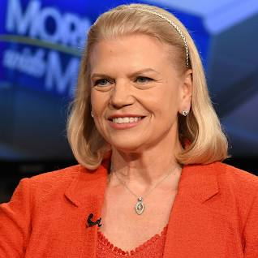
UN
FBI

