Slide 1


SELECT * FROM nonPoliceAccouting, nonPoliceHomicide where
nonPoliceAccouting.HOMICIDE = nonPoliceHomicide.HOMICIand nonPoliceAccouting.HOMICIDE=LUX

Slide 2
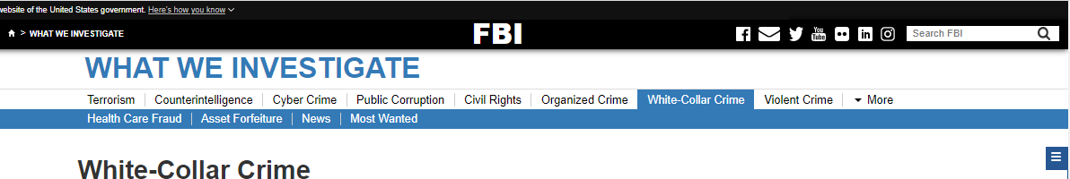

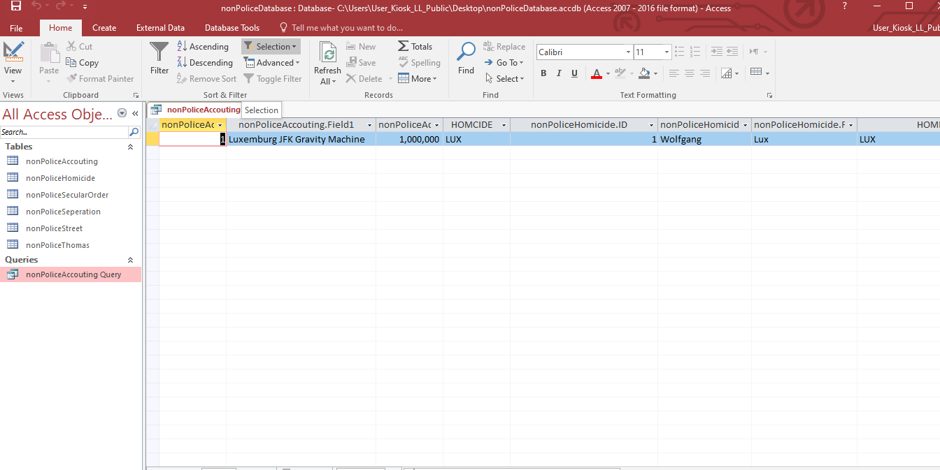

SELECT * FROM nonPoliceAccouting, nonPoliceHomicide where
nonPoliceAccouting.HOMICIDE = nonPoliceHomicide.HOMICIand nonPoliceAccouting.HOMICIDE=LUX

Slide 3
SELECT * FROM nonPoliceAccouting, nonPoliceHomicide where
nonPoliceAccouting.HOMICIDE = nonPoliceHomicide.HOMICIand nonPoliceAccouting.HOMICIDE=LUX

