Slide 1
Inversion Attacks

Slide 2
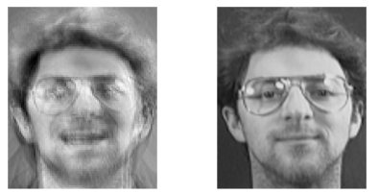
What is an Inversion Attacks ?
Reconnstruction of input data from Model
Example:
Model Inversion Attacks that Exploit Confidence Informationand Basic Countermeasures

Slide 3
Security concerns about Inversion attacks
Steal training data
Steal personal or confidential information
Example :
Medical Information about Persons
Reconstruct Pictures of People

Slide 4
What we want to do
Evaluate existing Inversion attacks on different models
Evaluate existing Inversion attacks on different datasets
If time is left :
Implement own Inversion attacks
Try defenses

Slide 5

Model Inversion
Based on the paper:
Matt Fredrikson, Somesh Jha and Thomas Ristenpart, “Model Inversion Attacks that Exploit Confidence Information and Basic Countermeasures”, CCS’15. Proceedings of the 22nd ACM SIGSAC Conference on Computer and Communications Security, October 2015, Pages 1322–1333.
Attacker has the white box access
Attacker has the white box access
Label is given
Label is given
X is optimized
Y = “cat”
X = [?,?,..?]

Slide 6
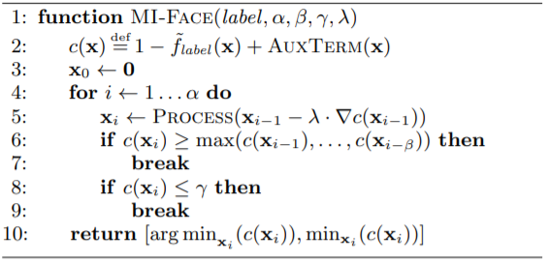

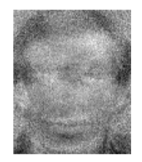
Algorithm
Gradient descent on X
Alpha, beta, gamma hyper-parameters
Training Sample
Inversion Image

Slide 7
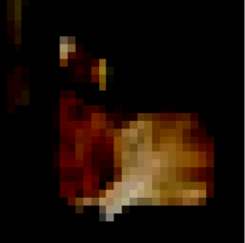

What we have achieved so far
A Cat in Cifar 10
A Cat after our attack

Slide 8
Roadmap
Week 2 (11-17):
more Inversion Attacks (1 per person )
Week 3 (18-24):
Finish Juypter Notebook
Start Paper
Week 4 (25-31):
Finish Paper

