Slide 1

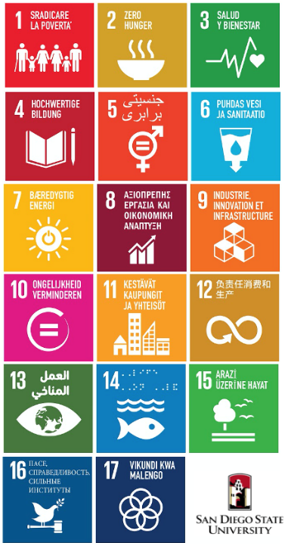
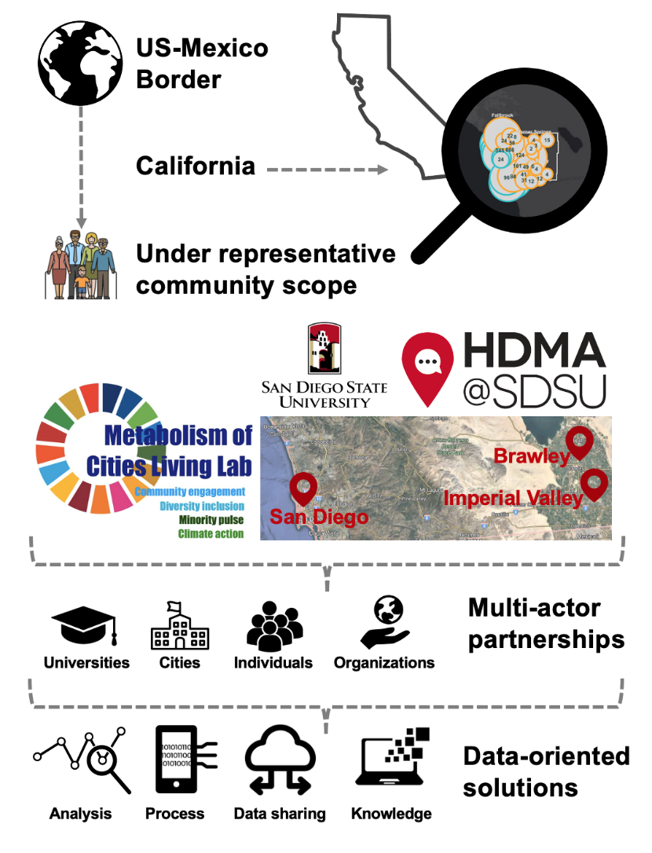

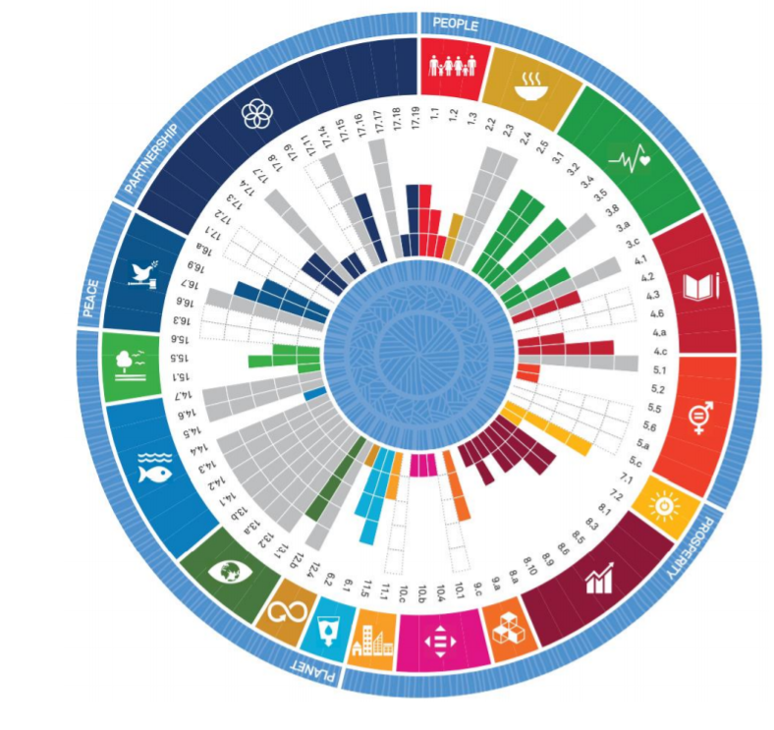
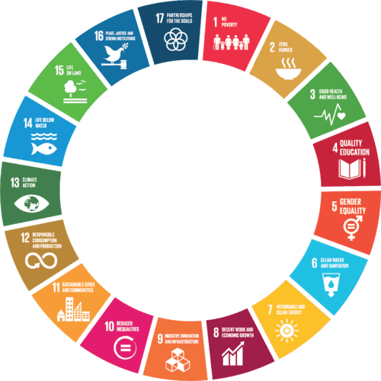
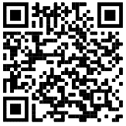



Metabolism of
Cities Living Lab
Ecological ceiling
Social foundation
Regenerative and distributive economy
*
*
*
*
*
Phase 1
Strengthening Diversity & Deliberation in Climate Adaptation Planning by viewing the city as a living organism through citizen science, data science, mathematical modeling & nature-based solutions.
SDSU as a Leader. “Empowering minorities in San Diego & Imperial County communities Post-COVID along the US-Mexico border while localizing the United Nations Sustainable Development Goals by 2030.”
* Phase 1 selected SDGs.
Find out more
About us
Our team
Donate
Visual material
Metabolism of
Cities Living Lab
Universidad Autónoma de Baja California
Notes:
Leverage data science for human impact

