Slide 1
gRPC Services
Luis Mejia
Sept 19th, 2019

Slide 2

What is gRPC?
gRPC is an RPC(Remote procedure Call) Framework created by google.
- gRPC makes it simple to call methods on a server application making it look like you are doing a local call in your client application.
Released in 2015 as Open Source
Notes:
Remote procedure calls
Es un protocolo para llamar métodos que corren en otra máquina o en otro proceso
Acrónimo recursivo

Slide 3
What is gRPC?
It is a high performance framework and Language agnostic.
Runs on top of Http2 as the transportation layer.
Supports streaming .
Notes:
Advantages of HTTP2
Concurrent downloads streamlined within a single TCP connection,
Enable browsers to fetch crucial assets of a web page first,
Optimize and improve HTTP header compression,
And integrating a feature known as 'Server Push' that allows the server to deliver crucial data before the browser asks for it.

Slide 4
Supported Languages
https://github.com/grpc
C++: follow the instructions under the src/cpp directory
C#: NuGet package Grpc
Dart: pub package grpc
Go: go get google.golang.org/grpc
Java: Use JARs from Maven Central Repository
Node: npm install grpc
Objective-C: Add gRPC-ProtoRPC dependency to podspec
PHP: pecl install grpc
Python: pip install grpcio
Ruby: gem install grpc
WebJS: follow the grpc-web instructions(uses a proxy)
Notes:
Grpc web uses envoy as a proxy

Slide 5
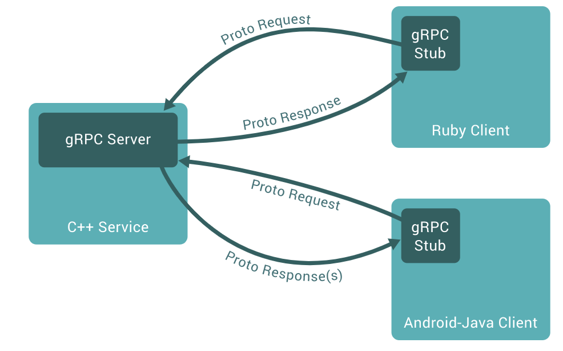
Comunication Client-Server
Notes:
Puedo tener clientes y lenguajes en diferentes

Slide 6
Protocol buffers (protobuf).
Protocol buffers are a mechanism to serializing structured data for communication protocols.
Protocol buffers are language-agnostic.
gRPC uses Protocol buffers as the contract definition for the services.
Protocol Buffers use the .proto extension and code can be auto generated out of their definition. (IDL)
Notes:
https://developers.google.com/protocol-buffers/docs/reference/proto3-spec
Bynary format serliaization
Avoid carácter encoding.

Slide 7
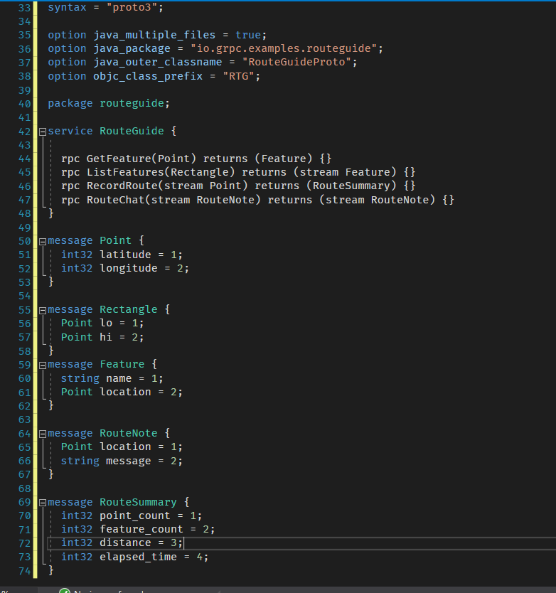
.proto files

Slide 8
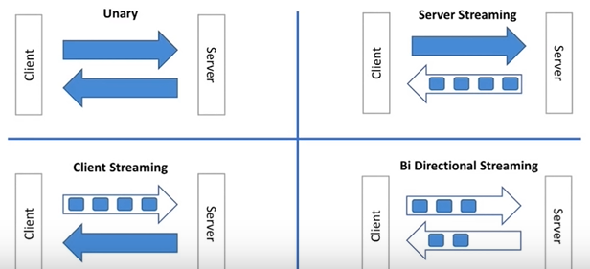
Communication Types
Unary
Server Streams
Client Streams
Bi-Directional Streaming.

Slide 9
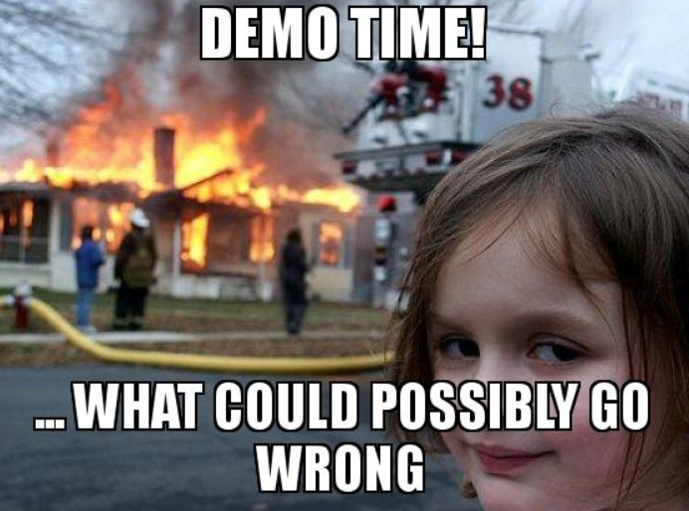
Demo

Slide 10
Common use scenarios
Connecting Microservices.
Connecting Mobile apps to backend services.
Replacing WCF or other SOAP based services

Slide 11
Authentication
Call Level
Bearer tokens
JWT
OAuth 2.0
OpenID Connect
Identity Server
WS-Federation
Channel Level
Client credentials

Slide 12
Advantages vs Disadvantages
+ High Performance
+ Duplex streaming
+ Autogenerated code
+ smaller payloads
+ We don’t care about serialization/deserialization
- Information transmitted is not human readable
- No browser support
- Debugging tooling (https://github.com/uw-labs/bloomrpc)

