Slide 1
Lint Softwares
Arnaldo Pina Neto

Slide 2

O que é?
- Deriva das “farpas” ou defeitos encontradas em tecidos feitos de lã.
https://en.wikipedia.org/wiki/Lint_(software)

Slide 3
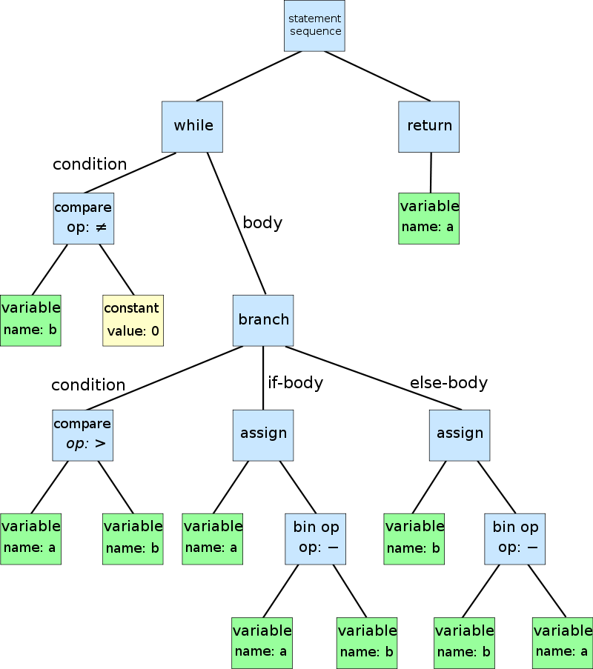
Parser
while b ≠ 0
if a > b
a := a − b
else
b := b − a
return a
.Abstract Syntax Tree
.Parse Tree
https://en.wikipedia.org/wiki/Abstract_syntax_tree

Slide 4
Motivação
Vídeo
https://www.youtube.com/watch?time_continue=145&v=SsoOG6ZeyUI

Slide 5
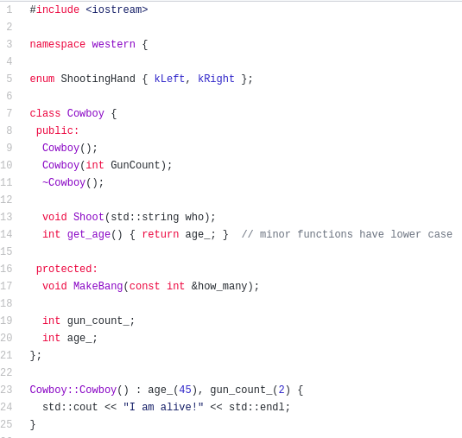
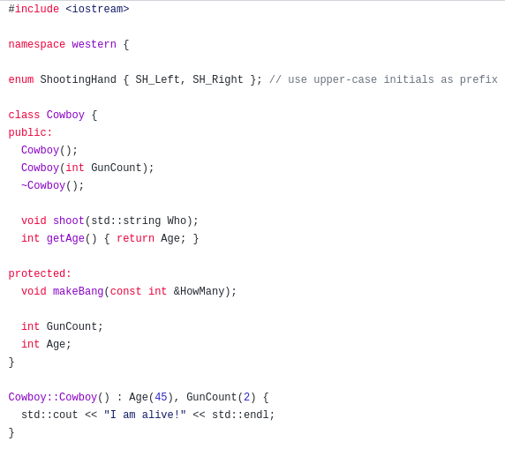
Styles: Google | LLVM
https://github.com/motine/cppstylelineup

Slide 6
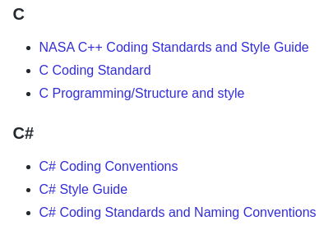
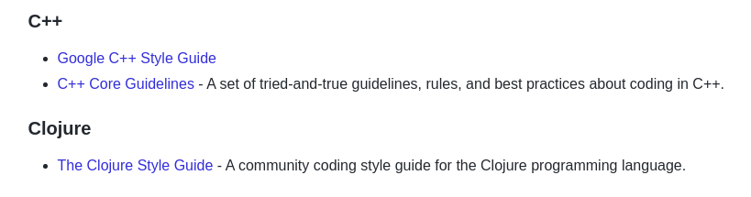
Motivação – Style Guides
https://github.com/Kristories/awesome-guidelines

Slide 7
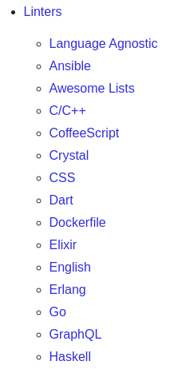
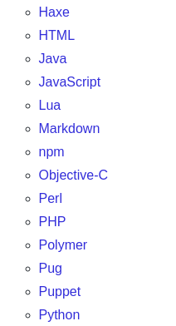
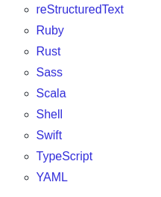
Exemplos – Linters Disponíveis
https://github.com/caramelomartins/awesome-linters#cc

Slide 8
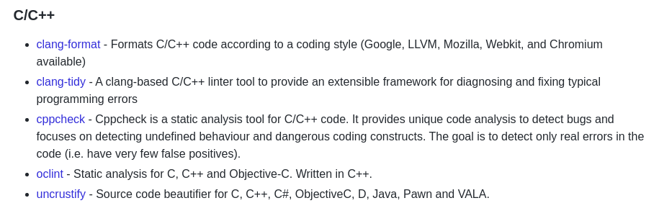
Exemplos – Linters em C / C++
https://github.com/Kristories/awesome-guidelines

Slide 9
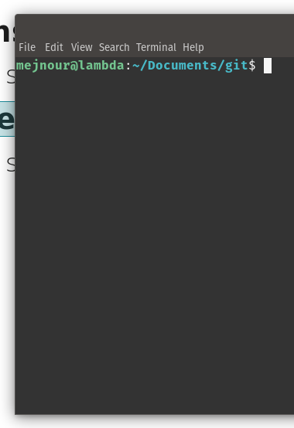
clang-format
Instalação:
  sudo apt install clang-format
Uso:
  clang-format -style=google -dump-config > .clang-format
  Clang-format -i -style=google file.cpp
Keys:
  google
  llvm
  chromium
  mozilla

Slide 10
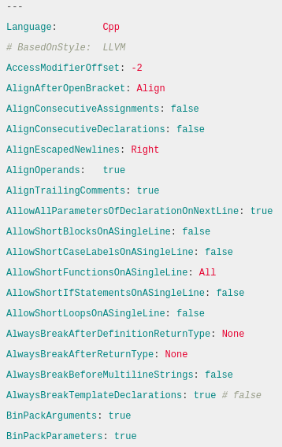
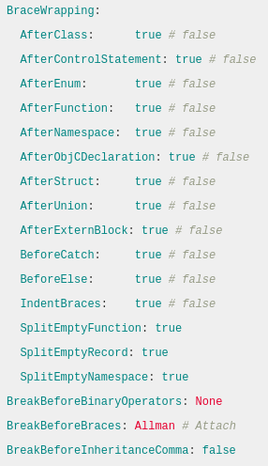
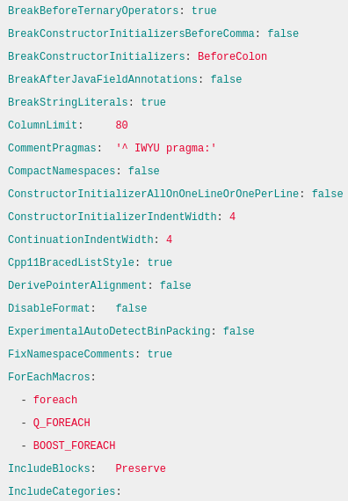
.clang-format
https://leimao.github.io/blog/Clang-Format-Quick-Tutorial/

Slide 11
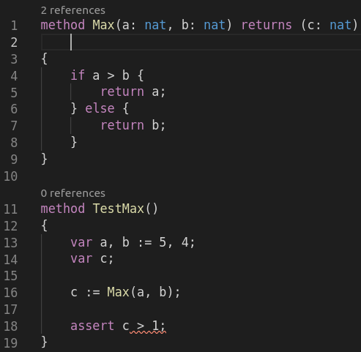
Dafny
method Max(a: nat, b: nat) returns (c: nat)
{
if a > b {
return a;
} else {
return b;
}
}
method TestMax()
{
var a, b := 5, 4;
var c;
c := Max(a, b);
assert c > 1;
}

Slide 12
Dafny
VSCode

