Slide 1
Regelmotorer
Johan & Pontus

Slide 2
Agenda
Introduktion
Drools
Labb

Slide 3
Introduktion

Slide 4
if (driver.getAge() < 25) {
premium *= 1.10;
}

Slide 5
if (driver.getAge() > 80) {
premium *= 1.05;
}

Slide 6
if (driver.getGender() == M) {
if (driver.getAge() < 25) {
premium *= 1.50;
} else {
premium *= 1.10;
}
}

Slide 7
if (car.getPrice() > 500_000) {
if (driver.getAge() < 25) {
premium *= 2.00;
} else {
premium *= 1.30;
}
}

Slide 8
if (driver.isNewCustomer()) {
premium *= 1.10;
} else {
premium -= 100 * driver.getHistory() .getDamageFreeYears();
}

Slide 9
if (driver.getAccomodation() == Accomodation.FLAT) {
if (driver.getAddress().getCrimeRate() < 0.01) {
premium *= 1.05;
} else if (driver.getAddress().getCrimeRate() >= 0.01 &&
driver.getAddress().getCrimeRate() < 0.10) {
premium *= 1.15;
} else if (driver.getAddress().getCrimeRate() >= 0.10) {
premium *= 1.25;
}
} if (driver.getAccomodation() == Accomodation.HOUSE) {
premium /= 1.05;
}

Slide 10
if (car.getCountryOfOrigin() == Countries.GB) {
premium *= 1.15;
} else if (car.getCountryOfOrigin() == Countries.DE) {
premium /= 1.15;
}

Slide 11
double calculatePremium(Driver driver, Car car) {
double premium = 1000.0;
if (driver.getAge() < 25) {
premium *= 1.10;
}
if (driver.getAge() > 80) {
premium *= 1.05;
}
if (driver.getGender() == M) {
if (driver.getAge() < 25) {
premium *= 1.50;
} else {
premium *= 1.10;
}
}
if (car.getPrice() > 500_000) {
if (driver.getAge() < 25) {
premium *= 2.00;
} else {
premium *= 1.30;
}
}
if (driver.isNewCustomer()) {
premium *= 1.10;
} else {
premium -= 100 * driver.getHistory().getDamageFreeYears();
}
if (driver.getAccomodation() == Accomodation.FLAT) {
if (driver.getAddress().getCrimeRate() < 0.01) {
premium *= 1.05;
} else if (driver.getAddress().getCrimeRate() >= 0.01 &&
driver.getAddress().getCrimeRate() < 0.10) {
premium *= 1.15;
} else if (driver.getAddress().getCrimeRate() >= 0.10) {
premium *= 1.25;
}
} if (driver.getAccomodation() == Accomodation.HOUSE) {
premium /= 1.05;
}
if (car.getCountryOfOrigin() == Countries.GB) {
premium *= 1.15;
} else if (car.getCountryOfOrigin() == Countries.DE) {
premium /= 1.15;
}
return premium;
}

Slide 12
Regelmotor
Indata
Utdata
Regler

Slide 13
Regelmotor
Fakta
Fakta
Regler

Slide 14
Användningsområden
Komplexa verksamheter
Många affärsregler
Affärsregler som ändras
Verksamhetsmänniskor behöver kunna läsa/skriva affärsregler

Slide 15
Programmeringsmodell
Deklarativ programmering
Regler och fakta
Inferensmaskin - expertsystem
When → Then

Slide 16
Programmeringsmodell
WHEN driver.age < 25
THEN
premium *= 1.10

Slide 17
RETE-algoritmen
Ett träd där löven är regler
Varje nod i trädet innehåller fakta
Gemensamma noder för flera regler
Noder kommer ihåg matchade fakta
Kräver mycket minne

Slide 18
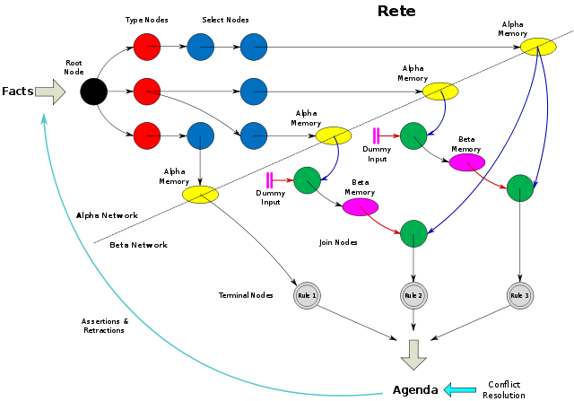

Slide 19
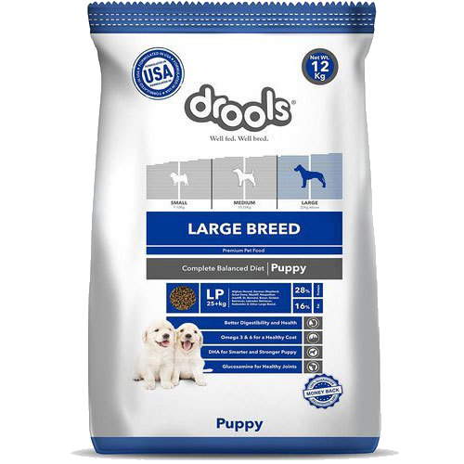
Drools?

Slide 20

Drools!

Slide 21
Drools
Highly efficient data model for storing and evaluating rules
Good performance for large rule systems
RETE/PHREAK algorithm

Slide 22
Drools
Rules are created in .drl files
Graphical interface also available (won’t talk about that today)

Slide 23
Drools IDE Support
Intellij only ultimate
Eclipse free

Slide 24
Drl file syntax
package
import
function //optional
query //optional
declare //optional
rule

Slide 25
package com.mejsla.drools
import org.slf4j.Logger

Slide 26
function int sizeOfList(List people) { return people.size(); }

Slide 27
query "people under the age of 21" person : Person( age < 21 ) end

Slide 28
declare Person name : String dateOfBirth : java.util.Date address : Address end

Slide 29
rule "Underage" when application : LoanApplication( ) Applicant(age < 21) then application.setApproved(false); update(application); end

Slide 30
Left-side of rule always in MVEL*
when $o : Order() $item : OrderItem( value > 100 ) from $o.items
* = MVFLEX Expression Language

Slide 31
Right-side of rule is MVEL or Java

Slide 32
rule "Underage" when application : LoanApplication( ) Applicant(age < 21) then insert new UnderageFact(); end

Slide 33
rule "Swedish applicant" when application: LoanApplication(country == “SE”) not UnderageFact(); then application.setApproved( false ); end

Slide 34
rule "Discount for orders that include US$100,00 of toys" when: $o : Order() $toysTotal : Number(doubleValue > 100 ) from accumulate( OrderItem( order == $o, type == "toy", $value : value ), sum( $value )
)

Slide 35
Easy Rules - ett alternativ
Enkel regelmotor
Helt Java-baserad
“If you like Drools, you will love Easy Rules!”
Inte samma prestanda

Slide 36
@Rule(name = "increase premium for young drivers")
public class IsDriverYoung {
@Condition
public boolean when(@Fact("age") int age) {
return age < 25;
}
@Action
public void then(Facts facts) {
Double premium = facts.get("premium");
premium *= 1.10;
facts.put("premium", premium);
}
}

Slide 37
Labb

Slide 38
Labb
Prova på Drools
https://github.com/mejsla/stepup-drools-2019
Instruktioner i README.md

Slide 39
Sammanfattning
Deklarativ programmering
Komplexa verksamheter med många regler
Affärsregler som ändras

Slide 40
Nästa steg
https://martinfowler.com/bliki/RulesEngine.html
https://www.drools.org
https://examples.javacodegeeks.com/ enterprise-java/jboss-drools-tutorial-beginners
http://www.jeasy.org

