Slide 1


SENTIMENTAL ANALYSIS OF DATA FOR STOCK PREDICTIONS MOVEMENTS
K. J. SOMAIYA INSTITUTE OF ENGINEERING AND INFORMATION TECHNOLOGY
Department of Computer Engineering
Academic Year 2017-18
BE Project- I Presentation by
- Juhi Gupta
- Anshul Jain
- Yash Bohra
Under the Guidance of
Prof. Sarita Ambadekar

Slide 2
OVERVIEW
Introduction
Machine Learning Intro
Data Gathering
Data Processing
Sentiment Analysis
Training Models
Challenges & their solutions
Most Difficult parts
Lessons Learned
Future Improvements
Screenshots
Conclusion

Slide 3
INTRODUCTION
Problem Statement: To predict stock prices based on news articles
EMH (Efficient Market Hypothesis) – Stocks can’t be predicted based on historical prices.
Stocks
  DJIA (Dow Jones Industrial Market Average) stock indices
News articles
  Show current market conditions about all the companies
Machine Learning
  Algorithms: MLP

Slide 4
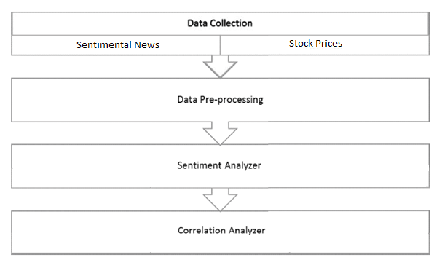
FLOW OF THE PROPOSED SYSTEM

Slide 5
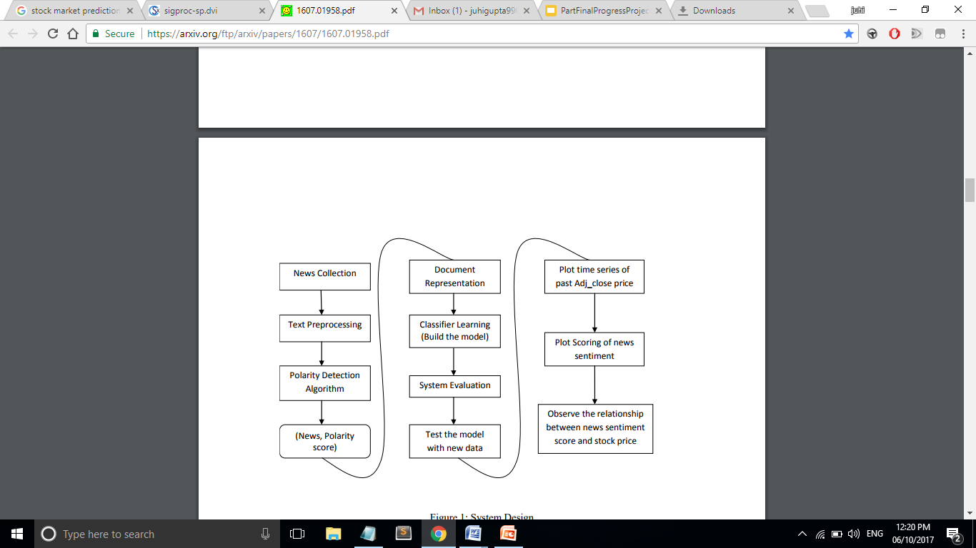
DETAILED DESIGN PLAN

Slide 6
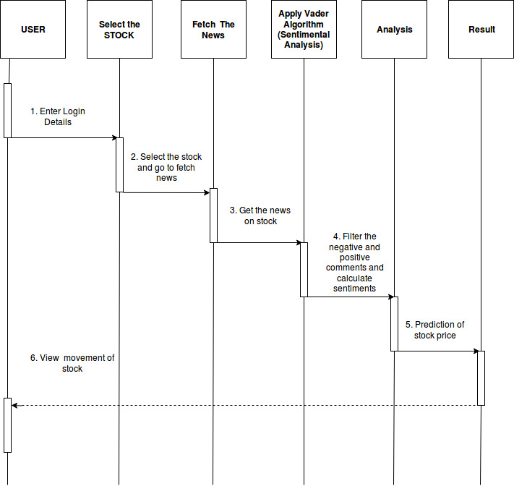
Go to website

Slide 7
DATA GATHERING
Stock Indices:
  DJIA index prices
  Snippet:
NY Times Archive API
  News articles
Both data are collected for 6 years i.e. 2011 - 2016

Slide 8
DATA PROCESSING
Articles Filtering:
  Sections included: 'Business', 'National', 'World', 'U.S.' , 'Politics', 'Opinion', 'Tech', 'Science', 'Health' and 'Foreign‘
  Approximately 400,000 articles selected from 1 Million articles
Merge stock indices closing price with articles
Storing (pickling) the data

Slide 9
MACHINE LEARNING INTRO
“Machine learning is concerned with computer programs that automatically improve their performance through experience.”​
    -- Herrbart Alexander Simon.​

Slide 10
SENTIMENT ANALYSIS
NLTK (Natural language toolkit) package
  It is a suite of open source Python modules, data sets and tutorials supporting research and development in Natural Language Processing
Vader Sentiment Analyzer (Valence Aware Dictionary and Sentiment Reasoner)
  A simple rule-based model for general sentiment analysis

Slide 11
TRAINING MODELS
Different models based on splitting of the data:
  Training data – 10 months, Testing data – 2 months (Repeat the process for 10 years of data)
Models applied:
  MLP

Slide 12
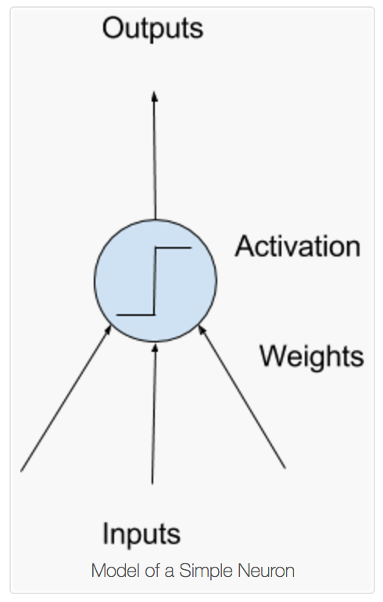
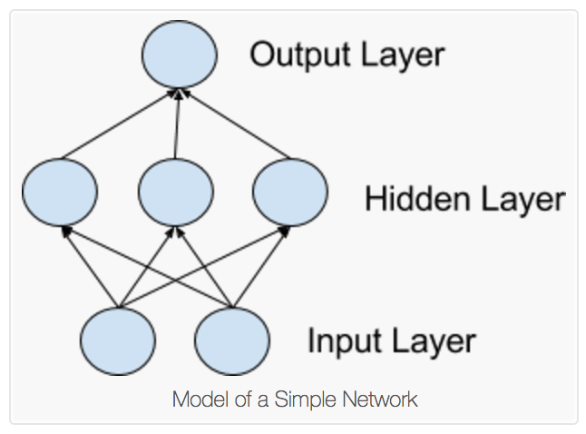
MULTI LAYER PERCEPTRON
(NEURAL NETWORKS)

Slide 13
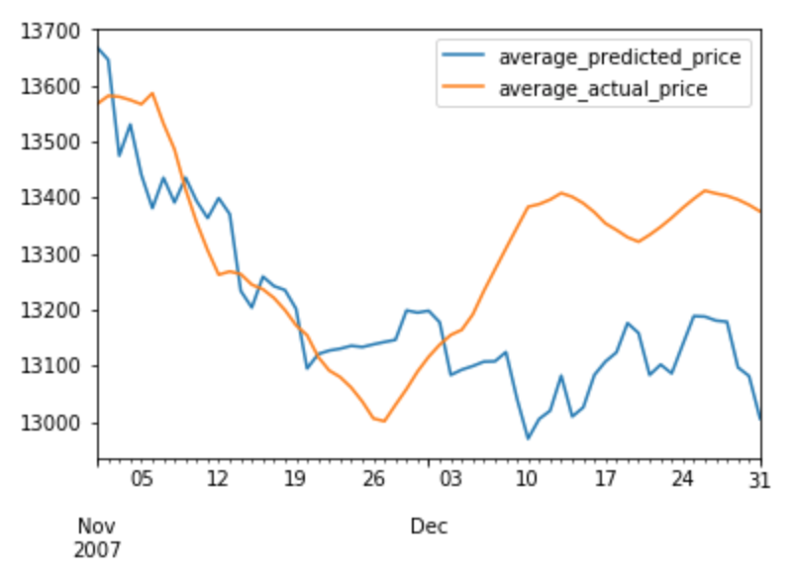
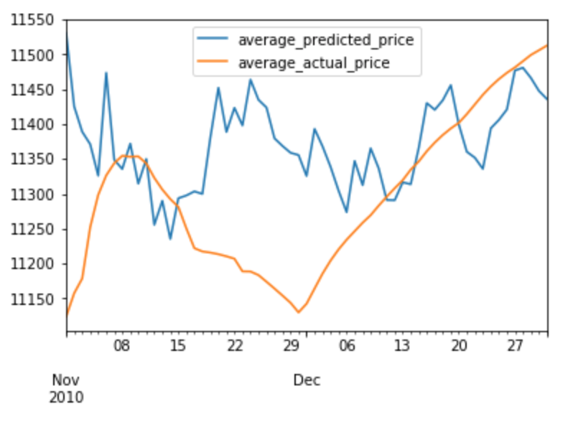
MLP CLASSIFIER
Code Snippet:
mlpc = MLPClassifier(hidden_layer_sizes=(100, 200, 100), activation='relu', solver='lbfgs', alpha=0.005, learning_rate_init = 0.001, shuffle=False)
mlpc.fit(numpy_df_train, train['prices'])
Method : For 10 Years
Training – 10 months
Testing – 2 months

Slide 14
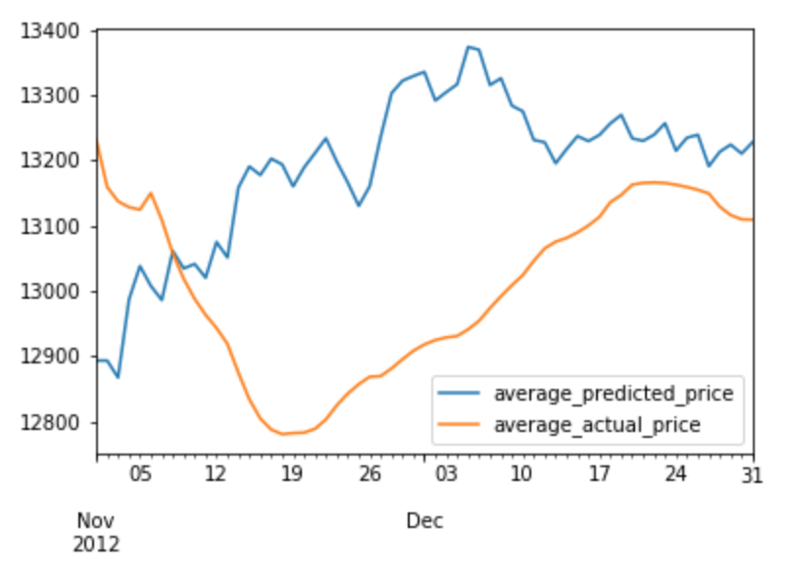
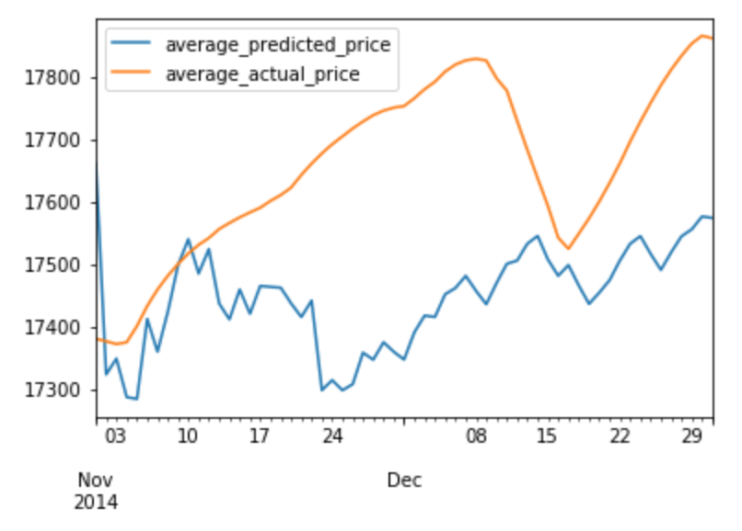
MLP CLASSIFIER (CONTINUED)

Slide 15
CHALLENGES AND THEIR SOLUTIONS
Missing stock indices – Interpolation
Filtering of the news articles – Skipping articles
High fluctuations in prices – Smoothing (Exponentially-weighted moving average – EWMA)

Slide 16
MOST DIFFICULT PARTS
Optimizing the results and applying machine learning algorithm
Data Gathering
Data preprocessing
Gather knowledge about the financial domain

Slide 17
LESSONS LEARNED
Any new technology/field could be learned given sufficient time and efforts
To collect comprehensive data without moving further ahead
Understanding roughly how the research process works
How to deal with financial data and sentiment analysis
How to apply machine learning models

Slide 18
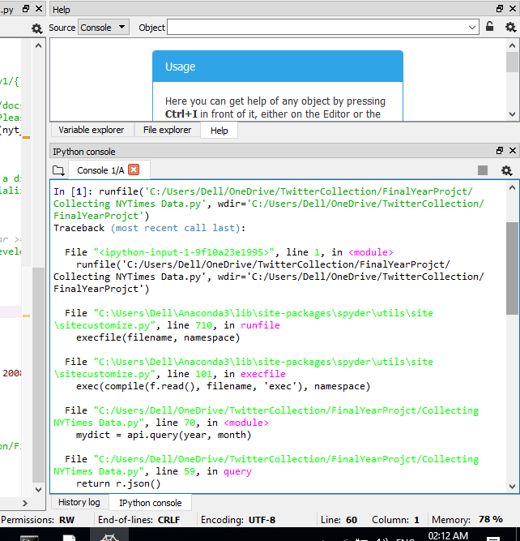
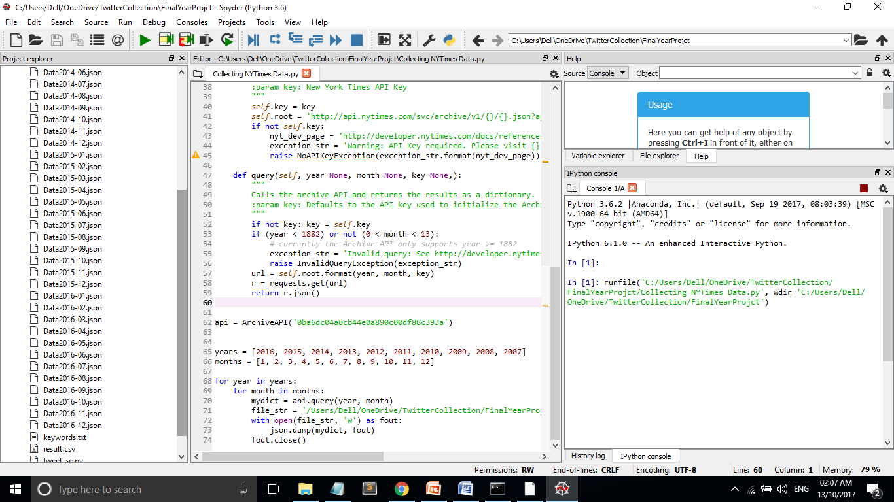
SCREENSHOT OF MODULE IMPLEMENTATION

Slide 19
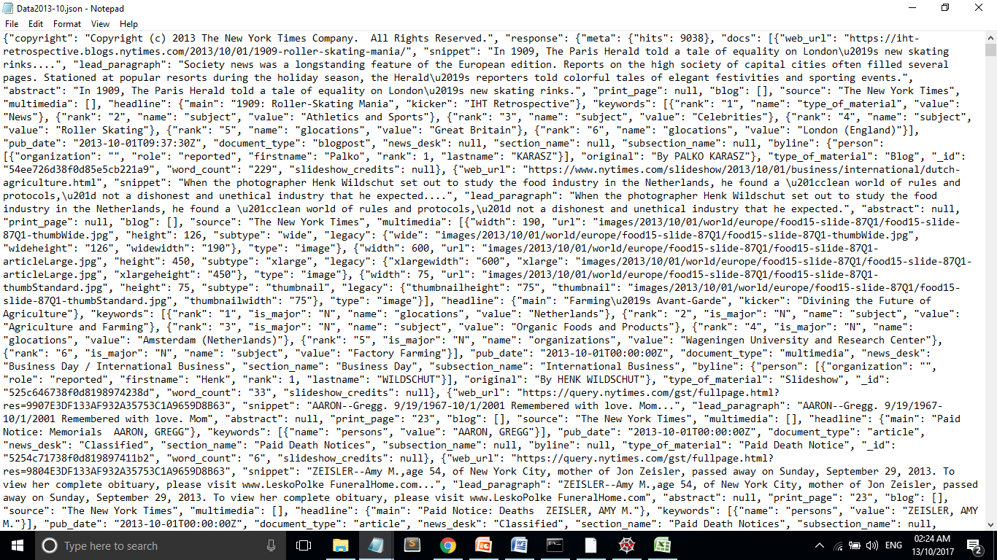

Slide 20
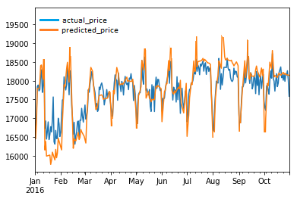

Slide 21
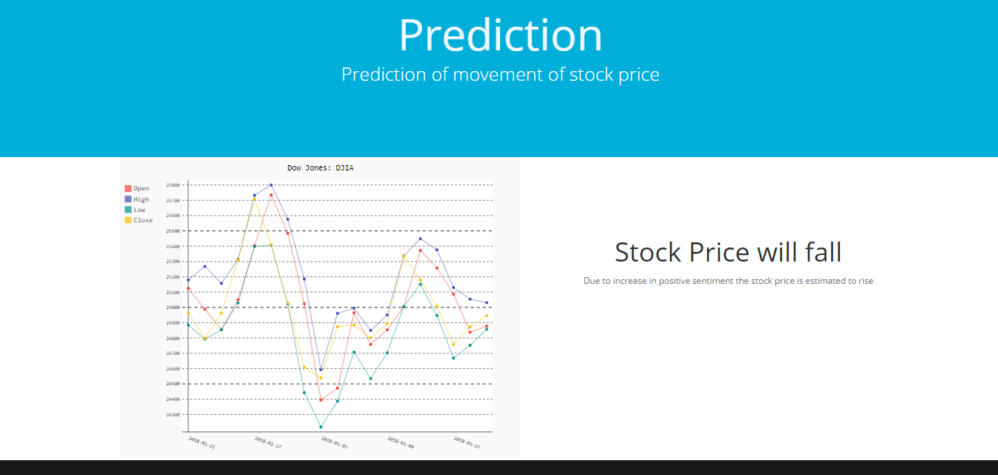

Slide 22
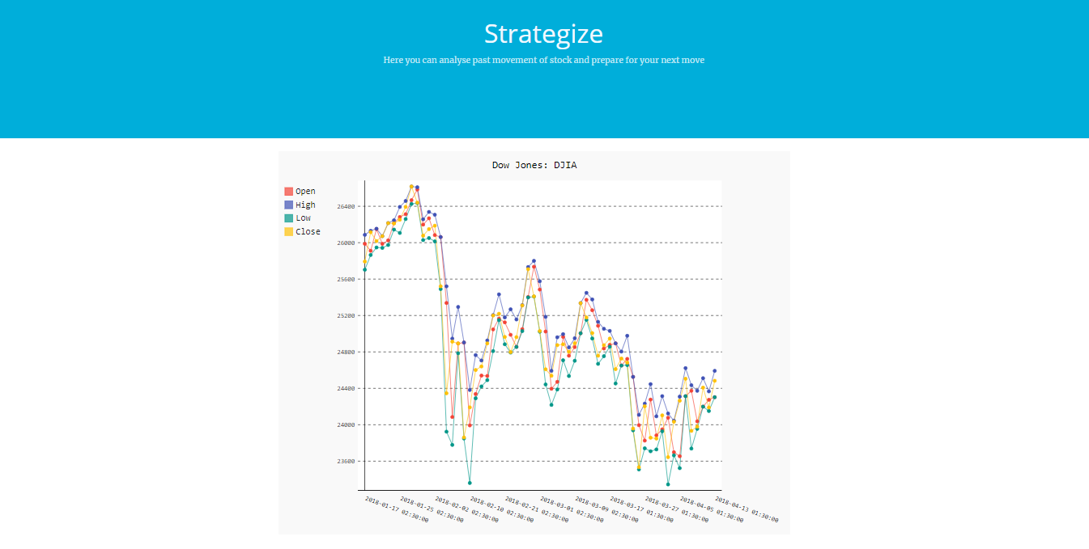

Slide 23
FURTHER IMPROVEMENTS
More optimized sentiment analysis specifically for news articles
We Could create a platform where data from multiple sources like news articles as well as tweets are considered.
More models should be taken into consideration for more precise prediction

Slide 24
PAPERS WE HAVE REFERRED
[1] Sentiment analysis of news articles for financial signal prediction” by Jinjian (James) Zhai Nicholas (Nick) Cohen and Anand Atreya
[2] Sentiment Analysis of Twitter Data for Predicting Stock Market Movements, International conference on Signal Processing, Communication, Power and Embedded System (SCOPES)-2016
[3] Graham Bowley, ”Wall Street Computers Read the News, and Trade on It”, New York Times, Dec 21, 2010.
[4] Stock Prediction Using Twitter Sentiment Analysis, Anshul Mittal Stanford University
[5] Twitter mood predicts the stock market, arXiv:1010.3003v1 [cs.CE] 14 Oct 2010
[6] Predictive Sentiment Analysis of Tweets: A Stock Market Application, Jasmina SmailovićMiha GrčarNada LavračMartin Žnidaršič
[7] Alec Go, Lei Huang and Richa Bhayani, ”Twitter Sentiment Analysis”, CS224N Final Report, 2009.

Slide 25
Thank You

