Slide 1
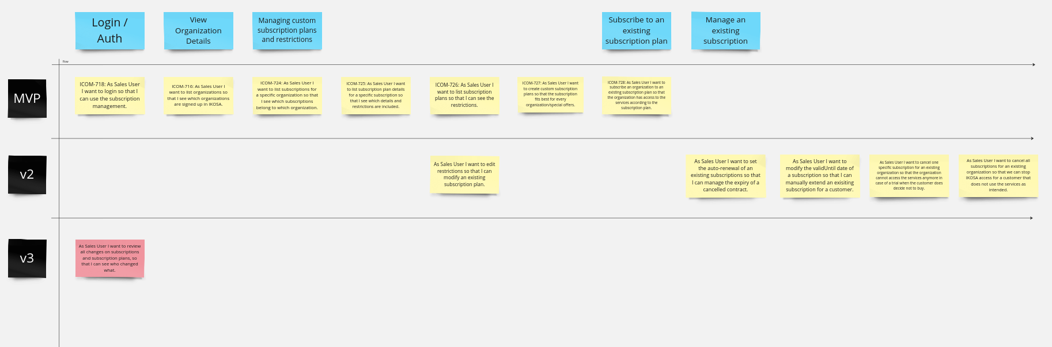
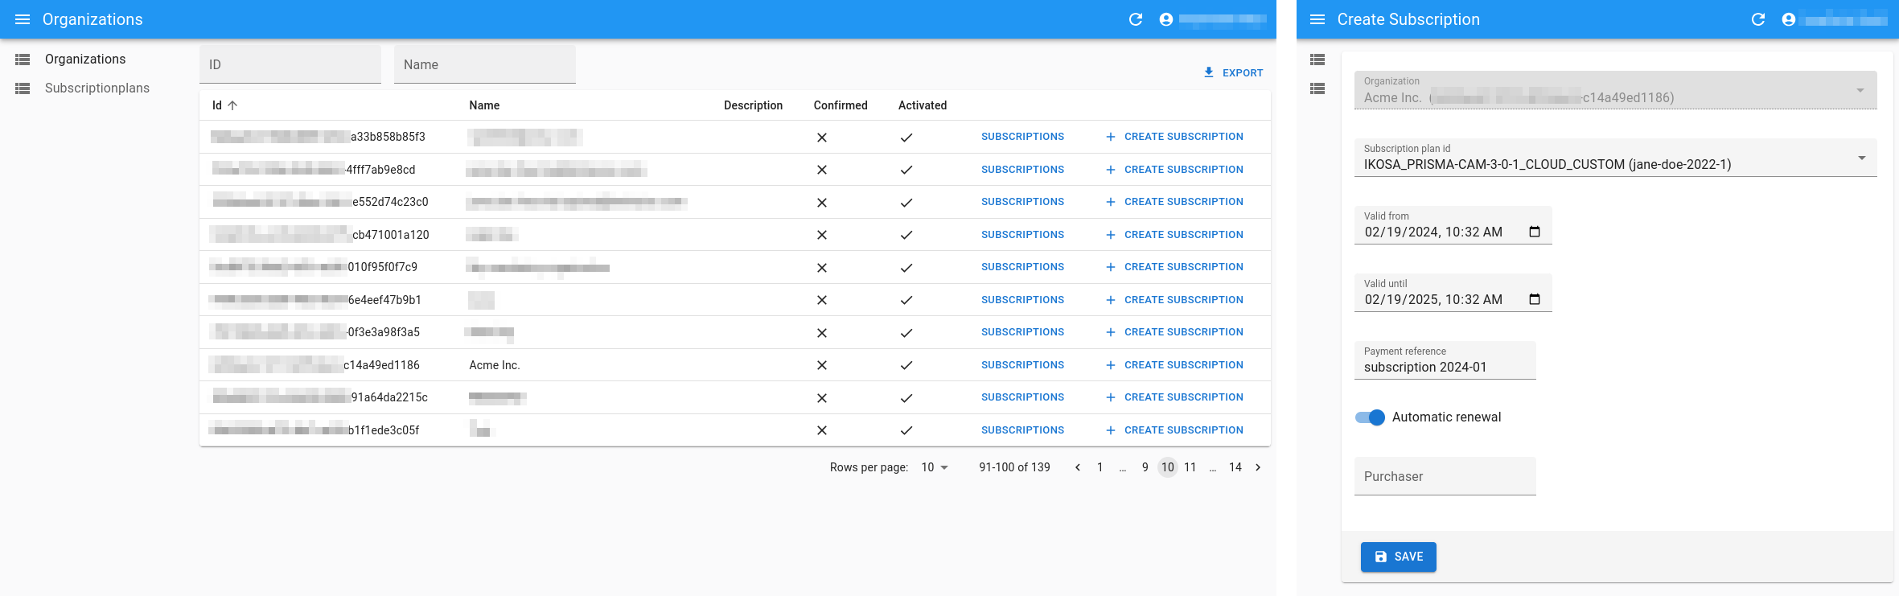
Degree program eHealth
KML Vision – IKOSA Platform Subscription Management Interface
Melina Kampitsch, BSc | Anna Kramer, BSc | Verena Pichler, BSc
Supervisor KML Vision: Jakob Hatzl, MSc
Supervisor FH Joanneum: DI Dr. Bernhard Neumayer
GENERAL INFORMATION & QUESTIONS
The business model of the IKOSA platform is based on a subscription model for various services. Users have access to these services via different subscription plans that they can subscribe to. The aim of the project was to develop an administration interface for the KML sales team to manage users' subscription plans.
RESEARCH DESIGN & METHODS
The requirements have been documented in a user story map and sliced into incremental releases using the online whiteboard tool Miro. The workflow has been designed with screen mockups using the online design tool Figma. Based on the requirements and workflows the required REST endpoints have been defined in the existing OpenAPI specification of the IKOSA backend API. Finally, after researching different implementation options, the react-admin Framework has been selected as the best option to implement the subscription management user interface.
RESULTS
Using the react-admin Framework, a single page application (SPA) was created to manage IKOSA subscriptions and subscription plans for organizations via pre-defined REST endpoints. The application accesses the backend via the previously defined REST endpoints and is secured via the OAuth 2.0 password flow.
Figure 1: The requirements for the subscription management interface organized in a user-story map
Figure 2: Table listing all organizations and forms for creating a new subscription for an organization
OUTLOOK
The goal of the project was to implement a minimum viable product (MVP) allowing to review subscriptions, create subscription plans and subscribe organizations to plans. Upcoming releases should enhance this feature set to allow editing existing subscription plans and manage existing subscriptions (extend, cancel, bulk-cancel).
References Miro | The Visual Workspace for Innovation (https://miro.com/index/)
Figma: The Collaborative Interface Design Tool (https://www.figma.com/)
OpenAPI Specification v3.0.2 (https://spec.openapis.org/oas/v3.0.2)
The OAuth 2.0 Authorization Framework (https://www.rfc-editor.org/rfc/rfc6749)
marmelab/react-admin: A frontend Framework for building data-driven applications (https://github.com/marmelab/react-admin)
KML Vision: Your Partner In Microscopy Image Analysis (https://www.kmlvision.com/)
eHealth (Master) Studiengangsleitung: robert.mischak@fh-joanneum.at

