Slide 1
<<Dr.Deepika Rani Sona, Dr.Mekala Manikanta ,Kakarla Akash Gangi Reddy,Dintakurthi Swaroop and Kondreddy Santhosh Kumar Reddy>> <<Dr.Mekala Manikanta and Kakarla Akash Reddy>> << School of Electrical Engineering, Vellore Institute of Technology,Vellore >>
3rd International Conference on Automation, Signal Processing, Instrumentation and Control (iCASIC 2024)
<<Paper ID-
186>>
Enhancing Sleep Tracking with Cough and Snore Recognition Using Edge Impulse Studio for Improved Respiratory Health Monitoring
Authors-Deepika Rani Sona, Rashmi Ranjan Das, Leela Praneeth Puli , Mekala Manikanta, Kakarla Akash Gangireddy , Swaroop Dintakurthi , Santhosh Kumar Reddy
School of Electronics Engineering
Vellore Institute of Technology,Vellore

Slide 2
Presentation Contents
Objective
Introduction
Brief Literature Review
Modelling / Design
Methodology
Experimentation / Simulation
Results and Discussions
Conclusion
Selected References

Slide 3
Objective
This research aims to develop a noninvasive sleep tracking system using Edge Impulse Studio to detect cough and snore sounds during sleep. By recognizing these respiratory events, the system enhances traditional sleep tracking, identifying potential respiratory health issues and improving overall sleep quality monitoring
Problem: Traditional sleep tracking lacks cough and snore detection, missing critical respiratory health insights.
Solution: Leverages Edge Impulse Studio to create an AI model for cough and snore recognition using the Google AudioSet Dataset.
Implementation: Deploys model in a tableside device for unobtrusive monitoring, avoiding discomfort from wearables.
Results: Achieved 93.1% accuracy in detecting coughs and snores, enhancing respiratory health insights without disturbing the user’s sleep.

Slide 4
Introduction
Sleep is essential for health and well-being, with respiratory events like coughing and snoring often indicating potential issues such as sleep apnea or other respiratory problems.
Traditional sleep tracking methods, however, typically require wearables or invasive setups, which can disrupt sleep and lack detailed respiratory insights.
This project introduces a noninvasive sleep tracking solution using Edge Impulse Studio to train a machine learning model that accurately detects coughs and snores in sleep audio data.
Leveraging accessible audio datasets and advanced processing techniques, this system enhances respiratory health monitoring without discomfort, providing a user-friendly, accurate way to track and improve sleep quality.

Slide 5
Literature Survey
Overview of Sleep Tracking and Respiratory Health Monitoring Research
Study | Methodology | Focus | Limitations
Smith et al. (2018) | Smartphone-based system using earphones to capture acoustic signals and accelerometer data | Identifying sleep events and disturbances via smartphone sensors | Limited sensor accuracy, discomfort due to earphone requirement
Jones et al. (2019) | Polysomnography (PSG) and pressure-sensitive mats | Detection of central sleep apneas in clinical sleep studies | Intrusive setup, impractical for long-term use
Li et al. (2020) | Snore classification using CNN and Mel-spectrograms | Differentiating between normal snoring and SAHS (Sleep Apnea Hypopnea Syndrome) | Requires large amounts of labeled snore data

Slide 6
Advances in Cough and Snore Detection Techniques
Study | Algorithm/Technique | Findings | Limitations
Zhao et al. (2021) | Spectral entropy with CNN and DNN combination | High accuracy in snore detection using Mel-spectrograms | Sensitive to ambient noise, requires robust noise filtering
Kim et al. (2021) | Audio-based cough detection using K-NN classifier | Effective detection of cough events using energy thresholding | Lower accuracy in environments with background noise
Sharma et al. (2022) | Spirometer with neural network for airflow analysis | Improved cough detection accuracy by analyzing airflow signal patterns | Expensive setup, not suitable for continuous monitoring

Slide 7
Machine Learning and Non-Invasive Techniques in Sleep Monitoring
Study | Machine Learning Model | Feature Extraction | Application
Huang et al. (2021) | CNN with Edge Impulse Studio | MFCC for cough and snore detection | Deployable model for real-time respiratory event tracking
Ahmed et al. (2020) | Neural networks with smartphone data | Mel-filterbank and DCT for feature extraction | Personalized snore detection via mobile application
Gonzalez et al. (2022) | Support Vector Machines | Audio segment classification with Mel spectrograms | Sleep monitoring via bedside sensors, non-invasive

Slide 8
Novelty
This study introduces a novel, noninvasive approach to sleep tracking by combining cough and snore detection within a single system, using Edge Impulse Studio for embedded machine learning.
Unlike traditional sleep monitoring, which often requires uncomfortable wearables or invasive setups, this solution leverages a bedside device to capture audio data during sleep.
The integration of advanced machine learning models, trained on a diverse audio dataset, provides high accuracy (93.1%) in detecting respiratory events, enabling real-time health insights without disrupting sleep.
This unique system simplifies sleep monitoring, offering a user-friendly, holistic method for assessing respiratory health, potentially marking an advancement in early detection and management of sleep-related health issues.

Slide 9
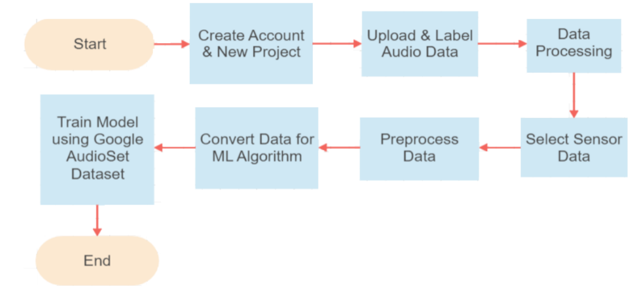
Modelling / Design
System Block Diagram for the recognition algorithm

Slide 10
The experimental setup involves using the Google AudioSet dataset, consisting of over 200,000 audio segments, from which cough and snore sounds are selected for training.
These audio samples are preprocessed using Mel-Frequency Cepstral Coefficients (MFCC) extraction, which involves steps like pre-emphasis, framing, FFT, and the application of a Mel filter bank.
The processed data is fed into a neural network model trained using Edge Impulse Studio, with parameters such as learning rate, batch size, and epoch count optimized for best performance.
The model’s performance is evaluated based on accuracy and confusion matrix metrics, achieving an accuracy of 93.1% for snoring and slightly lower for coughing due to dataset limitations.
Post-training, the model undergoes quantization-aware training (QAT) for efficient deployment on embedded devices, specifically targeting bedside systems.
The system is tested under real-world conditions, simulating natural sleep environments to assess the effectiveness of cough and snore detection.
The deployed system provides real-time data for respiratory health monitoring with minimal user intrusion.

Slide 11
Methodology
1. Data Collection & Preprocessing: Audio samples of coughs and snores are collected from the Google AudioSet dataset and labeled accordingly. Preprocessing involves feature extraction using Mel-Frequency Cepstral Coefficients (MFCCs), which capture the spectral characteristics essential for sound classification.
2. Model Training: The processed data is used to train a neural network model in Edge Impulse Studio, with Keras as the backend. The model architecture includes Conv2D layers for feature learning, Dropout layers to prevent overfitting, and a Dense layer for classification. Hyperparameters such as learning rate, batch size, and epoch count are optimized to achieve high accuracy.
3. Quantization & Optimization: Post-training, the model undergoes quantization-aware training to enhance computational efficiency without sacrificing accuracy. This step reduces the model size, making it suitable for deployment on low-power, embedded devices.
4. Deployment: The optimized model is designed for deployment on a bedside device, enabling non-intrusive sleep tracking. The device records audio during sleep and uses the model to detect respiratory events, logging data to provide health insights.

Slide 12
Simulation / Experimental Details
The experimental setup involves using the Google AudioSet dataset, consisting of over 200,000 audio segments, from which cough and snore sounds are selected for training.
These audio samples are preprocessed using Mel-Frequency Cepstral Coefficients (MFCC) extraction, which involves steps like pre-emphasis, framing, FFT, and the application of a Mel filter bank.
The processed data is fed into a neural network model trained using Edge Impulse Studio, with parameters such as learning rate, batch size, and epoch count optimized for best performance.
The model’s performance is evaluated based on accuracy and confusion matrix metrics, achieving an accuracy of 93.1% for snoring and slightly lower for coughing due to dataset limitations.

Slide 13
Post-training, the model undergoes quantization-aware training (QAT) for efficient deployment on embedded devices, specifically targeting bedside systems.
The system is tested under real-world conditions, simulating natural sleep environments to assess the effectiveness of cough and snore detection.
The deployed system provides real-time data for respiratory health monitoring with minimal user intrusion.

Slide 14
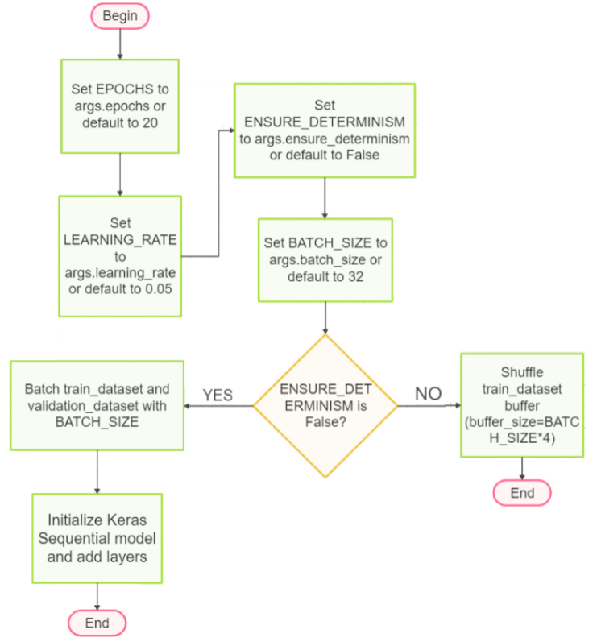
Flow diagram of the proposed system

Slide 15
Results & Discussion
The trained machine learning models for cough and snore detection achieved an accuracy of 93.1% for snoring and slightly lower for coughing, primarily due to the limited diversity of the cough dataset.
The snore detection model showed promising performance with fewer misclassifications, as evidenced by the confusion matrix, where correct classifications significantly outnumbered misclassifications.
The use of Edge Impulse Studio enabled seamless deployment to a bedside system, ensuring minimal user interference while providing accurate respiratory health monitoring. Additionally, the diversity of features and the optimization of preprocessing techniques contributed to improved model accuracy.
While the cough model's performance can be enhanced with a more diverse dataset, the overall results validate the system's potential for non-invasive sleep health tracking, offering users a more comfortable and efficient alternative to wearable devices.

Slide 16
Data used in training the snore model
Model | Total number of features | Accuracy in percentage
Using Edge Impulse studio and MFCC | 200 | 93.1%
Without using Edge Impulse studio and using WTCC | 26 | 93.57%

Slide 17
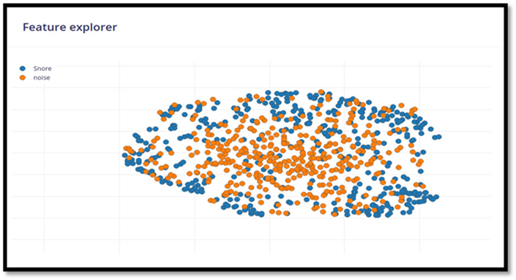
Generated features for snore

Slide 18
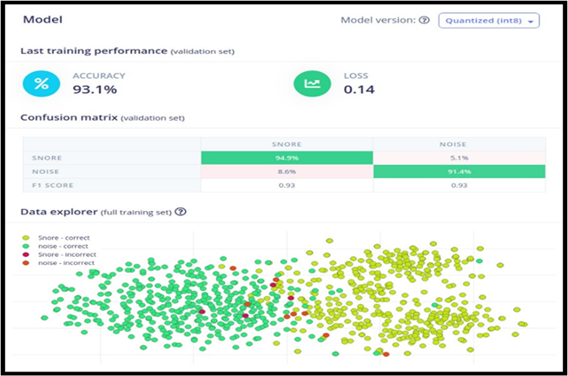
The model performance for snore

Slide 19
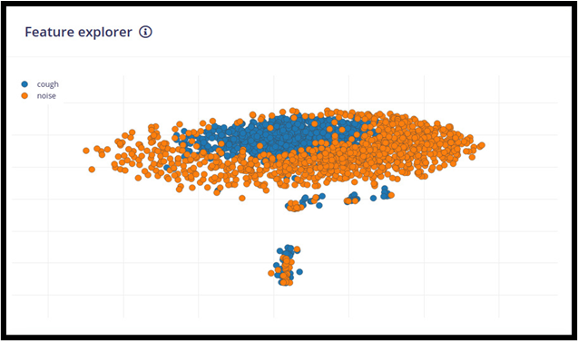
Generated features for cough

Slide 20
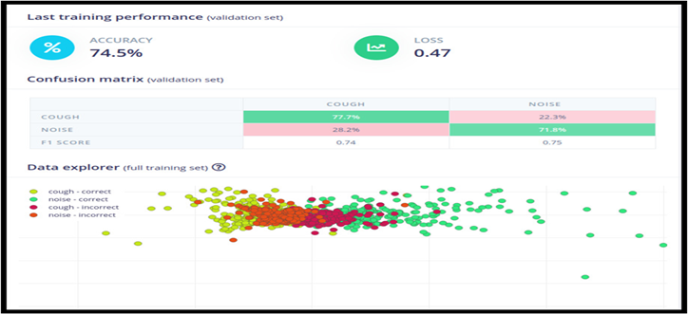
The model performance for cough

Slide 21
Conclusion
This research presents a novel, non-invasive approach to sleep tracking by integrating cough and snore detection using machine learning and Edge Impulse Studio.
The proposed system, which utilizes the Google AudioSet dataset and advanced signal processing techniques like MFCC, achieves high accuracy in recognizing respiratory events during sleep.
With a focus on comfort and ease of use, the system eliminates the need for traditional, intrusive wearable devices, offering a user-friendly solution for continuous sleep health monitoring. The results demonstrate the feasibility of deploying such models on embedded devices, enabling real-time tracking and early detection of respiratory issues.
This work lays the foundation for future developments in personalized, unobtrusive sleep monitoring systems, with potential applications in clinical settings and everyday health management.

Slide 22
References
[1] Ren, Y., Wang, C., Chen, Y., Yang, J., & Li, H. (2019). Noninvasive fine-grained sleep monitoring leveraging smartphones. IEEE Internet of Things Journal, 6(5), 8248-8261.
[2] Xu, S., Faust, O., Silvia, S., Chakraborty, S., Barua, P.D., Loh, H.W., Elphick, H., Molinari, F. and Acharya, U.R., 2022. A review of automated sleep disorder detection. Computers in Biology and Medicine, p.106100.
[3] Jiang, Y., Peng, J., & Zhang, X. (2020). Automatic snoring sounds detection from sleep sounds based on deep learning. Physical and engineering sciences in medicine, 43(2), 679-689.
[4] Jané, R., Fiz, J. A., Solà-Soler, J., Mesquita, J., & Morera, J. (2011, August). Snoring analysis for the screening of sleep apnea hypopnea syndrome with a single-channel device developed using polysomnographic and snoring databases. In 2011 Annual International Conference of the IEEE Engineering in Medicine and Biology Society (pp. 8331-8333). IEEE.
[5] V. R. Swarnkar, U. R. Abeyratne and R. V. Sharan, "Automatic picking of snore events from overnight breath sound recordings," 2017 39th Annual International Conference of the IEEE Engineering in Medicine and Biology Society (EMBC), Jeju, Korea (South), 2017, pp. 2822-2825, doi: 10.1109/EMBC.2017.8037444.

Slide 23
Thank you
Questions & Discussion

