Slide 1

FLIGHT FARE PREDICTION USING MACHINE LEARNING
INSTRUCTOR
Ram Hariharan
SUBMITTED BY:
Meghana Kandru
Lakshya Kumar
Srijan Srivastava

Slide 2
Overview
Visualizations
Preprocessing and Transformation
Model Results

Slide 3
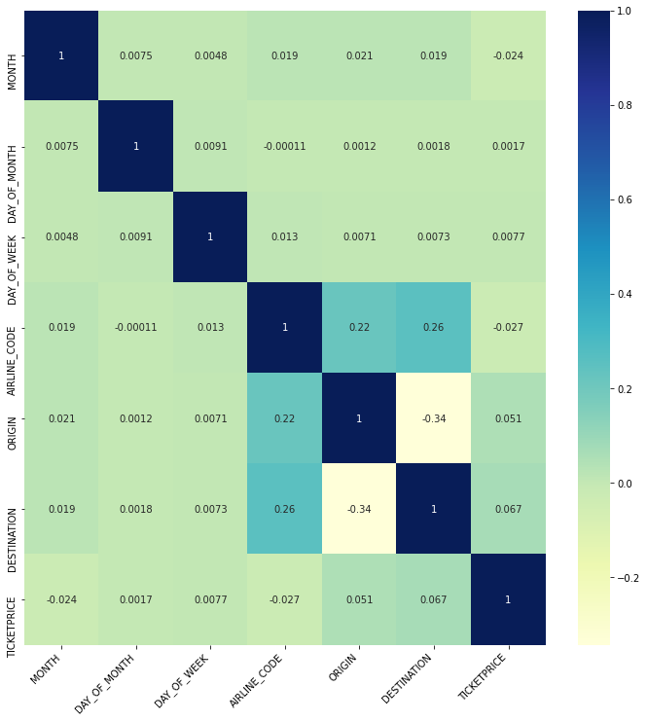
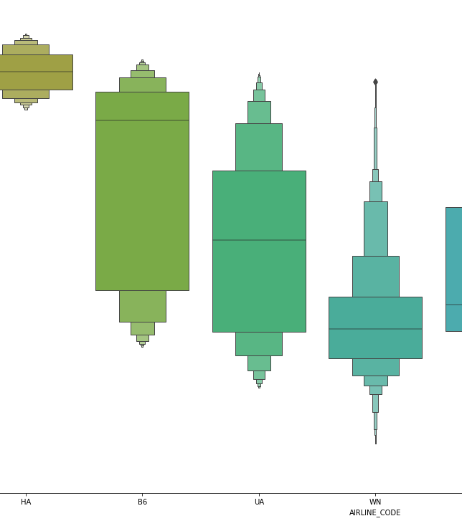
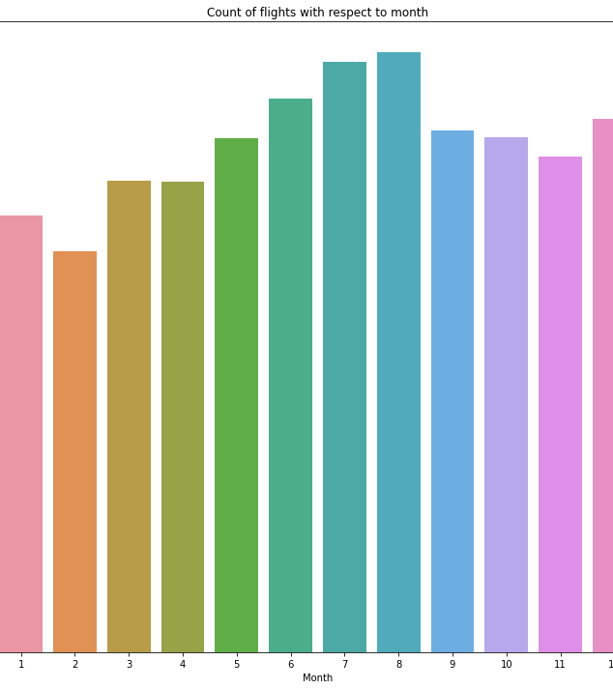
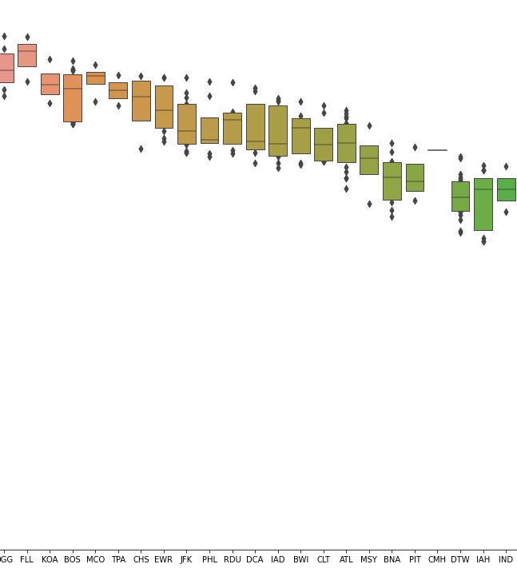
Visualizations
Heat Map
Ticket Price vs Airline
Flight Count vs Month
Ticket Prices vs Origin

Slide 4
Data was taken as input and since our aim was prediction, this use case was a regression problem with target as ticket prices and other features as predictors
Duplicates and null values were dropped, and columns were renamed to simplify and avoid confusion
Log transformation was performed on the data to eliminate data skewness and prevent any bias weighing in on ticket price predictions
Different models were fit with the training data and cross validation was performed to evaluate scores
Categorical data was converted into numerical using encoding
Data was split into training and test set with an 80/20 ratio
PREPROCESSING AND TRANSFORMATION

Slide 5
RESULTS
Model | Test Accuracy
Linear Regression | 0.934
OLS Regression | 0.934
Polynomial Regression | 0.934
Ridge Regression | 0.913
Random Forest | 0.888
Lasso Regression | 0.107

