Slide 1

Fraud Transaction Prediction for International Remittance
YASWANT MEKA

Slide 2

Introduction
Detecting fraud transactions is very crucial for safeguarding financial assets, preserving trust in financial systems, and protecting individuals and businesses from substantial economic losses and potential long-term reputational damage. It plays a pivotal role in maintaining the integrity and stability of the global economy by mitigating risks, ensuring regulatory compliance, and fostering a secure environment for online transactions. It is crucial for:
Financial Protection: Prevents significant financial losses for individuals and businesses.
Consumer Safety: Safeguards individuals from identity theft and unauthorized charges.
Business Reputation: Preserves trust by demonstrating a commitment to security.
Regulatory Compliance: Meets industry regulations for enhanced security measures.
Operational Continuity: Minimizes disruptions caused by fraudulent activities.
Global Impact: Addresses international financial crimes for a secure global ecosystem.
Cybersecurity Enhancement: Integral to overall cybersecurity efforts.
Adaptability: Evolves to stay ahead of emerging fraud tactics.

Slide 3

Motivation
The primary goal of our project is to create a robust algorithm specifically tailored for detecting fraud in the realm of International Remittance. Given the vast number of daily transactions occurring globally, especially in the context of cross-border money transfers, establishing an effective system to identify and address fraudulent activities is indispensable. Our focus centers on developing a predictive model that enhances the security of international financial transactions, ensuring a seamless and secure transfer of money over the internet across diverse regions worldwide.

Slide 4

Data
Within our dataset, encompassing 11,000 records and 23 variables, specific attributes emerge as pivotal for predicting fraudulent transactions. Notably, the geographic details of both senders and receivers offer valuable insights into transaction origins. Employee status, categorized as admin or non-admin, proves influential in gauging the likelihood of fraudulent activities. Transaction amounts, reflective of monetary values, serve as fundamental indicators of potential irregularities.
Timestamps, capturing transaction chronology, introduce a temporal dimension to our analysis. These variables collectively serve as the cornerstone of our fraud prediction model, and unraveling their interplay is imperative for effective risk assessment. Our focus is on delving deeper into these attributes, aiming to uncover intricate patterns and relationships. This exploration is essential for the development of a robust fraud detection model.
Our ongoing analysis involves a meticulous examination of the connections between these attributes, aiming to identify nuanced patterns indicative of fraudulent behavior. This approach enhances the accuracy and reliability of our predictive model, reinforcing our commitment to effective fraud detection.

Slide 5

Data Preprocessing
In preparing our dataset consisting of 11,000 rows and 23 features for analysis, thorough data preprocessing was pivotal. Our initial steps involved meticulous cleaning to address null values present across the features, ensuring a comprehensive and reliable dataset for analysis.
Moreover, recognizing the imbalance in our target variable, we implemented the Synthetic Minority Over-sampling Technique (SMOTE). This technique allowed us to effectively address the imbalance, generating synthetic samples to create a balanced distribution in the target variable. The utilization of SMOTE enhances the robustness of our dataset, ensuring a more accurate and representative model training process, thereby bolstering the reliability of our fraud detection model.

Slide 6
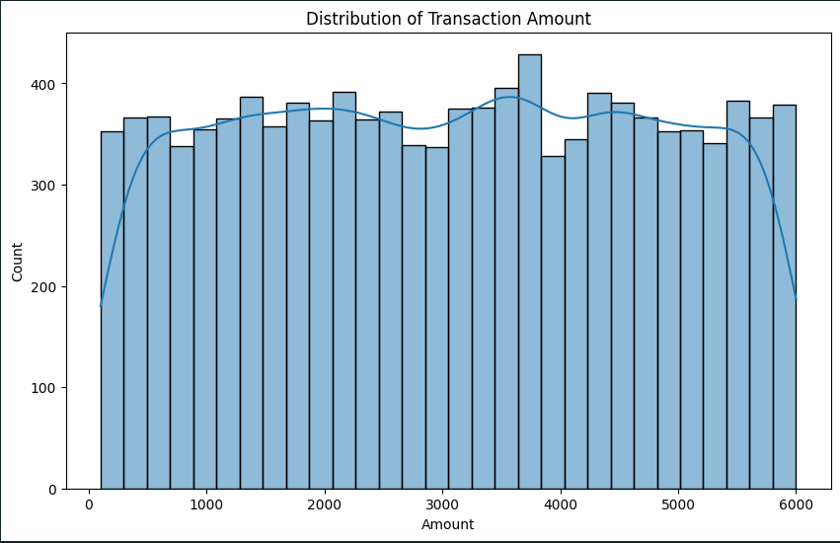
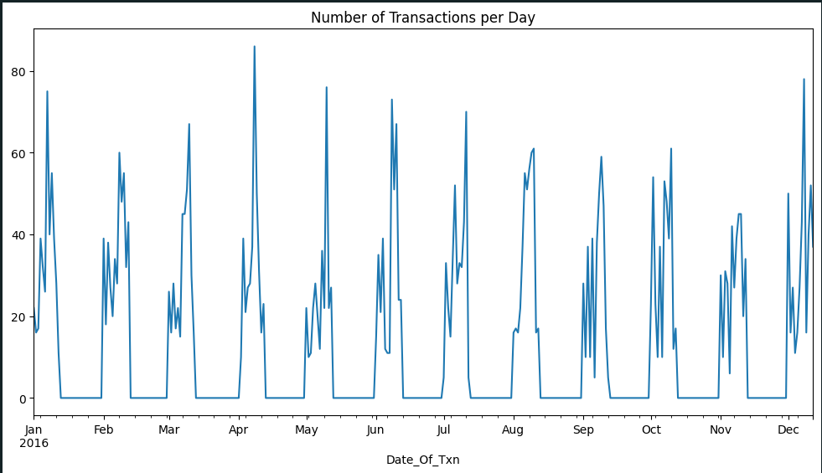
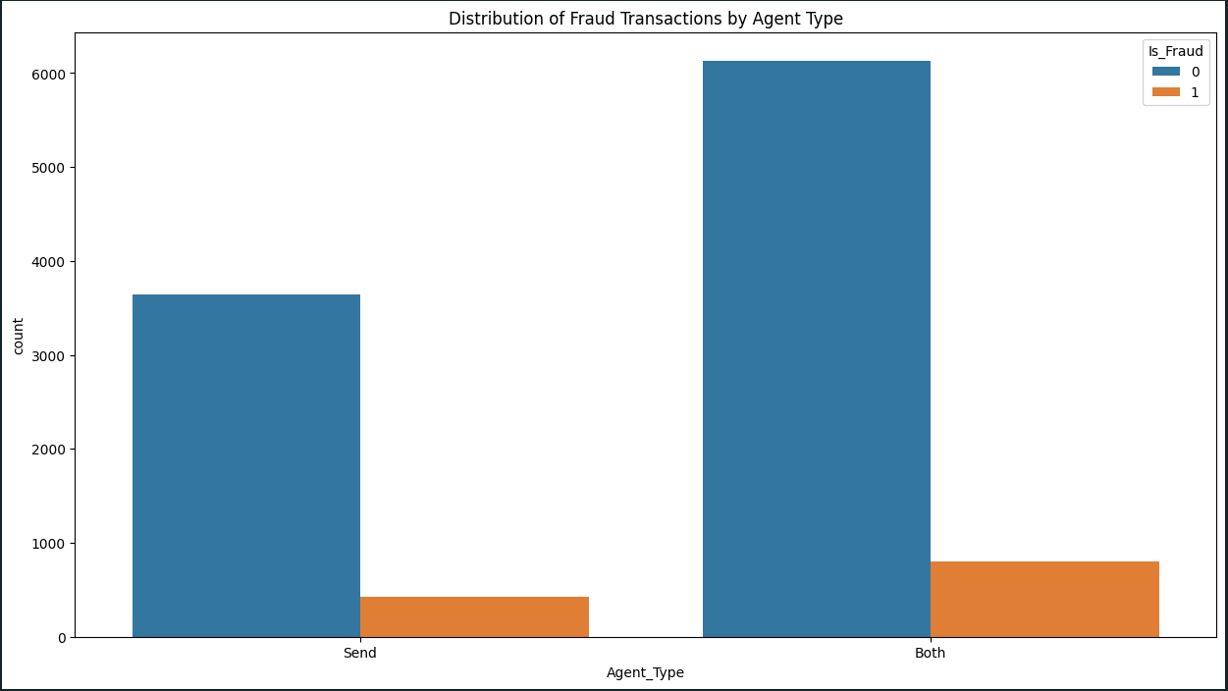
Exploratory Data Analysis (EDA)
In our dedicated exploration of the fraud transaction dataset, the Exploratory Data Analysis (EDA) phase has unearthed crucial insights that form the bedrock of our understanding of fraudulent patterns. Visualizations, carefully crafted to enhance interpretability, have played a pivotal role in conveying these findings.
Distribution Anomalies:
The first graph shows the distribution of Transaction amount across the dataset and the count of these amounts for all the transaction over the entire dataset.
Transaction Amount Patterns:
Visual representations of transaction amounts offer a nuanced view of the distribution, pinpointing potential irregularities and aiding in the identification of fraudulent outliers.
Temporal Trends in Fraud:
Time-series visualizations and chronological charts have allowed us to uncover temporal trends, discerning patterns that may indicate fraudulent behavior over specific time intervals.
Objective: The purpose of our Exploratory Data Analysis is not only to unveil key patterns but also to inform the subsequent stages of feature engineering and model development. These insights are integral to the construction of a robust fraud detection system tailored to the intricacies of our specific dataset.

Slide 7
Methodology
Our methodology for detecting fraud transactions is anchored in the robust Random Forest Classifier, a powerful ensemble learning algorithm known for its versatility and accuracy in classification tasks. The steps involved in our approach are as follows:
Feature Engineering:
Selected features from the dataset, emphasizing those identified during Exploratory Data Analysis as crucial in detecting fraudulent transactions.
Engineered additional features, where applicable, to enhance the model's ability to discern patterns.
Train-Test Split:
Partitioned the dataset into training and testing sets, with a focus on maintaining the integrity of the underlying patterns within the data.
Random Forest Classifier:
Implemented the Random Forest Classifier, an ensemble model that aggregates the predictions of multiple decision trees.
Leveraged the model's ability to handle non-linearity and capture intricate relationships within the data.
Model Training and Validation:
Trained the Random Forest Classifier on the training set, iteratively refining the model to optimize performance.
Validated the model using the testing set to ensure its generalizability to unseen data.
Evaluation Metrics:
Utilized a range of evaluation metrics such as accuracy, precision, recall, and F1 score to comprehensively assess the model's performance in identifying fraudulent transactions.
Objective: Our methodology combines the strengths of the Random Forest Classifier with meticulous data preprocessing, strategic feature engineering, and effective handling of imbalances to construct a robust fraud detection system. This approach aims to enhance the accuracy and reliability of identifying fraudulent transactions within our dataset.

Slide 8

Supervised Machine Learning (Random Forest Classifier)
In supervised learning, the Random Forest Classifier stands out as an ensemble learning method, harnessing the strength of multiple decision trees. This approach combines the predictions of numerous trees to enhance accuracy and generalization. Random Forest is known for its robustness against overfitting and provides insights into feature importance. The training process involves data splitting into training and testing sets, with each decision tree trained on a different subset of data. With applications ranging from finance to healthcare and marketing, Random Forest is a versatile tool for classification tasks. Its power lies in the collaborative decision-making of individual trees, making it suitable for both beginners and seasoned machine learning practitioners

Slide 9
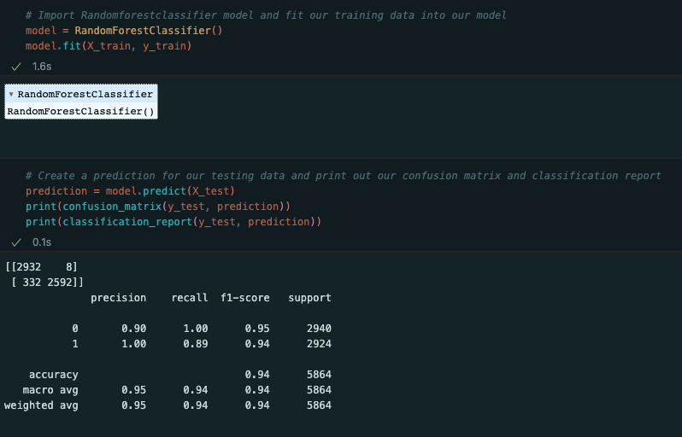
Model Evaluation and Results
Confusion Matrix:
True Positives (TP): 2592
True Negatives (TN): 2932
False Positives (FP): 8
False Negatives (FN): 332
Precision:
The precision for class 0 (non-fraud) is 0.90, and for class 1 (fraud) is 1.00.
Precision indicates the accuracy of positive predictions.
Recall (Sensitivity):
Recall for class 0 is 1.00, and for class 1 is 0.89.
Recall measures the model's ability to capture all positive instances.
F1-Score:
F1-score for class 0 is 0.95, and for class 1 is 0.94.
F1-score is the harmonic mean of precision and recall, providing a balanced measure.
Accuracy:
Overall accuracy of the model is 94%.
Key Points:
The model exhibits high precision and recall for both classes. The balanced F1-score indicates robust performance across both precision and recall. An overall accuracy of 94% showcases the model's effectiveness in correctly classifying instances.
Objective: These evaluation metrics underscore the Random Forest Classifier's proficiency in accurately identifying fraudulent transactions, with a balanced emphasis on precision, recall, and overall accuracy.

Slide 10

Model Comparision

Slide 11
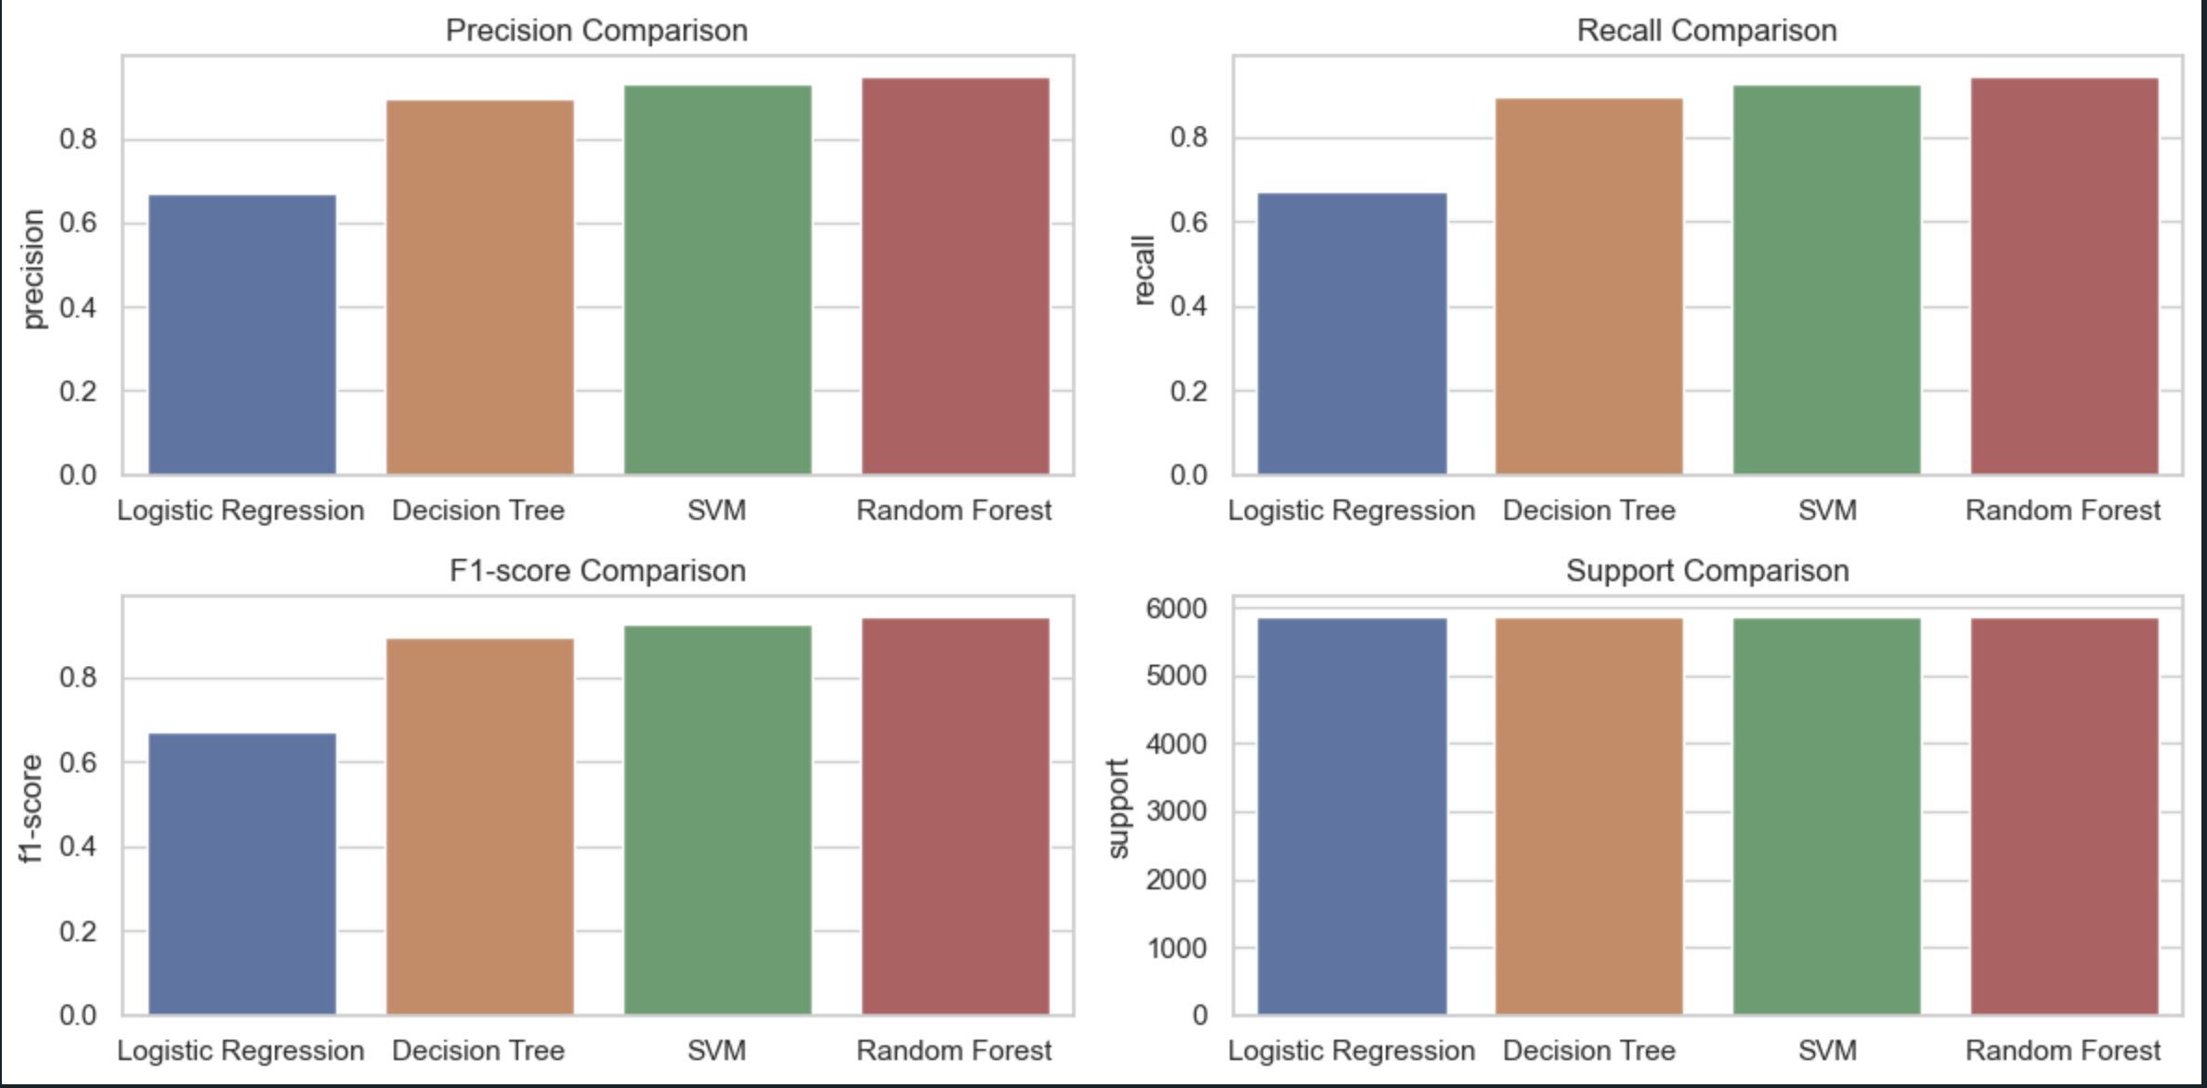
Different Model Comparision

Slide 12

Conclusion

Slide 13
Conclusion
In conclusion, our fraud transaction detection project has achieved significant milestones in enhancing the security and reliability of financial transactions. Key takeaways from our endeavor include:
Robust Fraud Detection Model:
The implementation of a Random Forest Classifier, coupled with meticulous data preprocessing and feature engineering, has resulted in a robust model for identifying fraudulent transactions.
Effective Handling of Imbalances:
By utilizing the Synthetic Minority Over-sampling Technique (SMOTE), we successfully addressed imbalances in the dataset, ensuring the model's proficiency in recognizing both non-fraud and fraud instances.
High Precision and Recall:
The model exhibits high precision and recall for both non-fraud and fraud classes, indicating a balanced performance in capturing fraudulent activities while minimizing false positives.
Accurate Predictions:
The overall accuracy of 94% underscores the model's effectiveness in making accurate predictions, instilling confidence in its real-world applicability.
Contribution to Security:
Our project contributes to the broader goal of enhancing the security of international financial transactions, safeguarding businesses and individuals from potential economic losses and reputational damage.
Continuous Improvement:
As the landscape of fraud evolves, our commitment extends to continuous improvement. Future iterations will involve staying abreast of emerging fraud patterns and incorporating advanced techniques for even more robust detection.

