Slide 1

RESUME SCREENING: TEXT CLASSIFICATION

Slide 2
TRAUMA :

Slide 3
INTRODUCTION:
Resume Process of filtering resumes to identify suitable candidates.
Crucial step in recruitment to manage large volumes of applications.
Aims to automate and streamline candidate selection process.
Enhances efficiency and reduces manual effort in HR tasks.
NLP techniques enable efficient extraction of relevant information from resumes.
Ensures that only qualified candidates proceed to the next stage of the hiring process.

Slide 4
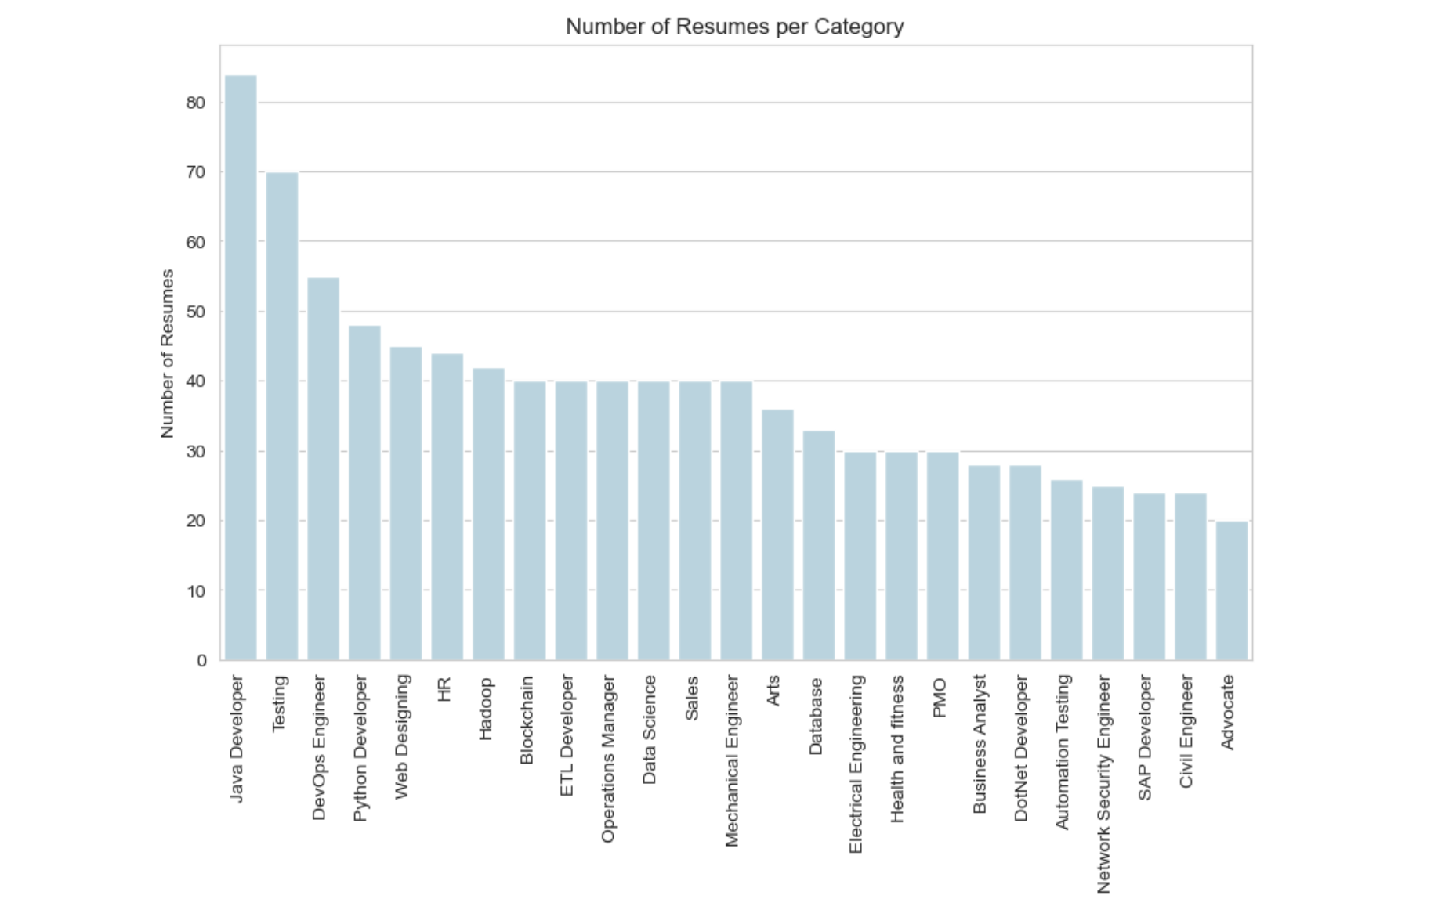
DATA :

Slide 5
METHODOLOGY:
DATA: Dataset: 'UpdatedResumeDataSet.csv'. Variables: Contains resumes and their respective categories.
DATA CLEANING: Removal of URLs, numbers, and punctuation marks. Standardizing text by converting it to lowercase. Eliminating extra spaces.
PROCESSING: Encoding categories using Label Encoder for classification. Train and Test Split: 80% for training, 20% for testing.
CLASSIFIERS USED:
Logistic Regression
Linear SVC
KNN
Naive Bayes

Slide 6
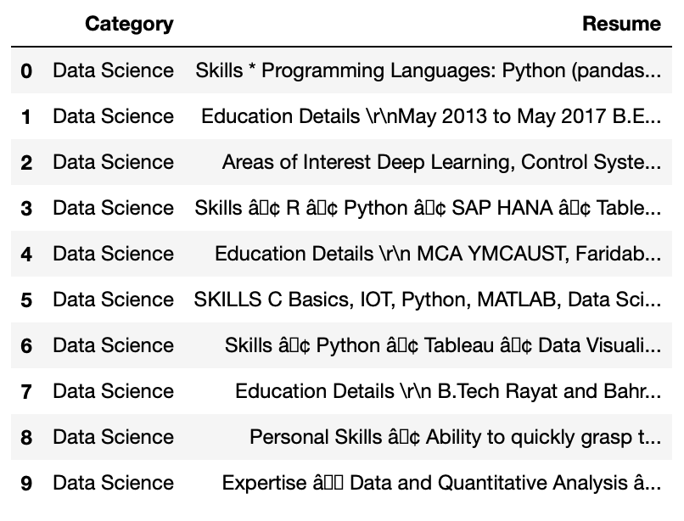
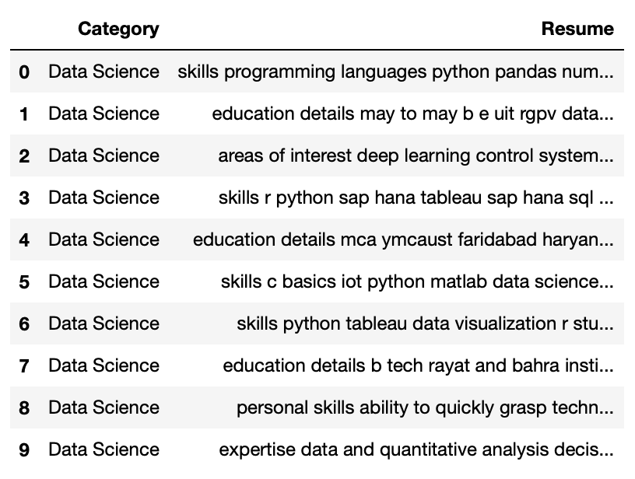
DATA CLEANING :
Text Standardization: Converting all text to lowercase and corrects special misformatted characters, ensuring uniformity in the dataset.
Irrelevant Content Removal: Eliminates URLs, numbers, punctuation marks, and extra spaces, focusing solely on relevant textual information for analysis.
Uncleaned
Cleaned

Slide 7
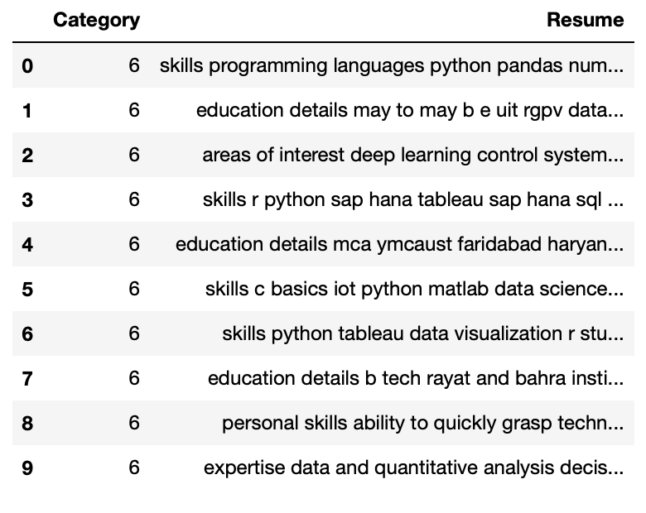
PROCESSING AND MODEL TRAINING :
Label Encoding:
Transformed categorical labels into numerical values using LabelEncoder.
Data Splitting:
Divided the dataset into training and testing sets using train_test_split.
Model Preparation:
Prepared the data for model training by encoding categories and splitting into train/test sets.

Slide 8
PIPELINE WORKFLOW - TEXT VECTORIZATION :
Utilizes scikit-learn's Pipeline to combine data preprocessing and model training steps into a single workflow.
With pipelines - easily experiment - different preprocessing techniques and model architectures by modifying components within the pipeline.
This promotes reproducibility of results and allows for efficient comparison of different model configurations.
Employs TfidfVectorizer to convert text data into numerical vectors using the TF-IDF technique, preserving import and word frequencies while downscaling common ones.

Slide 9
ACCURACY OF FOUR CLASSIFERS USED:
Logistic Regression: 0.99 (before tuning) and 0.99 (after tuning)
Linear SVC: 0.99 (before tuning) and 0.99 (after tuning)
KNN: 0.99 (before tuning) and 0.98 (after tuning) [KNN is sensitive to the choice of hyperparameters, such as the number of neighbors (k) and the distance metric]
Naive Bayes: 0.98 (before tuning) and 0.99 (after tuning)

Slide 10
WHY SVC ?
Optimal for Small Datasets: With just 963 rows of data, Support Vector Classification (SVC) was chosen for its capability to deliver robust performance even with limited training examples.
Categorical Job Description: The dataset comprises 25 unique job categories, each associated with a job description, making SVC an apt choice for its ability to handle multi-class classification tasks effectively.
Sparse Data Efficiency: Given the sparse nature of text data, where each job description represents a high-dimensional feature space, SVC's efficiency in handling such data structures was deemed advantageous for this task.

Slide 11
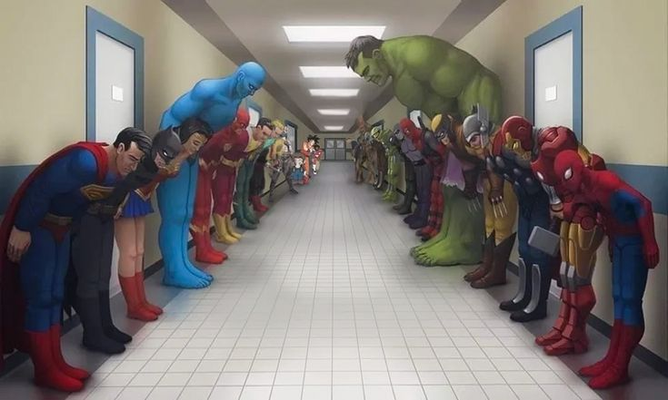
WHY NOT LOGISTIC REGRESSION, KNN, NAIVE BAYES ?
Logistic Regression: Not suitable for non-linear relationships.
K-Nearest Neighbors (KNN): Computationally expensive for large datasets.
Naive Bayes: Assumes independence among features, which may not hold true for job descriptions.
*SVC

Slide 12
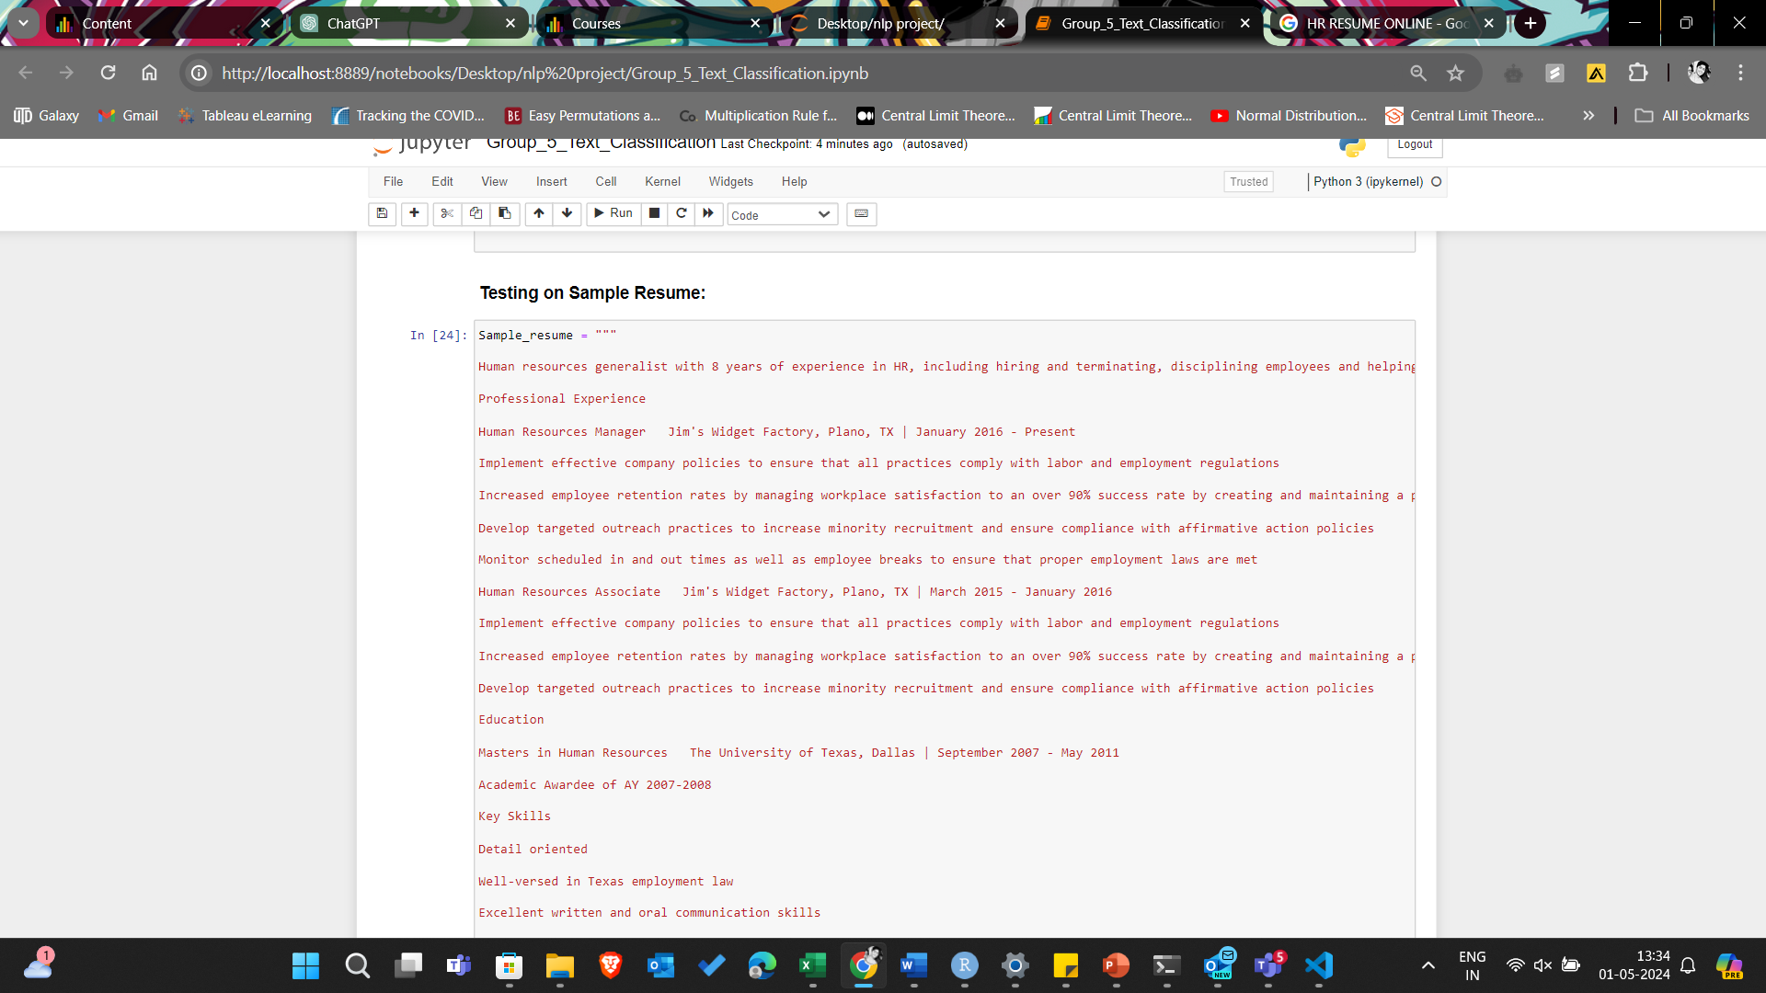
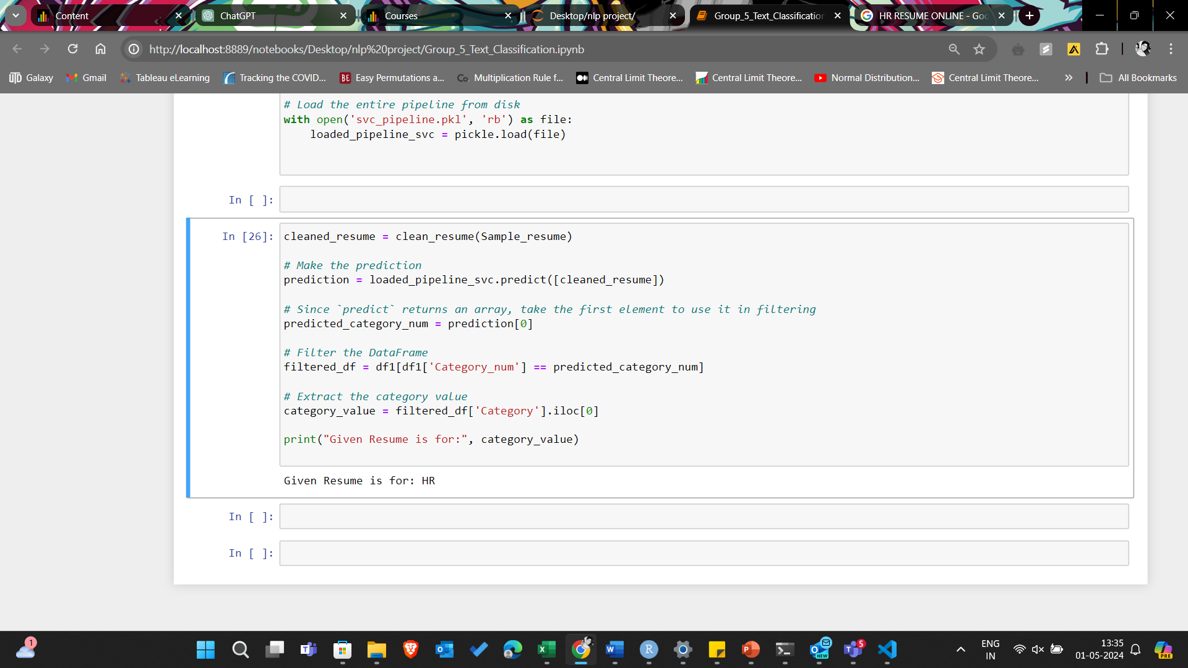
SAMPLE RESUME :

Slide 13

AFTER THERAPY :
You before knowing how resume screening works !
You after this presentation !

