Slide 1
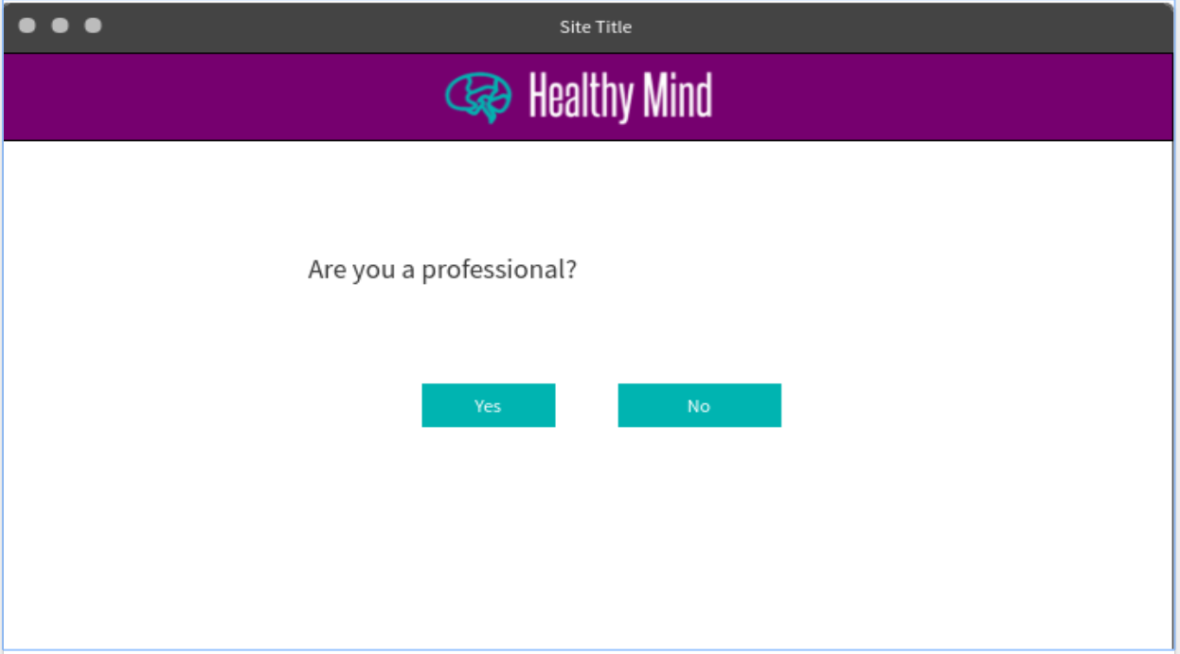
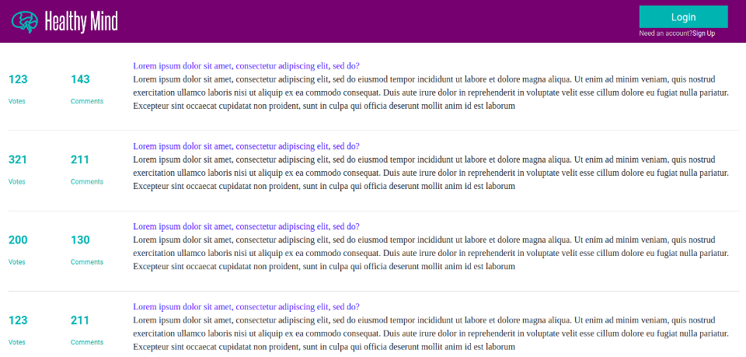

Slide 2
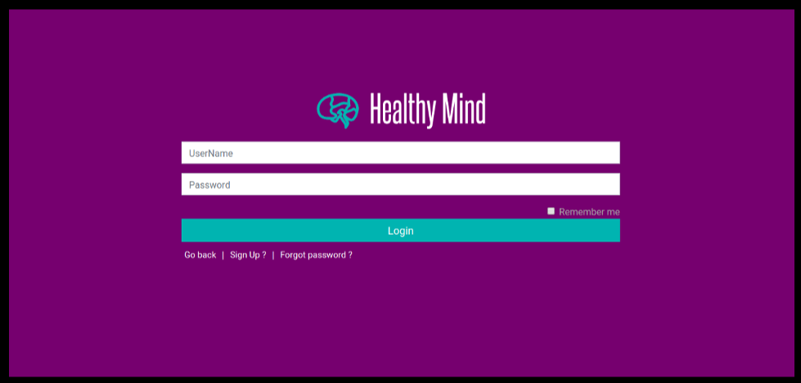

Slide 3
Buffalo
********

Slide 5
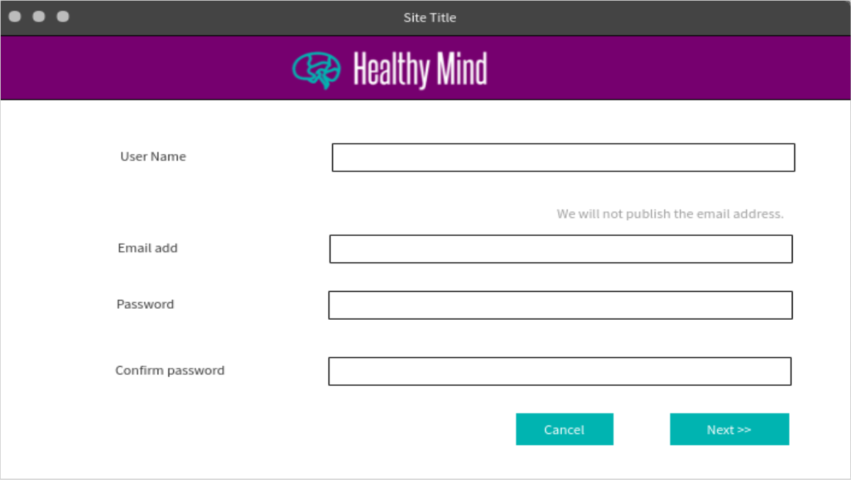

Slide 6
Athena
Athena@uga.edu
********
********

Slide 7
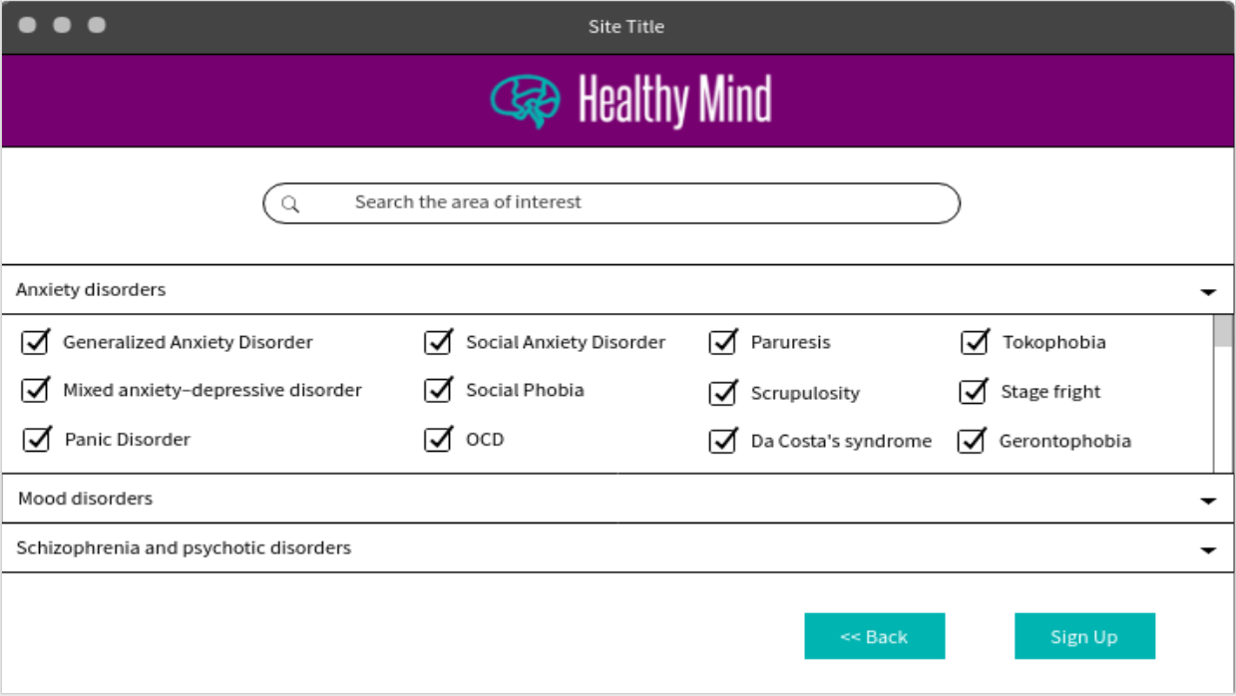

Slide 9
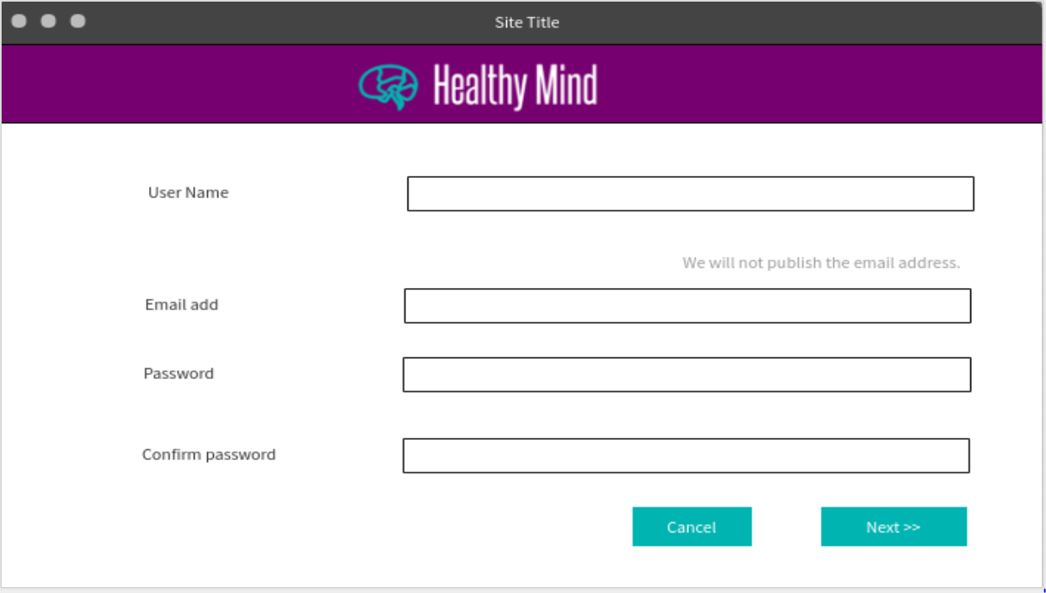

Slide 10
Jane Eyre
Athena@uga.edu
********
********

Slide 11
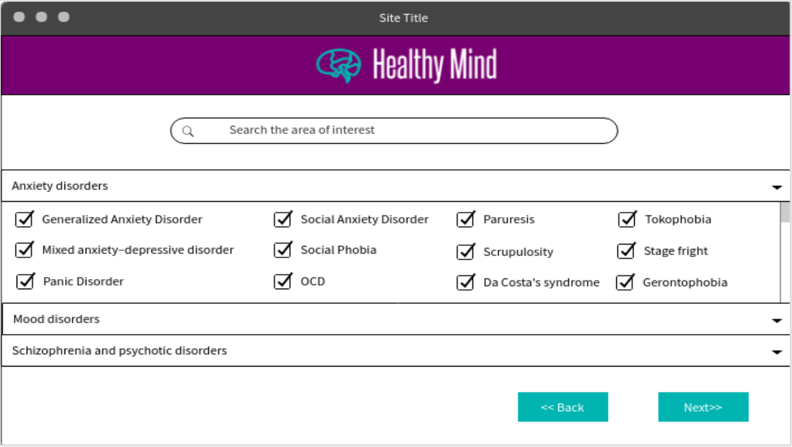
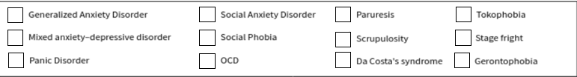

Slide 13
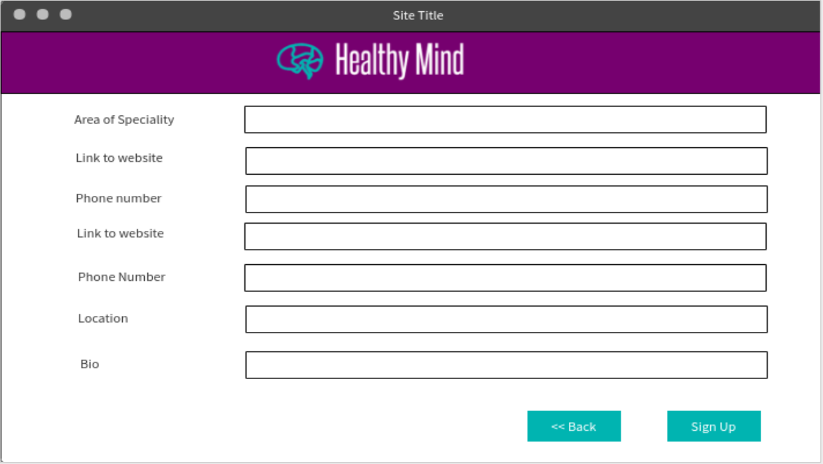

Slide 14
Stress
Demo.com
111-867-5309
Only have one website
Only have one number
L.A, Antarctica
Have 11 years of experience working with college age kids. I have my PHD from…

Slide 15
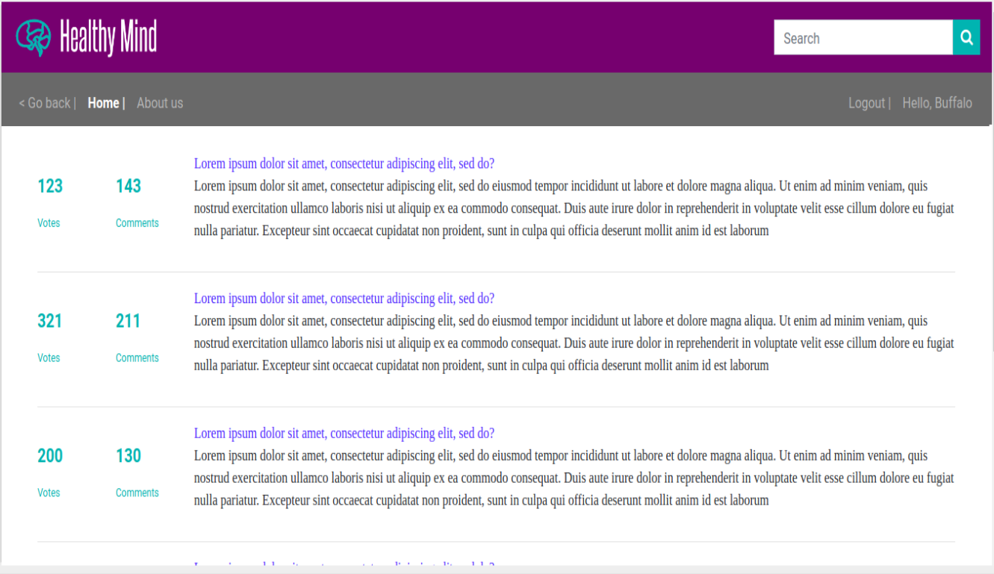
Posted By : Butterfly
Posted By : Dr. Jane Eyre
Posted By : Butterfly

Slide 16
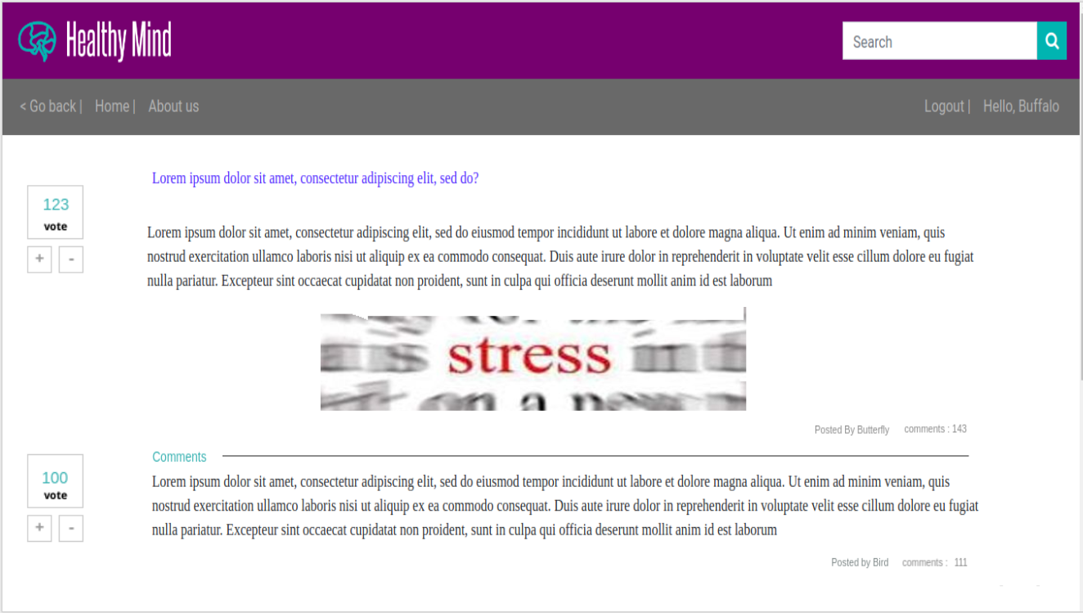

Slide 17
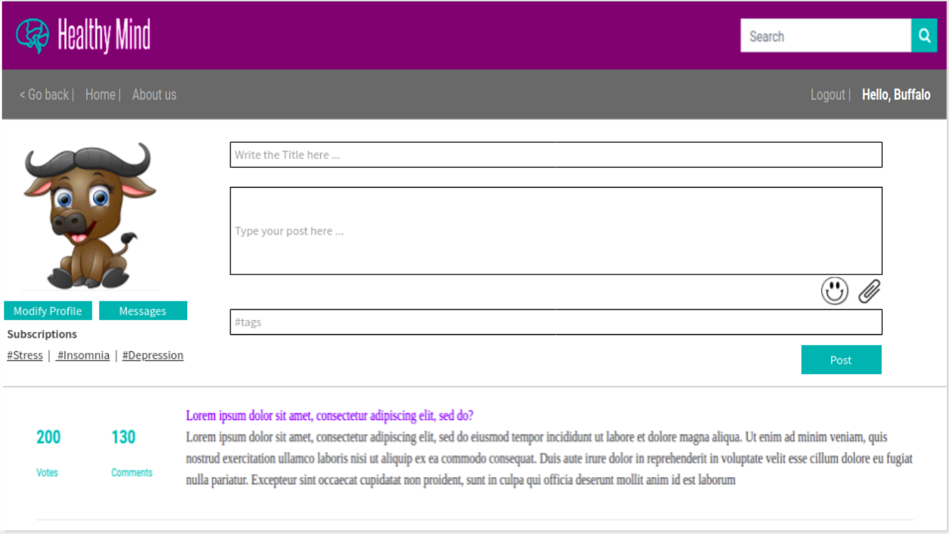

Slide 18
Stressful day
Does anyone have any tips on how to deal with stress?
#Stress

Slide 19
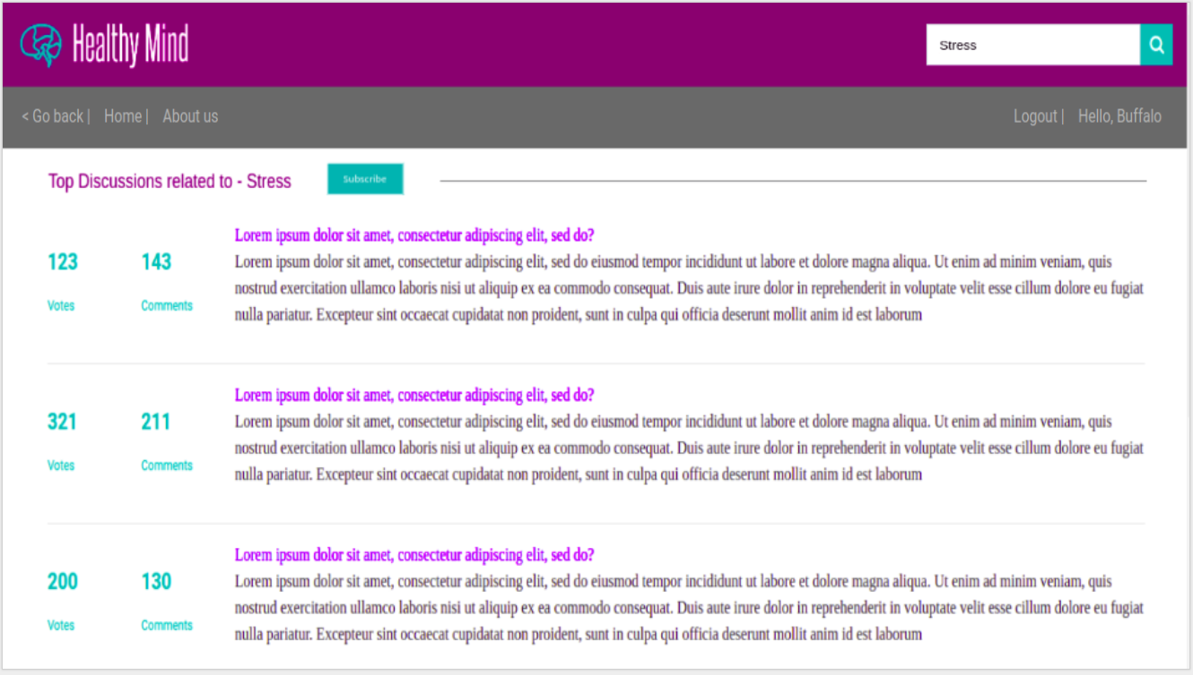
Posted By : Butterfly
Posted By : Dr. Jane Eyre

Slide 20
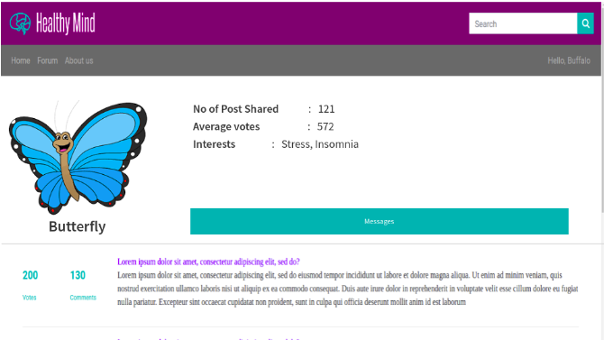

Slide 21
