Slide 1

Introduction to Zombie.js
Victor Tkachenko

Slide 2
Automation testing allows to:
verifying functional requirements
producing load testing
checking database

Slide 3
Zombie.js: what it is?
Zombie.js is a lightweight framework for testing client-side JavaScript code in a simulated environment

Slide 4
Also we have another headless web browsers:
PhantomJS
NightwatchJS
HtmlUnit (based on Java)
Ghost, Twill, Spynner (based on Python)
Awesomium (based on .NET/C++). Commercial
SimpleBrowser (based on .NET4.0/C#)
EnvJS (based on JavaScrpt via Java/Rhino)
Watir-webdriver with headless gem (Ruby via WebDriver)
Selenium WebDriver (based on Node.js)
Other…

Slide 5
What do we get from Zombie.js?
very fast
easy to run
easy to understand
based on promise-object
support mainstream test frameworks
no need to use IDE such as Visual Studio etc.

Slide 6
Zombie.js supports
HTML5 parsing and dealing with tag soups
DOM Level 3 implementation
HTML5 form fields (search, url, etc)
CSS3 Selectors with some extensions
Cookies and Web Storage
XMLHttpRequest in all its glory
setTimeout/setInterval
pushState, popstate and hashchange events
alert, confirm and prompt
WebSockets and Server-Sent Events

Slide 7

Operation system support

Slide 8
Dependencies
unix-based OS
g++
node.js
node-gyp package
python (from 2.5 to 3.0 version)

Slide 9
How to install
We should type in command line:
  sudo apt-get install g++
  sudo apt-get install python-software-properties
  sudo apt-get install nodejs-legacy
  sudo apt-get install npm
  npm install zombie

Slide 10
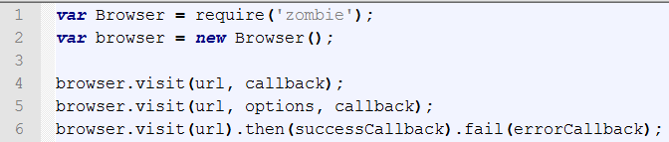
How to run

Slide 11
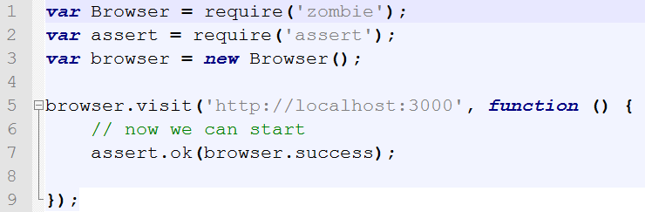
Getting started

Slide 12
API for managing DOM
browser.query(selector);
browser.queryAll(selector);
browser.text(selector);
browser.html(selector);
browser.body
browser.document
browser.evaluate
support xpath selectors

Slide 13
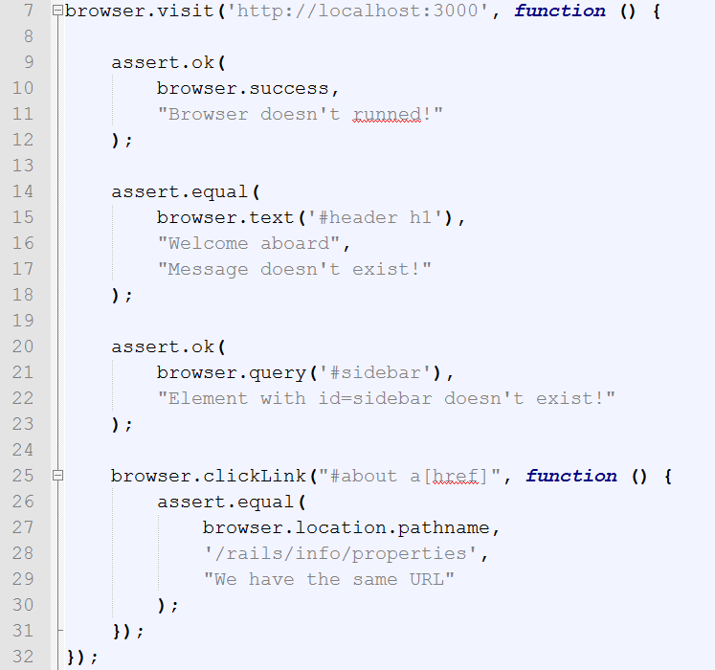
DOM manipulation

Slide 14
Navigation
browser.clickLink(selector/text, callback(e, browser, status));
browser.back
browser.load
browser.history
browser.link
browser.reload
browser.location
browser.statusCode
browser.redirected
browser.visit

Slide 15
API for managing Forms
browser.attach(selector, filename, callback);
browser.fill(selector, text);
browser.select(selector, value);
browser.pressButton(selector/text in button);
browser.check(field, callback);
browser.choose(field, callback);
browser.field(selector);
browser.button(selector);

Slide 16
API for state management
browser.cookies(domain, path);
browser.localStorage(host);
browser.sessionStorage(host);

Slide 17

browser.fork();

Slide 18
Callbacks API based on promises
We have a few functions based on promises such as visit, wait, clickLink, load

Slide 19
Events API
browser.fire(name, target, callback);
browser.wait(callback);

Slide 20
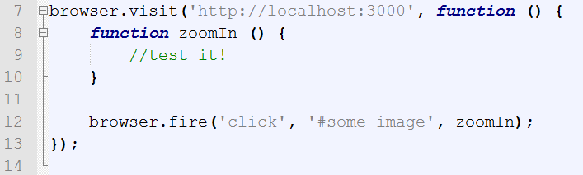
Firing event

Slide 21
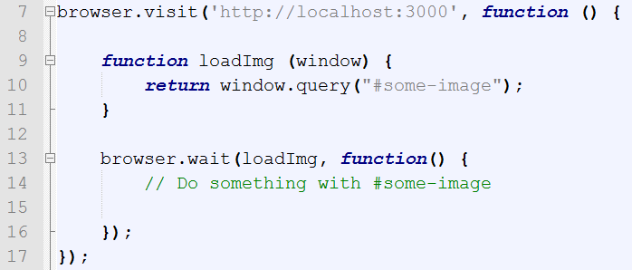
How to use

Slide 22
Debug API
browser.dump();
browser.lastError();
browser.resources();
browser.log(arguments);
browser.viewInBrowser(name);

Slide 23
Windows management
windows.all();
windows.count;
windows.current;
windows.close(window);
windows.select(window);
windows.get(name || index);

Slide 24
We have options such as
debug
loadCSS
runScripts
headers
maxWait
userAgent
site
waitFor
and other

Slide 25
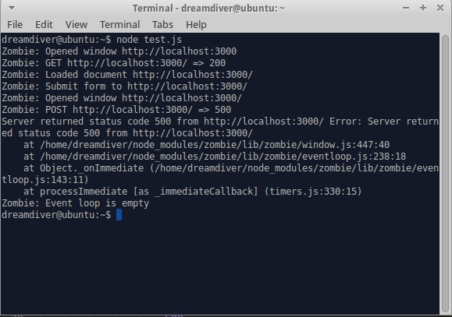
browser.debug = true;

Slide 26


Slide 27


Slide 28
Used literature
https://www.google.com.ua/#q=zombie.js

Slide 29
Contact info
Skype: victor.tkachenko6
E-mail: vtkach@softserveinc.com

