Slide 1
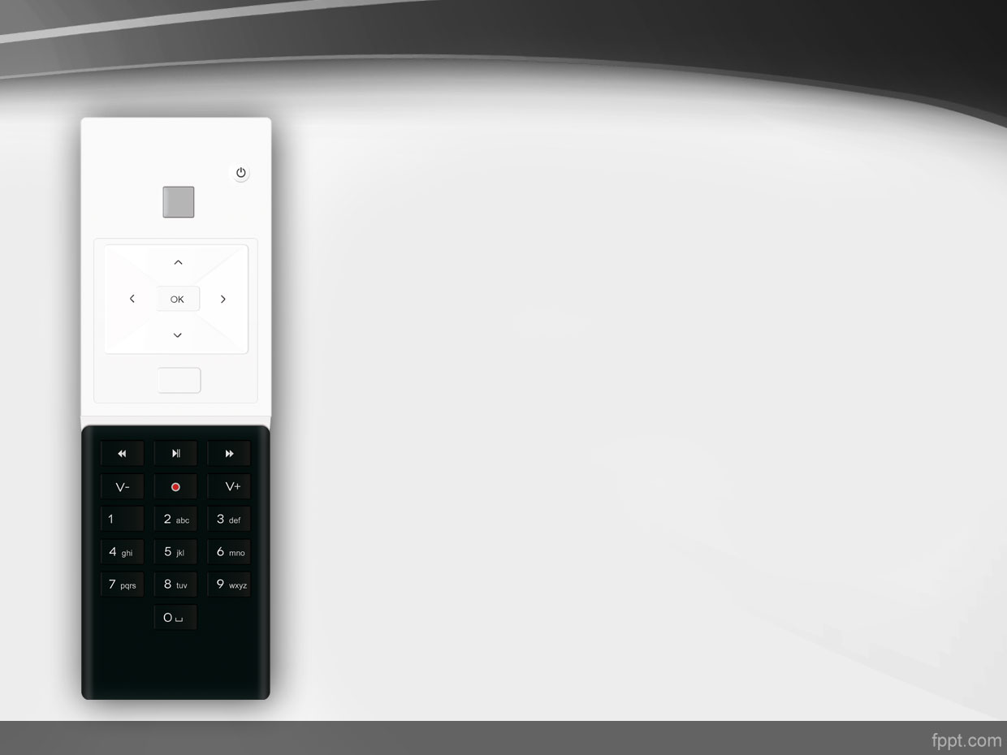
AppDomains in .Net
Prepared by:
Leonid Molotiievskyi

Slide 2


Agenda
Introduction
What is AppDomain?
General problems witch can be solved by AppDomains
How it works?
How can we interact between AppDomains?
MarshalByRefObject
Lifetime & Lease
Common mistakes programming AppDomains
Performance optimization
Conclusion

Slide 3

Introduction
Many environments have their own models of scoping code execution:
For an Operating System it is a process;
For the .Net CLR, the AppDomain is the fundamental scope of code execution.

Slide 4
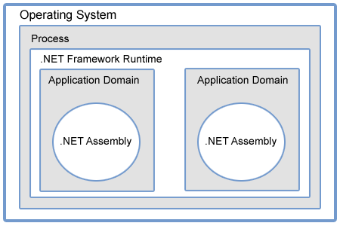
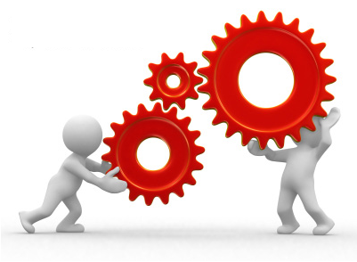
What is AppDomain?
AppDomain is an abstraction created by the CLR
An AppDomain can reside in exactly one OS process
But an OS process can host multiple AppDomains

Slide 5
It can solve:
Support 3rd party plugins
Run some 3rd party modules by our application
Run test libs.
Security (you can run a set of code with specific trust levels)
Isolation (you an run different versions of assemblies etc.).

Slide 6
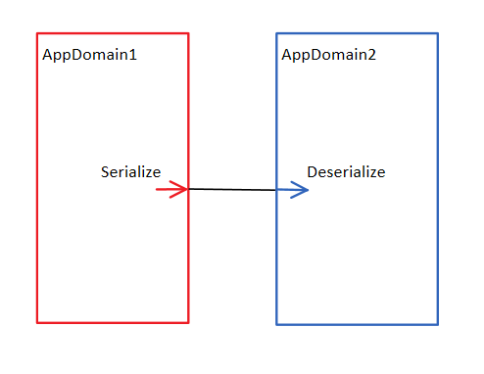
How it works?
Requirement for object transfer:
It should be Serilizeble or be inherited from MarshalByRefObject

Slide 7
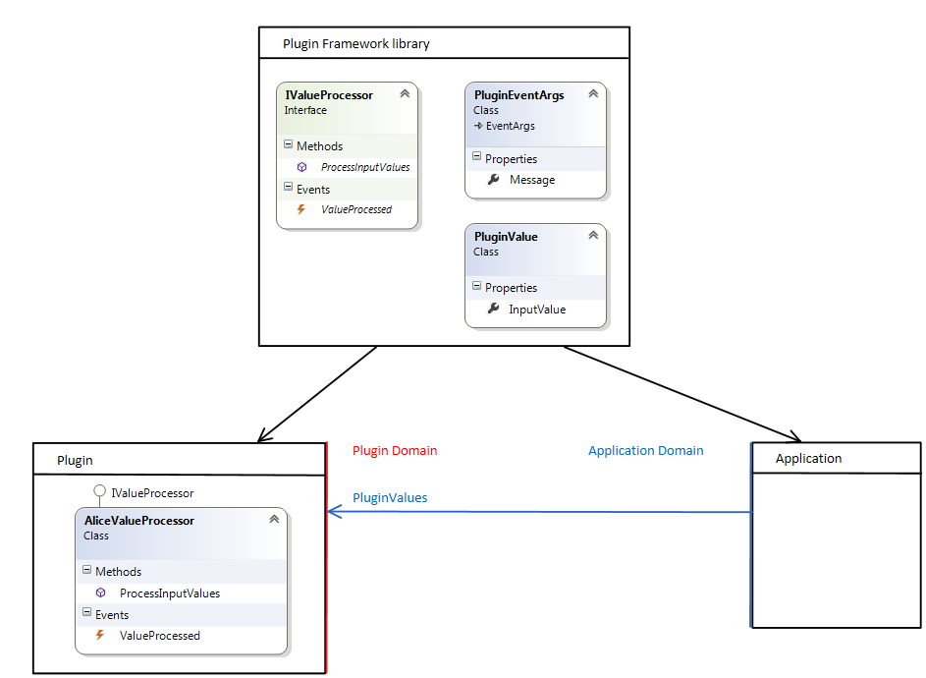

Common interaction approaches
One way approach.

Slide 8

One way approach

Slide 9
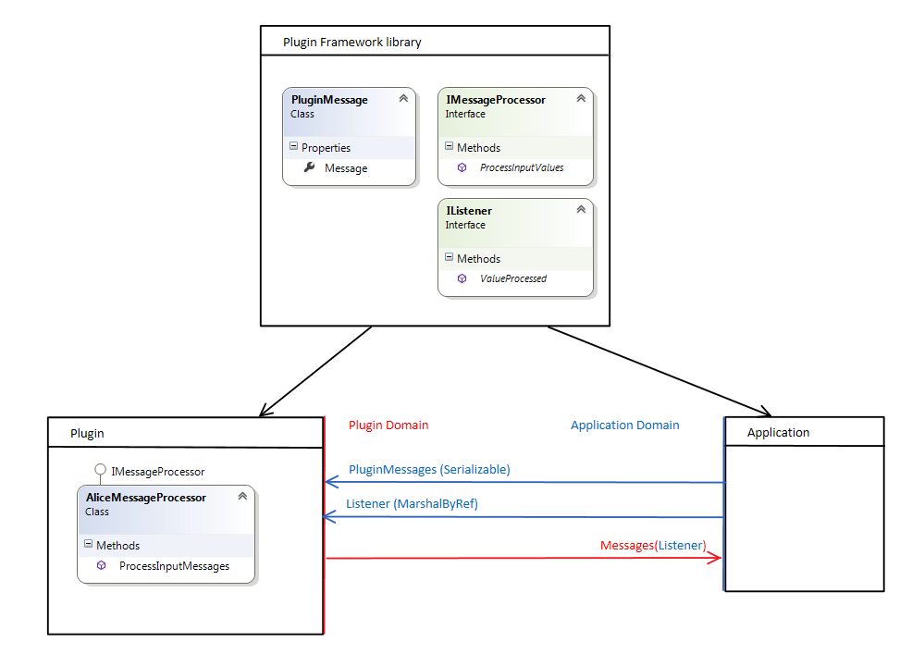

Common interaction approaches
Two way approach (Listener approach)

Slide 10
Two way approach

Slide 11
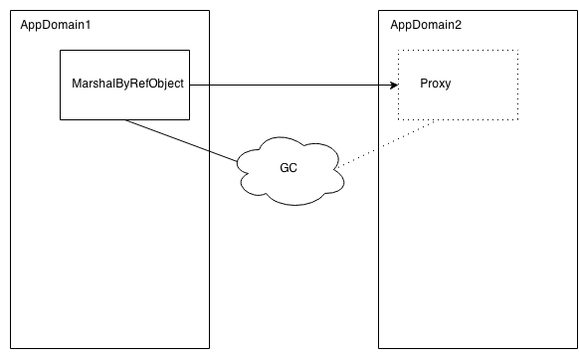
MarshalByRefObject
Between AppDomains or machines, rather than serialize and transfer the object, the object stays at one end and a proxy is created at the other.

Slide 12
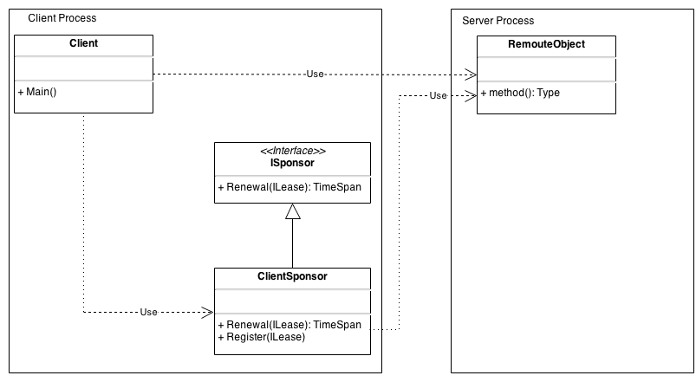
Lifetime & Lease
An object that implements the ISponsor interface can become a sponsor by registering itself with the lease manager.
The ISponsor interface is used by the lifetime service to call back to the sponsor.

Slide 13
Lifetime & Lease

Slide 14
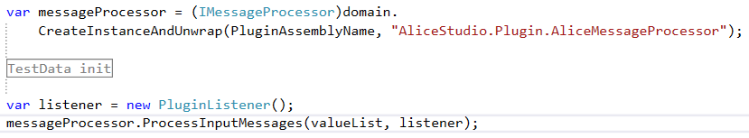

Common mistakes
Following lines of code doesn’t mean that code will be executed in separate app domain.

Slide 15

Common mistakes
Confusing with [Serializeble] and MarshalByRefObjects
Each MarshalByRefObject has lifetime. So you need to manage this time.
Using MarshalByRefObjects where is not needed.

Slide 16
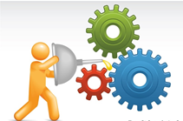
Performance optimization
Each AppDomain has its own private copy of a type’s static data.
The JIT compiler can generate code either on a per-AppDomain basis or on a per-process basis. So we can decide which one to use.
There are three types of Loader Optmizations:
  SingleDomain
  MultiDomain
  MultiDomainHos

Slide 17

Conclusion

Slide 18

Questions

Slide 19
References
Managing the Lifetime of Remote .NET Objects with Leasing and Sponsorship: http://msdn.microsoft.com/en-us/magazine/cc300474.aspx
Remoting Architecture: http://www.codeproject.com/Articles/18997/Remoting-Architecture-in-NET

