Slide 1
Java Web Application Security with Apache SHIRO
(Java in the world of hacking)
“Security is a quality, and as all other quality, it is
important that we build it into our apps while we are
developing them, not patching it on afterwards like
many people do.”
-- Erlend Oftedal

Slide 2



Andriy Novak
Java Developer
Certified Linux Administrator

Slide 3
Why are we here?
Purpose
  To learn more about Java webapp security.
Goals
Show how to implement Java webapp security.

Slide 4
Session Agenda
Security Issue in Web apps.
  Security Basics
  OWASP
  Security Development:
  JAVA EE 6
  Apache Shiro.

Slide 5
Security issues in Web Applications
WHAT?
  - XSS
  - CSFR
  - Broken session
  WHY?
  - Environment limitations
  - Developers sometimes think about security in last turn.

Slide 6
Implementing Security
Use SSL
Use Security token in critical REQUESTS
Use powerful Security Framework such as Apache Shiro
OWASP Security coding Guide.

Slide 7
OWASP
Open Web application Security Project.
“Hacking” tutorials - training lessons.
Hacking tools.

Slide 8
Security Development
Spring
JAVA EE 6
JAAS
JSecurity
Apache Shiro

Slide 9
Java EE 6
Java EE Security Demo - HD
http://www.youtube.com/watch?v=8bXBGU7uo4o
xml based
container managed authentication

Slide 10
Java EE 6 Security config
Add security constraint to web.xml
<security-constraint>
  <web-resource-collection>
    <web-resource-name>users</web-resource-name>
    <url-pattern>/users</url-pattern> # /users* regexp forbidden in urls matcher, EE limitation
    <http-method>GET</http-method>
    <http-method>POST</http-method>
  </web-resource-collection>
  <auth-constraint>
  <role-name>ROLE_ADMIN</role-name>
  </auth-constraint>
</security-constraint>
<security-role>
  <role-name>ROLE_ADMIN</role-name>
<security-role>

Slide 11
Java EE 6 Security config
Basic
<login-config>
  <form-login-config>
    <form-login-page>/login.jsp</form-login-page>
    <form-error-page>/login.jsp?error=true</form-error-page>
  </form-login-config>
</login-config>
FormBased Authentication
<login-config>
  <auth-method>BASIC</auth-method>
  <realm-name>Java EE Login</realm-name>
</login-config>

Slide 12
Java EE 6 Security config
realm.properties contains usernames and hashed/obfuscated passwords e.g
jetty: MD5:14243ef87908e089e4aade,ROLE_USER
admin: MD5:45543ef845608sd456f9df0e,ROLE_ADMIN

Slide 13
JAVA EE 6 SSL
Add
  <user-data-constraint>
  <transport-guarantee>CONFIDENTIAL</transport-guarantee>
  </user-data-constraint>
to <security-constraint> in web.xml
* loginService should be defined in pom.xml.

Slide 14
JAVA EE 6 SSL
<security-constraint>
  <web-resource-collection>
    <web-resource-name>users</web-resource-name>
    <url-pattern>/users</url-pattern> # /users* regexp forbidden in urls matcher, EE limitation
    <http-method>GET</http-method>
    <http-method>POST</http-method>
  </web-resource-collection>
  <auth-constraint>
  <role-name>ROLE_ADMIN</role-name>
  </auth-constraint>
  <user-data-constraint>
  <transport-guarantee>CONFIDENTIAL</transport-guarantee>
  </user-data-constraint>
</security-constraint>

Slide 15
JAVA EE 6 Security Limitations
    No error messages for failed logins
    No Remember Me
    Container has to be configured
    Doesn’t support regular expressions for URLs

Slide 16
Apache Shiro
Apache Shiro (pronounced "sheeroh", a Japanese word for castle) is a powerful open source software security framework that performs authentication, authorization, cryptography and session management. Shiro has been designed to be an intuitive and easy-to-use while still providing robust security features.
With Shiro’s easy-to-understand API, you can quickly and easily secure any application – from the smallest mobile applications to the largest web and enterprise applications.

Slide 17
SHIRO HISTORY
Shiro's predecessor, JSecurity, was founded in 2004 by Les Hazlewood and Jeremy Haile because they could not find a suitable Java security frameworks that operated well at the application level and they were frustrated with JAAS. Between 2004 and 2008, JSecurity was hosted on SourceForge and its committer list grew to include Peter Ledbrook, Alan Ditzel, Tim Veil.^{[1]}
In 2008, JSecurity project was submitted to the Apache Software Foundation (ASF) and accepted into their Incubator Program to be stewarded by mentors in order to become a top level Apache Project.^{[1][2]} Under the ASF's Incubator, Jsecurity was renamed Ki (pronounced Key) and shortly later renamed Shiro by the community because of trademark concerns.^{[3][4]}
The project continued to grow while in the Apache Incubator, adding Kalle Korhonen as a project committer.^{[5]} And in July 2010, the Shiro community released its official version 1.0, marking a period of stability in the code base.^{[6]} Following the release of version 1.0, the Shiro community created a Project Management Committee and elected Les Hazlewood as its chair. On September 22, 2010, Shiro became a Top Level Project (TLP) in the Apache Software Foundation.

Slide 18
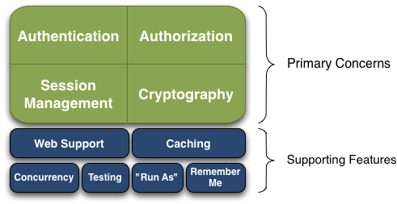
Apache Shiro provides
Authentication: Sometimes referred to as 'login', this is the act of proving a user is who they say they are.
Authorization: The process of access control, i.e. determining 'who' has access to 'what'.
Session Management: Managing user-specific sessions, even in non-web or EJB applications.
Cryptography: Keeping data secure using cryptographic algorithms while still being easy to use.
Web Support: Shiro's web support APIs help easily secure web applications.

Slide 19
Authentication with Apache Shiro
Authentication is the process of identity verification - you are trying to verify a user is who they say they are. To do so, a user needs to provide some sort of proof of identity that your system understands and trusts.
The Shiro framework is designed to make authentication as clean and intuitive as possible while providing a rich set of features.

Slide 20
Apache Shiro Authentication Features
Subject Based.
Single Method call.
Rich Exception Hierarchy.
'Remember Me' built in.
Pluggable data sources.
Login with one or more realms.

Slide 21
Authorization with Apache Shiro
Authorization, also called access control, is the process of determining access rights to resources in an application. In other words, determining "who has access to what." Authorization is used to answer security questions like, "is the user allowed to edit accounts", "is this user allowed to view this web page", "does this user have access to this button?" These are all decisions determining what a user has access to and therefore all represent authorization checks.
Authorization is a critical element of any application but it can quickly become very complex. Shiro's goal is to eliminate much of the complexity around authorization so that you can more easily build secure software. Below is a highlight of the Shiro authorization features.

Slide 22
Apache Shiro Authorization features
Subject-based
Checks based on roles or permissions
Powerful and intuitive permission syntax
Multiple enforcement options
Strong caching support
Pluggable data sources
Supports any data model

Slide 23
Permission Check
Subject currentUser= SecurityUtils.getSubject();
Programmatic
  Permission printPermission = new PrinterPermission(“laserjet3000n”,“print”);
  If (currentUser.isPermitted(printPermission)) {
  //do one thing (show the print button?)
  } else {
  //don‟t show the button?
  }
Annotation
  @RequiresPermissions(“account:create”)
  public void openAccount( Account acct ) {
  //create the account
  }

Slide 24
Session Management with Apache Shiro
Sessions are buckets of data that your users carry with them for a period of time when using your application. Sessions have traditionally been exclusive to web or EJB environments. No more! Shiro enables sessions for any application environment. Further, Shiro offers to a host of other great features to help you manage sessions.

Slide 25
Apache Shiro Session Management Features
POJO/J2SE based (IoC friendly)
Session Storage
Easy and Powerful Clustering
Heterogeneous Client Access
Event listeners
Host address retention
Inactivity/expiration support
Transparent web use
Can be used for SSO

Slide 26
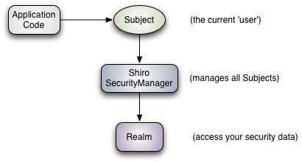
Apache
Shiro Architecture
High-Level Overview
Subject: currently executing user.
SecurityManager: is the heart of
Shiro’s architecture that coordinates
its internal security components
that together form an object graph.
Realms: Realms act as the ‘bridge’ or ‘connector’
between Shiro and your application’s security data.

Slide 27
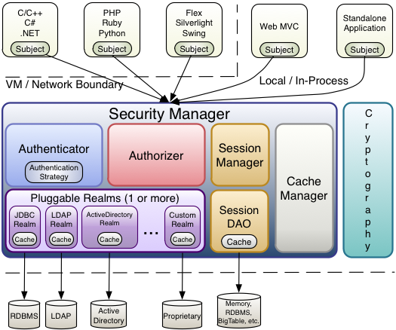
Apache
Shiro Architecture in details

Slide 28
Cryptography with Apache Shiro
Cryptography is the practice of protecting information from undesired access by hiding it or converting it into nonsense so know one else can read it. Shiro focuses on two core elements of Cryptography: ciphers that encrypt data like email using a public or private key, and hashes (aka message digests) that irreversibly encrypt data like passwords.
Shiro Cryptography's primary goal is take what has traditionally be an extremely complex field and make it easy for the rest of us while providing a robust set of cryptography features.

Slide 29

Apache Shiro Cryptography Features
Simplicity Features
Interface-driven, POJO based
Simplified wrapper over JCE
“Object Orientifies” cryptography concepts
Runtime Exceptions
Cipher Features
OO Hierarchy
Just instantiate a class
More secure default settings
Hash Features
Deault interface implementations
Built-in Hex and Base64 conversion
Built-in Salt and repeated hashing support

Slide 30
Apache Shiro Web Integration
Shiro is designed to greatly simplifies how you secure web applications base on simple URL pattern matching and filter chain definitions. In addition to Shiro's API, Shiro's web support includes a rich JSP tag library to control page output.

Slide 31
Apache Shiro Web Features
Simple ShiroFilter web.xml definition
Protects all URLs
Innovative Filtering (URL-specific chains)
JSP Tag support
Transparent HttpSession support

Slide 32
Web.xml
<filter>
  <filter-name>ShiroFilter</filter-name>
  <filter-class>org.apache.shiro.web.servlet.IniShiroFilter</filter-class>
<init-param><param-name>config</param-name><param-value>
  [main]
    realm = com.my.custom.realm.Implementation
    securityManager.realm= $realm
  [urls]
    /account/** = authc
    /remoting/** = authc, roles[b2bClient], ...
</param-value></init-param>
</filter>
<filter-mapping>
  <filter-name>ShiroFilter</filter-name>
  <url-pattern>/*</url-pattern>
</filter-mapping>

Slide 33
JSP Tag support
<%@ taglib prefix="shiro" uri="http://shiro.apache.org/tags" %>
<shiro:guest>
Hi there! Please <a href="login.jsp">Login</a>
or <a href="signup.jsp">Signup</a> today!
</shiro:guest>
Hello, <shiro:principal/>, how are you today?
equialent to:
Hello, <%= SecurityUtils.getSubject().getPrincipal().toString() %>, how are you today?

Slide 34
JSP Tag support
<shiro:hasRole name="administrator">
<a href="admin.jsp">Administer the system</a>
</shiro:hasRole>
<shiro:lacksRole name="administrator">
Sorry, you are not allowed to administer the system.
</shiro:lacksRole>

Slide 35
Configuration
pretty simple, easy to read and maintain – plain text ini format
# =======================
# Shiro INI configuration
# =======================
[main]
# Objects and their properties are defined here,
# Such as the securityManager, Realms and anything
# else needed to build the SecurityManager
[users]
# The 'users' section is for simple deployments
# when you only need a small number of statically-defined
# set of User accounts.
[roles]
# The 'roles' section is for simple deployments
# when you only need a small number of statically-defined # roles.
[urls]
# The 'urls' section is used for url-based security
# in web applications.

Slide 36
Configuration: Example of [main] section
[main]
sha256Matcher = org.apache.shiro.authc.credential.Sha256CredentialsMatcher
myRealm = com.company.security.shiro.DatabaseRealm
myRealm.connectionTimeout = 30000
myRealm.username = jsmith
myRealm.password = secret
myRealm.credentialsMatcher = $sha256Matcher
securityManager.sessionManager.globalSessionTimeout = 1800000
Shiro by default uses Apache Commons BeanUtils.
myRealm.setConnectionTimeout(30000);
myRealm.setUsername("jsmith");
securityManager.getSessionManager().setGlobalSessionTimeout(1800000);

Slide 37
Configuration: Example of [users] and [roles] sections
[users]
# username = password,role1,role2,…,roleN
admin = secret
lonestarr = vespa, goodguy, schwartz
darkhelmet = ludicrousspeed, badguy, schwartz
[roles]
# 'admin' role has all permissions, indicated by the wildcard '*‘
admin = *
# The 'schwartz' role can do anything (*) with any lightsaber
schwartz = lightsaber:*
# The 'goodguy' role is allowed to 'drive' (action) the winnebago (type) with # license plate 'eagle5' (instance specific id)
goodguy = winnebago:drive:eagle5

Slide 38
Configuration: Example of [urls] section
[urls]
/index.html = anon
/admin/** = ssl, authc, roles[administrator]
/rest/** = ssl, authc, rest
/remoting/rpc/** = ssl, authc, perms["remote:invoke"]
[main] # (main should be in the top of shiro.ini)
# configure Shiro's default 'ssl' filter to be disabled while testing:
ssl.enabled = false

Slide 39
“Security is a quality, and as all other quality, it is
important that we build it into our apps while
we are developing them, not patching it on afterwards
like many people do.”
Erlend Oftedal

Slide 40
?
Questions
?
?
?

Slide 41
Thank you for Attention.

