Slide 1

Steps to Cloud for Dummies
On example
by Serhii Borysov 12/01/2012

Slide 2
Introduction
Case description
Amazon Web Services - at first sight
AWS structure and main services
What should we do?
Divide et impera!
Just scale It!
Practical part. AutoScaling in action

Slide 3
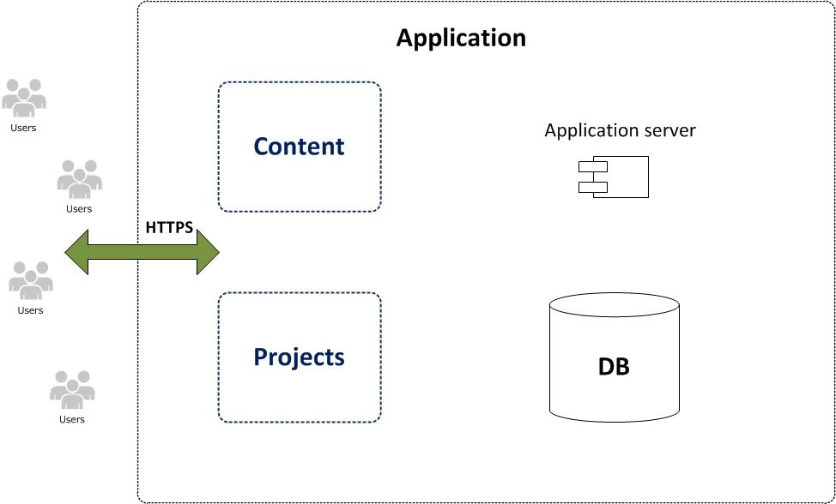
Case description

Slide 4

Amazon Web Services - at first sight

Slide 5
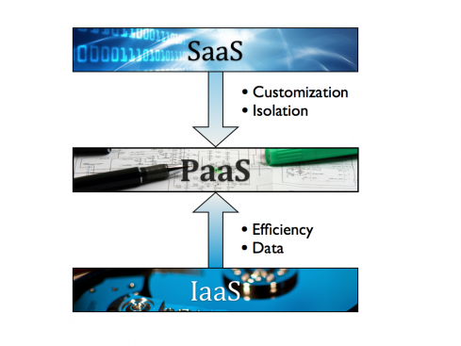
Amazon Web Services - at first sight

Slide 6
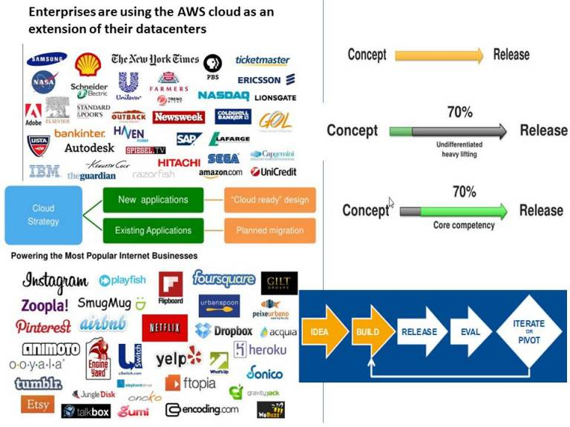
AWS structure and main services

Slide 7
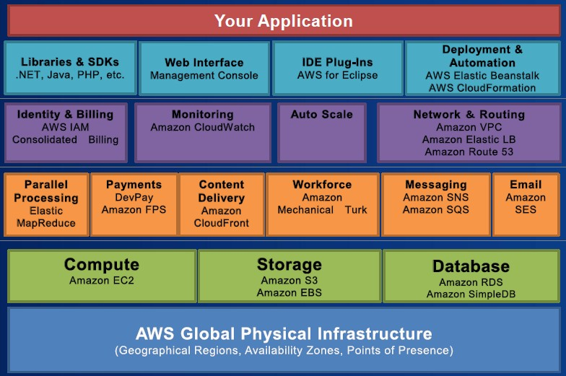
AWS structure and main services

Slide 8
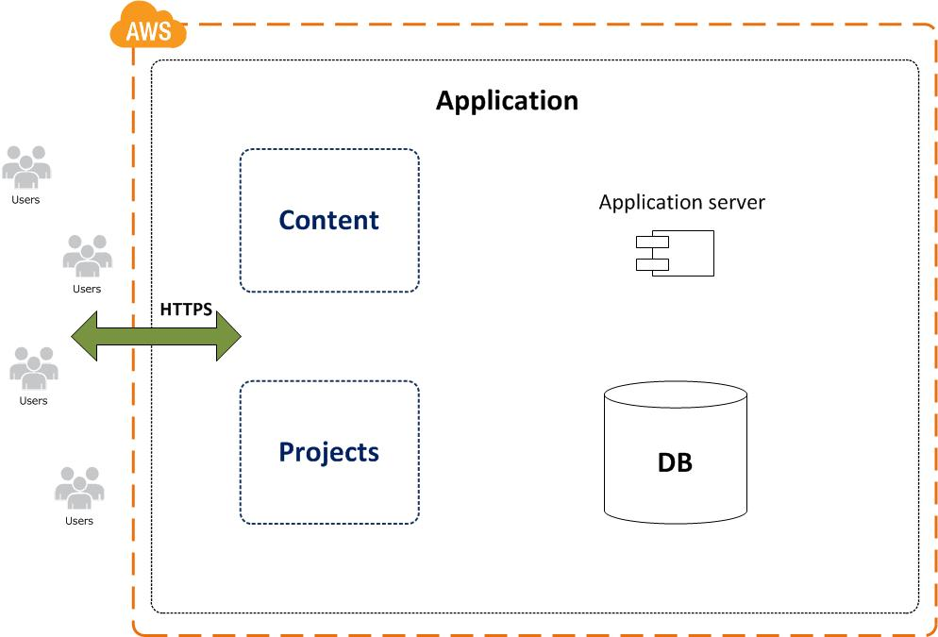
What should we do?

Slide 9
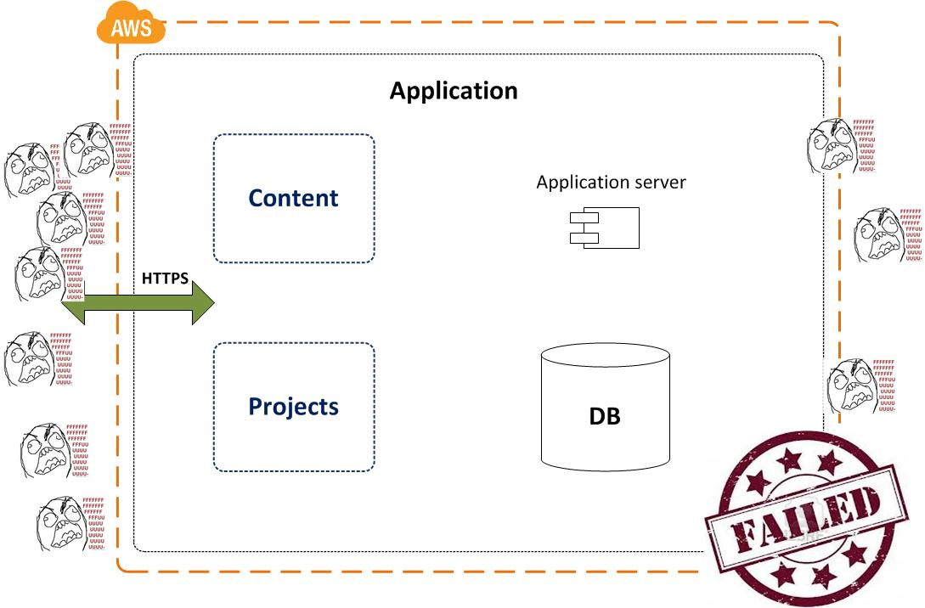
What should we do?

Slide 10
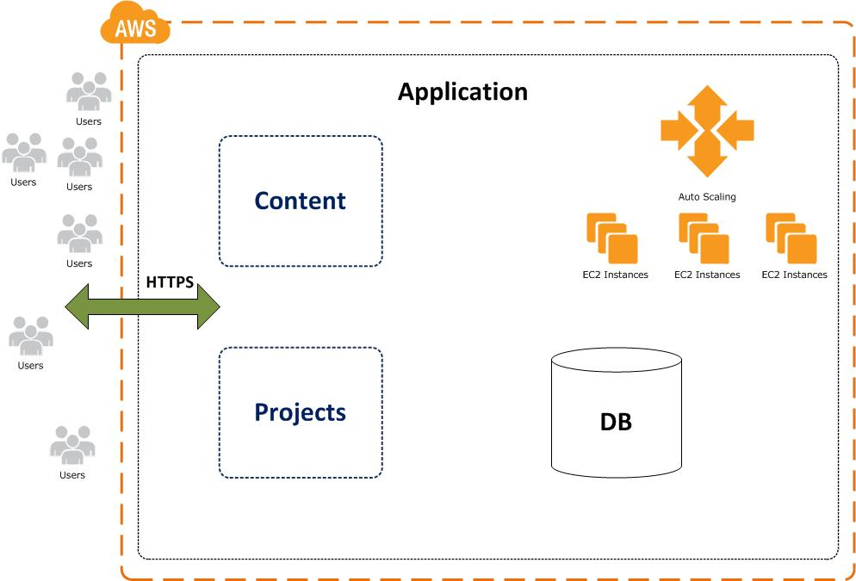
Divide et impera!

Slide 11
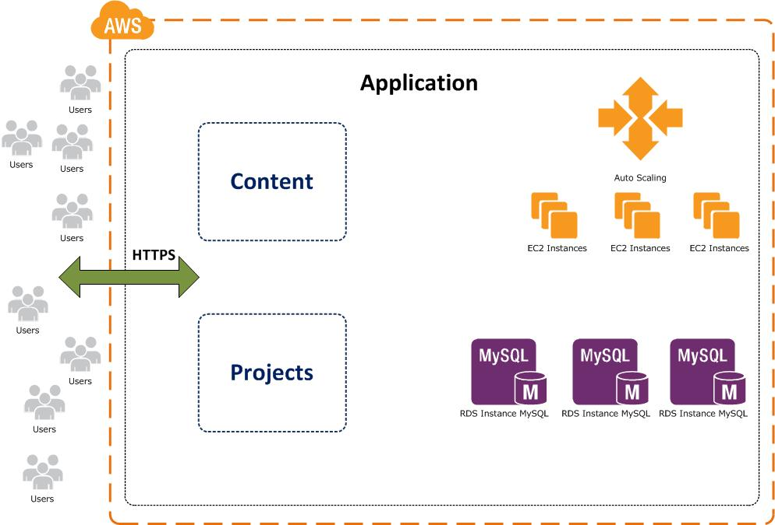
Divide et impera!

Slide 12
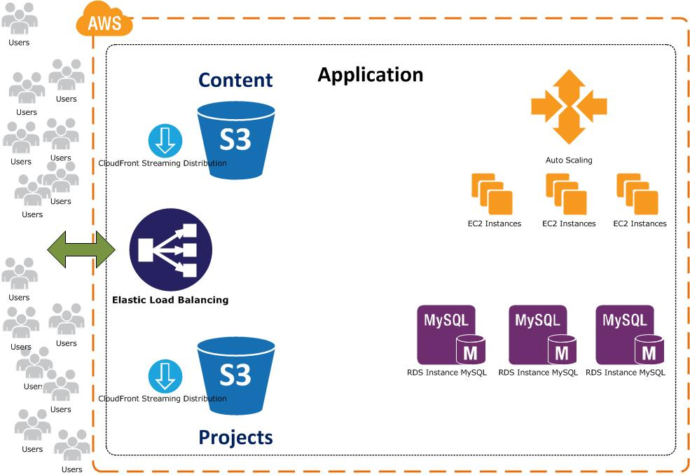
Divide et impera!

Slide 13
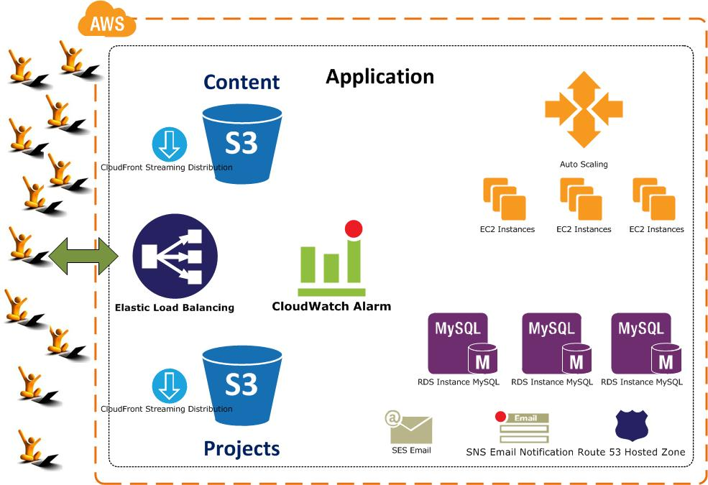
Divide et impera!

Slide 14
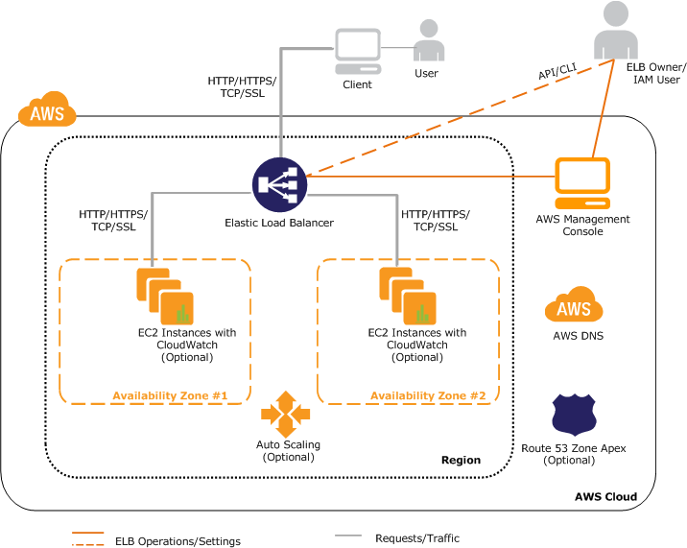
Just scale It!

Slide 15
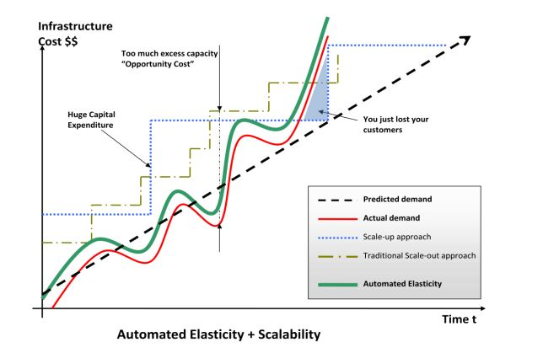
Just scale It!

Slide 16
AutoScaling in action
http://trainingappinventor.appspot.com/

Slide 17

Questions

