Slide 1
Flex with Java/Ruby
Mariia Bilokurova
2012

Slide 2

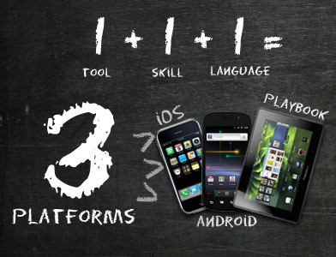
What is Flex
Flex is a powerful application framework.
It was built for making Rich Internet Applications
Flex allows developers to create:
traditional applications for browser and the desktop
mobile applications for Android, iOS and Blackberry Tablet OS

Slide 3

Why does Flex need somebody else?
Because it wasn’t built for making server side logic ☹
It was built for creating client-side applications that run over the Internet talking to remote servers.
So, remote servers are Flex’s best friends ☺

Slide 4

Server Integration
Flex integrates with:
PHP
Ruby
Java
Spring
Hibernate
.NET
ColdFusion
SAP
Flex communicate with listed above using:
REST
SOAP
JSON
AMF

Slide 5
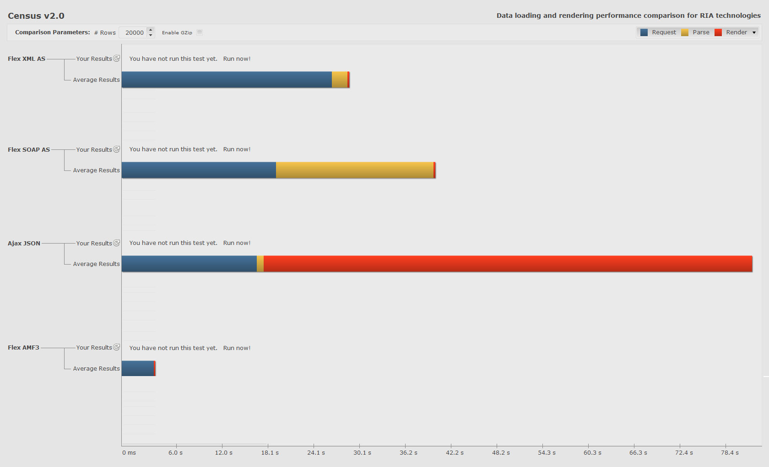
Format comparison
Data for grid with 20 000 rows
XML
Request Time: 26.1 s
Parse Time: 1.9 s
Render Time: 230 ms
Total Time: 28.3 s
Transfer Size:
4.3 MB
Client memory: 155.4 MB
SOAP
Request Time: 19.1 s
Parse Time: 19.6 s
Render Time: 275 ms
Total Time: 39.0 s
Transfer Size:
3 MB
Client memory: 119.4 MB
Transfer Size:
2 MB
Client memory: 102.1 MB
JSON
Request Time: 16.8 s
Parse Time: 860 ms
Render Time: 60.7 s
Total Time: 78.4 s
AMF3
Request Time: 4.0 s
Parse Time: 52 ms
Render Time: 193 ms
Total Time: 4.2 s
Transfer Size:
336.1 KB
Client memory: 81.4 MB

Slide 6

What is AMF
Action Message Format is a binary format used to:
serialize objects graphs such ActionScript objects and XML
send messages between an Flex client and a remote service

Slide 7

Let’s talk more about AMF
Why is AMF so cool?
AMF is a binary protocol, so:
it can use pointers
it transmitted data in the same format as Flash Player stores its objects in memory
reads data from stream -> Flash Player memory
no de-marshaling and de-serializing
and AMF is still encapsulated in HTTP, so:
no concerns with firewalls
normal web debugging methods can be used;
http headers with a binary body

Slide 8

Let’s talk more about AMF
Java
(WebORB, BlazeDS. etc.)
Ruby
(RubyAMF, RocketAMF, WebORB , etc)
JavaScript
(JSAMF)
PHP
(AMFPHP, WebORB , etc)
Who can
understand
this AMF?
iOS
(CocoaAMF)
Python
(PyAMF, Plasma, etc)
And much more..

Slide 9
Let’s talk more about AMF
Java
(WebORB, BlazeDS. etc.)
Ruby
(RubyAMF, RocketAMF, WebORB , etc)
Who can
understand
this AMF?

Slide 10



WebORB installation for Java and Ruby
WebORB installation:
- for Java it’s distributed in the form as a jar file
for Ruby on Rails it’s distributed as a plugin
Next what needs to be done:
properly manage Flex configuration files in the WEB-INV/flex folder
add precompiled weborb.swc file to Flex application

Slide 11

WebORB configuration for Java and Ruby
Configuration settings that should be properly defined:
Endpoint. It’s just an URL where WebORB listens for the incoming requests.
<endpoint uri="weborb.wo" />

Slide 12

WebORB configuration for Java and Ruby
Configuration settings that should be properly defined:
Endpoint. It’s just an URL where WebORB listens for the incoming requests.
<endpoint uri="weborb.wo" />
Channel. Defines the transport which clients can use to establish connections with the server and send requests. In case of using AMF it will be:
<channel-definition id="my-amf" class="mx.messaging.channels.AMFChannel">
<endpoint uri="weborb.wo" />
</channel-definition>

Slide 13

WebORB configuration for Java and Ruby
Configuration settings that should be properly defined:
Endpoint. It’s just an URL where WebORB listens for the incoming requests.
<endpoint uri="weborb.wo" />
Channel. Defines the transport which clients can use to establish connections with the server and send requests. In case of using AMF it will be:
<channel-definition id="my-amf" class="mx.messaging.channels.AMFChannel">
<endpoint uri="weborb.wo" />
</channel-definition>
Destination. Is just a logical unit, that represents a service exposed to a Flex client:
<destination id="HelloWorld">
<properties>
<source>com.service.ComputerInfoService</source>
</properties>
</destination>

Slide 14
WebORB configuration for Java and Ruby
Configure Flex client for connect and invoke server-side methods using RemoteObject:
<mx:RemoteObject id="compinfo"
destination="GenericDestination"
source="com.service.ComputerInfoService"
showBusyCursor="true" fault="faultHandler(event)" >
<mx:method name="getComputerInfo" result="getComputerInfoHandler(event)"/>
</mx:RemoteObject>

Slide 15
WebORB configuration for Java and Ruby
Configure Flex client for connect and invoke server-side methods using RemoteObject:
<mx:RemoteObject id="compinfo"
destination="GenericDestination"
source="com.service.ComputerInfoService"
showBusyCursor="true" fault="faultHandler(event)" >
<mx:method name="getComputerInfo" result="getComputerInfoHandler(event)"/>
</mx:RemoteObject>
Method ‘getComputerInfoHandler’ receives a result.
Using AMF data format it’s possible to:
store this ComputeInfo object directly to our application without any additional work
send some ComputerInfo object from Flex to our server side without any pre and post processing
relax, because WebORB will do all hard work for us, isn’t it cool? ☺

Slide 16

WebORB configuration for Java and Ruby
Configure Flex client for connect and invoke server-side methods using RemoteObject:
<mx:RemoteObject id="compinfo"
destination="GenericDestination"
source="com.service.ComputerInfoService"
showBusyCursor="true" fault="faultHandler(event)" >
<mx:method name="getComputerInfo" result="getComputerInfoHandler(event)"/>
</mx:RemoteObject>
Method ‘getComputerInfoHandler’ receives a result.
Using AMF data format it’s possible to:
store this ComputeInfo object directly to our application without any additional work
send some ComputerInfo object from Flex to our server side without any pre and post processing
relax, because WebORB will do all hard work for us, isn’t it cool? ☺

Slide 17

Questions

Slide 18

One more thing:
Thanks for attention! =)

Slide 19
Contacts
Europe Headquarters
52 V. Velykoho Str.
Lviv 79053, Ukraine
Tel: +380-32-240-9090
Fax: +380-32-240-9080
E-mail: info@softserveinc.com
Website: www.softserveinc.com
US Headquarters
12800 University Drive, Suite 250
Fort Myers, FL 33907, USA
Tel: 239-690-3111
Fax: 239-690-3116
Copyright © 2010 SoftServe, Inc.

