Slide 1
Gems, Snakes and
Amazon forests
by Serhii Borysov 7/6/2013

Slide 2
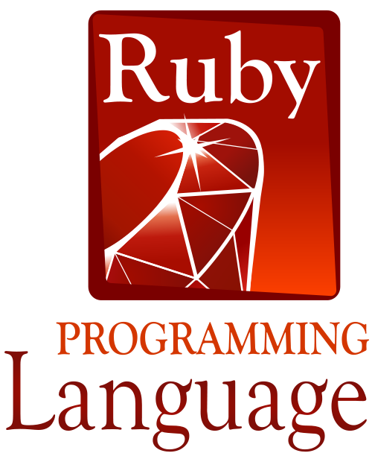
Why Gems?

Slide 3


Why Snakes?

Slide 4
Why Forests?

Slide 5

Amazon Web Forests

Slide 6
Benefits of usage Ruby and Python by deployment on Amazon Web services.
Scripting and API – basis of AWS automation.

Slide 7
Table of Contents
Puppet show
Chef is coming
Application Management for AWS
Ruby on AWS
Python on AWS
API

Slide 8
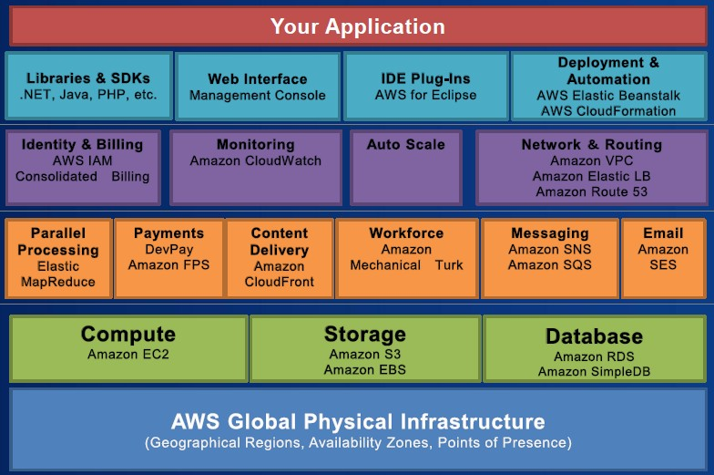
Introduction

Slide 9
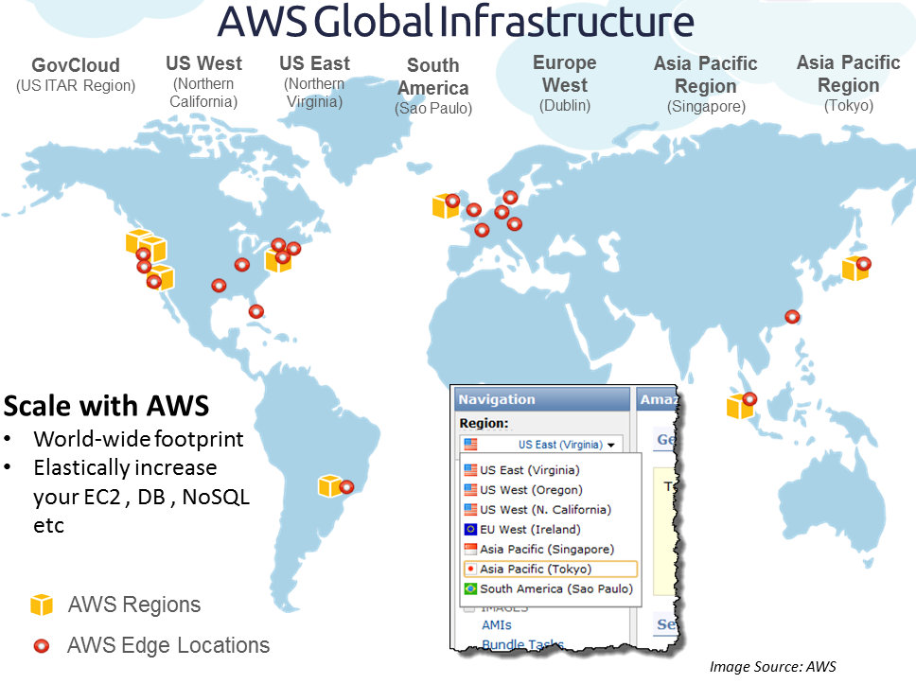
Introduction

Slide 10
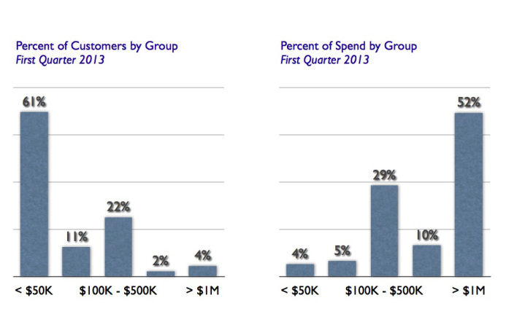
Case description

Slide 11

Puppet

Slide 12
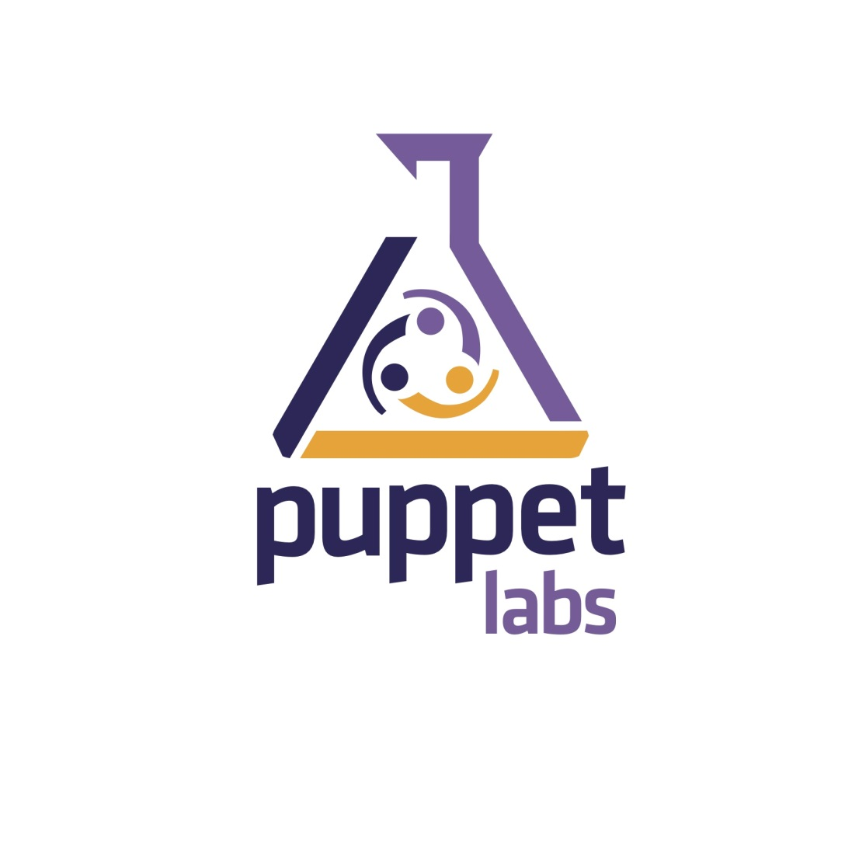
Puppet

Slide 13
Puppet
open-source configuration management tool
automation software uses Puppet's declarative language or a Ruby DSL (domain-specific language)
provisioning for virtual machines directly on Amazon EC2
written in Ruby

Slide 14
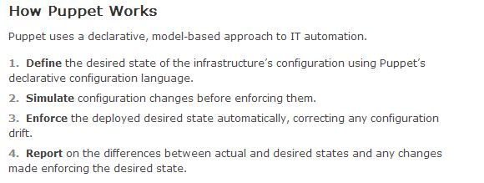
Puppet

Slide 15
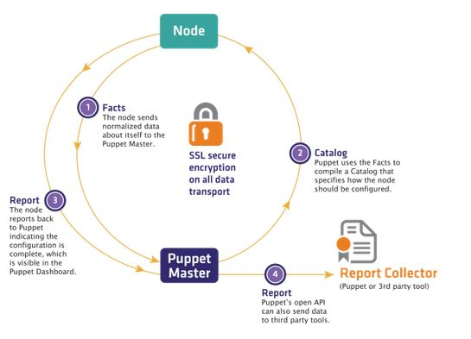
Puppet

Slide 16

Chef

Slide 17

Chef

Slide 18
Chef
Chef is an infrastructure automation and configuration management framework. Simply put, Chef is "Infrastructure as Code".
Chef supports a wide variety of cloud providers including Amazon AWS, Windows Azure, Google Compute Engine, OpenStack, Rackspace
written in Ruby

Slide 19
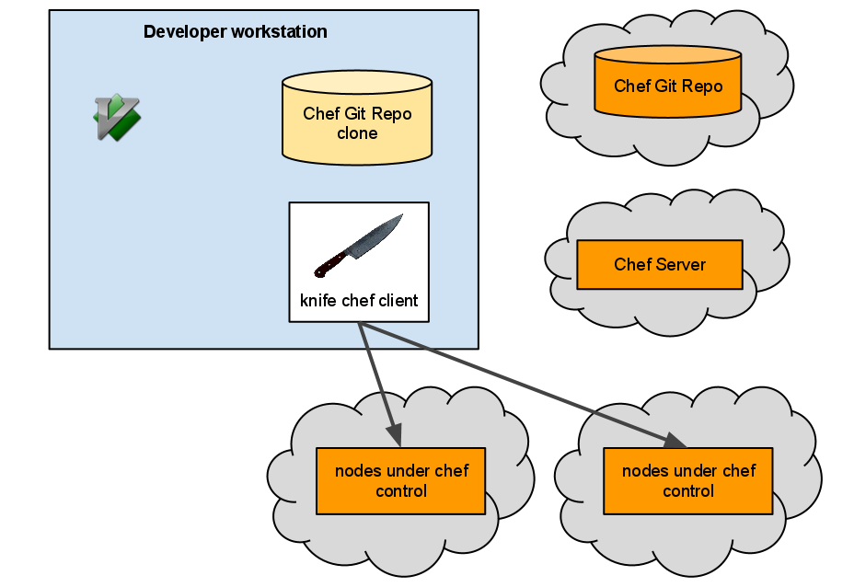
Chef

Slide 20
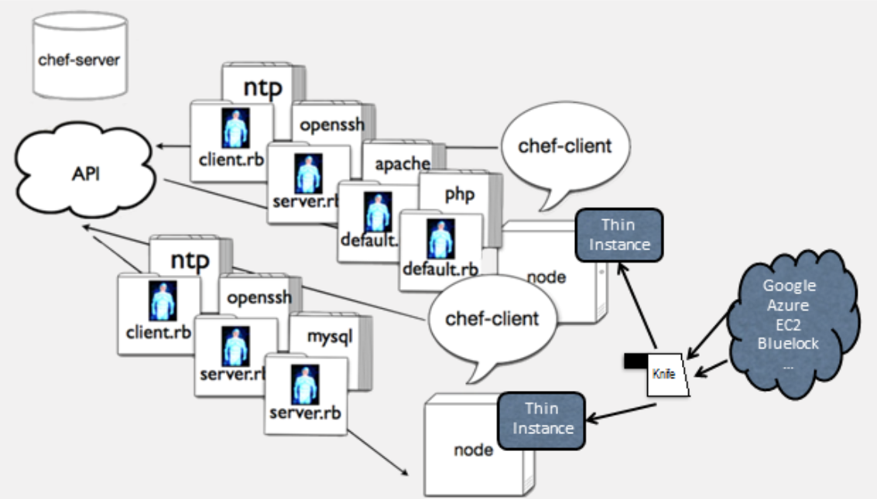
Chef

Slide 21
major configuration management systems
Bcfg2 (pronounced "bee-config") is a configuration management tool
written in python
CFEngine is a popular open source configuration management system
written in C

Slide 22
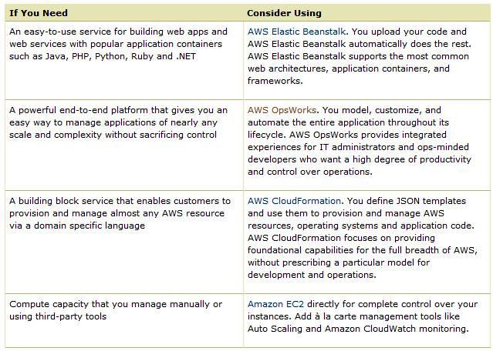
Application Management for AWS

Slide 23
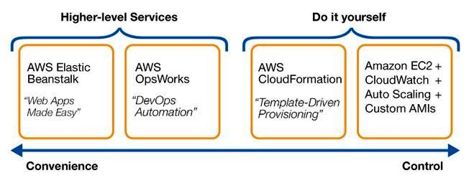
Application Management for AWS

Slide 24
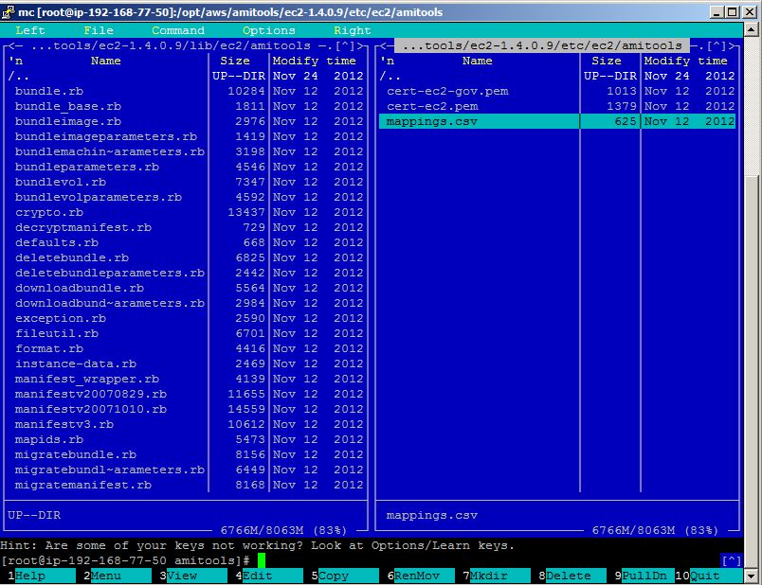
Ruby on AWS

Slide 25
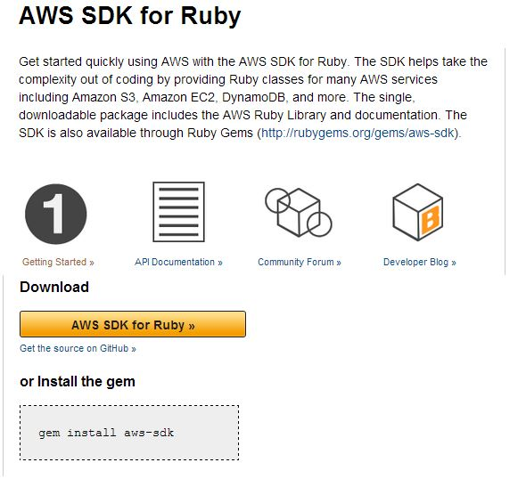
Ruby on AWS

Slide 26
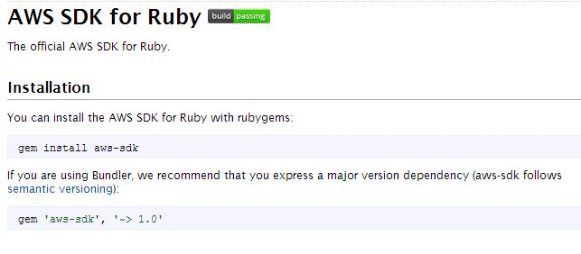
Ruby on AWS

Slide 27
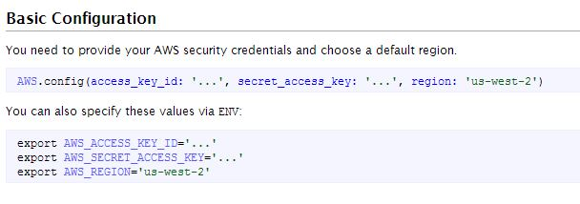
Ruby on AWS

Slide 28
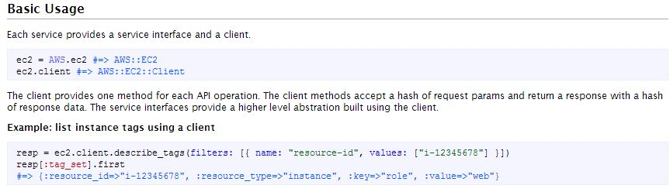
Ruby on AWS

Slide 29
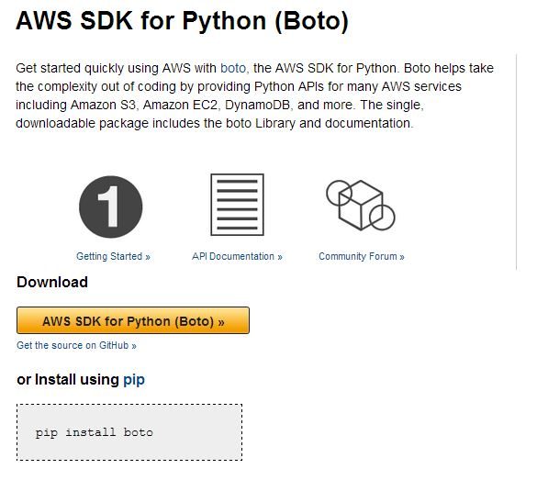
Python on AWS

Slide 30
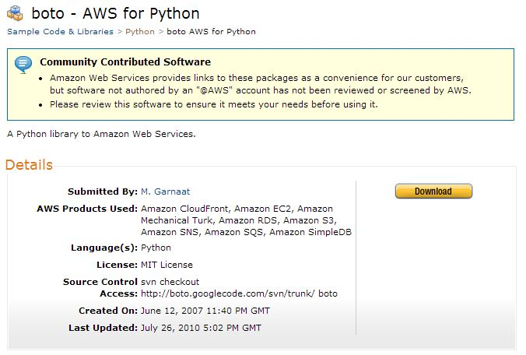
Python on AWS

Slide 31
API - CLI
ec2-create-image i-383c9875 --name “xxx" --description “xxx_Description" --verbose –-headers
as-create-launch-config TESTLC -i ami-41879a35 --key my_key --group sg-e50f1689 -t m1.medium --monitoring-enabled
as-set-desired-capacity GROUP_01 --desired-capacity 4
as-put-scaling-policy Up -g GROUP_01 --adjustment 1 --type ChangeInCapacity --cooldown 1200

Slide 32
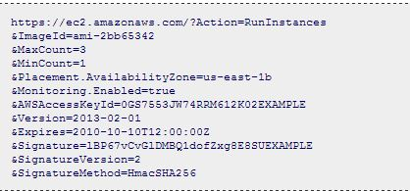
API – GET Request

Slide 33
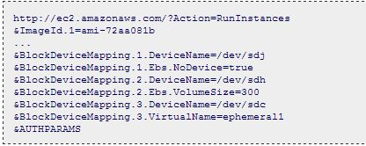
API – Query parameters

Slide 34


Slide 35
References
https://puppetlabs.com/
http://www.opscode.com/
https://learnchef.opscode.com/common-use-cases/multi-node-ec2/
http://aws.amazon.com/application-management/
http://docs.aws.amazon.com/AWSSdkDocsRuby/latest/DeveloperGuide/welcome.html
http://aws.amazon.com/sdkforruby/
http://docs.aws.amazon.com/AWSRubySDK/latest/frames.html
http://aws.amazon.com/python/

Slide 36

Questions

