Slide 1
Social Media Forensics
& OSINT Investigation
Framework
A Python-based public evidence collection, analysis, and reporting toolkit with GUI + CLI workflows.
PySide6 GUI
CLI automation
Forensic reports
Prepared by
ID Student Name
230104930
Mahmoud Samir Mahmoud Mekkawy
230105908
Salma Mohamed
230105995
Menna Reda
University Project Presentation
Notes:
Introduce the project as a safe, public-source investigation framework. Emphasize that it combines evidence capture, profile extraction, username search, network analysis, hashing, and final reports in one streamlined workflow.

Slide 2
Problem Statement
02 / 10
Public social evidence is useful — but fragile.
Investigators need a repeatable way to capture, validate, and explain public signals without crossing legal or ethical boundaries.
manual workflow
🔎
Scattered traces
Profiles, aliases, links, mentions, and archives live across many public platforms.
⏱
Volatile evidence
Pages change, disappear, or become gated; snapshots need timestamps and integrity.
Copy URL
Open page
Save proof
⚙
Manual workload
Checking usernames, saving pages, and building reports is slow and inconsistent.
🔐
Courtroom readiness
Evidence needs hashes, audit trail, provenance, and a clear chain of custody.
Compute hash
Write report
Risk: inconsistent evidence and missing context
Notes:
Explain the practical investigation problem: public information is spread across multiple sources and can change quickly. The tool reduces manual steps and adds forensic discipline through timestamps, hashes, and structured reports.

Slide 3
Project Objective
03 / 10
Objective: one safe workflow from target to report.
Build a production-oriented university project that collects only public evidence and produces auditable forensic outputs.
“Collect public-source evidence, preserve its integrity, analyze relationships, and produce a clear report bundle.”
1
2
3
4
5
Automate
one-button START plus CLI commands
Validate
URL guardrails and confirmed vs possible leads
Preserve
HTML, screenshots, metadata, hashes
Analyze
username search, archive lookup, graph metrics
Report
HTML/Markdown report + export bundle
Success criteria: accurate public findings, clean case hygiene, verified integrity, and reader-friendly outputs.
Notes:
State the objective as a complete workflow rather than a single script. Highlight that success is not only data collection; it also requires evidence integrity, case organization, and readable reporting.

Slide 4
System Overview
04 / 10
Two interfaces, one investigation engine.
The PySide6 GUI and CLI both call the same workflow modules, keeping outputs consistent across demos and automation.
Inputs
Case ID • URLs • Usernames • Reference profile
START Workflow
validation + orchestration
Collectors
profile • username • archives • web search
Case Store
snapshots • cache • evidence rows
Outputs
reports • graphs • manifests • ZIP bundle
GUI mode
output structure
PySide6 GUI
Case Manager • Evidence Locker • START button
CLI mode
archive • username • recover • graph • report • verify • export
data/<case_id>/
snapshots/ cache/
graphs/ reports/
exports/
Notes:
Walk through the system at a high level. Inputs enter through the GUI or CLI, the shared workflow validates and orchestrates collectors, then the case store preserves artifacts and exports reports, graphs, and bundles.

Slide 5
Key Features
05 / 10
Core features built for forensic clarity.
🧭
Public URL guardrails
📸
Snapshot preservation
👤
Profile extraction
Reject private/internal/credential-bearing targets.
Store HTML, metadata, timestamps, headers, screenshot when available.
Extract public handles, bios, canonical links, metadata, and visible signals.
🌐
Username search
🕰
Archive lookup
🧾
Forensic report bundle
Check public URL patterns and confidence-score candidate leads.
Record public historical archive availability and limitations.
Generate HTML/Markdown, manifests, CSV, graph files, and ZIP export.
Design principle: confirm before promoting — blocked, login-gated, or 404 checks remain evidence, not findings.
Notes:
Summarize the feature set. Emphasize the accuracy rule: the tool separates confirmed public findings from possible leads and unavailable checks, which is important for responsible OSINT.

Slide 6
Workflow / Architecture
06 / 10
Investigation workflow: repeatable and exportable.
The recommended flow keeps one active case context and produces stable latest outputs for review.
1
Active case
2
Target intake
3
Collect & extract
4
Search & archive
5
Build graph
6
Verify & export
MODULE LAYERS
GUI / CLI
Workflow Orchestrator
Collectors + Analysis
Storage + Reports
Case Bundle
Stable outputs: network_latest.* and report_latest.* reduce clutter during repeated test runs.
Notes:
Describe how a user runs an investigation from active case setup to final export. Mention that stable output names make repeated demos easier and keep the case directory clean.

Slide 7
Evidence Collection & Chain of Custody
07 / 10
Evidence integrity is built into every artifact.
Snapshots, exports, and reports are tied to timestamps, SHA-256 hashes, and a chain-of-custody record.
01
Collect
public URL / username
02
Preserve
HTML, metadata, screenshot
03
Hash
SHA-256 artifact digest
04
Record
manifest + chain link
05
Verify
OK / issue counts
chain_of_custody.json
Why it matters
• proves artifact integrity
• supports repeatability
• separates raw evidence from findings
• allows later verification
{
"artifact_sha256": "...",
"event_type": "evidence_added",
"timestamp_utc": "...",
"previous_hash": "..."
}
Notes:
Explain the chain-of-custody flow: collect public evidence, preserve it, compute hashes, write the manifest and chain file, then verify later. This is what turns simple scraping into a forensic-style process.

Slide 8
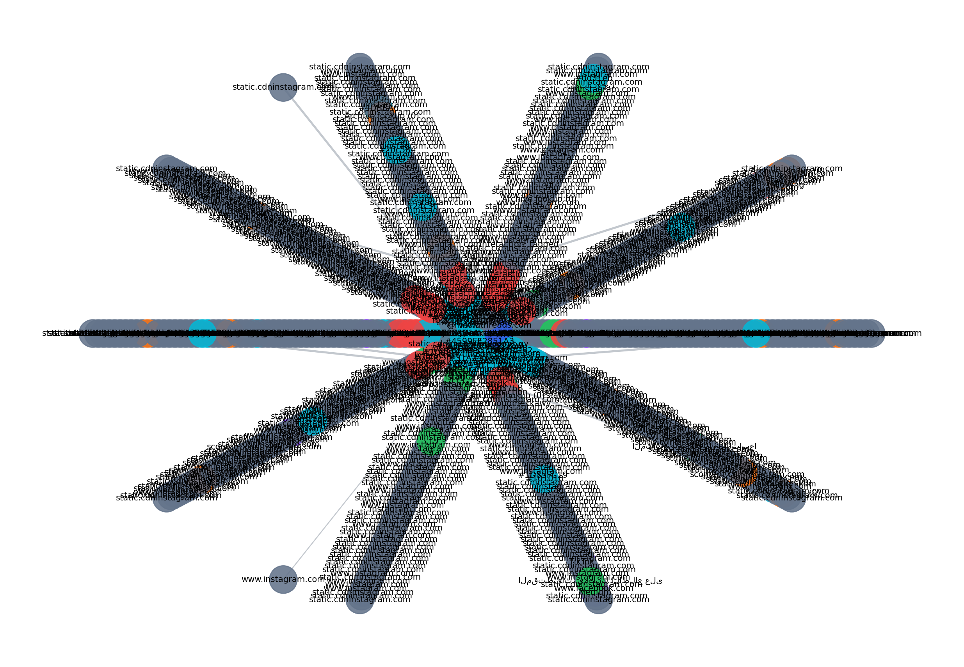
Network Graph & Reporting
08 / 10
Analysis becomes visual, searchable, and report-ready.
network_latest.png
report_latest.html
Executive Dashboard
17
0
ZIP
hash OK
issues
bundle
Sections
• summary first
• confirmed accounts
• candidate leads
• graph metrics
• evidence timeline
• export links
Report formats
HTML for review
Markdown for sharing
CSV for spreadsheet workflows
Manifest JSON for verification
Graph outputs: PNG • GEXF • JSON • interactive HTML
Notes:
Show the network graph and explain that relationships are stored as multiple formats for technical and non-technical review. The final report is designed to start with a summary and then let the reviewer drill down into evidence.

Slide 9
Responsible Use / Legal Scope
09 / 10
Designed for lawful public-source investigation.
The framework records what is publicly available and documents access limitations instead of bypassing them.
IN SCOPE
OUT OF SCOPE
✓ Public profiles and pages
✓ Public metadata and links
✓ Public archives and cached availability
✓ Evidence hashing and preservation
✓ Manual review of candidate leads
✕ Login bypass or private content
✕ CAPTCHA or paywall circumvention
✕ Accessing deleted/private accounts
✕ Credential-bearing URLs
✕ Claims without public validation
Ethical design choice: blocked or gated pages are stored as limitations or possible leads — not as confirmed findings.
Notes:
This slide is important for a university defense. Make clear that the tool avoids private access and does not bypass controls. Its value is in structured public evidence collection, validation, and reporting.

Slide 10
Results, Testing & Conclusion
10 / 10
Outcome: a complete public OSINT case toolkit.
The project demonstrates collection, analysis, reporting, and verification in a single repeatable pipeline.
GUI
CLI
HTML
SHA-256
ZIP
PySide6 one-button workflow
automation commands
forensic report
hash verification
evidence bundle
Testing summary
• smoke pipeline passes
• hash integrity verified
• graph/report/export files generated
• 404 and blocked checks are not promoted as accounts
• duplicate targets are handled cleanly
Conclusion
This framework turns scattered public social media traces into auditable, organized, and defensible case evidence while respecting legal and ethical boundaries.
Future scope: richer platform adapters, better graph summarization, and investigator collaboration features.
Notes:
Conclude by tying results back to the project goal. The key achievement is a full pipeline: intake, collection, validation, hashing, graphing, reporting, and export. Mention future improvements briefly.

