Slide 1

Control Systems toolbox
MATLAB
成员：葛 海 康
赵 伟 达
周 煌
郑 超
主讲人：葛海康

Slide 2
Control Systems toolbox structure
Linear representation
Time domain analysis
Frequency domain analysis
Functions of analysis and design
Stability analysis
System controllability
System observability
. . . . . .
Graphic analysis and design tool

Slide 3
One.
Introduction
Two.
LTI Object
Group division
Three.
LTI Viewer
Four.
SISO Design Toll

Slide 4
Linear time-invariant object (LTI)
Object
Linear time-invariant system
Control Systems Toolbox
System
Domain
Time domain
Frequency domain

Slide 5
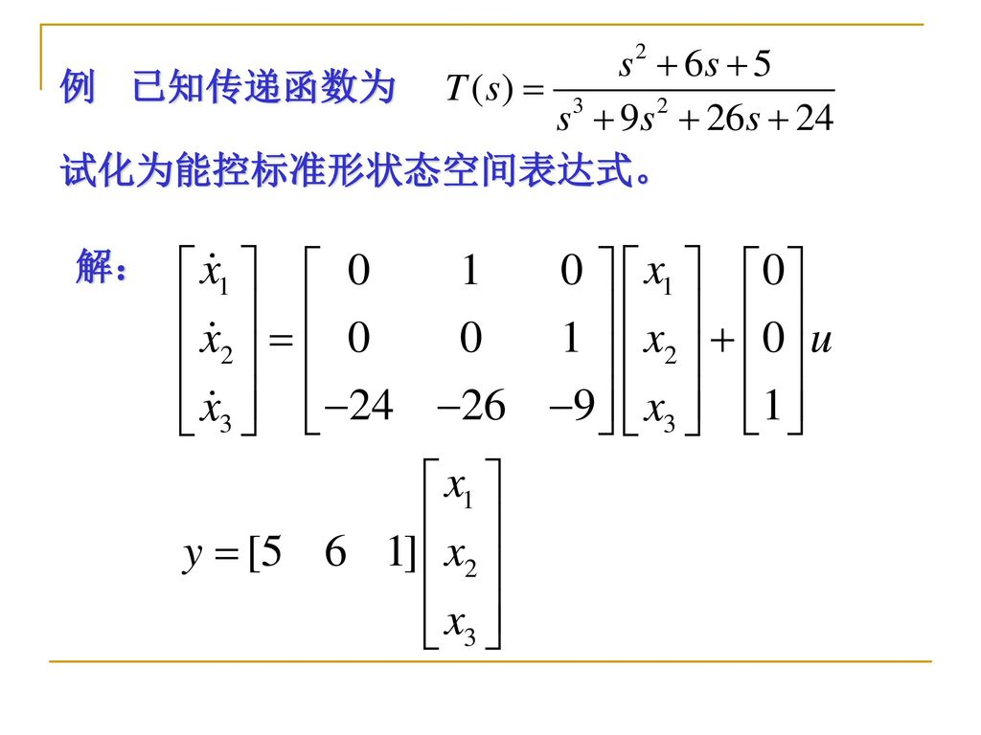
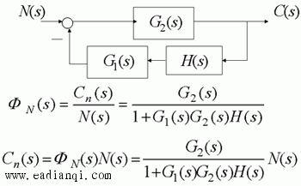
Classical control
Modern control
Transfer function
State space

Slide 6
Starting…
System modeling
System analysis
System design
Ending…

Slide 7
System modeling
State space
encapsulate
Transfer function
LTI
Pole-zero model

Slide 8
System analysis
LTI observer
Time domain characteristics
Frequency characteristics
overshoot
peak time
rise time
.
.
.
root trajectory gain
stability margin
.
.
.

Slide 9
System analysis
LTI observer
Time domain characteristics
Frequency characteristics
overshoot
peak time
rise time
.
.
.
root trajectory gain
stability margin
.
.
.

Slide 10
System design
Root trajectory design of linear system
Frequency method design
SISO Design Tool
Pole configuration of linear system
Linear system observer

Slide 11
Thanks

