Slide 1

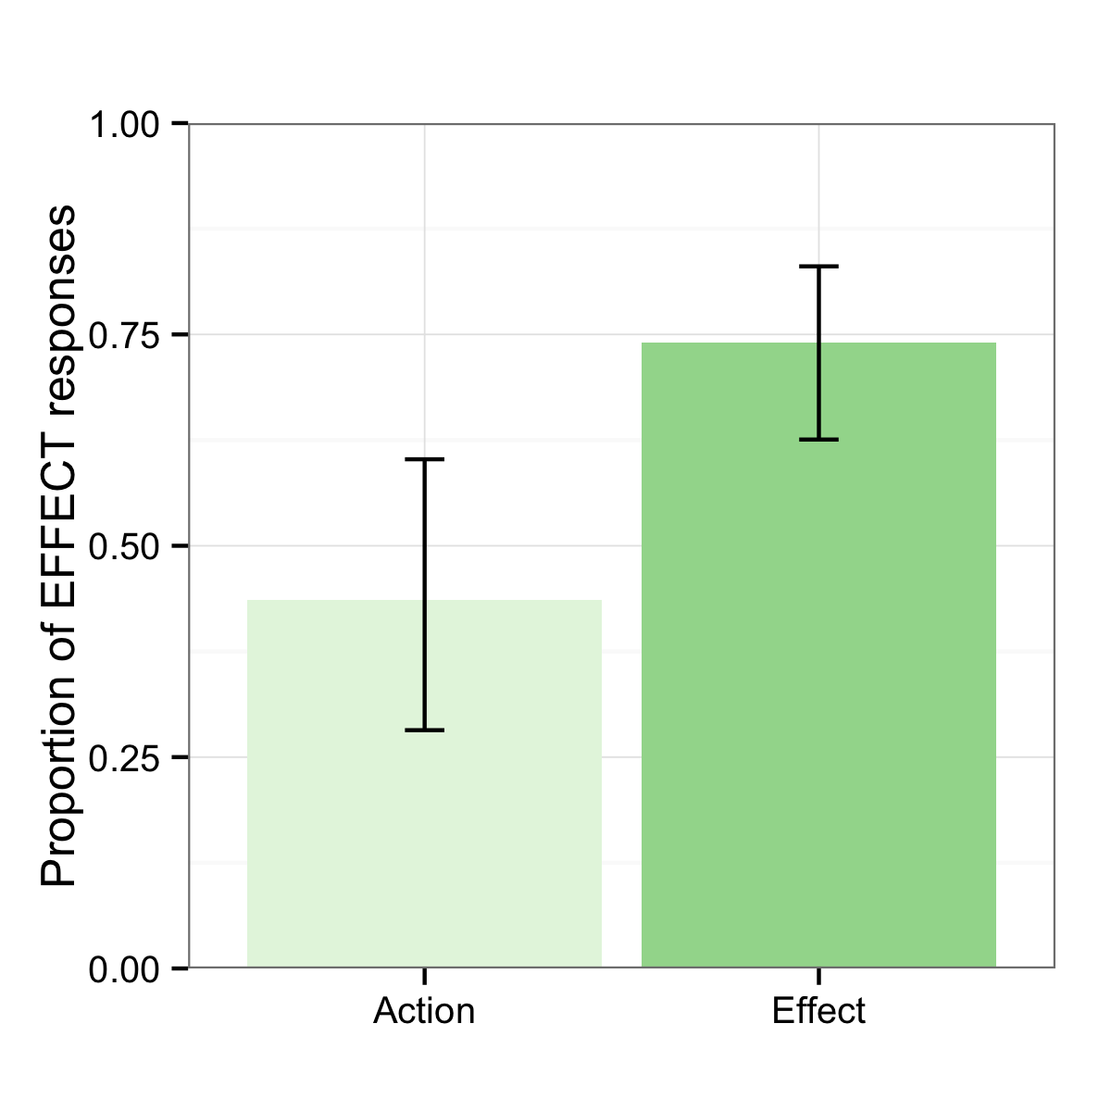
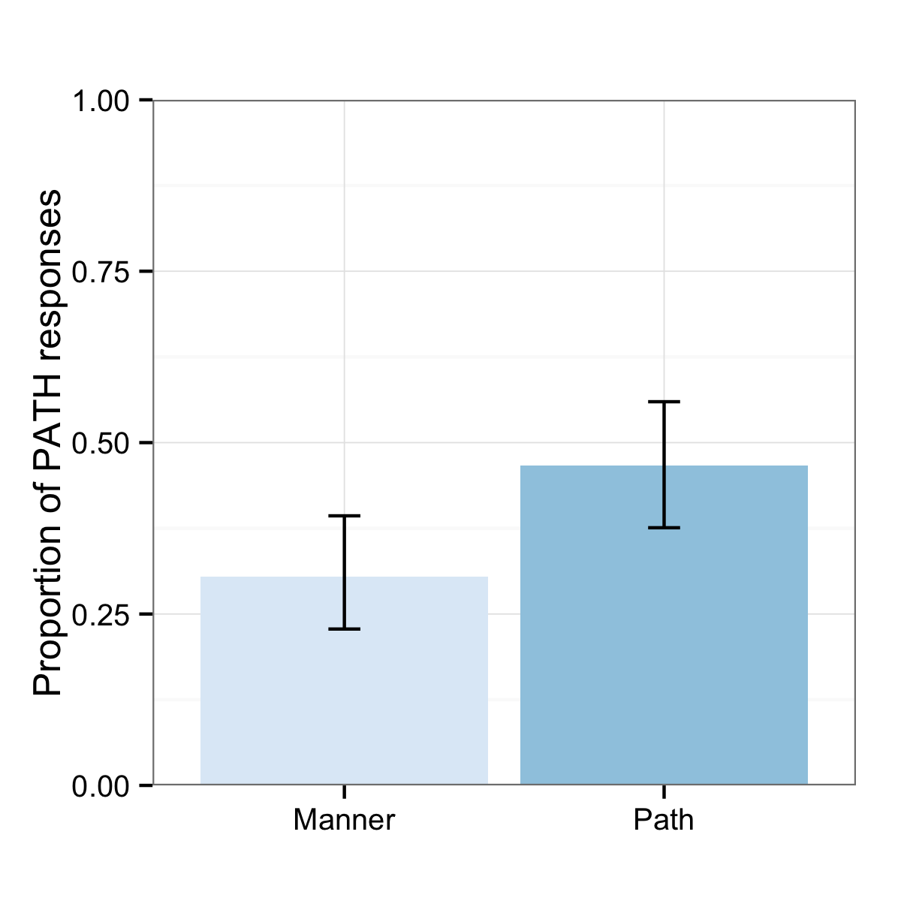
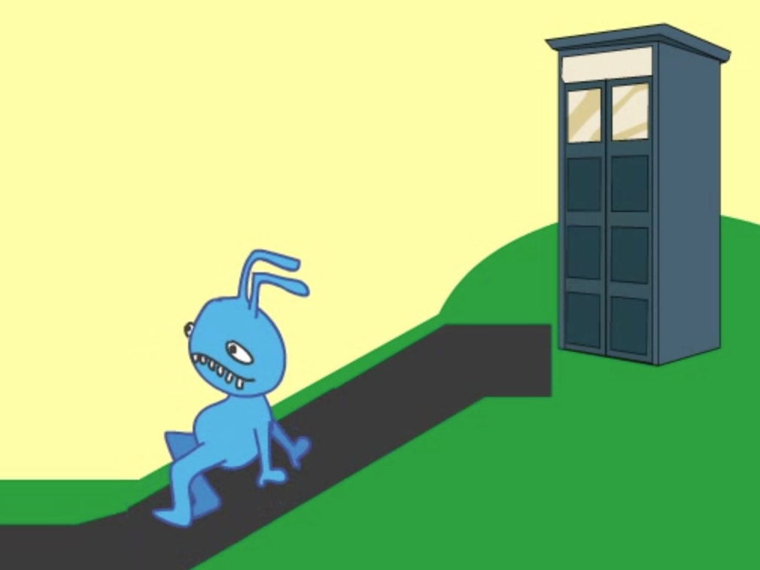
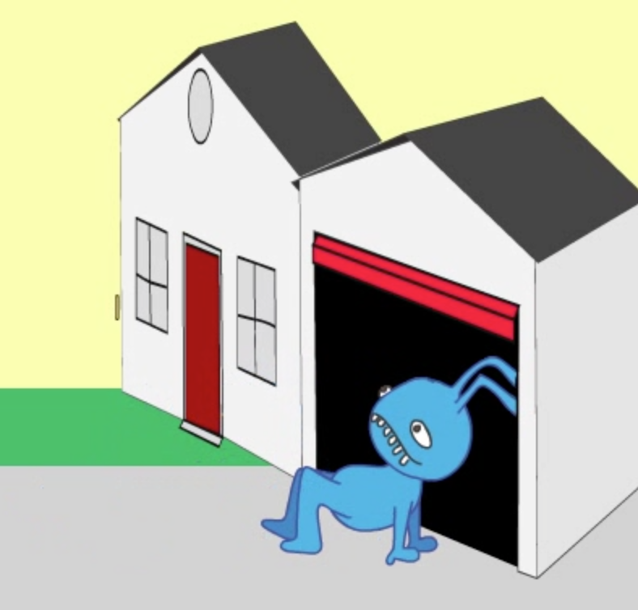
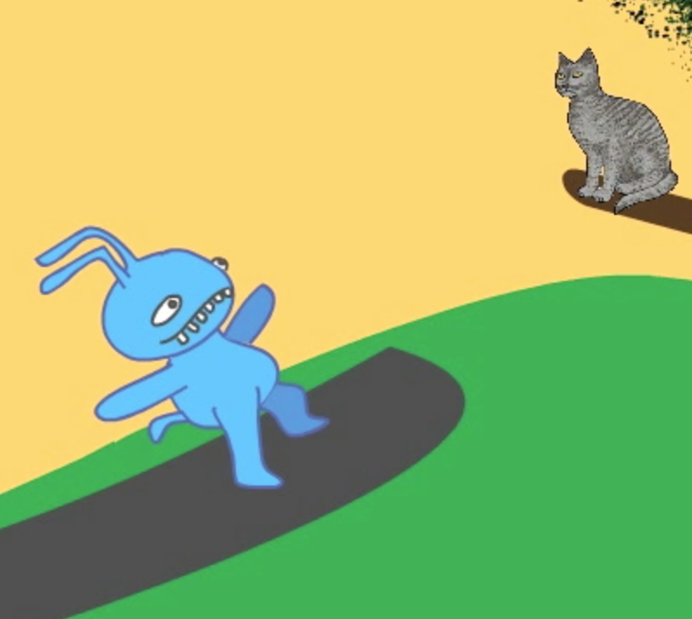
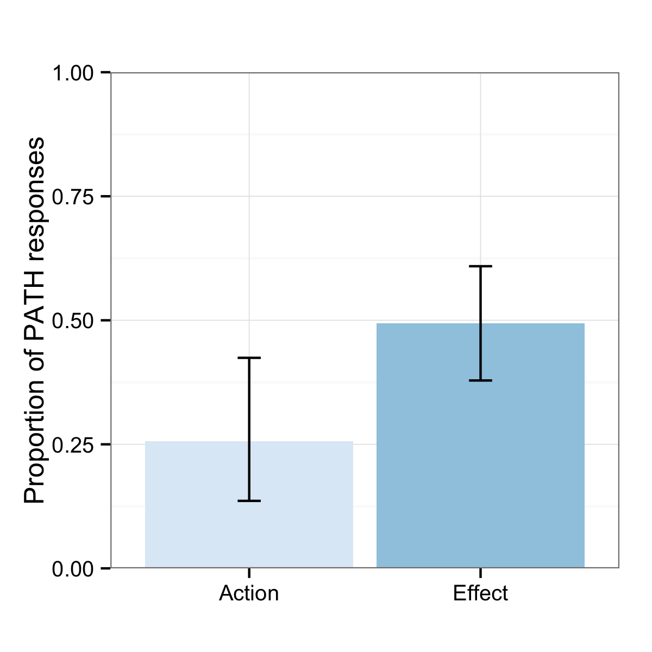
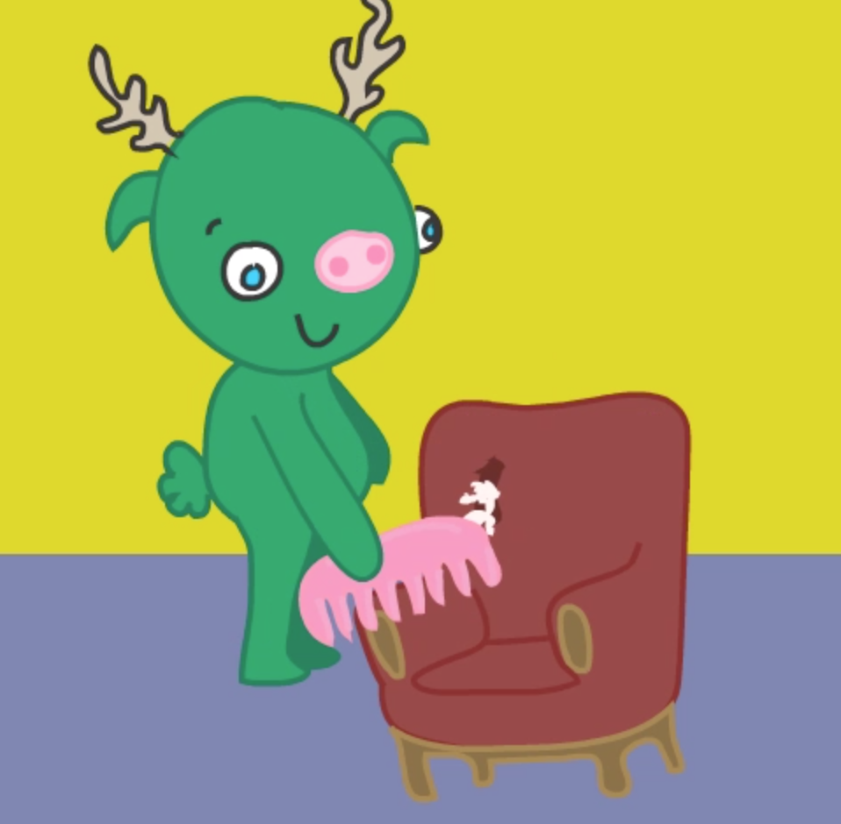
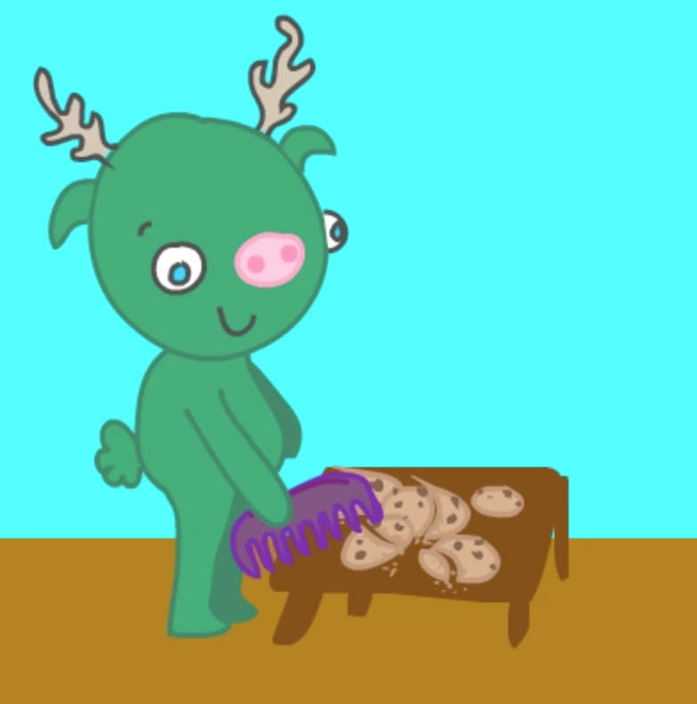
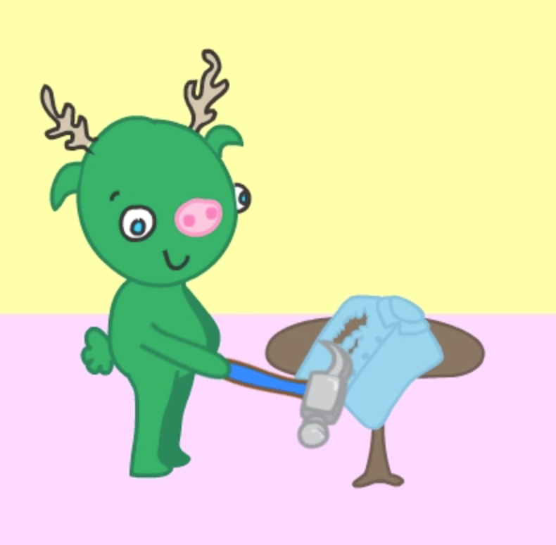

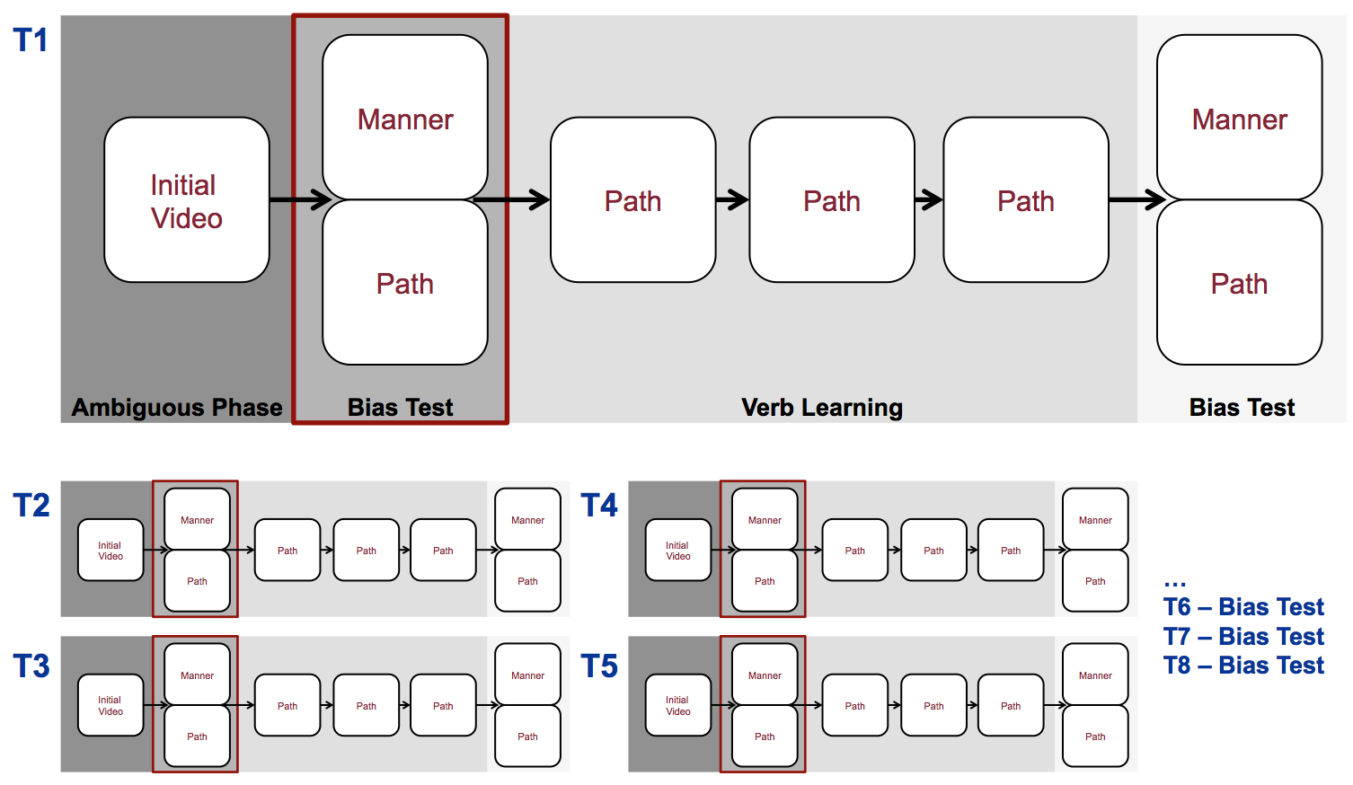
Changing 4-6yo’s means/outcome verb biases within and across domains
Melissa Kline, Annelot de Rechteren van Hemert & Jesse Snedeker
She ran into the room Manner
She entered the room running Path
She flattened the can with a hammer Action
She hammered the can flat Effect
Frequencies of verb type vary across languages (Talmy 1985, Levin & Rappaport Hovav 2010)
Biases change with training (Shafto, Havasi & Snedeker 2014)
Adult biases carry over between domains (Geojo 2014)
Suggests that verb semantics involves a more general representation of means vs. outcome (Levin & Rappaport Hovav 2010); young babies also care about this distinction in nonlinguistic contexts (Csibra & Gergely 2007)
Do young children use ‘umbrella’ means/outcome representations to predict verb meaning?
Experiment 1 – Manner/Path biases
After learning Manner verbs, children expected subsequent verbs (bias test, trials 2-8) to have manner extensions; after learning Path verbs they made more path guesses (n=34, replication, Shafto et al. Exp. 3 with new stimuli)
Experiment 2 – Action/Effect biases
Learning Action (manner) or effect Effect verbs altered children’s verb meaning predictions in a new domain (trials 2-8). (n=15, ongoing)
After learning ACTION Change-of-state verbs (trials 1-8) children then guessed that novel verbs for Motion events were MANNER verbs (trials 9-16)
After learning EFFECT Change-of-state verbs they were more likely to expect PATH motion verbs
Experiment 2 – Action/Effect biases
Does training in one event domain lead to bias changes for verbs in another domain?
If early (domain-general) cognitive representations drive these biases, we should expect transfer.
If children (unlike adults) do not represent any similarities in event structure between Motion and Change-of-State domains we should see no transfer.
Motion scene with manner (center) and path (right) meaning extensions. Adults accept He’s krading up the hill for meanings like both ‘ascend’ and ‘crabwalk’
Method
4-6yo children learned 8 distinct novel verbs each in the sequence shown below (Path condition). Analysis focuses on the initial guesses for children make over the course of the training session
Paralleling Experiment 1, Experiment 2 uses Change-of-State events that can generalize along a dimension of action ( center, e.g. ‘combing’) or effect (right, e.g. ‘ripping’).
Conclusions
These findings provide initial evidence that the kinds of event representations used for verb meanings involve domain-general representations of means and outcome which may be related to early cognitive models of goal-directed action
References
Csibra, G., & Gergely, G. (2007). “Obsessed with goals”: Functions and mechanisms of teleological interpretation of actions in humans. Acta Psychologica, 124(1), 60–78.
Geojo, A. (2014). Breaking and Entering: Verb Semantics and Event Structure (Doctoral dissertation). Harvard University.
Rappaport Hovav, M., & Levin, B. (2010). Reflections on manner/result complementarity. In E. Doron, M. Rappaport Hovav, & I. Sichel (Eds.), Syntax, Lexical Semantics, and Event Structure (pp. 21–38). Oxford, UK: Oxford University Press.
Shafto, C. L., Havasi, C., & Snedeker, J. (2014). On the plasticity of semantic generalizations: Children and adults modify their verb lexicalization biases in response to changing input. Developmental Psychology, 50(3), 794–808.
Acknowledgments
Thanks to our research assistants (Nason Heywood & Rebecca Zhu), The Harvard Foundations of Human Behavior Initiative, the Snedeker Lab for discussion and to participating children and their families!

Slide 2
T1
Ambiguous Phase
Bias Test
Verb Learning
Bias Test
Manner
Manner
Initial Video
Path
Path
Path
Path
Path
T2
Initial Video
Manner
Path
Path
Path
Manner
T4
Initial Video
Manner
Path
Path
Path
Manner
Path
Path
Path
Path
…
T6 – Bias Test
T7 – Bias Test
T8 – Bias Test
T3
Initial Video
Manner
Path
Path
Path
Manner
T5
Initial Video
Manner
Path
Path
Path
Manner
Path
Path
Path
Path

