Slide 1

Using CAS for Web Application
Cas&SpringMVC Using CAS 5.x for SpringMVC

Slide 2
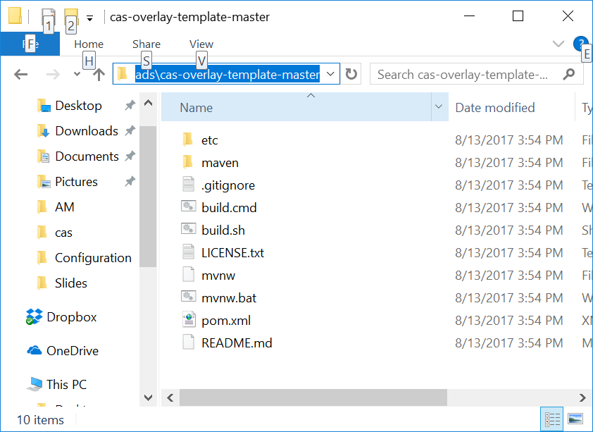
Download CAS Overlay
Link: https://github.com/apereo/cas-overlay-template/archive/master.zip

Slide 3
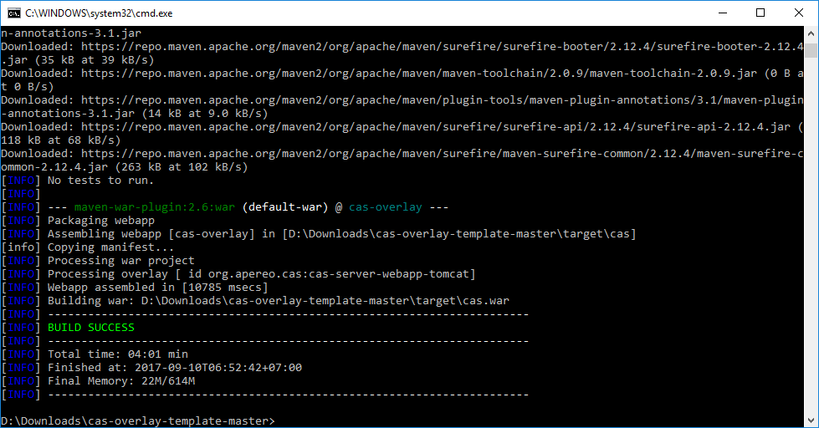
Package the cas.war
Execute command: mvn package
D:\Downloads\cas-overlay-template-master\target\cas.war

Slide 4
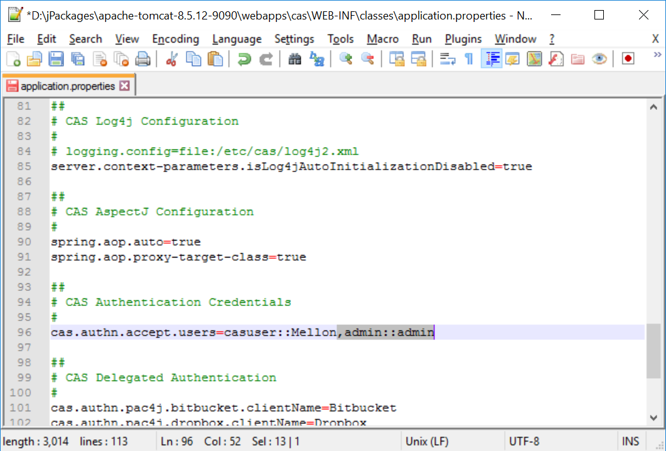
Deployment
Copy file “cas.war” into $TOMCAT_HOME\webapps.
Restart the Tomcat.
Add default users:
Modify “$TOMCAT_HOME\webapps\cas\WEB-INF\classes\application.properties”.
cas.authn.accept.users=casuser::Mellon,admin::admin

Slide 5
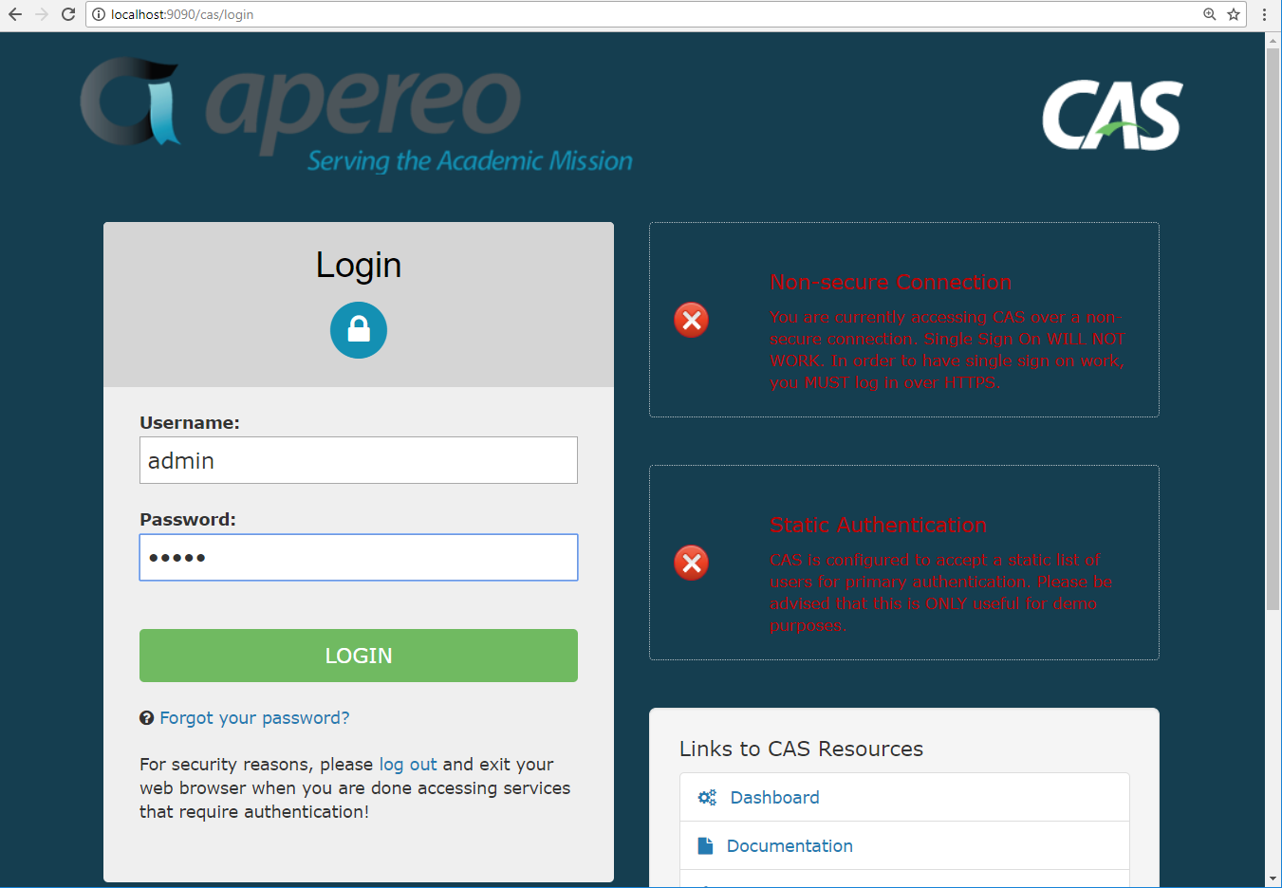
Verify the deployed CAS

Slide 6
Alternative deployment method
Deploy the cas into the integrated Tomcat in Eclipse

Slide 7
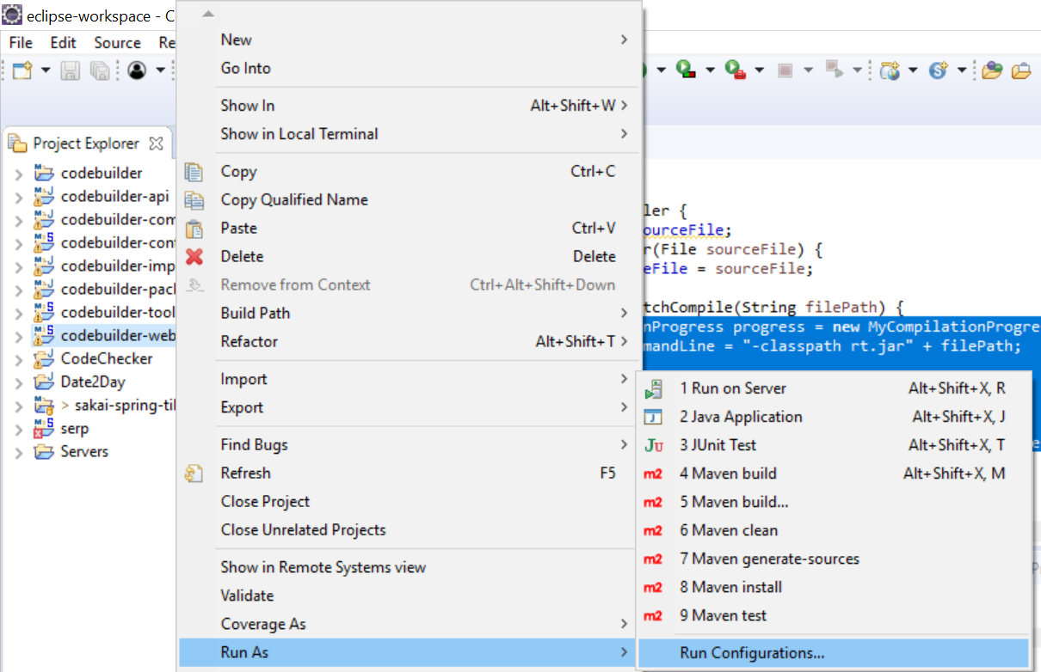
Locate deployed webapps folder in Eclipse

Slide 8
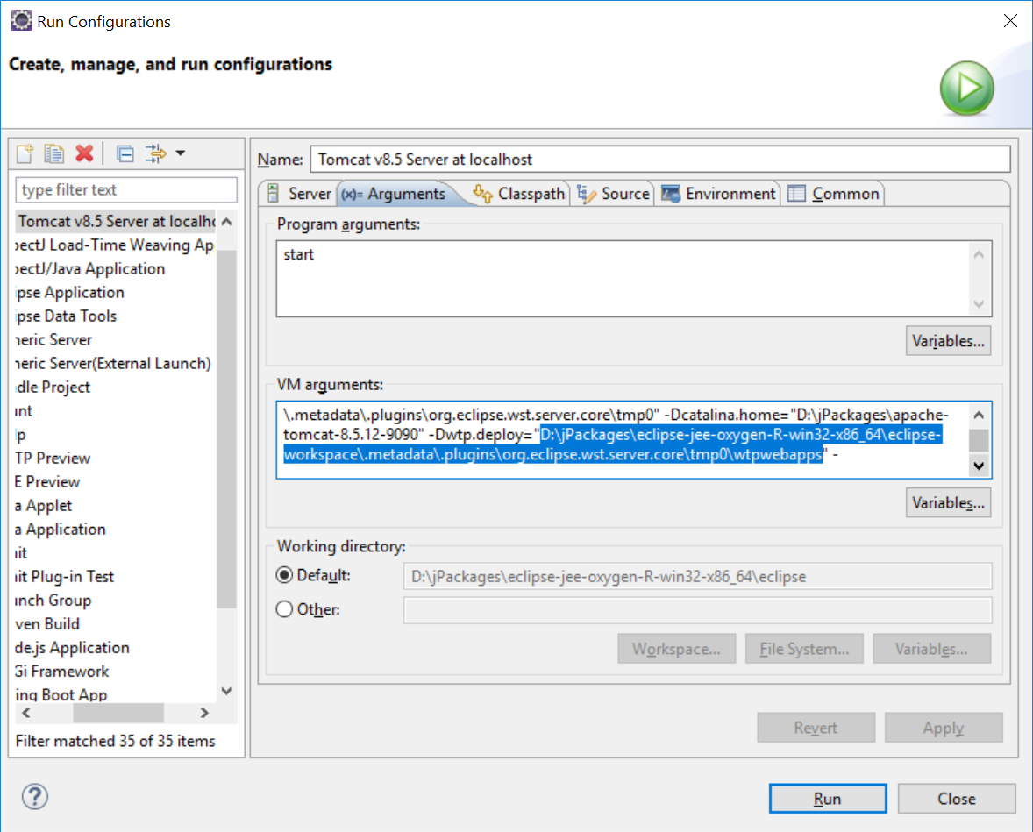
Get value of “wtp.deploy”

Slide 9
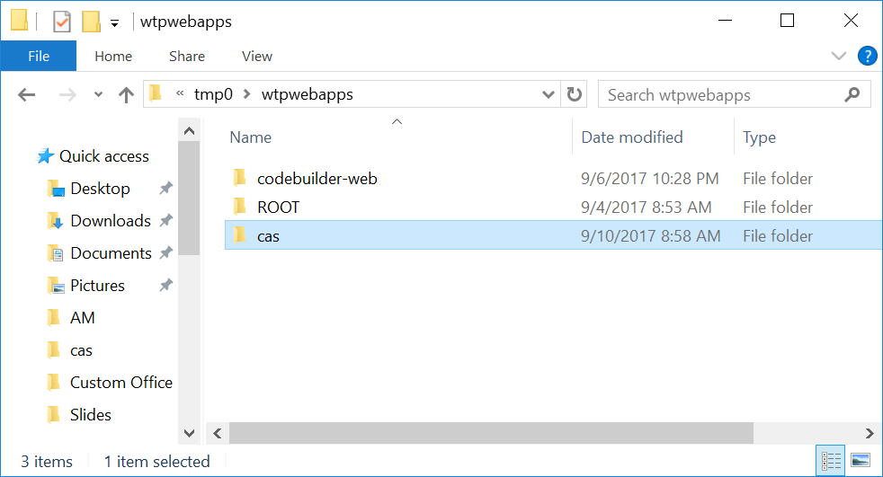
Copy “cas” into “wtp.deploy”

Slide 10
Summary
You can deploy the cas from war file.
There are 2 ways to run the cas:
Run in a dedicated Tomcat
Run in the Tomcat which is integrated in Eclipse.

