Slide 1
FINAL PRESENTATION
CMU 94-844 · GENERATIVE AI LAB · SPRING 2026
Generating Product Images
from Customer Reviews
An orchestrated multi-agent pipeline: RAG → structured LLM analysis → dual-backend diffusion → VLM self-correction
TEAM
Mohammad Taha Zakir · Mel Wong · Asli Gulcur · Smridhi Patwari · Vishnu Bala
Prof. Beibei Li · Heinz College, Carnegie Mellon University

Slide 2
01 · PROJECT OVERVIEW
The Challenge
THE PROMPT
Q1
Q2
Can a language model read thousands of customer reviews and tell a diffusion model what a product actually looks like?
Data Collection
RAG + LLM Analysis
3 diverse products + listings + reviews
Chroma index · 12-query retrieval · structured brief
Q3
Q4
We build a pipeline that extracts visual cues from text, turns them into grounded image prompts, renders candidates across two models, and self-corrects failures with a VLM critic.
Image Generation
Agentic Workflow
DALL·E 3 + Gemini 3.1 · iterative prompts
Supervisor · harnesses · VLM critic loop
CMU 94-844 · Generative AI Lab · Spring 2026
2 / 15

Slide 3
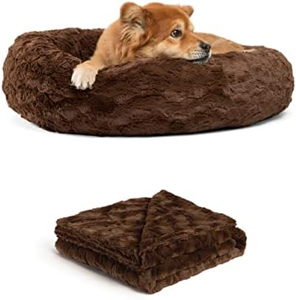
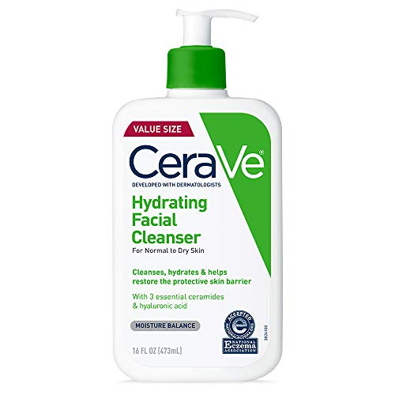
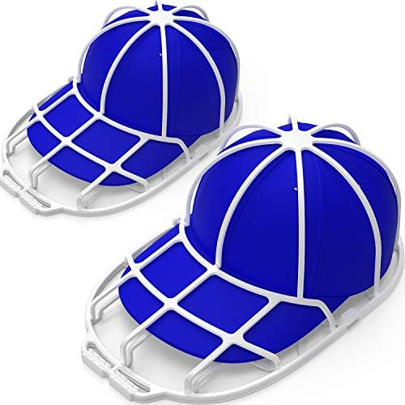
Q1 · PRODUCT SELECTION
Three Products, Three Failure Modes
Backward-design criterion: each product had to create a distinct challenge for diffusion models so Q3 comparisons would be analytically interesting.
SOFT-GOODS TEXTURE
LABELED CPG PACKAGING
RIGID PLASTIC GEOMETRY
Pet Bed Donut Cuddler
CeraVe Hydrating Cleanser
YEENOR Hat Washer Cage
Fur, plushness, loft · color accuracy · washability. Tests whether diffusion can render soft textures believably.
Micro-text on a bottle · pump integrity · lotion-not-foam consistency. Classic label hallucination challenge.
Ribbed molded plastic · clip-secured 3D silhouette. Strong geometry test for diffusion models.
~68K ratings
~500 reviews sampled
~21K ratings
CMU 94-844 · Generative AI Lab · Spring 2026
3 / 15

Slide 4
Q1 · DATA COLLECTION
From Scraping Walls to Curated Corpus
What we tried first
COLLECTION PROTOCOL
Direct scraping of Amazon product pages returned 503 errors and CAPTCHA challenges. Live scraping introduces fragility (rate limits, bot-detection, layout drift) that breaks academic reproducibility.
Source
Amazon Reviews 2023 (curated)
Review filter
len(text) > 20, newest first
Where we landed
Cap per product
500 reviews
Amazon Reviews 2023 dataset (Hou et al., 2024; McAuley Lab, UCSD) — per-category JSONL with product metadata and review text. We pulled slices for Pet Supplies, Beauty, and Home and filtered to our three ASINs.
Review fields
text · rating · title · date
Listing fields
title · description · image URLs
Total products
3 across 3 categories
Lesson: for reproducible academic work, curated datasets beat live scraping.
CMU 94-844 · Generative AI Lab · Spring 2026
4 / 15

Slide 5
Q2 · TEXT ANALYSIS
RAG Infrastructure
Listing text + reviews → chunks → embeddings → ChromaDB → 12-query retrieval. Every decision is designed to get the LLM the right evidence.
1
2
3
4
5
Chunk
Embed
Index
Retrieve
Dedupe
paragraph-batch
≤400 tokens
text-embedding-
3-small
ChromaDB
(persistent)
12 targeted
queries
53–67 unique
chunks / product
Chunking A/B: Sliding vs. Paragraph-Batch
UNIQUE CHUNKS RETRIEVED (12 queries, dedup)
Both strategies indexed 502 chunks total. Differences of ≤1 chunk per product. Amazon reviews are short self-contained paragraphs, so sliding windows over a 200-word review inflate the index without enriching retrieval. We adopted paragraph-batch.
Pet Bed
67
Hat Washer
56
CeraVe
53
CMU 94-844 · Generative AI Lab · Spring 2026
5 / 15

Slide 6
Q2 · LLM ANALYSIS
The Insights Analyst Agent
A 7-step chain of thought
MODEL
gpt-5.4-mini
1
Category norms
Which shot types persuade in this category
Temperature 0.35
Consumer landscape
2
Needs, benefits, concerns from retrieved excerpts
ROLE
Listing vs. reviews
Senior e-commerce analyst
3
Which bullets reviewers elevate or dispute
4
Cross-review benefits
OUTPUT SCHEMA
Independent agreement across reviewers
ReviewImageryBrief
Brand visual codes
5
Pydantic-validated. Every planned shot carries a rationale_from_reviews field — analytical traceability by design.
On-brand palette and mood cues from text
6
Shot plan
3–5 shots, one clear job per shot
7
Prompts
Written last — fully grounded in the chain above
CMU 94-844 · Generative AI Lab · Spring 2026
6 / 15

Slide 7
Q2 · SAMPLE OUTPUT
CeraVe Planned Shots
“
A lotion-form, non-foaming face wash positioned as gentle, fragrance-free, and moisturizing. Reviewers describe a soft, creamy, light-lotion feel that leaves skin clean but not stripped. The emotional tone is clinical, dependable, and comfort-first.
#
ROLE
KEY RATIONALE (from reviews)
Hero product
Establish the exact bottle — address leakage/pump worries with intact, sealed presentation
1
Consumer in-use
Smooth lotion-like spread (not suds) on damp skin — reinforce skin-feel consensus
2
Formula texture macro
Answer the biggest expectation gap: not bubbly, but creamy and non-aerated
3
Packaging detail
Pump/cap geometry addressing repeated packaging complaints
4
Daily routine context
Lifestyle frame reinforcing AM/PM staple for sensitive skin
5
CMU 94-844 · Generative AI Lab · Spring 2026
7 / 15

Slide 8
Q3 · IMAGE GENERATION
The Creative Director Agent
A second structured LLM call converts the grounded brief into photography-style prompts tuned for diffusion models.
01
02
03
Lighting & Staging
Material Textures
Negative Constraints
“soft neutral daylight”
“rich brown faux-fur depth”
“no fake seals, no barcode”
Prescribes exact lighting conditions and scene composition per shot role — hero, detail, lifestyle.
Surface descriptors anchor diffusion rendering to the material reality described in reviews.
Explicit exclusions suppress hallucinated text and keep the product silhouette clean.
CMU 94-844 · Generative AI Lab · Spring 2026
8 / 15

Slide 9
Q3 · VISUAL COMPARISON
Original vs. AI-Generated Hero Shots
Same prompts, two backends. Qualitative inspection of each product's hero frame against the listing photo.
Product
Original Listing
OpenAI (dall-e-3)
Gemini (flash-img)
Pet Bed
OpenAI render
Gemini render
Faux-fur depth · palette faithful
Warmer environment · richer context
CeraVe
OpenAI render
Gemini render
Clinical bottle · label-safe
Warmer environment · richer context
Hat Washer
OpenAI render
Gemini render
Rigid 3D geometry accurate
Warmer environment · richer context
Verdict: pipeline approximates silhouettes, colors, and lifestyle context — but no model achieves pixel-perfect SKU fidelity or accurate micro-text.
CMU 94-844 · Generative AI Lab · Spring 2026
9 / 15

Slide 10
Q3 · MODEL COMPARISON
OpenAI vs. Gemini: Where Each Wins
Both models received identical planned_shots[].prompt content with only a short provider-specific suffix. Differences come from rendering aesthetics, not information asymmetry.
OpenAI · chatgpt-image-latest
Gemini · 3.1-flash-image-preview
Composition
Tight studio / catalog frames
Composition
Lifestyle background + environment
Color
Faithful to palette cues
Color
Richer, warmer, occasional boost
Text on product
Headline words render OK
Text on product
More label detail = more hallucination
Constraints
Follows 'no foam, no splash' reliably
Constraints
Sometimes generates excluded elements
Failure mode
Soft generic seal silhouettes
Failure mode
Hallucinated label characters
Best for
Hero + macro detail shots
Best for
Consumer-in-use lifestyle shots
CMU 94-844 · Generative AI Lab · Spring 2026
10 / 15

Slide 11
Q4 · AGENTIC WORKFLOW
The Supervisor Orchestrates Five Agents
Fixed sequence · validated handoffs · typed JSON artifacts · loud failures (no silent merges)
Q1 · Data
Q2 · Analyst
Q3 · Creative
Image Gen
VLM Critic
Catalog + reviews
ReviewImageryBrief
CreativePromptPack
DALL·E 3 + Gemini
Accept · Reject · Revise
SUPERVISOR (src/agent.py) · orders steps · logs q2_analyst / q3_creative · enforces shot_index match at merge
HARNESS ENGINEERING
Structured Output
Bounded Retries
Telemetry
Loud Failures
Pydantic schemas + JSON response_format
2 attempts · temp=0 on retry
agent_id · attempts · duration · tokens
shot_index mismatch → explicit error
CMU 94-844 · Generative AI Lab · Spring 2026
11 / 15

Slide 12
AGENTIC LOOP
The VLM Critic That Catches Diffusion Failures
Why a critic at all?
CASE STUDY
DALL·E 3 and Gemini 3.1-flash introduce predictable artifacts: unreadable micro-text, anatomical errors, floating or impossibly-balanced objects. A second agent — gpt-5-mini as VLM — grades each output against the originating prompt.
CeraVe · Gemini · extra-arm artifact
REJECTED
ACCEPTED
✗
✓
Three-stage loop
1
Evaluate
Base64 image + prompt → VLM scoring against brand / category rubric
Anatomical error: a hallucinated third arm pumping the lotion bottle.
Revised prompt removed ambiguous staging. Anatomy correct, composition preserved.
2
Reject
Failing image archived to /rejected/ with rejection_feedback.json
3
Revise
Suggested_prompt_revision fed back into image generator
CMU 94-844 · Generative AI Lab · Spring 2026
12 / 15

Slide 13
RESULTS
Hero-Shot Evaluation (VLM Scoring, 1–5)
All 6 hero shots (3 products × 2 models) were scored by gpt-5.4-mini on 5 dimensions. Overall mean: 4.7 / 5.
4.7
5.0
5.0
4.2
Overall mean
Color palette
Label / text
Photorealism (weakest)
Product
Model
Color
Silhouette
Realism
Label
Staging
Overall
Pet Bed
OpenAI
5
4
4
5
5
4.6
Pet Bed
Gemini
5
4
5
5
4
4.6
CeraVe
OpenAI
5
4
4
5
5
4.6
CeraVe
Gemini
5
5
4
5
5
4.8
Hat Washer
OpenAI
5
5
4
5
5
4.8
Hat Washer
Gemini
5
5
4
5
5
4.8
Mean
5.0
4.5
4.2
5.0
4.8
4.7
CMU 94-844 · Generative AI Lab · Spring 2026
13 / 15

Slide 14
REFLECTION
Challenges & Lessons Learned
01
VLM Over-Constraint
02
Infrastructure > Model
03
One Scene per Prompt
THE PROBLEM
THE PROBLEM
THE PROBLEM
Early critic rejected photorealistic images for minor background drift. False-rejection rate was unsustainably high.
Base64-encoded PNG payloads (>4MB) to gpt-5-mini triggered SSLV3_ALERT_BAD_RECORD_MAC errors — a network-stack failure, not a model failure.
Packing multiple visual ideas into a single prompt caused catastrophic label hallucinations. Diffusion can't render regulatory micro-text.
THE FIX
THE FIX
THE FIX
Recalibrated prompt to tolerate deviations from strict textual literalism when realism and physics held. Rejection rate dropped; visual quality preserved.
In-memory JPEG compression at 85% (≈300KB payload), exponential backoff on transient drops. Reliable pipelines are a software engineering problem.
Strict one-scene-per-prompt discipline. Instruct models to obscure small text in favor of silhouette. Decomposed steps beat monolithic prompts.
CMU 94-844 · Generative AI Lab · Spring 2026
14 / 15

Slide 15
TAKEAWAYS
Four things we'd carry into a production pipeline
01
02
Structure > raw prompting
One agent per reasoning step
Typed JSON handoffs + Pydantic validation caught silent drift that monolithic prompts would have hidden.
Analyst, Creative Director, VLM Critic — each with one clear job — reliably outperformed any single large prompt.
03
04
Model selection per shot role
Harness beats model choice
OpenAI for pack-shots and macro detail. Gemini for lifestyle and environmental context. Choose per job, not per project.
Bounded retries, schema validation, telemetry, and a VLM critic did more for output quality than swapping base models.
Thank you.
Questions welcome.

