Slide 1
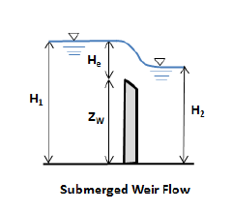
h1
Y1
Zc
Y2
Free flow:
h1 = Y1 –Zc
Q = f(h1)

Slide 2
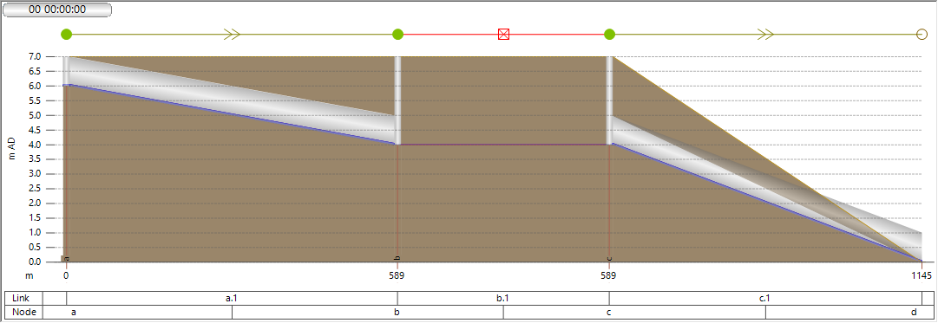
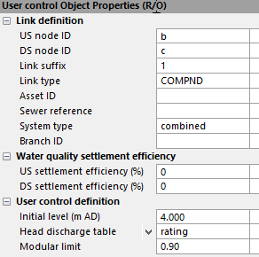

Slide 3
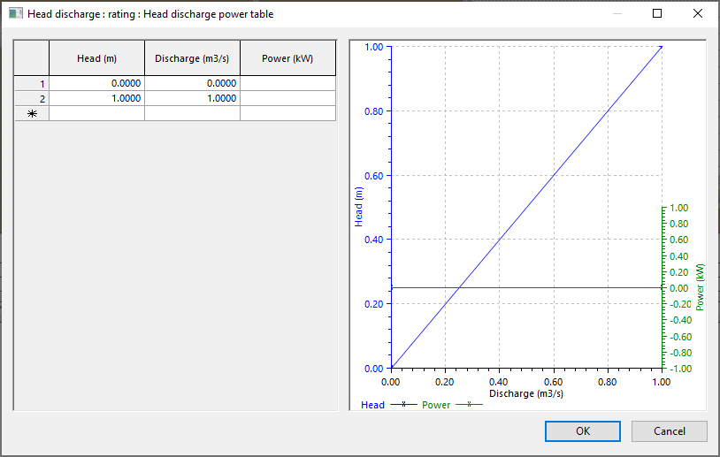
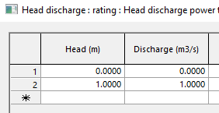

Slide 4
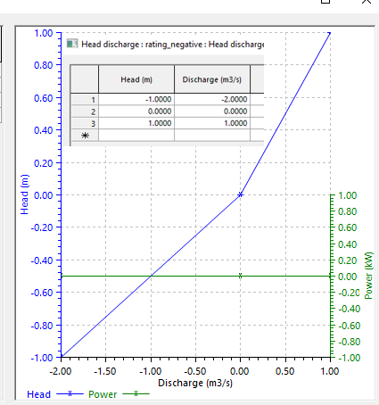
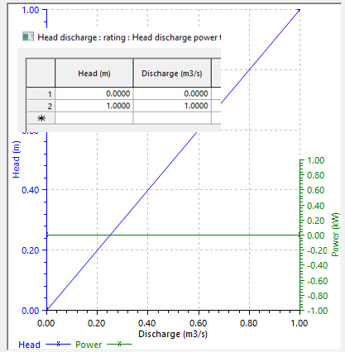

Slide 5
h1
h2
Y1
Zc
Y2
Drowned Flow
h1 = Y1 –Zc
h2 = Y2 – Zc
When h2/h1 <= m, it is drowned
Q = f(h1)*drownf ?? (eq. Q=f(y1))
where
drownf = √[ (1 - (y₂ - z_{c}) / (y₁ - z_{c})) / (1 - m) ]
or
drownf = (1 - (y₂- z_{c}) / (y₁- z_{c})) / (0.3 * (1 - m))
if the first formula gives drownf < 0.3
h ₁ = upstream depth of water above crest = y₁ - z_{c}
h ₂ = downstream depth of water above crest = y₂ - z_{c}
z _{c} = crest elevation
m = modular limit
For negative flows switch h₂ and h₁

Slide 6
Help | User-Defined Control Data Fields (InfoWorks) | Autodesk
Modular limit for the user defined control.
If set to greater than 0, the upstream depth is used to determine the flow from the specified head discharge table; a drowning factor is applied to the flow if the ratio of downsteam depth to upstream depth exceeds the modular limit.
If set to 0, the flow is based on head difference when drowned. Drowning occurs once the downstream level is above the crest.
m = 0 or leave blank
Free flow:
Y2 <= Zc
Q = f(Y1 – Y2)
Drowned: for free flow
Y2 > Zc
Do you still calculate the drowning factor?

